Slide 1
End Customer
Quick Reference Guide

Slide 2
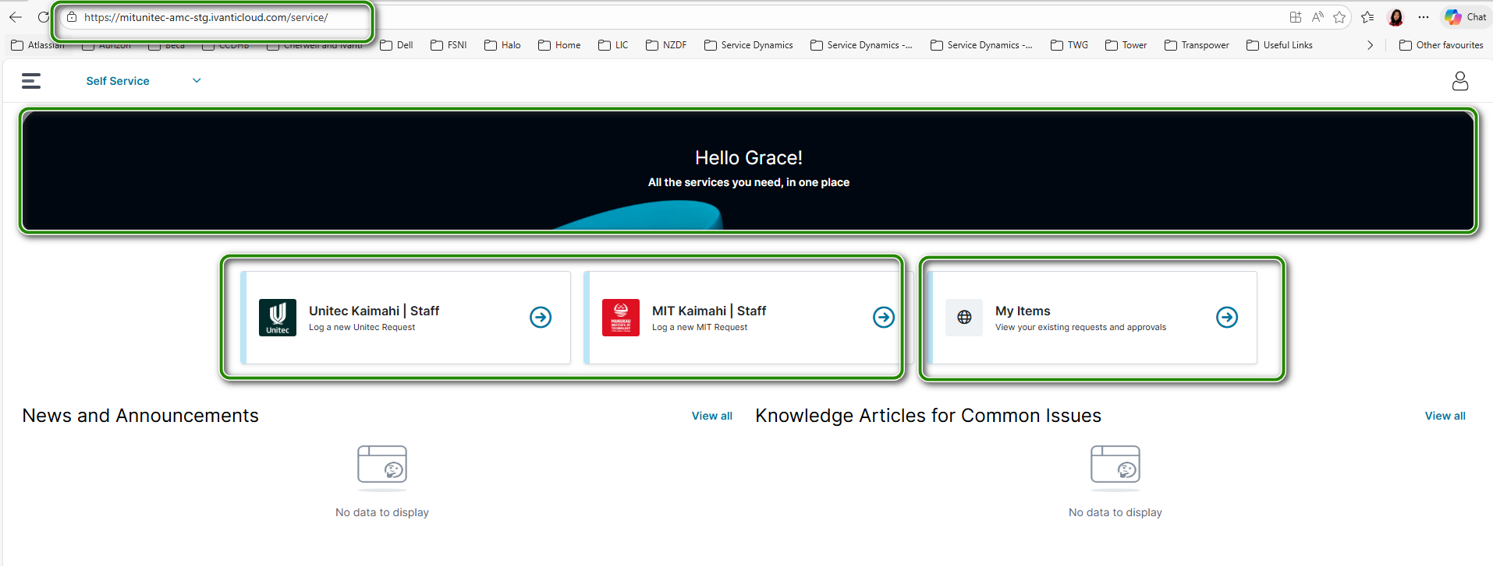
Portal Overview
01
03
Represents the tile that directs to the catalog available for Unitec and MIT employees.
Type URL - https://mitunitec-amc.ivanticloud.com/service/
NOTE: The screenshot shows staging URL.
02
Represents the welcome banner
04
Provides the end customer the list of tickets they submitted for action of IT.
01
02
03

Slide 3
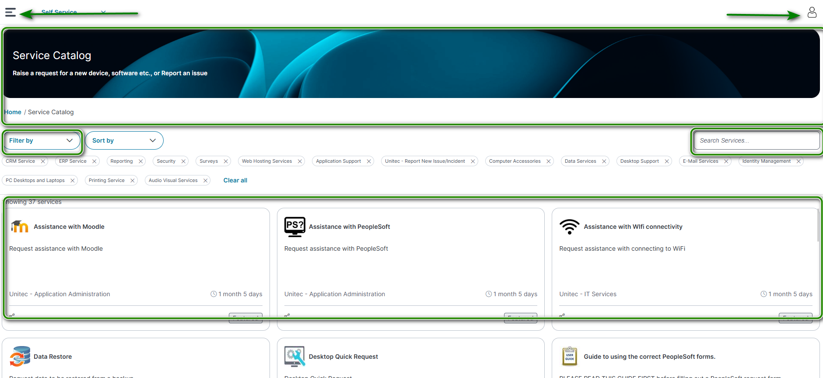
Navigating the Portal
A self-service portal available to both MIT and Unitec staff has been created to allow end customers to submit requests
01
02
03
04
05
06
01
Allows you to go back to the portal home page, or view your requested items
04
filter to use to navigate through the different catalog available
02
05
Search box – use this to type keywords for the catalog
This is your profile icon
03
This is called the banner page
06
Catalog tiles displaying based on the filter selected

Slide 4
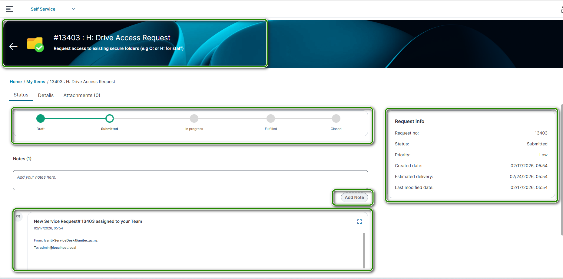
Navigating the ticket view
01
01
Ticket title
02
Shows the status progress of the ticket
02
05
03
Allows the end customer to add notes to the ticket visible to the assigned support personnel
03
04
04
Shows the comments add or emails sent about the ticket.
05
Other ticket information

