Slide 1
Helen Gremillion Professor of Social Practice
Gender, Culture, Medical Practice, and Community Partnered Research

Slide 2


Slide 3


Slide 4


Slide 5

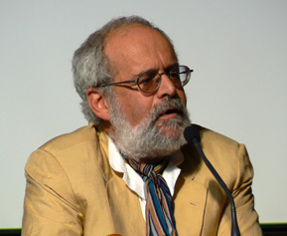
Overview

Slide 6


Slide 7


Slide 8



Slide 9


Slide 10



Slide 11


Slide 12

Conclusion
Provide a brief summary of your presentation. Remind the audience what you covered in the previous slides.

Slide 13
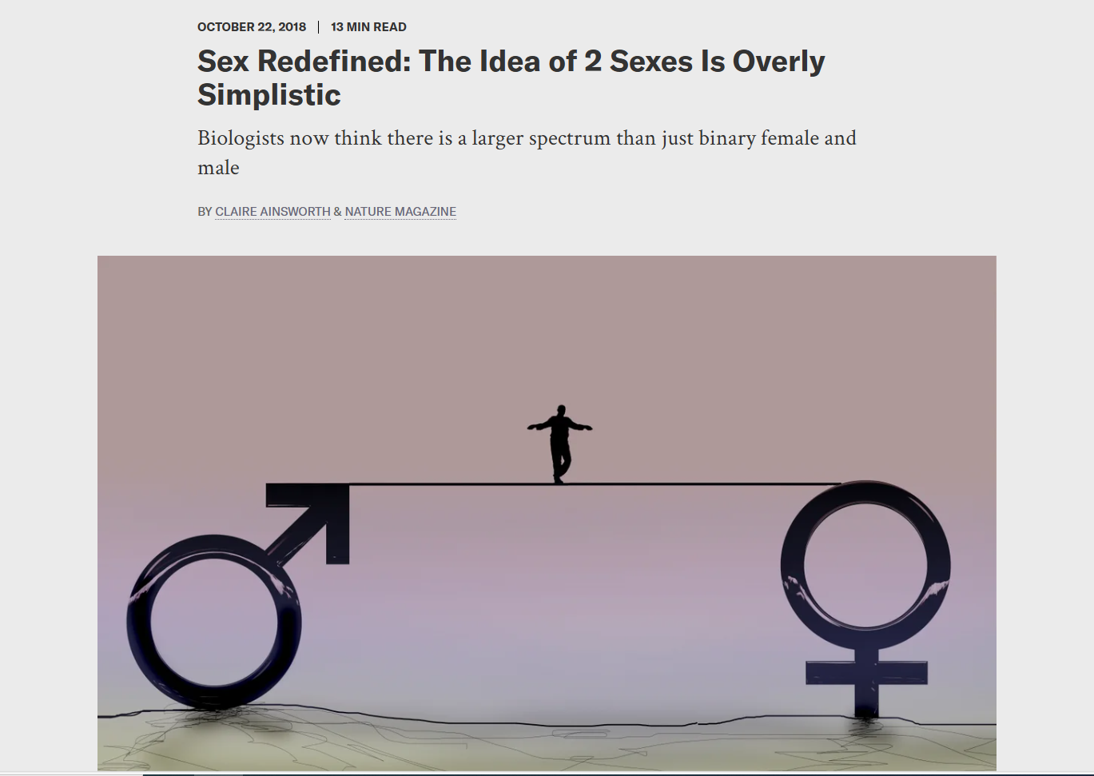
Questions & answers
Invite questions from the audience.

Slide 14

Resources
List the resources you used for your research:
Source #1
Source #2
Source #3

Slide 15


Slide 16
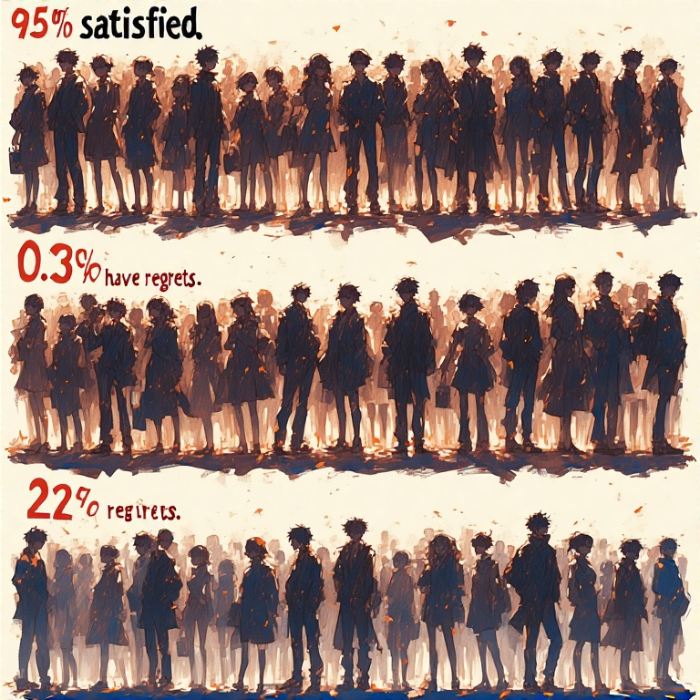
Overview
98% satisfied
0.36% have regrets
22% regret knee surgery

Slide 17

Questions & answers
Invite questions from the audience.

Slide 18
Thank you for attending!

