Slide 1
Whanaungatanga | Relationships
Notes:
Whanaungatanga places an emphasis on building relationships and strengthening connection with others. ​Fostering unity, kotahitanga | interconnectedness, a sense of community and a feeling of belonging will help you and your team navigate the year ahead. ​
​

Slide 2
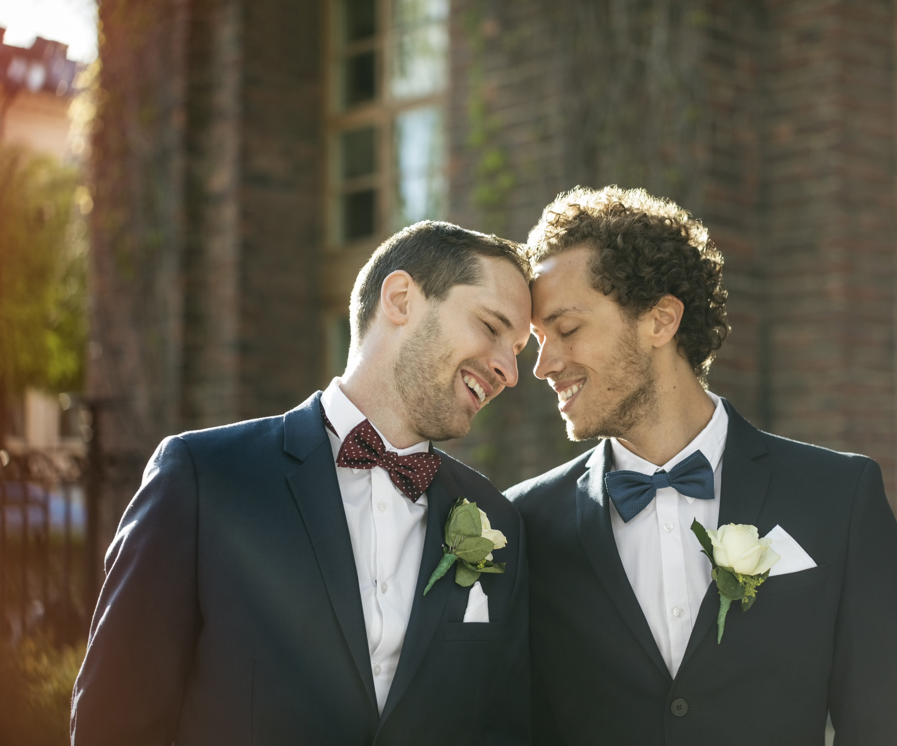
My life events
Activity
Draw a picture of five key events that have shaped you as a person. Choose events that you’re comfortable sharing with your team.
Share your picture with the team describing how these events have shaped you as a person.
Reflection
What did we learn about each other from this activity?
How has this strengthened us as a team and brought us together?
Notes:
This is one example of a whanaungatanga activity. For other ideas and suggestions, refer to the Whanaungatanga Activities document on the Leadership learning page.
Ask kaimahi to individually draw a picture of five key events that have shaped them. Examples could include, first job, overseas experiences, major life events, special moments. Allow 10 minutes for this. Then ask people to share their pictures (maximum 5 minutes each) and display the pictures on the wall, if you are in a room together. Note: encourage people to be mindful about what they share as some significant events can generate strong emotions they may not be prepared for. This activity is suitable for face to face and online hui.
Resources
Paper and coloured pens (if the hui is online, ask kaimahi to make sure they have pens and paper available)

