Slide 1
Tikanga mahi | Ways of Working
Notes:
To discuss and agree how the team will work together, agree a team operating rhythm, and how best to engage with partners and stakeholders. This is often referred to as a team charter. For this activity, use the values that are meaningful to you and your team. These could be our Te Pūkenga values (manawa nui, manawa roa, manawa ora) or the values of your business division.

Slide 2
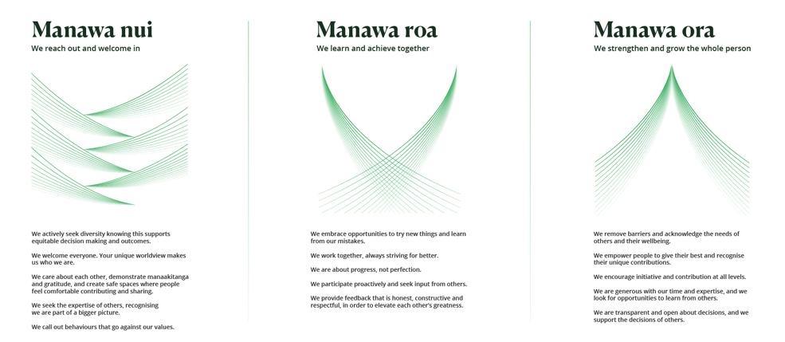
Ō matou uara | Our values
Notes:
Note: This slide is a placeholder to be populated as appropriate depending on the team. For National/Regional teams Te Pūkenga values may apply. For Divisional and/or local teams, divisional values or co-values may apply. If no specific set of values is applicable, we recommend positioning this activity Tikanga mahi | Ways of Working’
Introduce the applicable values, this may be a one-pager, a set of cards, videos, etc. and are the vehicle to discuss how we want to work together as a team. Acknowledge we all come with our own values to varying degrees – personal, organisational, divisional, etc. And these can be strongly held. Encourage your team to use all the values that are meaningful to them in this activity.

Slide 3

A closer look at our Values
Divide into groups and allocate one value for each group
In your groups
  If you are using Te Pūkenga values, watch the video for your value
  Discuss the key themes of each value
  Draw a picture that visually represents that value or theme for your group
Share your picture with the wider group
Notes:
Note for Leaders: This slide will need to be adapted according to the relevant set of values used.
Part 1
Divide into small groups (break out rooms if online) and assign one value per group.
Review video/discuss key themes of the values. For example; a key theme for Manawa nui could be collaboration, a key theme for Aroha | Respect could be we treat each other the way we would like to be treated.
Each group draws a picture that represents the value for them (5-10 minutes) and then each group shares their picture with the wider group.
Closing out the exercise: Think about the key themes you’ve captured as we move into the next exercise.
Collect pictures; these can be laminated for future use if desired.

Slide 4

Values/ways of working in practice
In your group:
What does this value or way of working look like in practice for our team?
What does it mean for how we want to work together with each other, our wider community, stakeholders, and partners?
Capture key points on paper:
How do we want to work as a team?
What does this value look like, sound like, feel like?
Share with the wider group.
Notes:
Note for Leaders: This slide will need to be adapted according to the relevant set of values used.
If time allows you could rotate tables so each group gets some time to discuss and add to the key points of others, then bring everyone back together and ask for feedback on any additions or overall observations.
Part 2
In the same small groups, discuss what these key themes look like in practice for your team and what they mean for how we want to work together – with each other, our communities and partners/stakeholders.
Then, capture on flip chart paper how we want to work as a team - what does this look, sound, feel like?
Each group feeds back to the wider group. Ask for feedback and make any additions. If time allows, you could rotate tables or break out rooms, so each group gets some time to discuss/add to the key points.
Closing the activity: Collate and theme the information discussed and use this as the basis for your team charter.

Slide 5

Rhythms & rituals
How will we communicate as a team, connect, work together, have fun in our:
  One-on-ones
  Team hui – when, where, how long, how often;
  What's working well now, what do we want
  to change?
  Communication
  Sharing information ie. Documents
  Social connection
  Supporting each other
  Recognising and celebrating together
Notes:
Rhythms & Rituals
To finish this section, there are some practical considerations to discuss around how we collaborate and communicate as a team . If these have not be captured during the activity, discuss as a wider group now. Capture agreements on a whiteboard and incorporate into your team charter.
Closing the activity: Outputs to be collated and themed.

