Slide 1
Te ara whakamua | Navigating the Current Context
Notes:
Note to Leader: Only use this activity if it’s relevant to your team. We wouldn’t recommend doing this activity if you have new or highly engaged kaimahi.

Slide 2
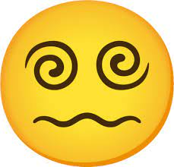

Purpose of this exercise
We have been in a period of intensive change and uncertainty for a long time…
Sometimes dealing with all of that can feel very overwhelming!
This exercise is about understanding the broader context in which we operate, and the multiple challenges and uncertainties we are grappling with.
Let's get clear about what we can influence or control, and what we can't – so we can focus on those things and move to action.
Notes:
Begin by explaining the purpose of the activity which is about understanding the broader context in which we operate and the multiple challenges and uncertainties we are grappling with.
We want to get clear about what we can influence/control and what we can’t - so we can focus in and move to action.

Slide 3
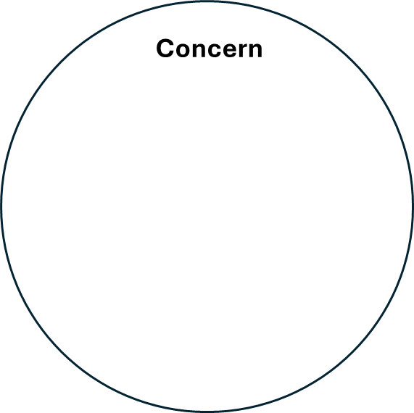
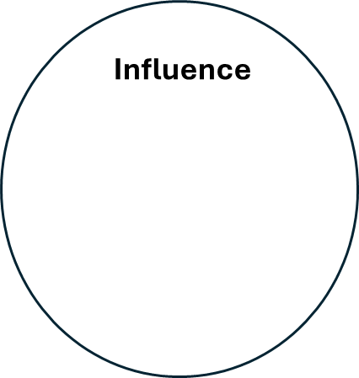
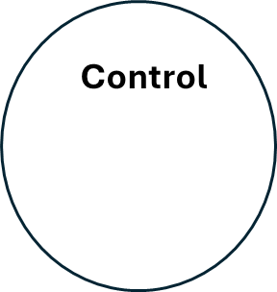
Circles of control
Draw a large circle. Write down on post-it notes all the things you are currently concerned about (one post-it per concern) and stick them around the edges of the circle. This is your circle of concern – it covers everything that affects you.
2. Draw a smaller circle inside the first. Move into this circle all the post-it notes with concerns that you can influence in some way. This is your circle of influence – it includes the things that you can impact or effect.
3. Draw a third circle inside your circle of influence. Move into this circle anything that is directly under your control. This is your circle of control – it includes the things that you have complete authority over.
Notes:
Note: the slides build throughout the exercise.
This activity can be done as a larger group or individually, but generally works better in smaller groups (say groups of 3-4). For an online hui use Microsoft Teams break-out rooms and online collaborative tools such as a virtual Whiteboard.
Allow approximately five minutes for each of the following three steps:
Draw a large circle. Write down on post-its all the things you are currently concerned about & stick them around the edges of the circle. This is your circle of concern – it covers everything that affects you.
Draw a smaller circle inside the first. Move into this circle all the post-its with concerns that you can influence in some way. This is your circle of influence – it includes the things that you can impact or affect.
Draw a third circle inside your circle of influence. Move into this circle anything that is directly under your control. This is your circle of control – it includes the things that you have complete authority over.

Slide 4
Our circles of control
Discuss and share:
What do you notice about your circles?
Is it unclear where anything sits?
What's left in your circle of concern? Is there anything you can do to move them into your circle of influence?
Where are you currently spending the majority of your focus, time and energy?
How do you prioritise and manage your circles?
Notes:
Once the exercise has been completed, ask each group to discuss the questions (5 minutes) and then share their thoughts/observations with the wider group (10 minutes).

Slide 5
Wrapping it up
Being able to recognise the difference between the things you can change and those you can’t will help build resilience.
The more you focus on your circles of influence and control, the bigger those circles become.
The key is perspective:
  recognise and acknowledge the things you can't control, but don't get sidetracked by those
  be intentional about where to invest your focus, time and energy towards the things you can influence or control.
.
Source: Stephen Covey, the 7 Habits of Highly Effective People, Simon and Schuster, 2004.
Notes:
Closing out the exercise -
The key here is perspective – be aware of and informed about what concerns you (us) but focus on what you (we) can influence and control.
The model comes from Stephen Covey, 7 Habits of Highly Effective People (2004)
This is a really useful exercise to revisit on a fairly regular basis and can be done individually or in groups.
This activity can be used in a wide range of contexts – work, professional, personal – whenever there is a complex and changing environment. This was used effectively with teams during Covid.
Being able to recognise the difference between what we can and can’t control can influence and impact resilience. At times we all focus on things that impact us but over which we have no control – this reduces our resilience because we expend energy on things we cannot change, instead of investing in things we can.
There is a significant amount of useful information online on this model; here is one example: https://learningloop.io/glossary/circles-of-influence
For development on this model, check out this LinkedIn course: Covey's circles of control, influence, and concern (linkedin.com)

