Slide 1
Kaha me ngā āheitanga |Strengths and Opportunities
Notes:
To explore and identify individual and collective strengths as well as areas for development. Kaimahi are more engaged and motivated when they are doing mahi | work that plays to their strengths. This leads to greater efficiency and increased performance.

Slide 2
Flow state -
Matching level of challenge with capability and resources
Source: Mihaly Csikszentmihalyi
CHALLENGE
Overwhelmed
when the level of challenge and capability match we are happy and engaged
IN FLOW
Stressed
Too much challenge for available skillset and resources
Unwell
CAPABILITY & RESOURCES
Bored
Cynical
Disengaged
Capability but not enough challenge
Notes:
The optimum state where we are happy and engaged is called ‘flow’. This is a state where our level of challenge is just enough combined with the right amount of skills and resources. Too much or too little challenge and skill results in being stressed, disengaged and/or bored. Understanding our strengths, weaknesses and/or vulnerabilities can help us to optimise a flow state in our mahi.

Slide 3
What is a strength?
A strength is a behaviour that comes naturally to us. It happens relatively seamlessly and easily, gives us the energy to succeed and connects us to a purpose and sense of achievement.
Talent x Investment = Strength (Gallup)
Talent = Innate patterns of thought, feeling or behaviour
Investment = Time spent practicing or developing skills & building knowledge
Types of strengths:
character strengths
performance/talent based strengths
learned behaviours
Notes:
Share definition of a strength from the slide and three types of strengths (character, performance/talent and learned behaviours).

Slide 4
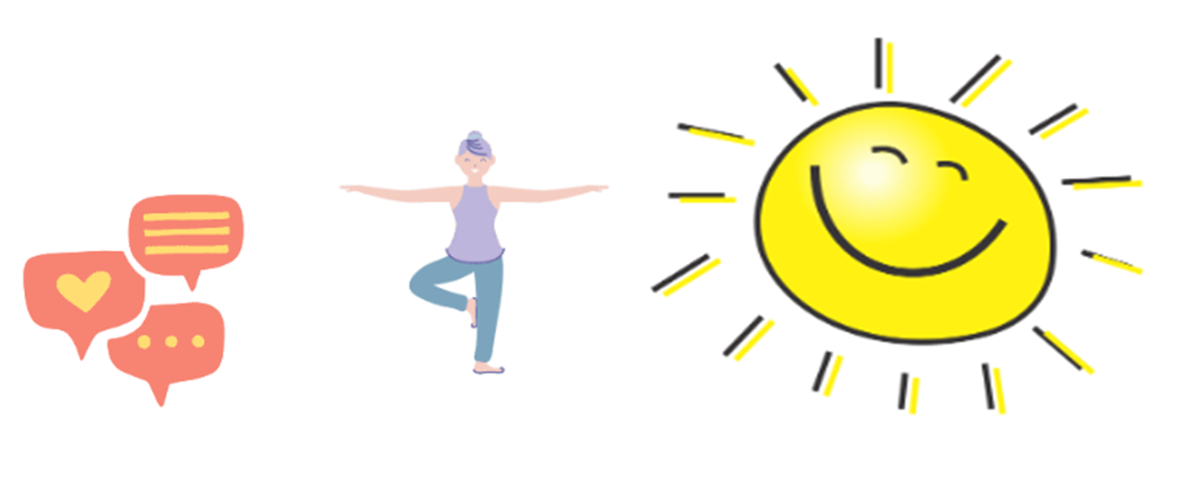
Good news!
Whatever you want to accomplish, your strengths can help you:
  Increase your happiness at home and in your mahi (work)
  Improve your relationships
  Improve health through increased balance
  Increase your performance, engagement and satisfaction
  Achieve your life goals
  Reduce your stress
  Find meaning and purpose in your life
Notes:
What are the possible benefits from working to our strengths? Discuss opportunities or just share the slide. Can they add any more benefits?

Slide 5
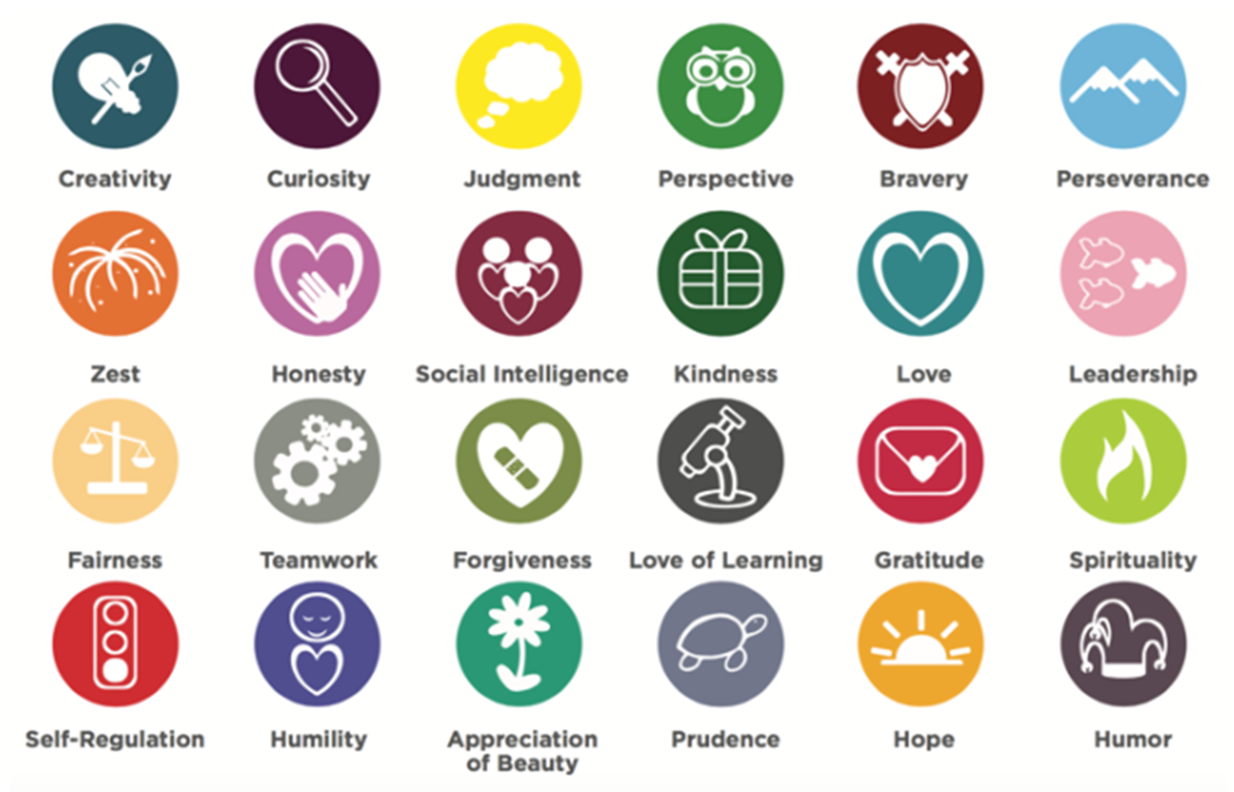
Character Strengths
Take a strengths survey: VIA Character Strengths Survey & Character Reports | VIA Institute
Notes:
What character strengths do you recognise in yourself?
What character strengths do you recognise in our team members? As a team, do we cover the whole range of strengths indicated on the slide?
This can prompt discussion or be a self-reflective exercise.
Suggest the team complete the free VIA Character Strengths Survey as a follow up exercise.

Slide 6

What are your work strengths?
Passion
What activities are you drawn to?
Learning
What skills or knowledge do you pick up quickly?
Satisfaction
When do you feel a strong sense of fulfilment?
Flow
When are you so immersed in something that you lose all sense of time?
Excellence
Where do you excel? What comes easily to you?
Notes:
Introduction to work strengths. Allow time for team to think about the reflection questions and then in pairs discuss these. We recommend you give some examples from your own experience to create rapport with your team and lead into the next activity.

Slide 7

What are we really good at?
Work together to create a team profile of our collective strengths.
Identify specific:
character strengths
performance/talent based strengths
learned behaviours
Ēhara tāku toa i te toa takatahi, engari he toa takitini.
Our strength is not made from us alone, but made from many
Notes:
Work in groups to create a strengths profile of the team. Some kaimahi may have difficulty identifying their own strengths but are more comfortable recognising those strengths in others. Share the profiles that have been created and discuss the collective strength that is contained within your team. Take time to acknowledge these.
Suggested approach - this could be a diagram with the different areas of strengths listed, a graphical depiction of people and what their strengths are or simply a list. Allow the team to be creative in how they present this.

Slide 8
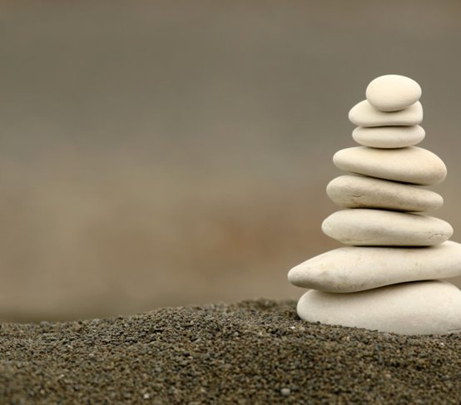
Building on your strengths...
Now we have identified our team strengths, what next?
Some questions to ask yourself:
  How have you been working to your strengths?
  What do you love to do and are good at?
  Can you work to your strengths every day? What's stopping you?
  Are those things you can influence or control?
What opportunities do we have to utilise our strengths to maximise a Flow State?
Create an action plan with specific goals and activities aimed at building on our strengths.
Notes:
An evaluation of how your team is doing at working to the identified strengths. Sometimes we can get side tracked and forget just how resourceful we are. Allow time for people to think about the review questions. Tip: You could ask for a thumbs up or down of where team members think they are at.
Embrace a growth mindset – seeing yourself as work in progress, capable of changing and growing, never static, and never finished with the journey of self-improvement. This is the key for planning your development – this is for you! Take this time to focus on yourself – as we know that playing to our strengths will make us much happier, engaged, motivated and give us energy to get through our days with a sense of achievement and connecting to a greater purpose.
What opportunities are there to utilise the team strengths to maximise flow state for our team members?
Create an action plan with specific goals and activities to build team strengths, thinking about the following;
Look for existing places that you are already on the right track but that you can amplify their effectiveness or grow their benefits. Grow the good, to get to great!
Some habits or behaviours or situations that get in the way – minimise, reduce friction to get out of your own way. I.e. what time of your day are you playing to your strengths? Look at energy levels.
How will you celebrate these goals and successes? This is important! Don’t skip this part! You need to celebrate along the way – little steps, little milestones, this will keep you on track and help you to stay motivated and excited to keep doing what you love.

