Slide 1
Change Support Survey
June 2022
Institutional Summary

Slide 2
Response Rates
56%
The 2022 Change Support survey was initially open for two weeks, from 25 May to
8 June 2022, and then was extended for a further week to 15 June 2022
450 staff completed the survey which equates to an overall response rate of 56%.
This is lower than the 2021 Pulse Survey (68%) which was run mid year.

Slide 3
Response Rates
Response rates vary by area and team with academic staff showing lower rates when compared to non-academic.

Slide 4
Survey Objective & Questions
Survey Objective
The Change Support Survey was intended to inform our approach to change support and where we focus our time, effort and resources to best meet the needs of our kaimahi
This survey was undertaken in place of the Engagement Pulse Survey that we would typically undertake around this time of year.
Engagement Questions
I feel a sense of commitment to Unitec
Change Support Questions
My manager keeps me up to date on the
Te Pūkenga changes
There are enough tools to support employee wellbeing through change.
My manager supports me through any changes happening at work.
Open Question
Do you have any feedback you would like to share regarding the forthcoming Te Pūkenga changes?

Slide 5
Engagement Question:
I feel a sense of commitment to Unitec
Overall engagement as measured by this question has dropped by 8 percentage points from our previous survey in August 2021.

Slide 6
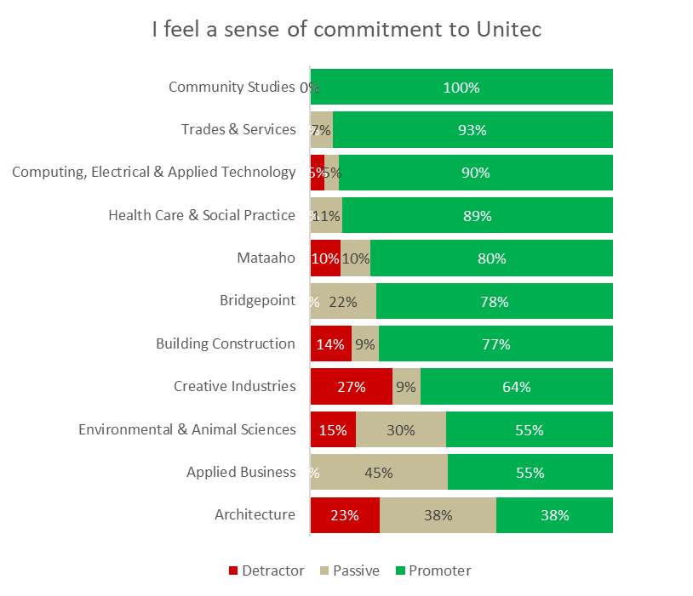
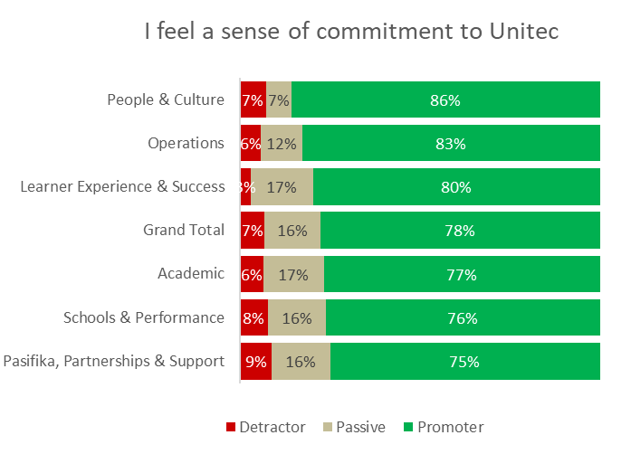
Engagement Question:
I feel a sense of commitment to Unitec
Schools
Support Areas
Note: Rating on a 5-point scale, Strongly Agree to Strongly Disagree
Community Studies has the highest level of engagement out of the Schools, while People & Culture show the highest engagement from the Support Teams.

Slide 7
Change Support Questions
Schools
Question | Applied Business | Architecture | Bridgepoint | Building Const & Engineering | Community Studies | Computing Electrical & Applied Engineering | Creative Industries | Environ mental & Animal Sciences | Health Care & Social Practice | Mataaho | Trades & Services | Schools Total
My manager keeps me up to date on the Te Pūkenga changes | 5.2 | 5.8 | 6.5 | 7.0 | 9.1 | 6.9 | 7.4 | 7.9 | 8.2 | 5.9 | 5.3 | 6.8
There are enough tools to support employee wellbeing through change | 5.0 | 4.3 | 5.0 | 4.8 | 5.6 | 4.8 | 5.6 | 3.8 | 4.2 | 4.7 | 4.7 | 4.7
My manager supports me through any changes happening at work | 7.1 | 6.7 | 7.1 | 7.1 | 8.0 | 6.3 | 7.3 | 8.0 | 7.8 | 6.5 | 6.4 | 7.1
Note: Averages taken from ratings on a 0-10 scale.
Average ratings were highest for “My manager supports me through any changes happening at work” and lowest for “There are enough tools to support employee wellbeing through change”
Highest ratings for manager communication & support were for Community Studies, Environmental & Animal Sciences and Health Care & Social Practice.

Slide 8
Change Support Questions
Support Areas
Item | Academic | Corporate Governance | Learner Experience & Success | Operations | Pasifika, Partnerships & Support | People & Culture | Support Areas Total | Schools & Performance | Grand Total
My manager keeps me up to date on the Te Pūkenga changes | 7.9 | 9.5 | 7.1 | 7.3 | 7.5 | 8.6 | 7.2 | 6.8 | 7.2
There are enough tools to support employee wellbeing through change | 4.7 | 7.3 | 5.5 | 5.6 | 5.7 | 6.7 | 5.1 | 4.6 | 5.1
My manager supports me through any changes happening at work | 7.6 | 9.0 | 7.9 | 7.2 | 7.5 | 8.1 | 7.4 | 7.0 | 7.4
Note: Averages taken from ratings on a 0-10 scale.
As with Support Areas, average ratings were highest for “My manager supports me through any changes happening at work” and lowest for “There are enough tools to support employee wellbeing through change”
See Appendix A for a more detailed breakdown at team level.

Slide 9

Feedback Themes
1048 comments received
Overview: Key themes across questions
Feedback was very consistent and the same key themes emerged across all questions
The impact of ongoing uncertainty and the need for clarity was the overriding theme throughout – the overwhelming majority of comments pertained to this in some form.
Key themes closely related to this across all questions were:
  Concern about job security and conditions of employment
  Increasing sense of loss of confidence in Te Pūkenga
  Change fatigue and issues relating to workload and resources
  Support for managers and recognition that they are doing the best they can to communicate with and support their teams with the limited information they have

Slide 10
Feedback Themes
273 responses to this question
Open Question:
Do you have any feedback you would like to share regarding the forthcoming
Te Pūkenga changes?
Common themes
Ongoing uncertainty & lack of clarity – around what the future looks like, what will change and the implications of that for staff, learners and communities; impact on wellbeing/change fatigue
Need for better communication from Te Pūkenga – more transparency, less high level, more concrete information with specific timeframes. Recent roadshow positive.
Loss of confidence in Te Pūkenga – things are being pushed through regardless of impact/implications; how are decisions being made; impact of implementation on staff, students & communities; significant risk; lack of change readiness
“It appears to me that Te Pukenga is out of its depth and a long way behind in its delivery plan…
seems like TP has taken on way more change than it can handle.”
I am surprised at the lack of a clear project plan with timelines and milestones. Decisions made by spokespersons from Te Pūkenga seem to be off the cuff and not following any plan.

Slide 11
Feedback Themes
Common themes
Programme unification and associated implications – speed of transition; decisions being rushed; time for preparation before implementation; impact on workload/resources; limited consultation processes; lack of clarity re benefits to learners; what level of autonomy is retained; quality concerns and need for QA; need for transition support
Speed of change overall – concern that decisions are being made too quickly/rushed; need to take the time to do it properly & get it right. For a few – a sense that things are moving too slowly, need to just get it done.
They seem recklessly fast paced & the shift to a nationwide common curriculum for Nursing & Social Work with planned commencement S1 2023 is much too rapid and likely to lead to disaster and a drop in quality
6 months out from the start of new programmes, there is no structure, or operating model, no sense of excitement about what the future holds, simply an increasing level of expectation that staff will run out old curricula whilst implementing a new curriculum that has not yet been shared without any indication about support or resource.
… this is a fast and furious process - and the reality of implementing change in a short time frame is not ideal and will cost twice as much in the long run

Slide 12
Feedback Themes
Common themes
Job security – importance of basic job and financial security; talk of redundancies unsettling; not knowing if I should be looking for a new job; overall impact on wellbeing; resignations; concern about potential timing of job losses
I appreciate that initiatives will be put in place around wellbeing for change, however nothing really
makes a dent unless people have basic financial security and stability at work
Conditions of employment – concern about potential loss of remuneration, changes to conditions of employment (leave entitlements, redundancy clauses etc); concerns about parity with colleagues
Loss of great staff / retention issues – people leaving due to ongoing uncertainty & lack of job security; need retention initiatives; flow on effect on workloads
Workload/resourcing and having to do more with less – increasing unsustainable; exacerbated by the transition; associated impacts on wellbeing, retention, quality, reliance on goodwill; little recognition
We don't really know what the changes will be. We have no real understanding of what the role of an academic will be within Te Pūkenga or whether we will have a place in the new structure.
We are haemorrhaging staff to the universities.
Not much good has come out of this transformation yet and I have questions that I believe needs to be answered to stop this current uncertainty and people leaving as if they are running from a tsunami.
It is like having a job on top of a job and neither get done well. If TP were serious about a positive change experience they would resource and not depend on the whims of goodwill.

Slide 13
Feedback Themes
Common themes
Support for the transition / positive opportunities - new ways of teaching & learning; benefits for students; sense of opportunity & excitement; looking forward to change; see opportunities in collaboration
I am in favour of the creation of Te Pukenga as I hope it will provide consistency and streamline education delivery and be more efficient financially. I understand that such an enormous change will take many years to embed and that there will be many challenges for all involved.
Sense of commitment to Unitec and the values of Te Noho Kotahitanga – despite ongoing uncertainty; remains a supportive environment & culture; importance of holding to values through transition
I feel strong commitment for Unitec because I know my role and feel supported. I can't say I feel that way about Te Pukenga because I am unclear on whether my role will exist.
If all the changes will be approached with Living Te Noho Kotahitanga values at the front/centre of the decisions I am confident that people will be looked after.
Loss of Unitec identity / values – impact on communities & trusted relationships; will take time to build TP brand; sense of sadness; honouring the whakapapa of Te Noho Kotahitanga

Slide 14
Feedback Themes
Less common themes
Bigger picture – political landscape & potential impact of a change in Government; changing landscape in terms of industry priorities & implications of this; how will ITPs, ITOs, WDCs all work together under Te Pūkenga
Impact on external stakeholders – importance of engagement with communities, suppliers
Leadership at Te Pūkenga – need for diversity; do they have enough vocational education experience
Pacific voice/visibility – seems to be lacking throughout
Impact on learners – concern about international market/relationships; focus on priority groups; limited information on how this will impact learners
Te Pūkenga operations – specific concerns about various aspects of Te Pūkenga operations; need for good training around new processes/systems; unknowns in relation to WDCs; how will timetabling and L&T support operate; standardisation of processes; financial & budgetary processes; IT/logistics support

Slide 15
Feedback Themes
280 responses to this question
Change Support Question:
My manager keeps me up to date on the Te Pūkenga changes
Common themes
Significant support for managers – recognition that managers are largely doing the absolute best they can; information is too high level and lacks clarity; low scores in this area are not a reflection on the manager
Regular updates – most managers are providing regular updates through team meetings, emails, etc; sharing upcoming events & encouraging participation; the issue is the lack of concrete information
Ongoing uncertainty & lack of clarity – what information is available is largely being shared but there are too many unanswered questions
Need for better communication from Te Pūkenga – too high level, not concrete enough; volume of information can be overwhelming; request for simpler, briefer, more targeted communication
Less common themes
Limited communication from manager – limited information; don’t hear much from manager but find out in other ways; not often covered in team meetings; only hear about my area/related to my role not about broader changes
No communication / issues with manager – (very small number of staff) – no communication; manager not engaging; no discussions in team meetings

Slide 16
Feedback Themes
262 responses to this question
Change Support Question:
There are enough tools to support employee wellbeing through change
Common themes
Tools are good but of limited use – support for tools that are available but they are of limited use when there is ongoing uncertainty/lack of clarity and lack of job security
all the tools in the world won’t help / wellbeing tools are of limited use without job security
Lack of awareness in some areas about what tools are available; not sure what is meant by “tools”
Time to engage with wellbeing tools and support mechanisms is challenging; exacerbated by ongoing workload/resource issues; staff need to be given time to attend and workload managed to enable
Need more targeted/tailored tools – those available are too generic/superficial; need to be more tailored, targeted, “on the ground”; need concrete, specific support in our roles, not more wellbeing workshops; more face to face, one on one support and conversation
Biggest need for support is around workload – increased for many; no support in terms of additional resource; concern about even higher workload coming with transition, new processes etc.
Less common themes
Loss of gym facilities – impact of this; was a valuable support mechanism for some staff
Resilience – acknowledgement that individuals have a role to play in developing their own resilience
Peer support is important; team collegiality; value of peer support in changing context

Slide 17
Feedback Themes
233 responses to this question
Change Support Question:
My manager supports me through any changes happening at work
Common themes
Great support from manager – very supportive; open, approachable; trusted; available & accessible; doing their best in a very difficult environment; full confidence in manager
Recognition that managers are constrained by lack of information and are themselves dealing with the same ongoing uncertainty and lack of clarity
Concern about manager wellbeing – recognition that managers are grappling with their own workload/uncertainties; some managers are too overwhelmed/overworked to be able to provide the required level of support
Biggest support need is around workload/resource – not enough resources to alleviate the workload and to free up manager/team time to provide support
Less common themes
Not the manager’s job – a few didn’t feel that providing support was the manager’s job, that Te Pūkenga should be providing the support required
Executive support – a few felt this was lacking; a few commented on positive support from executive
No support from manager or support not needed – no real support provided; no support required

Slide 18
Appendix
Team Results

Slide 19
Change Support Questions
- Average ratings for all teams
Question: My manager keeps me up to date on the Te Pūkenga changes
Office of CEO | 9.5
Academic Leadership | 9.2
Community Studies | 9.1
Library & Learning Commons | 9.0
Human Resources | 8.0
Health Care & Social Practice | 8.2
Te Korowai Kahurangi | 8.0
Timetabling | 8.0
Environmental & Animal Sciences | 7.9
Marketing & Communications | 7.9
Tūāpapa Rangahau | 7.7
Student Central | 7.7
Creative Industries | 7.4
Heads of School | 7.1
Enrolment Processing | 7.1
Te Puna Ako | 7.1
Building Construction & Eng. | 7.0
Computing, Electrical & Applied | 6.9
Learning & Achievement | 6.8
Bridgepoint | 6.5
Facilities Management | 6.5
Student Support & Scholarships | 6.4
Student Success Leadership | 6.3
Business Performance | 6.2
Mataaho | 5.9
Architecture | 5.8
Student Wellbeing | 5.5
Trades & Services | 5.3
Applied Business | 5.2
Note: Averages taken from ratings on a 0-10 scale.

Slide 20
Change Support Questions
- Average ratings for all teams
Question: There are enough tools to support employee wellbeing through change
Office of CEO | 7.3
Timetabling | 6.9
Facilities Management | 6.5
Student Central | 6.3
Student Support & Scholarships | 6.3
Academic Leadership | 6.2
Library & Learning Commons | 6.1
Human Resources | 6.1
Student Success Leadership | 6.0
Enrolment Processing | 6.0
Creative Industries | 5.6
Marketing & Communications | 5.6
Community Studies | 5.6
Learning & Achievement | 5.1
Applied Business | 5.0
Bridgepoint | 5.0
Building Construction & Eng | 4.8
Computing, Electrical & Applied | 4.8
Mataaho | 4.7
Trades & Services | 4.7
Business Performance | 4.7
Te Korowai Kahurangi | 4.6
Tūāpapa Rangahau | 4.4
Student Wellbeing | 4.3
Architecture | 4.3
Te Puna Ako | 4.3
Health Care & Social Practice | 4.2
Environmental & Animal Sciences | 3.8
Heads of School | 2.9
Note: Averages taken from ratings on a 0-10 scale.

Slide 21
Change Support Questions
- Average ratings for all teams
Question: My manager supports me through any changes happening at work
Academic Leadership | 9.5
Office of CEO | 9.0
Library & Learning Commons | 8.9
Student Central | 8.8
Marketing & Communications | 8.7
Student Support & Scholarships | 8.1
Environmental & Animal Sciences | 8.0
Community Studies | 8.0
Student Success Leadership | 8.0
Timetabling | 7.9
Learning & Achievement | 7.8
Health Care & Social Practice | 7.8
Tūāpapa Rangahau | 7.7
Facilities Management | 7.7
Te Korowai Kahurangi | 7.6
Human Resources | 7.4
Creative Industries | 7.3
Enrolment Processing | 7.2
Building Construction & Eng | 7.1
Applied Business | 7.1
Bridgepoint | 7.1
Architecture | 6.7
Te Puna Ako | 6.6
Mataaho | 6.5
Trades & Services | 6.4
Student Wellbeing | 6.3
Computing Electrical & Applied | 6.3
Heads of School | 5.6
Business Performance | 5.3
Note: Averages taken from ratings on a 0-10 scale.

Slide 22
Change Support Questions
- Teams excluded
Data for the following teams has not been included as there were fewer than 6 responses per team. However, their data has been “rolled up” into the averages for their broader support area.
Academic Operations Leadership
Academic Registry & Graduation
Accounts & Finance
Copy Centre
Goods & Transport
Health & Safety
Industry Workforce
Information Technology
International Student Support
IT Desktop Support
IT Infrastructure
IT Solutions Delivery
Learner Experience & Success Leadership
Learning & Development
Maia
Maintenance
Operations Leadership
Pacific Centre
Pasifika, Partnerships & Support Leadership
Security
Student Experience – Student Comms & Events
Student Finance
Unitec Pathways College

