Slide 1
Course Evaluation and Planning 2022
Sue Crossan
Te Korowai Kahurangi

Slide 2
Course Evaluation and Planning (CEP)
Key part of self-assessment, evaluation and academic quality compliance at Unitec

Slide 3
2022 version
Very similar to the 2021 version.
Here are some tips to help you get started….

Slide 4
Tip : Use Chrome as your browser
Testing has shown that the app is more reliable in Chrome

Slide 5

Tip : Finding the link to the new CEP
Use the CEP link you bookmarked last year
OR
Check on the Nest page for the link – Teaching & Research/Te Korowai Kahurangi/Academic Quality/Evaluation, Monitoring & Review/Course Evaluation and Planning (CEP)
OR
Use the link in the email with this presentation

Slide 6
Tip : Permissions screen
You may be asked to allow the CEP to connect to other Microsoft Office products which are part of your Unitec Office 365 account
Click Fix Connections if necessary then click ALLOW
Or just click ALLOW if your connections are all working

Slide 7

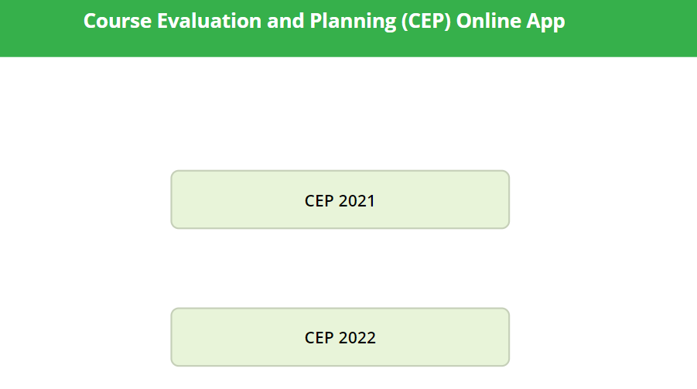
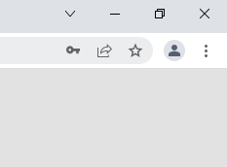
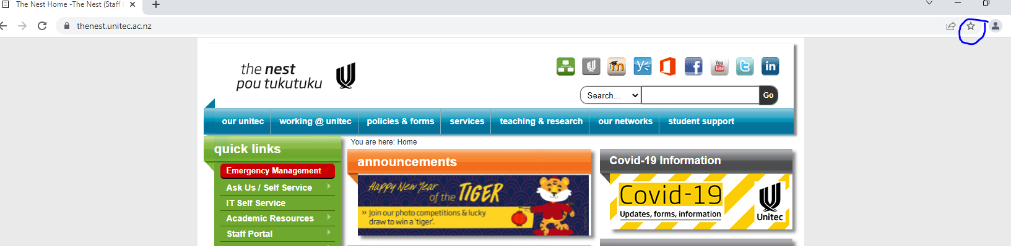
Welcome to the CEP!
Tip : Bookmark this landing page for easy access throughout the year
In Chrome, click on the star at the top right hand side of the bar at the top to create a bookmark

Slide 8

Tip
Look for the purple diamond icon in your bookmarks.
This is what my bookmarks look like on the bar at the top of my screen.

Slide 9
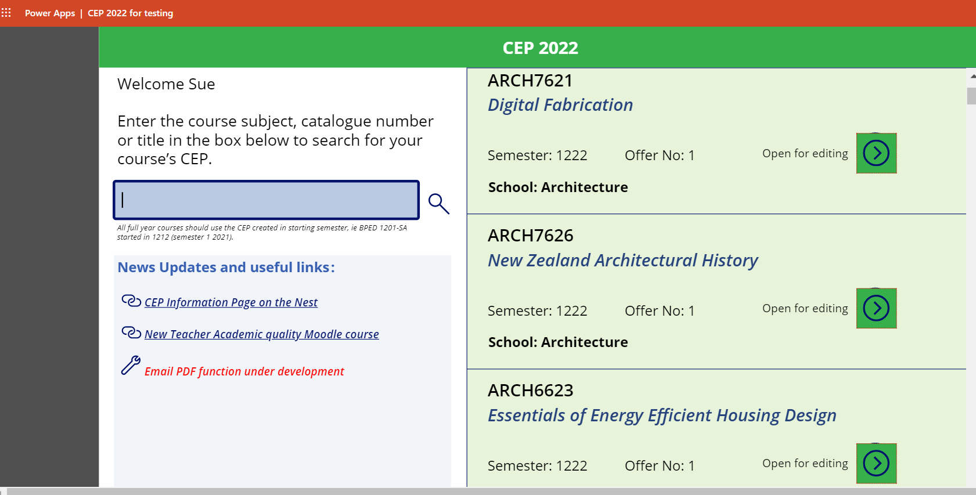
LANDING PAGE
Search field Ruler
Tip : Quick search – use the search field to type in a course subject, catalogue number or title– your course should appear on the right hand side
Use the ruler on right hand side to scroll down if your course doesn’t appear at the top
Note – semester: 1222 = semester 1 2022

Slide 10
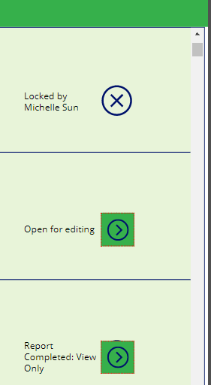
TIP : CEP STATUS
Locked by = another person is either working in the CEP or did not ‘SAVE AND EXIT’ so it is still open in their Microsoft Office 365 Unitec account
Open for editing = good to go ☺
Report completed: View only = report already submitted. You can still view the report or email a PDF to the course co-ordinator at this stage. Reports can’t be submitted until all mandatory questions are completed

Slide 11
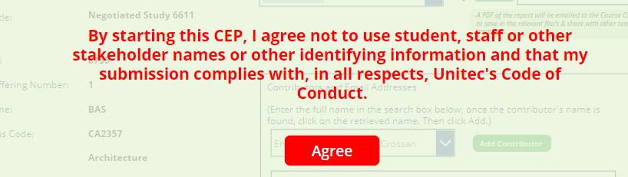
NOTE: Privacy warning!
You will get a pop-up reminder that names should never be mentioned in any of the comments in a CEP.
TIP : All data is published on a Power BI dashboard so it is not appropriate to mention students or staff by name

Slide 12
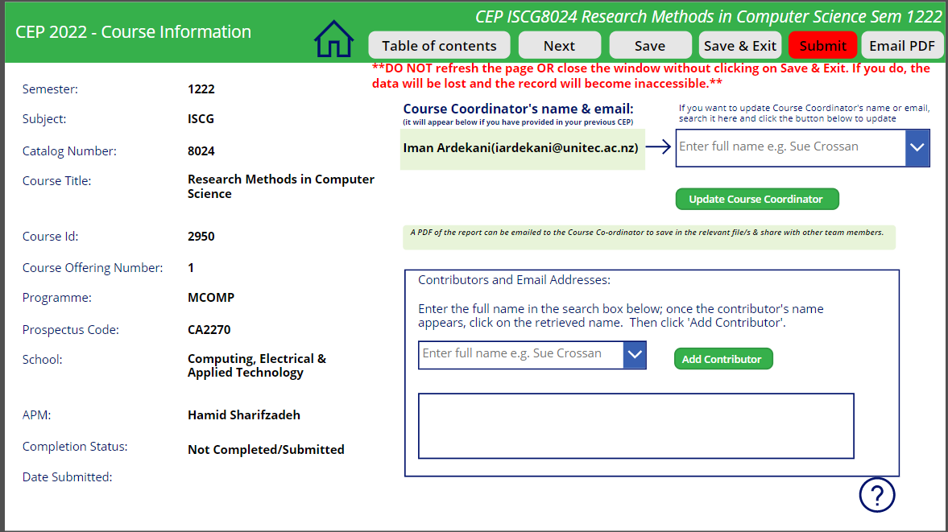

SECTION A
Information on the left hand side of Section A is picked up from Peoplesoft
If the Course Coordinator’s name is incorrect, click in the field to search for the correct email address and then ‘Update Course Coordinator’
Tip : If a PDF is requested, it will only be emailed to the Course- Co-ordinator
Any other lecturers teaching on the course can be added at this point by typing a name into the field and clicking ‘Add contributor’

Slide 13

Tip : Navigating the CEP:
Click on the Table of Contents tab to navigate to a specific section
OR
Click Next to move through in a linear progression
Return to the Home page where you selected your course by clicking on the Home icon

Slide 14
BEFORE
DURING
AFTER
The CEP has 3 sections.
1 BEFORE - the course begins
2 DURING – when assessments are marked and moderated
3 AFTER – reflection and evaluation when the course ends
Tip : The questions are adaptive; selecting ‘yes’ or ‘no’ to a question, will lead to a different question popping up next.

Slide 15

If you have any questions, click on the question mark icon to send your question to tkkinsights@unitec.ac.nz
Tip:

Slide 16
As you complete the AFTER section, you will be asked to reflect on data stored in Power BI. Tip : Click on these links to go direct to the dashboards.
When you click on the ‘filtered dashboard’ tab you may be asked to ‘request access’. You only need to do this once. Within 24 hours you should receive an email confirming access has been granted. You should then be able to use the Filtered Dashboard to see the results for the past two years for your course including for priority groups.

Slide 17

IMPORTANT NOTE!
‘Save’ means you are intending to leave the window open and come back to carry on later that day.
‘Save & Exit’ means that you have finished entering information for the day and want to close the window. If you don’t click ‘Save & Exit’, the CEP will remain open and locked in your name (it uses your Unitec Microsoft Office 365 account).
Warning: If you exit by closing the window, you will lose your work.
Tip : Remember to ‘Save & Exit’ when you have finished for the day.

Slide 18
You can email a copy of the PDF to the course co-ordinator when the CEP is complete before OR after it has been submitted.
Tip : Don’t forget to press SUBMIT when you have completed.
NOTE: The PDF function is not operational yet; it will be ready before semester 1 CEPs are completed.

