Slide 1

Health & Safety Induction
COVID-19 Protection Framework (CPF)
Red
For Unitec Staff and Learners
Notes:
Use title slide layout

Slide 2


Content
COVID-19 Protection Framework – Red principles
Personal health
Vaccination requirements
Information for while on campus
Face covering requirements
Contact tracing
Hygiene
Physical distancing
This presentation should take approximately 8-10 minutes

Slide 3
Covid-19 Protection Framework - Red
Covid Protection Framework (CPF) – Red
At CPF Red, action will need to be taken to protect both at-risk people and protect our health system from an unsustainable number of hospitalisations.
How we stay safe at CPF Red
Record keeping and scanning will be required
Face coverings will be mandatory on flights, public transport, in taxis, retail, public venues, and recommended whenever leaving the house
Vaccination certificate requirements
Tertiary education — vaccines are required for onsite access and delivery, with capacity based on 1 metre distancing
Staff and students will need to be vaccinated and provide proof of this to be onsite at CPF Red

Slide 4
Individual Roles and Responsibilities
Learner
Participates fully in learning on site while managing their own health and safety while following CPF Red guidelines . This includes wiping anything you have touched or used as you enter and before you leave.
Supervisor/Staff
The Supervisor is an academic member of staff who delivers teaching or conducts an operational task in a way that complies with all CPF Red guidelines.
Supervisors may be actively teaching or could be taking a more supervisory role only. The Supervisor has additional duties over and above staff who are managing their own health and safety in ensuring that learners are adhering to required CPF Red guidelines.
This induction must be delivered by Supervisors/Staff to Learners prior to the start of class
Supervisors/Staff are responsible to ensure Health & Safety monitoring and compliance is adhered to

Slide 5
Covid testing
Testing if onsite at CPF Red
If you have symptoms or have been to a location of interest, please get tested. If you have no symptoms or have not been at a Location of Interest, the Ministry of Health advice is not to get tested in order to free up resources for those who need to.
For any staff working on campus, our Te Puna Waiora Medical Centre offers testing, please call 0800 10 85 10 to book an appointment or alternatively visit a community testing centre or your GP.
Testing is free for everyone.
If you have a positive Covid-19 test, stay home, then contact your line manager.
For next steps guidance refer to the Nest Covid page: FAQs re Awaiting Test results or showing symptoms

Slide 6

Stay Home If You Are Sick
If you are sick:
If you have cold, flu or COVID-19 symptoms, stay home
Call your doctor or Healthline on
0800 358 5453 for advice about getting a test
Inform your manager or lecturer
By getting a test, you are helping keep your community safe. Testing is free for everyone
Staying at home if you are sick is one way to stop the spread of Covid-19.
For guidance refer to the Nest Covid page: FAQs re Awaiting Test results or showing symptoms

Slide 7
Vaccination requirement for staff and students
Before Arriving on Campus
Access to Unitec is dependent on compliance with the following Vaccination requirements. Non-compliance will result in removal from campus.
Completion of this induction does not grant immediate access to campus
Staff
Vaccination Status: Prior to coming onto Campus you will need to upload your vaccination passport details into the Unitec Vaccination Register.
'My Vaccine Pass': Download your vaccine pass and have this available to show should this be required.
Students
Students are required to follow the instruction on how to provide proof of double vaccination status.
'My Vaccine Pass': Download your vaccine pass and have this available to show should this be required.

Slide 8
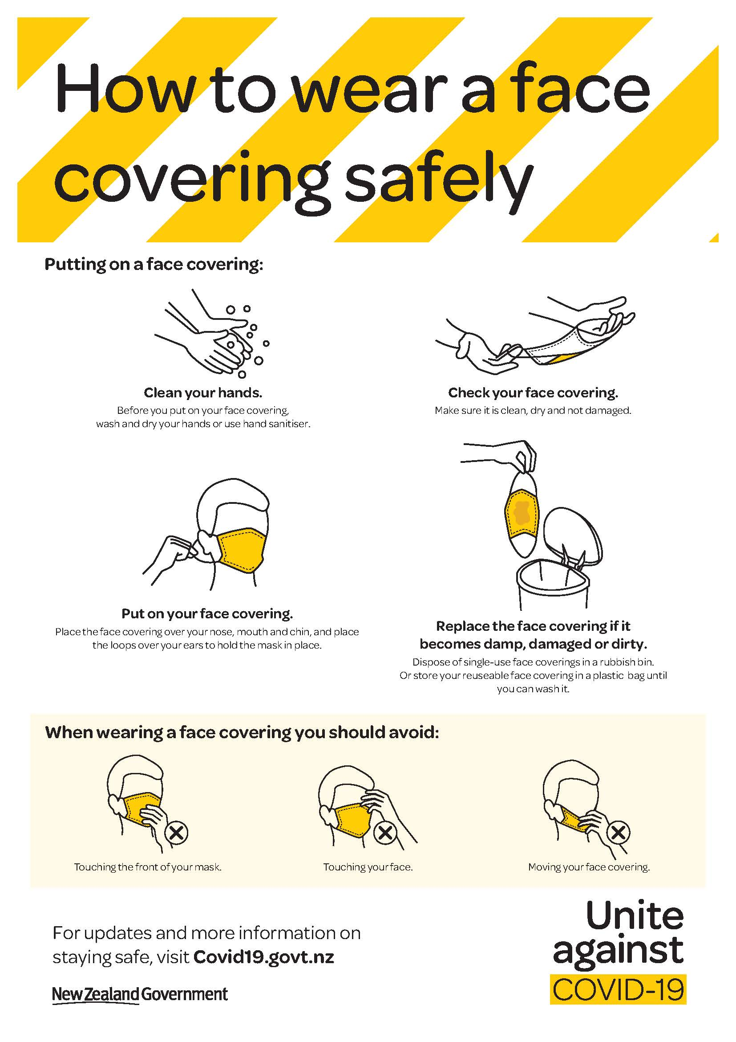
Face Coverings
Face Coverings at Unitec at CPF - Red
Staff and students should bring face coverings or masks when attending onsite activities.
They are mandatory at all times, both inside and outside the classroom. This also includes workshops and lifts.
Face coverings must be worn inside Te Puna Waiora and the Osteopathy clinic.
Face coverings outside of Unitec at CPF – Red
At CPF Red Face coverings will be mandatory on flights, public transport, in taxis, retail, public venues, and recommended whenever leaving the house

Slide 9
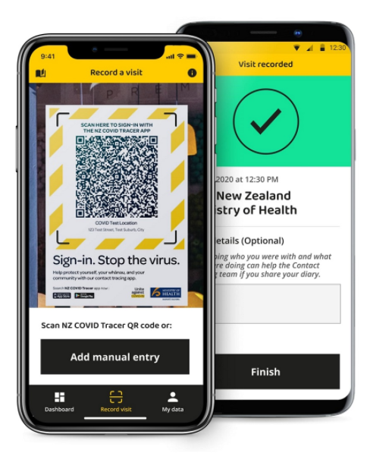

NZ Covid Tracer App
The faster we can contact people who might have been exposed with Covid-19, the faster we can stop the spread of the virus
Staff and Learners entering the facility must scan the NZ Covid Tracer QR code or provides details on a manual sign-in sheet to enable contact tracing.
Turn on Bluetooth tracing
The NZ Covid Tracer app has been updated to include Bluetooth tracing technology.
Bluetooth tracing allows you to receive an alert if you have been near another app user who tests positive for Covid-19.

Slide 10

Personal Hygiene
    Personal Hygiene
    Before entering the learning space, supervisors and learners will be required to wash their hands with soap and water for at least 20 seconds and dry thoroughly, using bathrooms that are located close to the learning space.

Slide 11
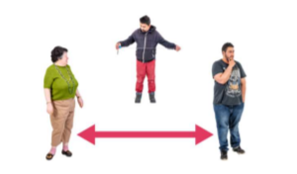
Physical Distancing
Classroom Numbers/Physical Distancing
Capacity is based on One (1) metre of physical distancing, where possible this must be maintained at all times across campus.
Machinery
Machinery is required to be sanitised before and after use. Hands must be sanitised before and after using the machinery.
Bathrooms
You are required to use bathrooms located closest to the rooms you are using.

Slide 12


Personal Protective Equipment - PPE
Supervisors and learners are to wear PPE if this is normally required (refer to Standard Operating Procedures (SOPs) and area-specific COVID-19 controls).
If PPE is not required, follow face covering requirements at all times.
PPE must not be shared and should be held by learners.
This includes lab coats, which should be taken away and laundered by learners themselves.

Slide 13

Leaving the Classroom/Workshop
Cleaning Equipment/Materials
Learners are required to sanitise surfaces and equipment before and after use. Supervisors will sanitise surfaces and equipment between classes.
Personal Hygiene
Supervisors and learners will remove their own PPE and take it away with them. Wash hands with soap for a minimum of 20 seconds and dry hands thoroughly before leaving.
Leaving the Campus
Supervisors and Learners are to leave campus and abide by CPF Red guidelines, including maintaining social distancing of 1 metre.

Slide 14
Confirmation
Please use the following link to confirm you have completed this refresher
H&S Refresher
If this does not work, copy and paste the following into your browser
https://forms.office.com/r/N8x0ZRgasg

