Slide 1
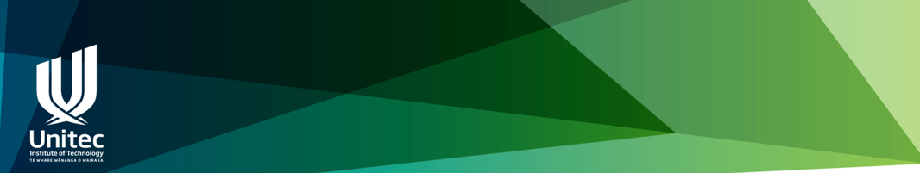
SMART Goals
for effective Āta

Slide 2
SMART goals can be used to:
Identify the actions we need to take to make improvements e.g to improve student success, staff wellness or our environment
Identify the actions to take to disseminate worthwhile practices
Make sure the actions are clear and in our control
Assess the effectiveness of actions taken

Slide 3
What are SMART goals?
Specific
Measurable
Achievable
Relevant
Time-Bound
Further reading: https://www.atlassian.com/blog/productivity/how-to-write-smart-goals

Slide 4
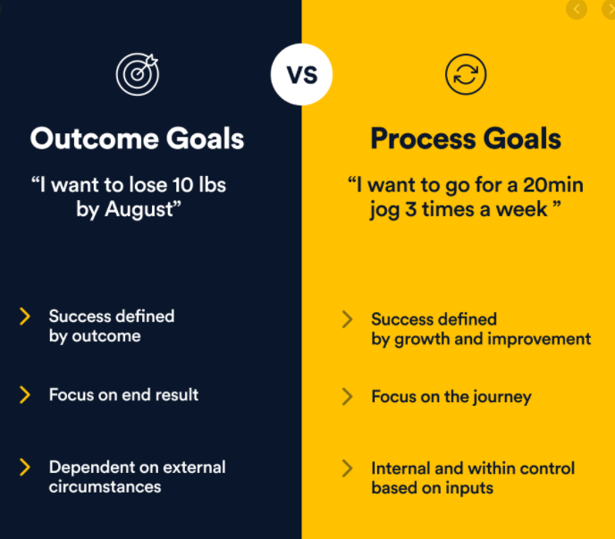
Further reading: https://www.developgoodhabits.com/process-goals/

Slide 5
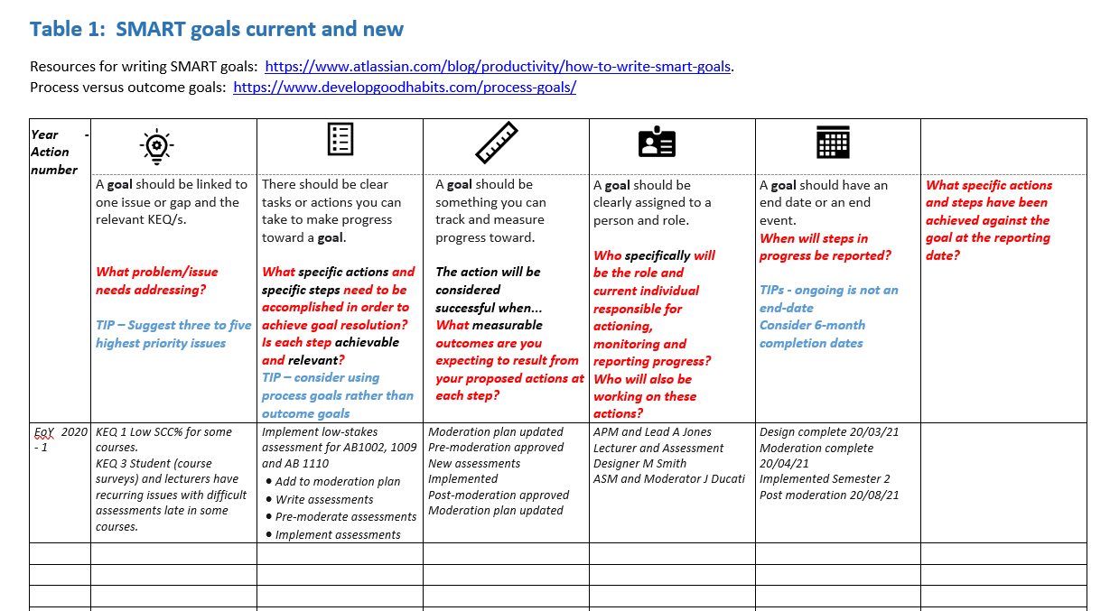
SMART goal template

Slide 6

Step 1 - Issue identification
Āta korero, Monitors Report, Consistency Review Report or other is used as a source to:
Identify the issues - problems and good practice
Prioritise issues to be addressed by a SMART goal
These may be linked to one or more relevant KEQ/s and TEI/s or other metrics
EXAMPLE of an issue linked to KEQs
  KEQ 1 Low SCC% for some courses AND
  KEQ 3 Student (course surveys) and lecturers have recurring issues with difficult assessments late in some courses.

Slide 7

Step 2 - Create a list of tasks and actions for each issue
There should be clear tasks or actions you can take to make progress toward a goal.
  specific actions
  specific steps in order
  Each step is Achievable and Relevant?
EXAMPLE
Implement low-stakes assessment for AB1002, 1009 and AB 1110
  Add to moderation plan
  Write assessments
  Pre-moderate assessments
  Implement assessments

Slide 8

Step 3 – Measuring success and progress
A goal should be something you can track and measure progress toward specific actions
  What Measurable outcomes are you expecting to result from your proposed actions at each step?
EXAMPLE
Moderation plan updated
Pre-moderation approved
New assessments implemented
Post-moderation approved
Moderation plan updated

Slide 9

Step 4 – Assign responsibility
A goal should be clearly assigned to a specific role and specific person
Where multiple persons are involved one person shall be specifically assigned as the lead
The lead and others should have Relevant skills and knowledge to complete their tasks and should be Achievable within their workplan
EXAMPLE
Lead A Jones – APM
Designer M Smith –Lecturer
Moderator J Ducati -ASM

Slide 10

Step 5 – Stipulate times
A goal should be Time-bound have an end-date or end event
  Milestones should be included
  Ongoing is not an end-date
  Recommend a 6-months completion time
  In some cases an event can be used to provide an end-date such as approval by NZQA
  Times should be Achievable
EXAMPLE
Design complete 20/03/21
Moderation complete 20/04/21
Implemented 1214
Post moderation 20/08/21

Slide 11
Step 6 – Track goals at PAQC
Goals should be tracked and reviewed
  It is OK to change a goal and this should be documented
EXAMPLE
Change personnel
Change timing
Delete some tasks
Add tasks

