Slide 1
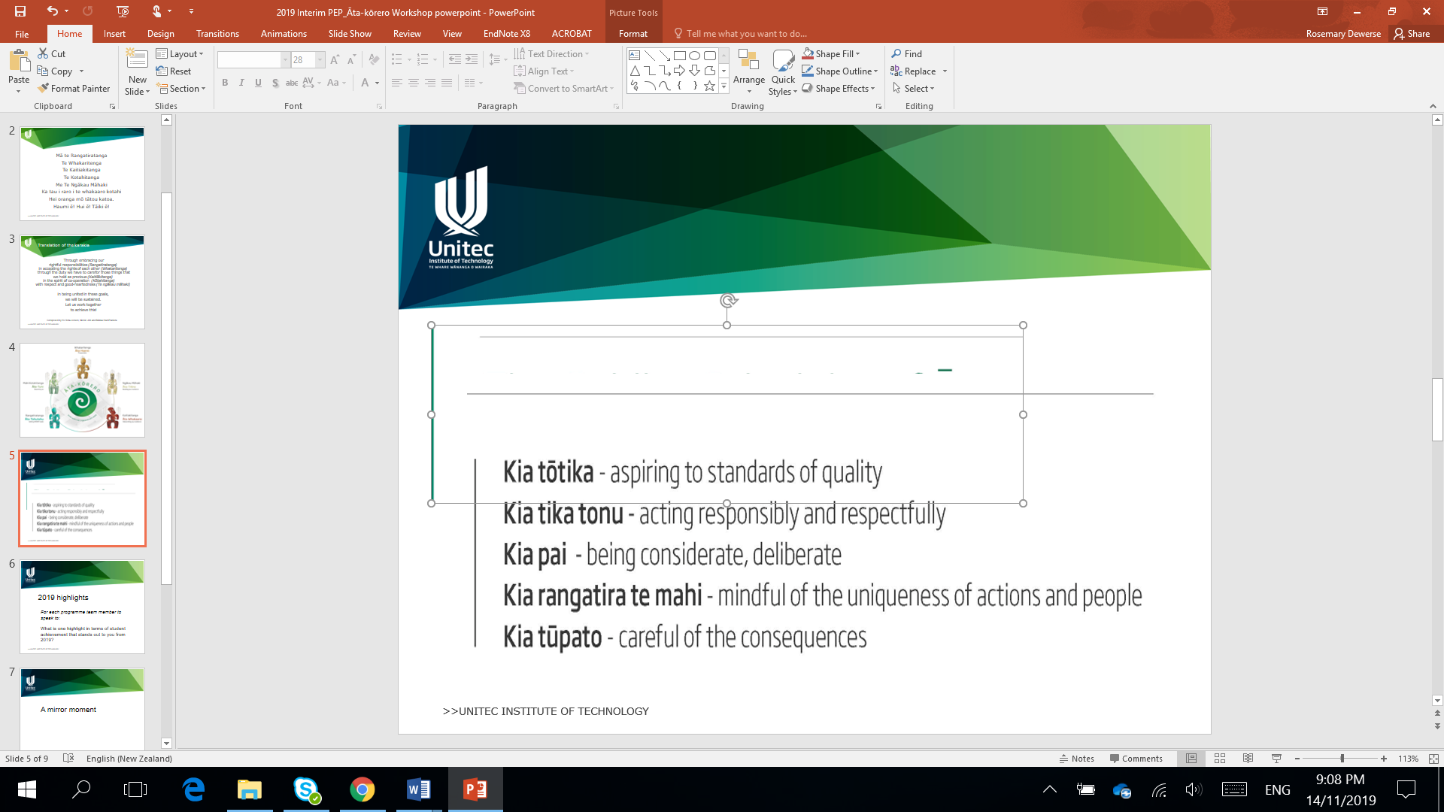
SMART Goals
for effective Āta

Slide 2
Mā te Rangatiratanga
Te Whakaritenga
Te Kaitiakitanga
Te Kotahitanga
Me Te Ngākau Māhaki
Ka tau i raro i te whakaaro kotahi
Hei oranga mō tātou katoa.
Haumi ē! Hui ē! Tāiki ē!
Karakia tīmatanga

Slide 3
Through embracing our rightful responsibilities (Rangatiratanga) ​
in accepting the rights of each other (Whakaritenga) ​
through the duty we have to care for those things that we hold as precious (Kaitiākitanga) ​
in the spirit of co-operation (Kōtahitanga) ​
with respect and good-heartedness (Te ngākau māhaki) ​
​
in being united in these goals, ​
we will be sustained. ​
Let us work together ​
to achieve this!
Composed and translated by Yo Heta-Lensen, Nicole Job and Matua Hare Paniora

Slide 4
Guiding principles
SMART goals in the PEP help to:
Identify the actions we need to take to improve student success and other KEQs
Make sure the actions are clear and in our control
Assess the effectiveness of actions taken
Take pū

Slide 5

Have the SMART goals from last time been actioned?
Are the SMART goals in the PEP and are they moved into other areas e.g. Workplans, ADEPS for action and tracking?
What new SMART goals do we need to address gaps?
What impact have the SMART goals had on KEQ outcomes?

Slide 6
What are SMART goals?
Specific
Measurable
Achievable
Relevant
Time-Bound
Further reading: https://www.atlassian.com/blog/productivity/how-to-write-smart-goals

Slide 7
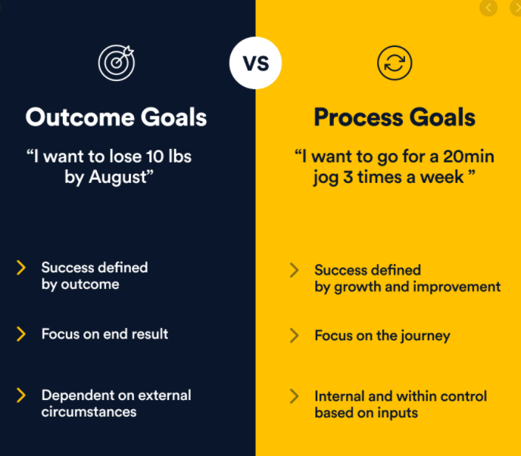
Further reading: https://www.developgoodhabits.com/process-goals/

Slide 8
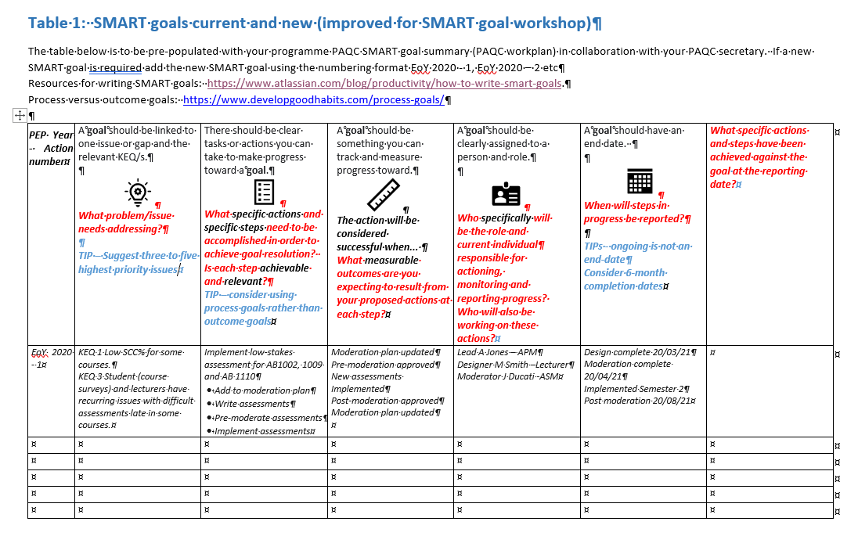
PEP SMART goal template

Slide 9

Step 1 - Issue identification
Āta korero is used to:
Identify the issues - problems and good practice
Prioritise three to five (as a guide) of these that will be addressed by a SMART goal
Link these to one or more relevant KEQ/s
EXAMPLE of an issue linked to KEQs
  KEQ 1 Low SCC% for some courses AND
  KEQ 3 Student (course surveys) and lecturers have recurring issues with difficult assessments late in some courses.

Slide 10

Step 2 - Create a list of tasks and actions for each issue
There should be clear tasks or actions you can take to make progress toward a goal.
  specific actions
  specific steps in order
  Each step Achievable and Relevant?
EXAMPLE
Implement low-stakes assessment for AB1002, 1009 and AB 1110
  Add to moderation plan
  Write assessments
  Pre-moderate assessments
  Implement assessments

Slide 11

Step 3 – Measuring success and progress
A goal should be something you can track and measure progress toward specific actions
  What Measurable outcomes are you expecting to result from your proposed actions at each step?
EXAMPLE
Moderation plan updated
Pre-moderation approved
New assessments implemented
Post-moderation approved
Moderation plan updated

Slide 12

Step 4 – Assign responsibility
A goal should be clearly assigned to a specific role and specific person
Where multiple persons are involved one person shall be specifically assigned as the lead
The lead and others should have Relevant skills and knowledge to complete their tasks and should be Achievable within their workplan
EXAMPLE
Lead A Jones – APM
Designer M Smith –Lecturer
Moderator J Ducati -ASM

Slide 13

Step 5 – Stipulate times
A goal should be Time-bound have an end-date or end event
  Milestones should be included
  Ongoing is not an end-date
  Recommend a 6-months completion time
  In some cases an event can be used to provide an end-date such as approval by NZQA
  Times should be Achievable
EXAMPLE
Design complete 20/03/21
Moderation complete 20/04/21
Implemented 1214
Post moderation 20/08/21

Slide 14
Setting Good SMART goals
SPECIFIC for PEPs
What do we want to achieve?
Who is involved?
Where does it get actioned?
When does it need to happen?
What are the requirements and constraints?
Why do we need to do this?

Slide 15
Step 6 – Track goals at PAQC
Goals should be tracked and reviewed
  It is OK to change a goal and this should be documented
  Recommend a 6-months completion time
  In some cases an event can be used to provide an end-date such as approval by NZQA
EXAMPLE
Change
Moderation complete 20/04/21
Implemented 1214
Post moderation 20/08/21

Slide 16
Ka wehe atu tātou
I raro i te rangimārie
te harikoa, me te manawanui
Haumi ē! Hui ē! Tāiki ē!
Karakia whakamutunga

