Slide 1

COVID-19 Health and Safety Refresher
Alert Level 2
February 2021
For Unitec Staff and Learners
Notes:
Use title slide layout

Slide 2
Contents
Contents of this presentation are 10 slides detailing:
What you need to know before entering campus while in COVID-19 Alert Level 2
Information for while on campus
Leaving campus
This presentation should take approximately 5-6 minutes.

Slide 3

Individual Roles and Responsibilities
Learners
Learners who are on campus will have the responsibility of managing their own health and safety by following Alert Level 2 procedures. This includes: wiping down anything they have touched or used before they leave, practicing good personal hygiene, scanning the QR codes for each building they enter for contact tracing purposes, and physical distancing of 1m if in class. It is recommended to wear face coverings while on campus.

Slide 4






Individual Roles and Responsibilities
Teaching and Support Staff
All teaching and support staff must comply with all Alert Level 2 procedures. All staff are responsible for ensuring that learners are adhering to the required COVID-19 procedures while following the Alert Level 2 procedures themselves. This includes: wiping down anything they have touched or used before they leave, practicing good personal hygiene, scanning the QR codes for each building they enter for contact tracing purposes, and physical distancing of 1m if in a class or the office. It is recommended to wear face coverings while on campus.
Poster Resources
There will be additional posters printed for teachers and staff that can be picked up from B107 if there is a specific requirement for a space. These posters include:

Slide 5
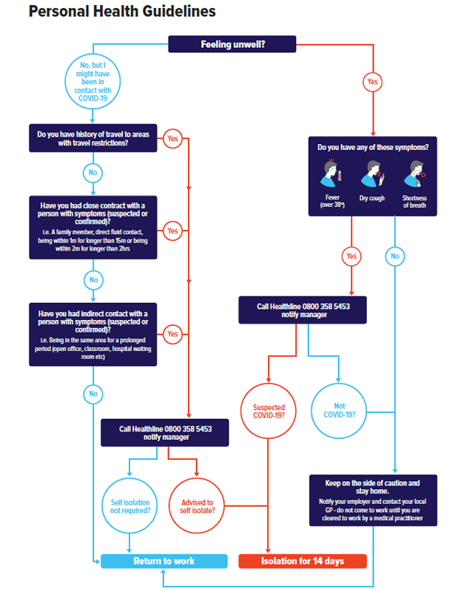

Before Arriving to Unitec
Follow the Personal Health Guidelines flowchart
Stay home if you are sick.
Call your GP before visiting them or call Healthline on 0800 358 5453.

Slide 6

Personal Hygiene & Sanitising
    Personal Hygiene
    Before entering the learning/office space, staff and learners are required to wash their hands with soap and water for at least 20 seconds and dry thoroughly, using the bathrooms that are located closest to the learning space. Cough/sneeze into elbows – not hands.
Hand Sanitising
There are selected sanitising stations around certain areas on both campuses. In common areas, sanitiser will be wall mounted and in other spaces sanitiser will need to be shared. Hand sanitiser bottles are available and can be picked up and refilled/replaced at Goods & Transport in Building 107. Please arrange top-ups as and when required.
Sharing of Tools
Tools must not be shared and need to be sanitised before and after use. Hands also need to be sanitised before and after using the tools.

Slide 7

Contact Tracing
    Buildings on Campus
At every building entrance on campus, there will be QR code posters. All learners and staff are required to sign in by scanning the QR code for each building they enter. If the learner or staff member does not have a smart phone, they must sign in on the physical sign-in sheet provided.
Turn on Bluetooth Tracing
The NZ COVID Tracer App has been updated to include Bluetooth tracing technology. Bluetooth tracing allows you to receive an alert if you have been near another app user who tests positive for COVID-19.
    Shuttle Buses
There will also be QR codes for contact tracing on Unitec shuttle buses, as well as physical sign-in sheets if the user does not have a smart phone. Face coverings or masks will be mandatory on shuttle buses.

Slide 8

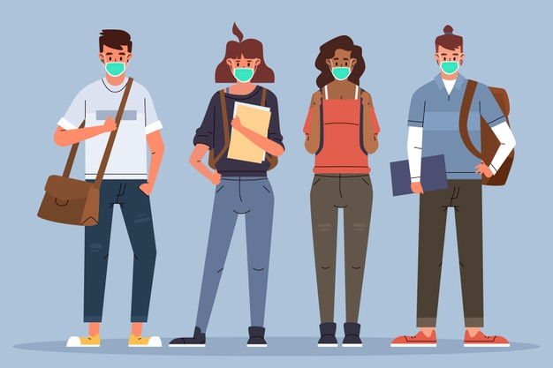
Physical Distancing & Face Coverings
Physical Distancing
Physical distancing of a minimum of 1 metre will apply in the learning space and office area and minimum of 2 metres around campus.
    Wearing a Mask or Face Covering
    If physical distancing of 1-2m cannot be maintained, learners and staff are required to wear a mask or face covering. Learners and staff must bring their own face covering to campus. If forgotten, masks will be available for purchase in Breaktime at Mount Albert and at reception at Waitakere. It is a legal requirement to wear a face covering on public transport.

Slide 9
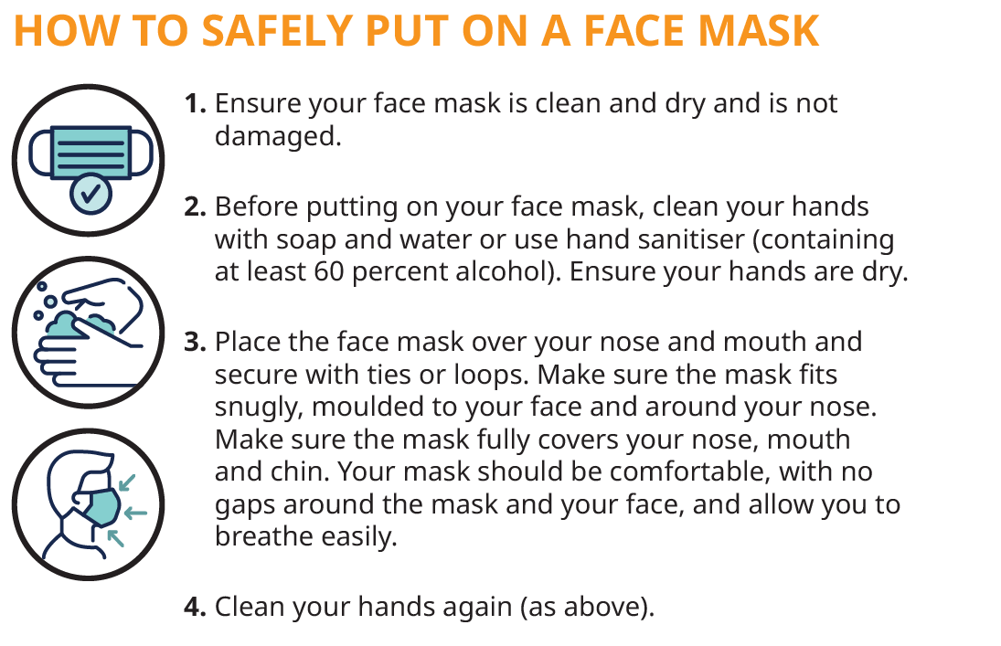
How to Safely Put on a Face Mask

Slide 10
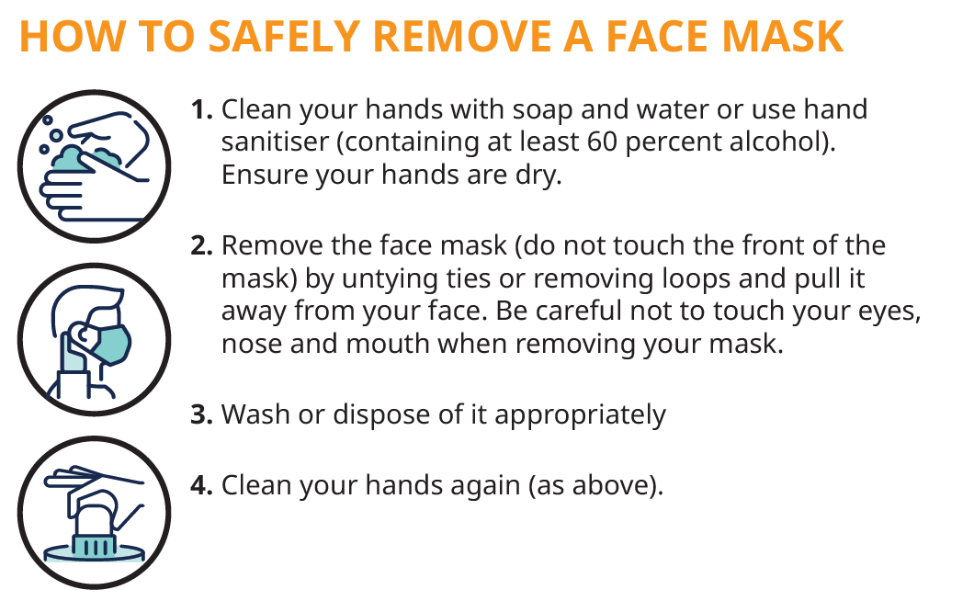
How to Safely Remove a Face Mask

Slide 11


Leaving Unitec
Cleaning Equipment/Materials
Learners are to sanitise surfaces and equipment that they have used. Staff will sanitise surfaces and equipment between classes.
Spray disinfectant for surfaces and cloths are available and spray bottles can be refilled/replaced at Goods & Transport in Building 107. Please arrange top-ups as and when required. Please organise responsibility of these tasks within your team
Personal Hygiene
Staff and learners will wash their hands with soap for a minimum of 20 seconds, (or sanitise), and dry hands thoroughly before leaving.

Slide 12
H&S Refresher Form
Please fill out the form here to confirm that you have completed the COVID-19 Health and Safety Refresher for Alert Level 2.
Full link:
https://forms.office.com/Pages/ResponsePage.aspx?id=sonzgIBzZ0u1J39xGleBMBnqlxWHveBJtFzQP5L5YkRURUYwVEUyMUtOMVBRSkJGNU9RWDRaR0xKSC4u

