Slide 1
Course Evaluation and Planning 2021
Sue Crossan
Te Korowai Kahurangi
scrossan@unitec.ac.nz

Slide 2
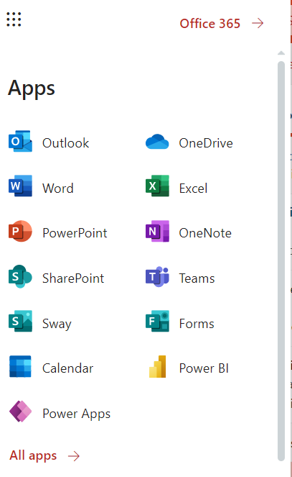

Good news!
Shorter!
Improved software! Microsoft Office 365

Slide 3

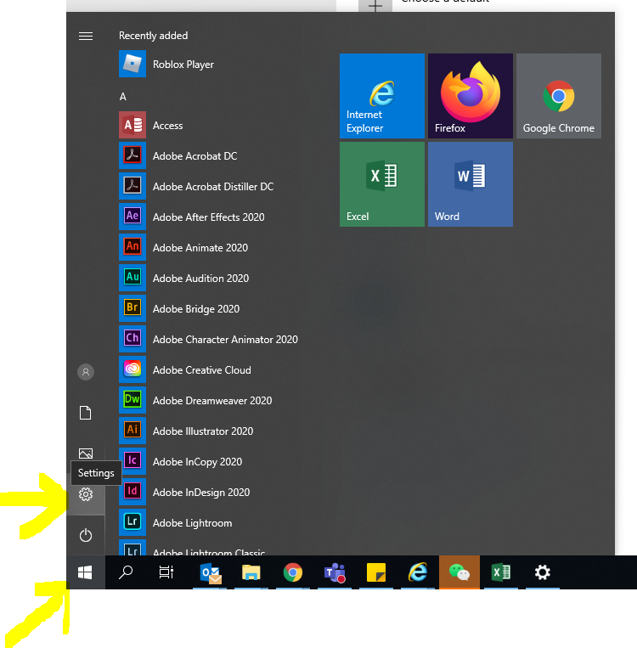
Make sure default browser is Chrome
Step 1: Click on the Windows Icon then click on Setting

Slide 4
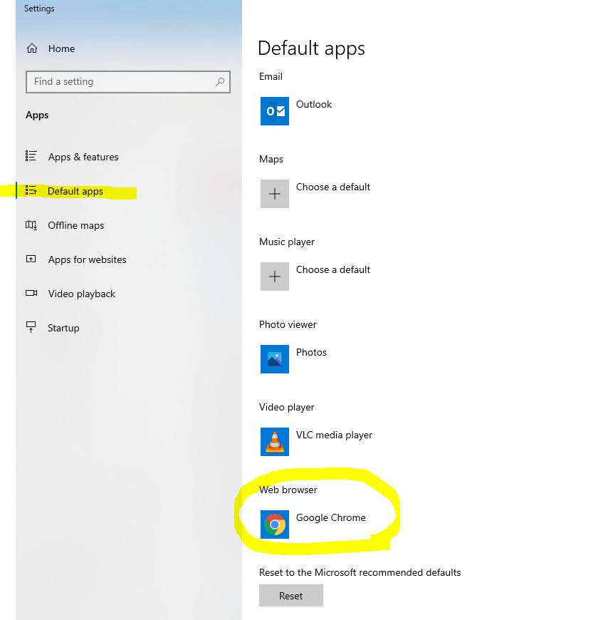
Step 2: Choose “Default apps” (or type in search for “Default apps” if it doesn’t automatically appear, )
Click on the icon under “Web browser” Select Google Chrome as the default internet browser.

Slide 5

How to access the CEP and get started
1. Access the CEP via the Nest page:
https://thenest.unitec.ac.nz/TheNestWP/teaching-and-research/te-korowai-kahurangi/evaluation-and-review/cep/
Click on the link and sign in and STOP!
The next screen needs authorising before you can access PowerApp. Click Allow after checking to make sure there are no connection errors.
If you get a request to ‘Fix Connection’ – click ALLOW, otherwise you won’t be able to access the CEP on your laptop.

Slide 6
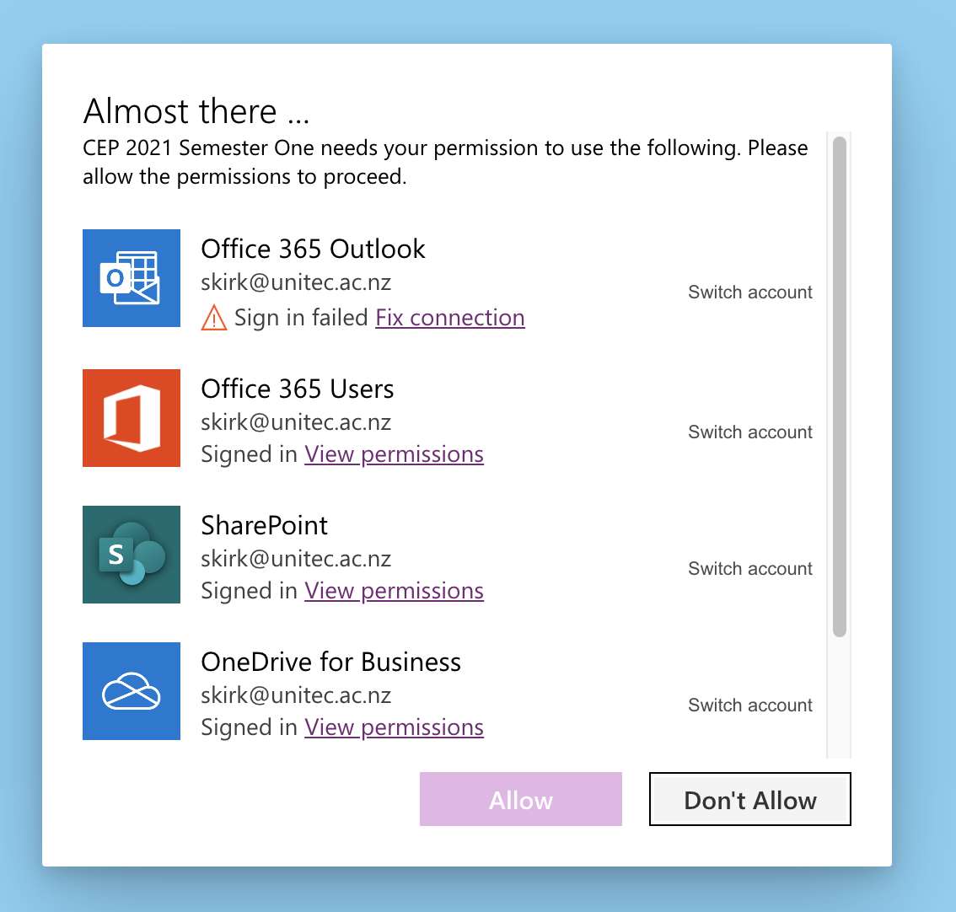
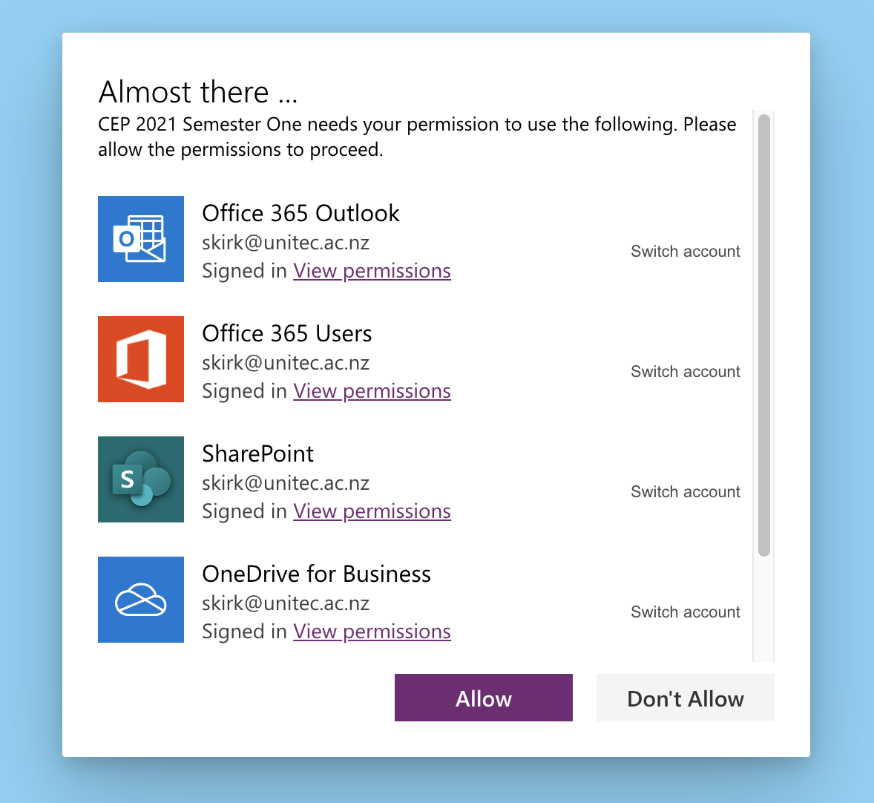



Slide 7
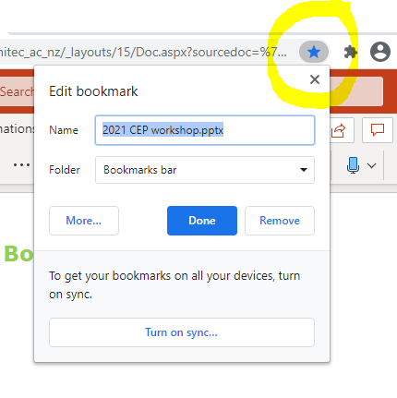
Book mark the link for easy access

Slide 8
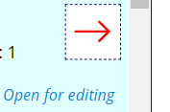
How to find your course on the
Landing page
Select using either the drop down menus or by entering a subject number and catalogue number
All courses running at Unitec in 2021 will be displayed on the right, scroll down to select
Click directly on the red arrow to open

Slide 9


Three modes: Locked/Edit/View
indicates someone else has the
 | Someone else has the CEP open - only one person can be editing at a time
 | No longer able to edit – can email the report or view
 | Ready to use

Slide 10
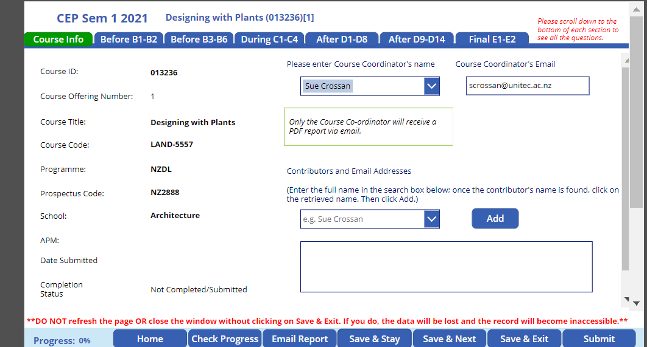



Course Info page

Slide 11
Designed for lecturers to complete at three stages:
BEFORE
DURING
AFTER
the course

Slide 12
Navigate using the tabs
Scroll down using the bars on the right of the screen
to reach all the questions underneath each tab
Links lead to more information on the Nest

Slide 13
Tips
Check progress – wait for it to calculate – dots moving across the top of the screen
During data transfer do not type or click - small dots moving
at the top of the screen – it can cause conflict

Slide 14


Tips (2)
Go in and out of the report as many times as you want using:
Do not close the window/browser without exiting – it will lock the form. Use
(If this happens by mistake, email tkkinsight@unitec.ac.nz)
Save data as you go regularly using

Slide 15

Tips (3)
D7 & D8 –
Request Access to ‘filtered dashboard’ or navigate Power BI using the live dashboard link
Once you have requested access, close the Power BI window. You should get access within 24 hours.
a

Slide 16

Only Submit when you are certain you have completed the form and won’t need to access it again. After submitting you can only View, or Email report, not Edit

Slide 17

Emailing the report
Email the report before you submit the completed version & at any time
It may take a few minutes to arrive
It will be emailed to the Course Co-ordinator
It may go into Junk or Other folder
Download the PDF using Adobe Acrobat
Save the CEP to your Programme’s CEP folder
Eg:
H:School/Programme/Course Eval and Plan CEP/Semester number
PDF formatting still under development – Feb 2020

Slide 18
January 2021
Feedback welcome:
scrossan@unitec.ac.nz

