Slide 1


Slide 2

All of our nominees and finalists

Slide 3
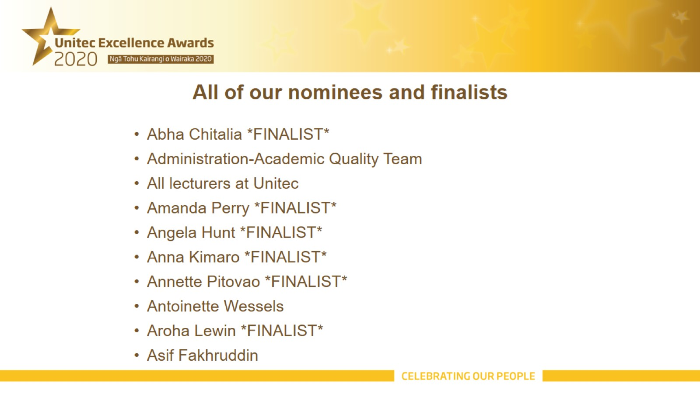
All of our nominees and finalists

Slide 4

All of our nominees and finalists

Slide 5
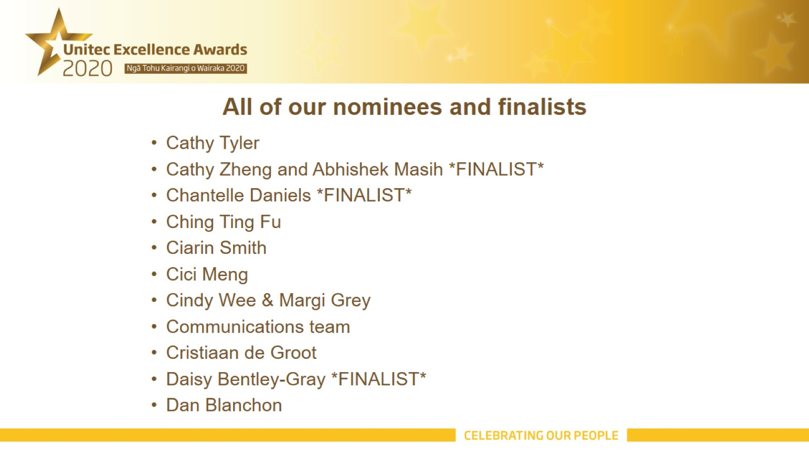
All of our nominees and finalists

Slide 6
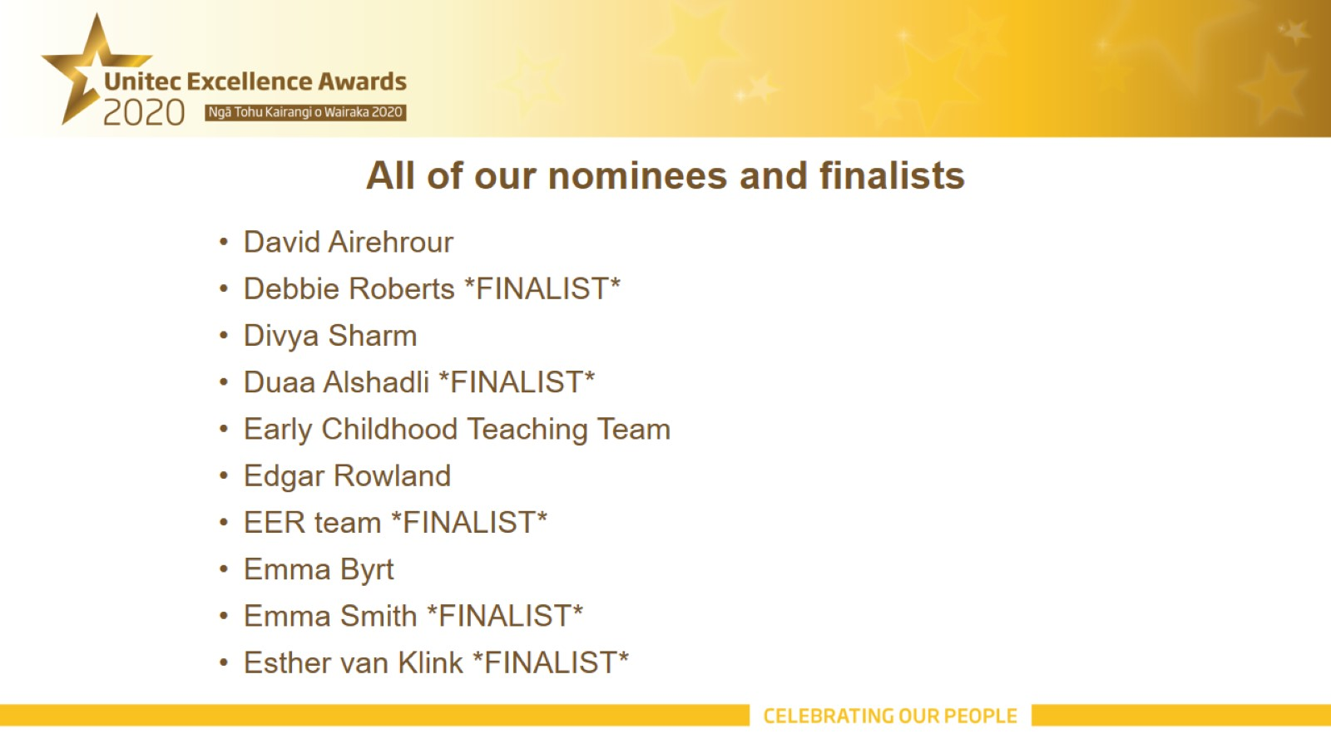
All of our nominees and finalists

Slide 7

All of our nominees and finalists

Slide 8

All of our nominees and finalists

Slide 9

All of our nominees and finalists

Slide 10
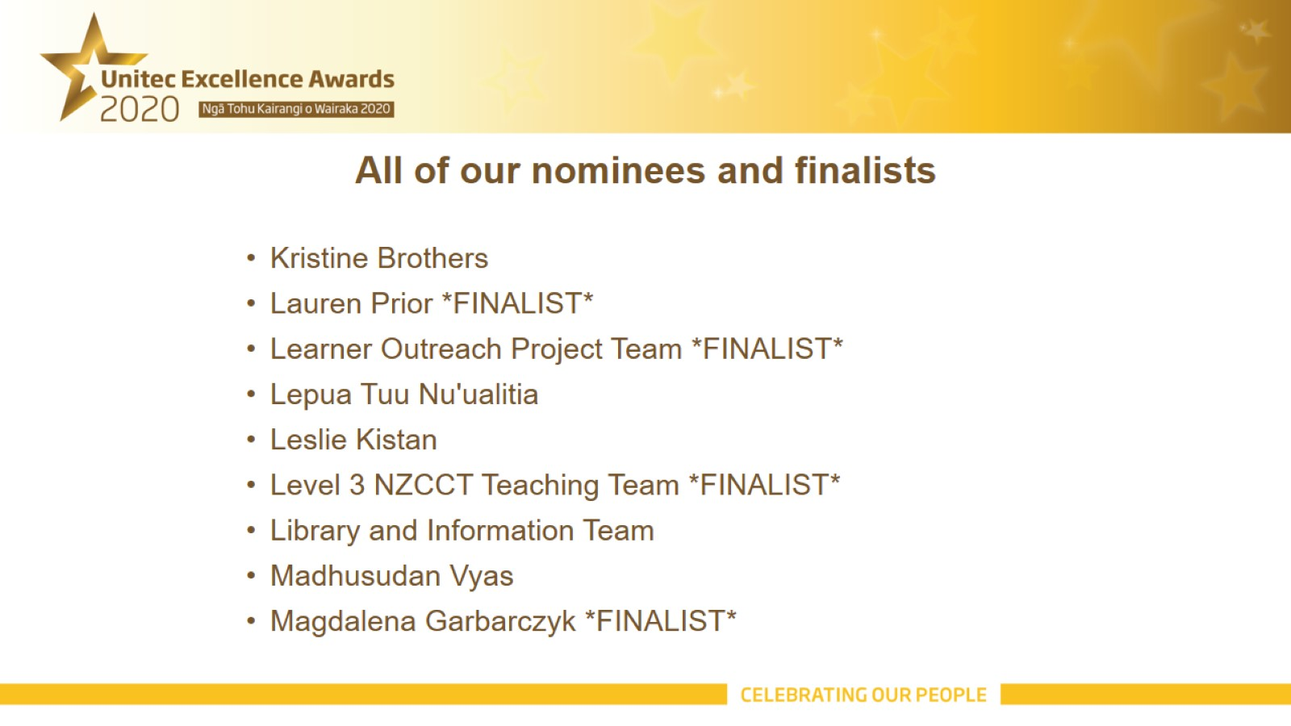
All of our nominees and finalists

Slide 11

All of our nominees and finalists

Slide 12
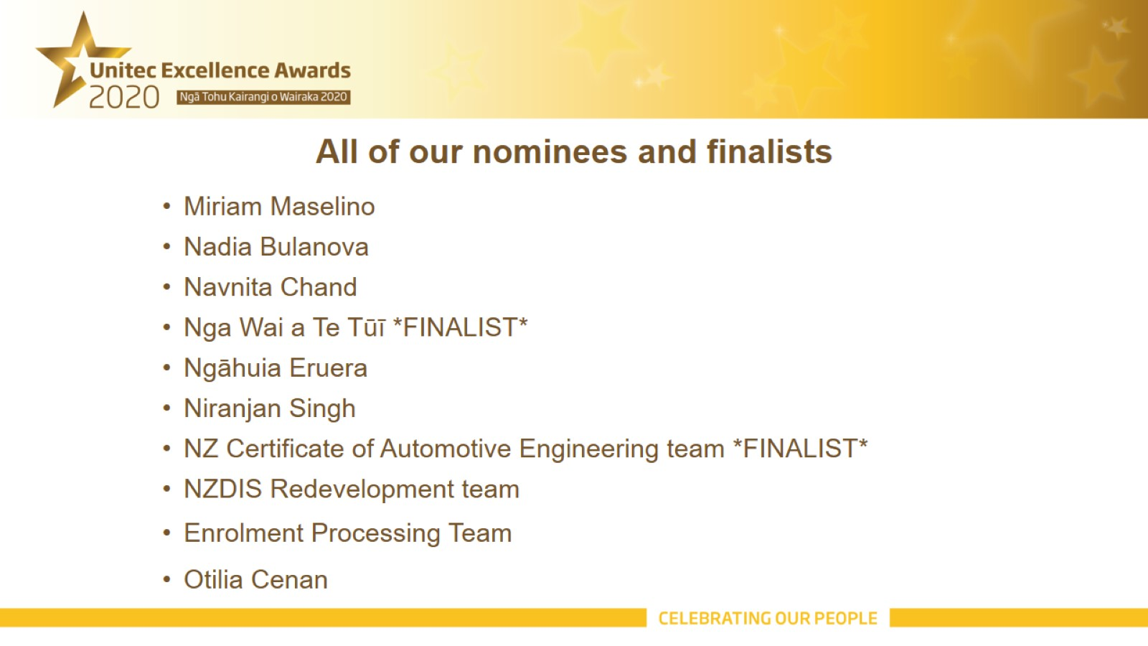
All of our nominees and finalists

Slide 13

All of our nominees and finalists

Slide 14
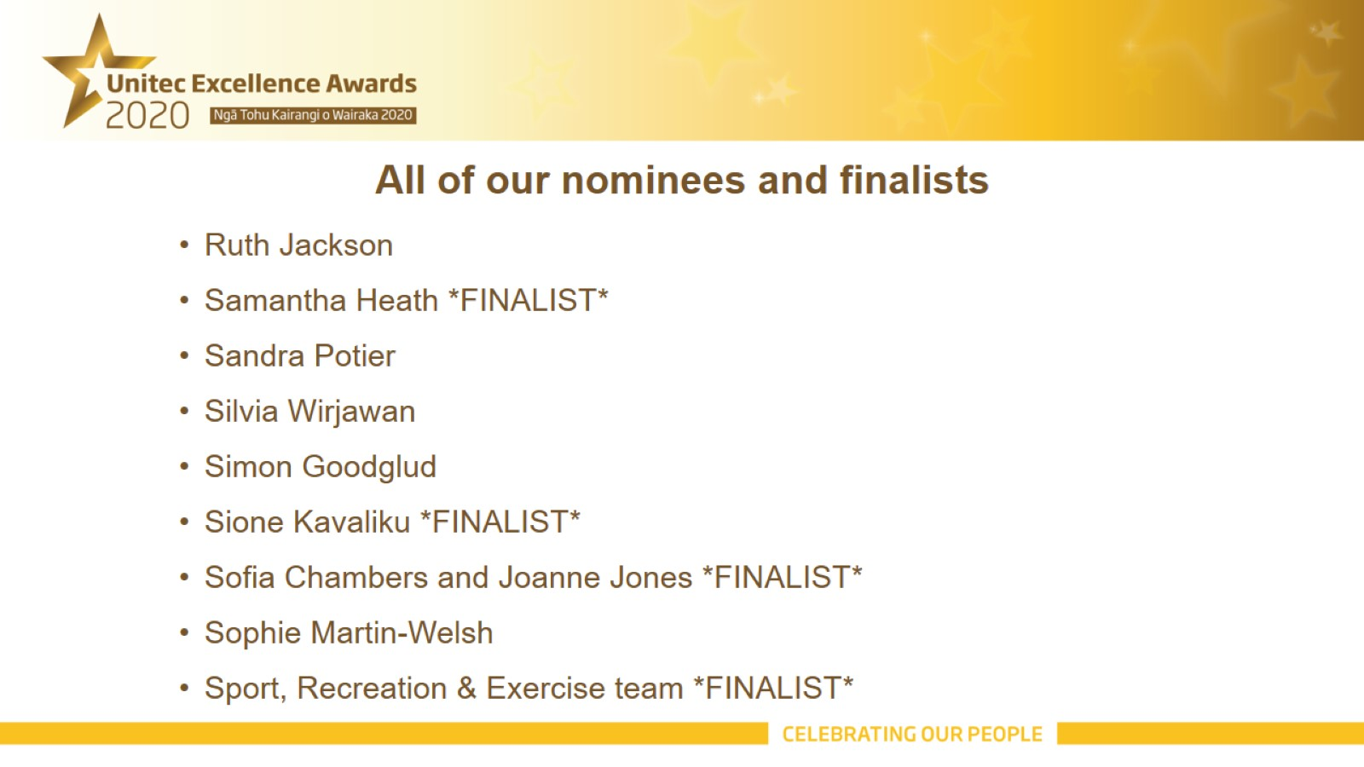
All of our nominees and finalists

Slide 15
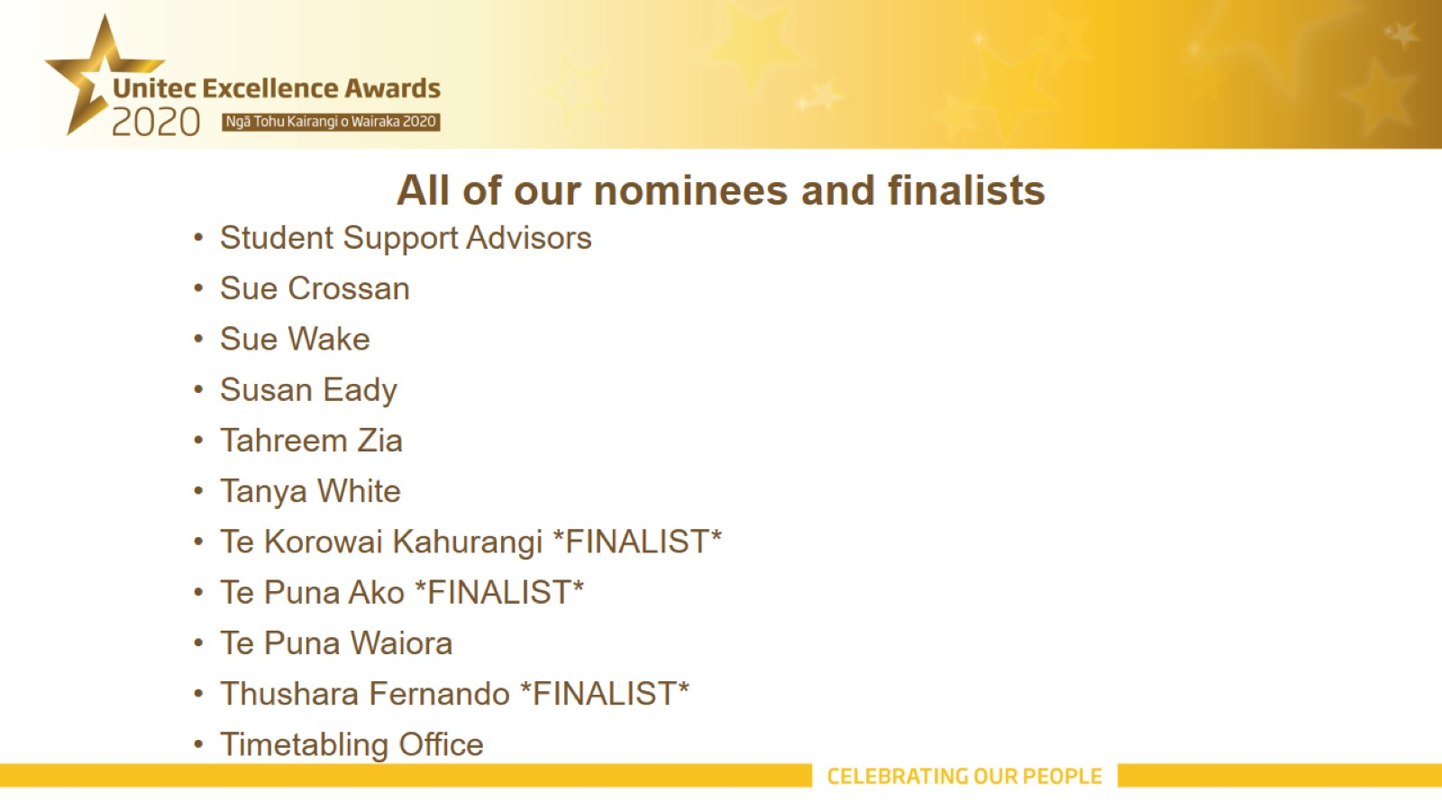
All of our nominees and finalists

Slide 16

All of our nominees and finalists

