Slide 1
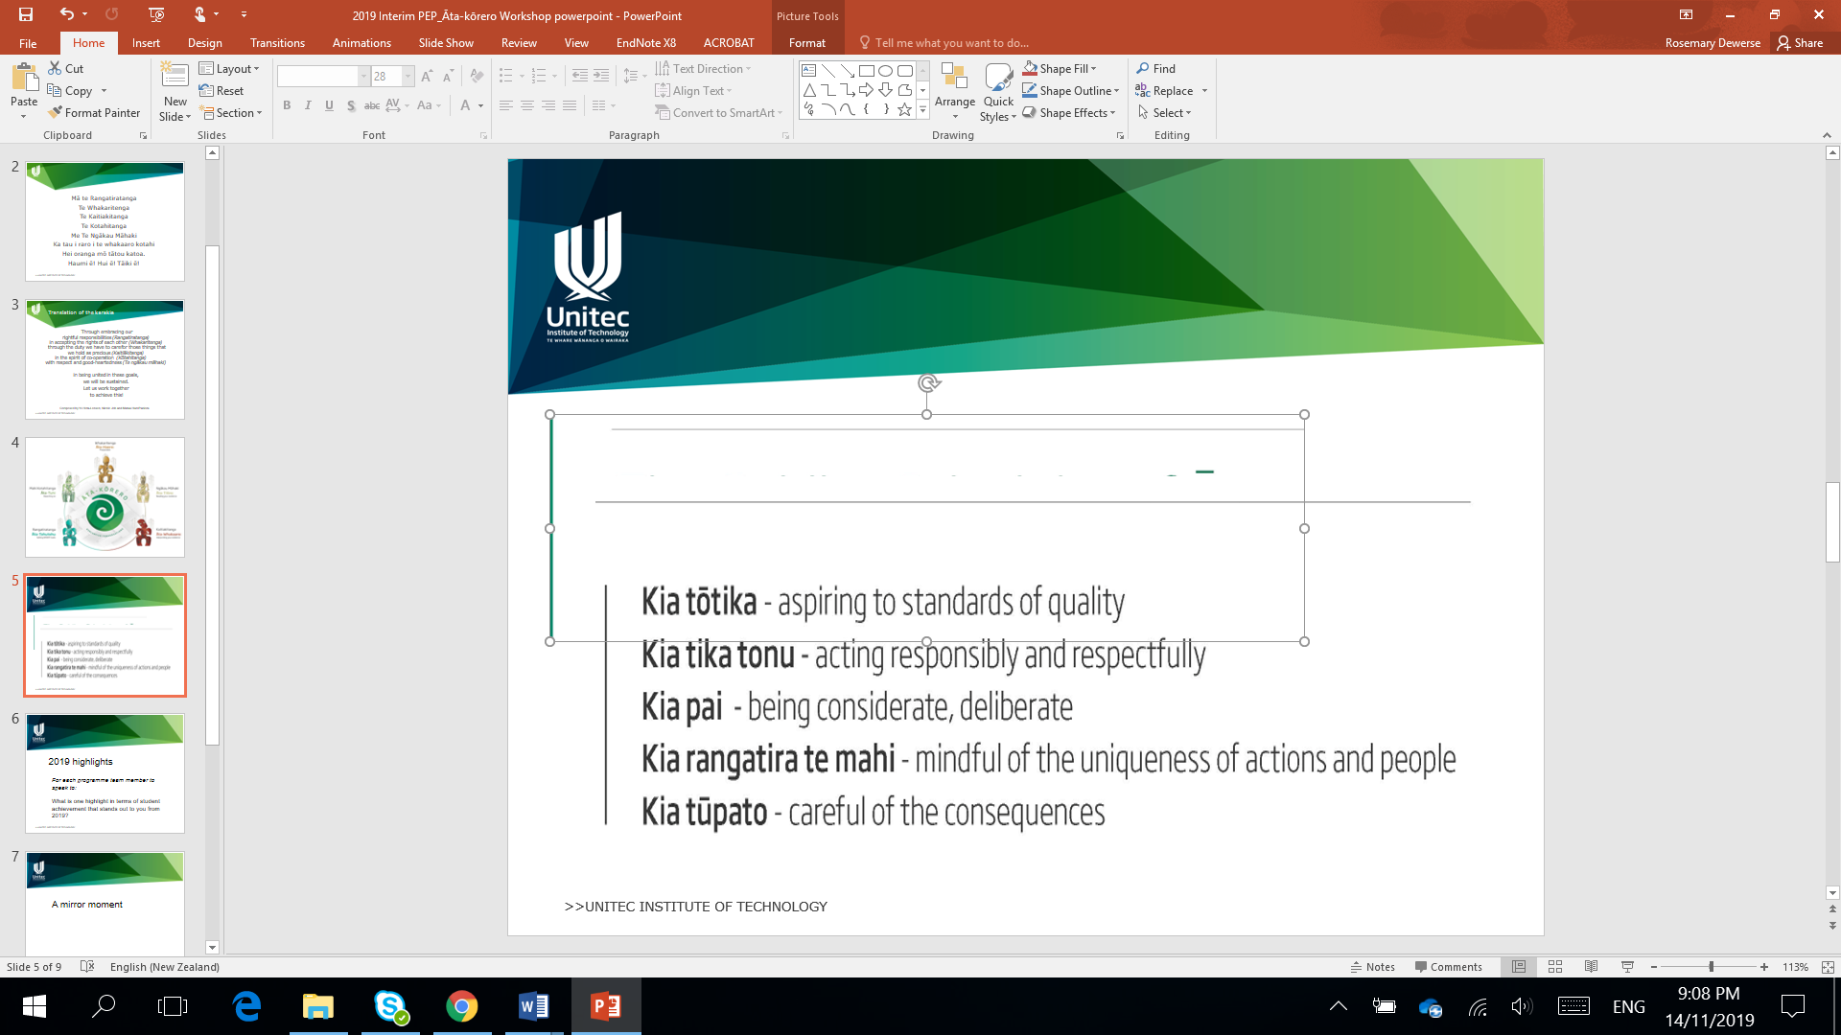
SMART Goals
for effective Ata

Slide 2
Mā te Rangatiratanga
Te Whakaritenga
Te Kaitiakitanga
Te Kotahitanga
Me Te Ngākau Māhaki
Ka tau i raro i te whakaaro kotahi
Hei oranga mō tātou katoa.
Haumi ē! Hui ē! Tāiki ē!
Karakia tīmatanga

Slide 3
Through embracing our rightful responsibilities (Rangatiratanga) ​
in accepting the rights of each other (Whakaritenga) ​
through the duty we have to care for those things that we hold as precious (Kaitiākitanga) ​
in the spirit of co-operation (Kōtahitanga) ​
with respect and good-heartedness (Te ngākau māhaki) ​
​
in being united in these goals, ​
we will be sustained. ​
Let us work together ​
to achieve this!
Composed and translated by Yo Heta-Lensen, Nicole Job and Matua Hare Paniora

Slide 4
Guiding principles
SMART goals in the PEP help to
. Identify the actions we need to take to improve student success and other KEQs
Make sure the actions are clear and in our control
Assess the effectiveness of actions taken
Take pū

Slide 5

Have the SMART goals from last time been actioned?
Are the SMART goals in the PEP and are they moved into other areas e.g. Workplans, ADEPS for action and tracking?
What new SMART goals do we need to address gaps?
What impact have the SMART goals had on KEQ outcomes?

Slide 6
Setting Good SMART goals
SPECIFIC
What do we want to achieve?
Who is involved?
Where does it get actioned?
When does it need to happen?
What are the requirements and constraints?
Why do we need to do this?

Slide 7
Setting Good SMART goals
MEASURABLE
What are the things we will measure to tell us:
How much/how many
We are on track
We are reaching milestones
How we will know when it is achieved

Slide 8
Setting Good SMART goals
ACHIEVABLE
Is this within the control of our team?
Who is the owner/persons(s) responsible
What resources are needed? (time, people, physical)
What resource constraints are there?

Slide 9
Setting Good SMART goals
REALISTIC
Can we do this with the resources/constraints we have
What are the steps along the way?
Are the goals the right size or are they too big to break down, or too small to be a stretch?

Slide 10
Setting Good SMART goals
Time Bound
Is there a completion date?
Are there dates for key milestones?

Slide 11
Some examples
Look at the goals below and see if these are SMART or not:
To improve SCC of priority groups to meet 2022 targets
To embed Matauranga Maori content in 80% of programme courses running in Semester 1 2021
To complete external moderation of all courses in 2021 and action feedback for Semester 1 2022.
To review the programme structure and timetable in 2021

Slide 12
This goal is not so SMART
To improve SCC of priority groups to meet 2022 targets
Why?
It is massive – there are a large number of steps to make this happen.
It is not achievable - Because it is so large, it is not clear what can be done, by who and when.
It doesnt have any clear timeframes of measurement – apart from a target that is far away

Slide 13
This goal is more SMART
Lecturers to embed Matauranga Māori content in 80% of programme courses before they run in Semester 1 2021
Why?
The action is very clear (embed MM)
It has a measurement number (80% of courses)
It has a clear timeframe (for Semester 1 courses)
We know where it needs to be done and by who
It could be improved by being clearer about what we hope it will achieve e.g. Improved SCC for Māori students

Slide 14
A PEP narrative example of a SMART Goal
In 2019 a gap was identified in the delivery of our practicum courses. Feedback from our IAC identified that students weren’t well prepared with skills in basic communication and soft skills before attending placement. A SMART goal was set to review our Level 5 pre –practicum and practicum courses to identify where these communication and soft :skills could be embedded in teaching and assessment and update by the end of 2020. The team completed the following actions:
Identified with the IAC the specific skill and competencies felt to be needed (Feb, 2020)
Reviewed the learning material and assessments for course xxxx and xxxx. In coruse xxxx we adapted the assessment to include examples of professional communication and time management components, with changes submitted and approved. (Semester 1 2020). These components were also explicitly included in classes.
Updated the placement feedback sheet in course xxxx to include comments on professionalism at the mid-point placement review and student placement reflections. A small number of marks were allocated in the rubric for this feedback and reflection.
This was trailed in Semester 2, 2020 and initial feedback from placements has been positive, with 3 placements noting an increase in communication. Where professionalism feedback shows gaps, we have been able to coach the student to support them to remain engaged in practicum.
In addition, SCC for the practicum course increased by 10% and there was a reduced number of deferrals for practicum hours.

Slide 15
A PEP narrative example of a SMART Goal
In 2019 a gap was identified in our SCC for Pacific students, with their SCC sitting at 70.5% compared to our general SCC of 83%. We set a SMART goal to increase Pacific SCC by 5% in 2020 with a view to continuous improvement to meet Unitec priority group targets by 2022. The actions we had identified to achieve this included:
Inviting ADLs to classes to meet students
Monitoring all Pacific Students on a priority group register and discussing actions to support struggling students at team meetings led by our Pacific Champion.
To have a beginning of semester lunch to welcome returning students back to the programme and enhance connections with Lecturers
The Impact of COVID 19 meant that we did not get to achieve all of these actions or meet the goal. A lunch was hosted in Semester 1 but not Semester 2. Monitoring and discussion of students was not able to be clearly communicated in the team due to lockdowns. This meant we were less consistent in our identification and support of Pacific students. As a result in Semester 1 Pacific SCC dropped due to a large number of DNCs and withdrawals. In Semester 2 although being mostly on campus, the second lockdown impacted a number of our Pacific students. We were more proactive in connecting with these students and each staff had a number of students to follow up with. Through this process students were supported to access APC processes and 80% of these students with APCs have successfully completed. This action reduced the number of DNCs and withdrawals and has meant that in Semester 2 Pacific SCC was at 72%. This increase suggests that support through follow up can increase SCC and is an action the team will continue to take in 2021. As such, the Smart Goal remains, but the actions will be modified.

Slide 16
Ka wehe atu tātou
I raro i te rangimārie
te harikoa, me te manawanui
Haumi ē! Hui ē! Tāiki ē!
Karakia whakamutunga

