Slide 1
Graduate Surveys
Institutional Summary
2020 results and 5-year trends
Te Korowai Kahurangi
August 2020
Notes:
Use title slide layout

Slide 2
Graduate Survey Overview
Unitec’s Graduate Surveys are carried out to provide a robust and consistent approach to measuring graduate outcomes, programme success and graduate satisfaction. Graduate surveys are monitored and audited to ensure reporting is done in a statistically fair manner.
Graduate surveys are sent out for completion online twice a year, in May and October to capture all the graduates graduating either in the middle or the end of the year. The survey aims to collect data about graduates’ employment or study status, further study plans, current job information and satisfaction with their learning experiences in Unitec. Graduates are also asked to comment on the expected Graduate Programme Outcomes (GPO) as outlined in the NZQA website.
Reporting of the 2020 wave (for 2019 graduates) is delivered at three levels:
Institutional Summary Report - Analysis and reporting of performance at institutional and school levels based on the latest Graduate Survey results; trend analysis based on 5-year combined survey results.
Graduate Survey Dashboard - Interactive dashboard which allows you to filter data by school, programme, course, class, priority group and year. Located in the Institutional Reports App of Power BI.
School Reports - Graduate KPIs and GPO analysis to support PEPs.
This Institutional Summary Report provides analysis of the 2020 graduate survey results and 5-year trend analysis where applicable:
Overall Graduate KPIs
  % Graduate Employed, Studying or Combined (GESC)
  % Employed
  % Further Study
  % Qualification relevant to Employment
Satisfaction with Unitec
  Likelihood of recommending Unitec (using the Net Promoter Score ratings)
  Qualification being worth the investment
  Qualification meeting the main job requirement
Ratings of learning experiences and skills acquired
Notes:
Explain Cohort timeframes
Outline EPI measures

Slide 3

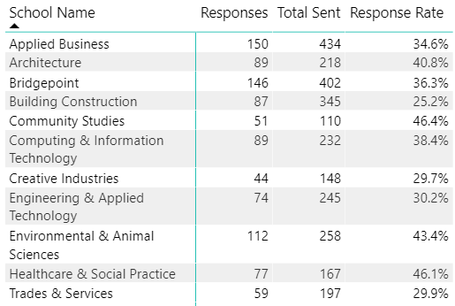
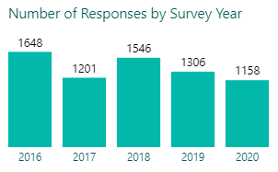
2020 Sample size and Response rate
Response rates are only available for 2019 and 2020.
NA
NA
NA
36.4%
37.1%
Surveys for 2019 graduates were sent out in October 2019 and May 2020. Slightly over one-third of the sample responded, amounting to 37.1% in response rate.
For priority groups except Pacific (43.7%), the response rates were lower than the Unitec average.
Community Studies led the other schools in response rate, standing at 46.4%, and Building Construction had the lowest at 25.2%.

Slide 4
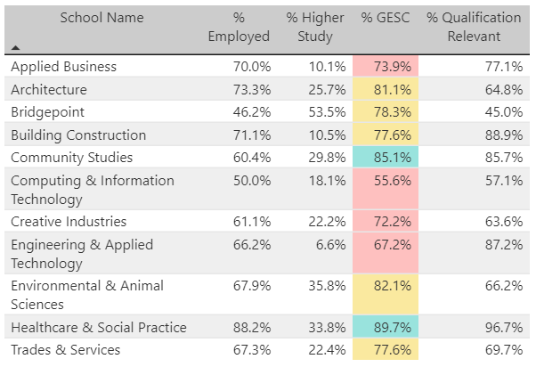
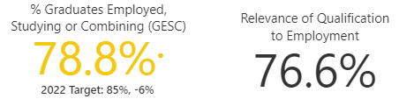


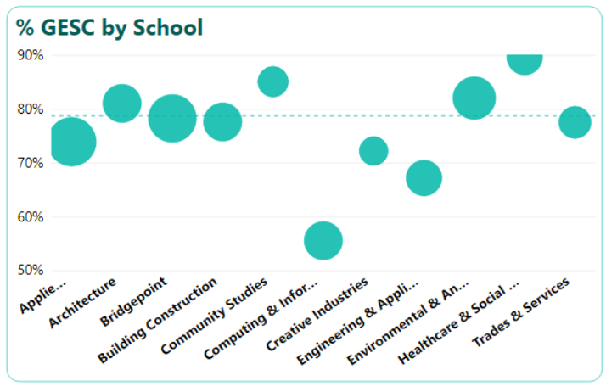
2020 Graduate KPIs
Top schools: Healthcare & Social Practice with % GESC at 89.7%, % Qualification Relevant to Employment at 96.7% and % Employed at 88.2% topped the list in all three indicators. The only other school that met the target of 85% in % GESC was Community Studies. Bridgepoint had the highest % Higher Study at 53.5% which has been a consistent pattern over the years.
Weak performers: Computing & Information Technology had the lowest % in all three indicators with % GESC at 55.6%, % Employed at 50% and % Qualification Relevant to Employment at 57.1% (discounting Bridgepoint which prepares students for further study). Engineering & Applied Technology followed with the second lowest % GESC at 67.2% which was mainly driven by a low of only 6.6% in Higher Study.
School contribution to % GESC: Environmental & Animal Sciences contributed favourably towards the institute rate given a high % GESC and a relatively large number of respondents.
Bridgepoint and Applied Business had the largest number of respondents (representing 26% of total) but a lower than average % GESC and so exerted a relatively larger downward pressure on the Institute rate. Computing & Information Technology had a medium respondent size but its % GESC was well below average, further pulling down the overall rate.
Size of the circle indicates the number of respondents
Notes:
Explain Cohort timeframes
Outline EPI measures

Slide 5
% GESC and Response Rate Benchmarks
 | Unitec | Unitec | Otago Polytechnic | Manukau Institute of Technology | Ara Institute of Canterbury | Southern Institute of Technology
Month/Year of the survey(s) | October 2019, May 2020 | October 2018, May 2019 | July 2019 | 2019 | 2019 | June 2019
Graduation year | 2019 | 2018 | 2018 | 2018 | 2018 | 2018
Number of months after graduation | 5 months | 5 months | 8 months | 6 months | NA | 7 months
% GESC | 78.8% | 82.4% | 94% | 76% | 87.2% | 97%
Response Rate | 37.1% | 36.4% | NA | NA | 46.2% | 46%
% GESC for 2018 graduates
  Unitec was below all the other four institutes except Manukau Institute of Technology.
Response Rates
  For Unitec, the response rates in both years are below that achieved by Ara and Southern Institute of Technology by about 9-10%.
  Number of months after graduation
  Compared with others, Unitec has the shortest time lapse between graduation and survey delivery.
  data based off publicly available 2019 annual reports of the respective institutes
Notes:
Explain Cohort timeframes
Outline EPI measures

Slide 6
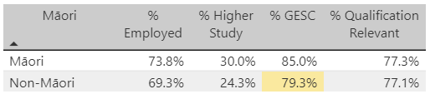
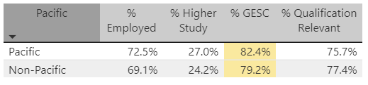
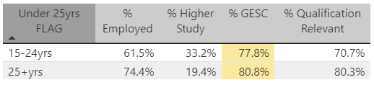
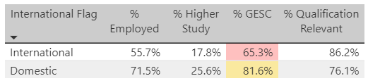
2020 Graduate KPIs for Priority Groups
Priority Groups:
The only group that met the 85% target in % GESC is the Māori group.
The International Group had the lowest % GESC, % Employed and % Higher Study at 65.3%, 56% and 18% respectively; but was top in % Qualification Relevant to Employment at 86.2%.
This group is also the least responsive group as it suffers the lowest response rate.
The Under 25yrs had the lowest % Qualification Relevant but the highest % Higher Study, suggesting this group was more interested in studying further and exploring career options.
Notes:
Explain Cohort timeframes
Outline EPI measures

Slide 7
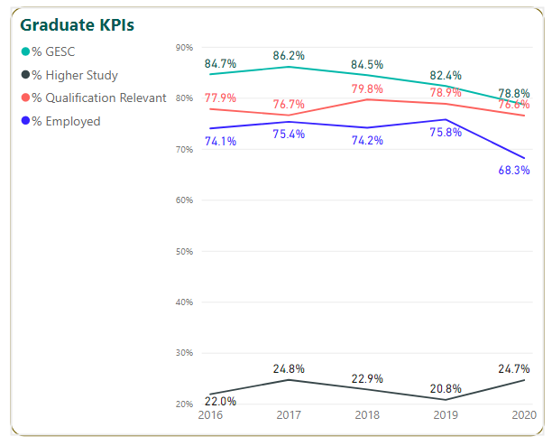
Graduate KPIs – 5-year trends
Trend:
In 2020, % GESC dropped by 3.6% from 2019, fuelled mainly by a 7.5% drop in % Employed which was mitigated by a 3.9% increase in % Higher Study.
The 2020 % GESC continued a decreasing trend over the past 5 years.
% Qualification Relevant to Employment fluctuated over the years and dropped by 2.3% from 2019 to 2020.
The survey was conducted in May during the lockdown which may have impacted both % Employed and % Higher Study.

Slide 8
2-year and 5-year trends by school
% GESC ( % Graduates Employed, Studying or Combining)
School | 2016 | 2017 | 2018 | 2019 | 2020 | 2019-2020 variance | 2016-2020 variance
Applied Business | 82.0% | 83.0% | 86.8% | 79.8% | 73.9% | -5.9% | -8.1%
Architecture | 89.0% | 80.9% | 82.1% | 82.5% | 81.1% | -1.4% | -7.9%
Bridgepoint | 77.8% | 85.7% | 79.2% | 80.0% | 78.3% | -1.7% | 0.5%
Building Construction | 92.7% | 90.7% | 80.0% | 80.2% | 77.6% | -2.6% | -15.1%
Community Studies | 93.6% | 88.0% | 93.6% | 90.0% | 85.1% | -4.9% | -8.5%
Computing & Information Technology | 66.7% | 67.1% | 62.4% | 55.9% | 55.6% | -0.3% | -11.1%
Creative Industries | 76.7% | 80.4% | 78.3% | 67.6% | 72.2% | 4.6% | -4.5%
Engineering & Applied Technology | 89.9% | 85.7% | 78.1% | 75.7% | 67.2% | -8.5% | -22.7%
Environmental & Animal Sciences | 81.3% | 92.9% | 87.1% | 86.5% | 82.1% | -4.4% | 0.8%
Healthcare & Social Practice | 84.2% | 84.3% | 91.0% | 87.7% | 89.7% | 2.0% | 5.5%
Trades & Services | 88.0% | 84.4% | 86.7% | 75.8% | 77.6% | 1.8% | -10.4%
High performers
Healthcare & Social Practice was the only school with an increase in both the 2-year and 5-year periods.
Community Studies stayed strong over the years but witnessed a drop in both periods.
Low performers
Over the 2-year and 5-year periods, 8 out of 11 schools saw a drop in % GESC.
Out of the 8 schools, half saw a 2-digit decline over the past 5 years. These are Engineering & Applied Technology (-22.7%), Building Construction (-15.1%), Computing & Information Technology (-11.1%) and Trades & Services (-10.4%)
Engineering & Applied Technology saw the largest decrease over both the 2-year (-8.5%) and the 5-year (-22.7%) periods respectively.

Slide 9
2-year and 5-year trends by school
% Employed
School | 2016 | 2017 | 2018 | 2019 | 2020 | 2019-2020 variance | 2016-2020 variance
Applied Business | 72.9% | 76.1% | 73.3% | 76.0% | 70.0% | -6.0% | -2.9%
Architecture | 74.6% | 66.7% | 66.7% | 73.8% | 73.3% | -0.5% | -1.3%
Bridgepoint | 41.4% | 47.7% | 42.4% | 39.2% | 46.2% | 7.0% | 4.8%
Building Construction | 91.3% | 89.1% | 74.6% | 78.7% | 71.1% | -7.6% | -20.2%
Community Studies | 79.8% | 76.4% | 80.6% | 91.4% | 60.4% | -31.0% | -19.4%
Computing & Information Technology | 61.9% | 62.1% | 54.5% | 52.3% | 50.0% | -2.3% | -11.9%
Creative Industries | 69.9% | 66.2% | 62.3% | 57.1% | 61.1% | 4.0% | -8.8%
Engineering & Applied Technology | 74.2% | 75.9% | 78.2% | 77.5% | 66.2% | -11.3% | -8.0%
Environmental & Animal Sciences | 77.1% | 77.0% | 71.6% | 78.8% | 67.9% | -10.9% | -9.2%
Healthcare & Social Practice | 75.7% | 80.9% | 90.2% | 88.1% | 88.2% | 0.1% | 12.5%
Trades & Services | 78.1% | 70.1% | 82.1% | 71.1% | 67.3% | -3.8% | -10.8%
High performers
Two schools saw an increase in both the 2-year and 5-year periods. These are Bridgepoint and Healthcare & Social Practice.
Low performers
Over the 2-year period, 8 out of 11 schools saw a drop in % Employed; this increased to 9 schools over the 5-year period.
Over both periods, Community Studies was the only school with a 2-digit decrease. Its 2-year decline reached 31%.
Building Construction saw an almost continuous drop since 2016, despite a slight climb in 2019.
Computing & Information Technology and Creative Industries stayed at a low rate over the years, consistently lower than all other schools over the years (excepting Bridgepoint which prepares students for further study).

Slide 10
2-year and 5-year trends by school
% Higher Study
School | 2016 | 2017 | 2018 | 2019 | 2020 | 2019-2020 variance | 2016-2020 variance
Applied Business | 13.7% | 23.2% | 19.4% | 9.2% | 10.1% | 0.9% | -3.6%
Architecture | 26.8% | 23.4% | 25.4% | 22.8% | 25.7% | 2.9% | -1.1%
Bridgepoint | 60.3% | 67.9% | 59.4% | 57.6% | 53.5% | -4.1% | -6.8%
Building Construction | 7.3% | 4.7% | 11.1% | 8.6% | 10.5% | 1.9% | 3.2%
Community Studies | 27.7% | 32.0% | 29.8% | 13.3% | 29.8% | 16.5% | 2.1%
Computing & Information Technology | 7.5% | 9.2% | 7.9% | 8.8% | 18.1% | 9.3% | 10.6%
Creative Industries | 12.2% | 26.8% | 21.7% | 11.8% | 22.2% | 10.4% | 10.0%
Engineering & Applied Technology | 23.2% | 6.1% | 12.5% | 11.4% | 6.6% | -4.8% | -16.6%
Environmental & Animal Sciences | 17.3% | 37.1% | 31.7% | 20.3% | 35.8% | 15.5% | 18.5%
Healthcare & Social Practice | 26.7% | 20.6% | 41.0% | 40.7% | 33.8% | -6.9% | 7.1%
Trades & Services | 30.0% | 37.8% | 46.7% | 24.2% | 22.4% | -1.8% | -7.6%
In contrast to the decreases observed for % Employed (and % GESC), % Higher Study showed a vigorous increase in various schools.
High performers
Five schools saw an increase in both the 2-year and 5-year periods with two of them registering very encouraging 2-digit increases over both periods. These are Environmental & Animal Sciences and Creative Industries.
Community Studies had the largest increase in % Higher Study from 2019 to 2020 (but interestingly had the lowest performance in % Employed over both periods).
Low performers
While Bridgepoint prepares students for further study and consistently had the highest % Higher Study, the rate has steadily declined over the past 5 years.
Building Construction and Computing & Information Technology had the lowest rates over the years. (The latter, however, managed to buck the trend with a 2-digit rise of 10.6% from 2019 to 2020.)

Slide 11
2-year and 5-year trends by school
% Qualification Relevant to Employment
School | 2016 | 2017 | 2018 | 2019 | 2020 | 2019-2020 variance | 2016-2020 variance
Applied Business | 76.0% | 65.5% | 78.5% | 75.3% | 77.1% | 1.8% | 1.1%
Architecture | 80.9% | 71.9% | 78.4% | 74.4% | 64.8% | -9.6% | -16.1%
Bridgepoint | 32.3% | 37.9% | 30.2% | 48.9% | 45.0% | -3.9% | 12.7%
Building Construction | 93.1% | 89.5% | 93.2% | 85.5% | 88.9% | 3.4% | -4.2%
Community Studies | 74.6% | 73.2% | 77.1% | 75.9% | 85.7% | 9.8% | 11.1%
Computing & Information Technology | 78.2% | 75.0% | 60.0% | 66.0% | 57.1% | -8.9% | -21.1%
Creative Industries | 59.1% | 51.4% | 34.8% | 45.0% | 63.6% | 18.6% | 4.5%
Engineering & Applied Technology | 86.5% | 83.7% | 87.7% | 70.2% | 87.2% | 17.0% | 0.7%
Environmental & Animal Sciences | 69.9% | 67.3% | 72.2% | 56.7% | 66.2% | 9.5% | -3.7%
Healthcare & Social Practice | 84.9% | 86.8% | 93.9% | 98.6% | 96.7% | -1.9% | 11.8%
Trades & Services | 80.9% | 81.6% | 87.1% | 62.5% | 69.7% | 7.2% | -11.2%
High performers
Building Construction and Healthcare & Social Practice consistently led other schools with high rates over the 5 years.
Engineering & Applied Technology and Creative Industries showed a 2-digit increase over the 2-year period, as well as an increase in the 5-year period. Engineering & Applied Technology saw a drop in % GESC in both periods as seen in the previous slide despite this robust improvement in the Qualification relevance to employment measure.
Community Studies, Bridgepoint and Healthcare & Social Practice also fared well with a 2-digit increase over the 5-year period.
Low performers
Four schools showed a decrease over the 2-year period compared with 5 schools over the 5-year period.
Three schools had a 2-digit decrease over the 5-year period, with Computing & Information Technology topping the list (-21.1%), followed by Architecture (-16.1%) and Trades & Services (-11.2%).
Of these three schools, Trades & Services and Computing & Information Technology had a 2-digit decrease in both % GESC and % Qualification Relevant to Employment over the 5-year period.

Slide 12
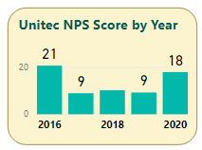


Graduate Net Promoter Scores
Unitec: In the 2020 wave, nearly half (43%) of the respondents were promoters of Unitec. The NPS score has suffered over the past 3 years but rose to 18 in 2020.
Would you recommend Unitec?
Based on respondents' answers on a scale of 0-10, respondents are categorised as Detractors, Passive or Promoters.
0: Not Likely to Recommend
10: Would Highly Recommend
Top performers: Bridgepoint got the highest score of 38 despite a drop from 2019 and 2016. Environmental & Animal Sciences saw a healthy increase of 13% from 2019 to become the second top performer. An encouraging trend is seen with seven schools out of 11 getting a 2-digit increase from 2019, topped by Trades & Services with a 34% rise.
Low performers: Creative Industries is the only school with a negative score of -6 despite a 2-digit improvement from 2016 and 2019. Architecture scored only 1 and saw a drop of 28% from 2016. Community Studies is the only school with a 2-digit drop over both the 2-year and 5-year periods. While nine schools saw an increase from 2019, six or more than half of the schools saw a drop from 2016.

Slide 13
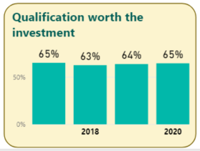
Qualification worth the investment
Unitec: The measure has stayed stable over the past 4 years (the question was added to the survey from 2017).
High performers:
Five schools saw increases over both the 2-year and 5-year periods, with Creative Industries and Applied Business registering a 2-digit increase over both periods.
Healthcare & Social Practice was the only school that stayed consistently above 70% throughout the 5 years.
Low performers:
Computing & Information Technology and Creative Industries have stayed in the low range of 36.8%-58.3% despite an increase over both periods.
Community Studies saw a huge drop of 26.2% from 2019 to 2020. This, combined with a drop of 36% in NPS score over the same period, reflect a concerning negative student perception of qualifications obtained from the school. (The 2020 response rate for the school is the highest of all at 46.4%, suggesting the result is the most representative compared with other schools.)
School | 2017 | 2018 | 2019 | 2020 | 2019-2020 variance | 2017-2020 variance
Applied Business | 55.5% | 57.3% | 51.9% | 67.2% | 15.3% | 11.7%
Architecture | 63.6% | 59.4% | 67.9% | 56.8% | -11.1% | -6.8%
Bridgepoint | 74.1% | 54.8% | 61.3% | 67.2% | 5.9% | -6.9%
Building Construction | 59.5% | 60.0% | 59.7% | 58.7% | -1.0% | -0.8%
Community Studies | 63.3% | 67.4% | 90.0% | 63.8% | -26.2% | 0.5%
Computing & Information Technology | 44.0% | 47.0% | 45.9% | 54.4% | 8.5% | 10.4%
Creative Industries | 48.2% | 36.8% | 45.5% | 58.3% | 12.8% | 10.1%
Engineering & Applied Technology | 73.5% | 65.6% | 71.6% | 65.6% | -6.0% | -7.9%
Environmental & Animal Sciences | 69.6% | 63.6% | 64.8% | 70.5% | 5.7% | 0.9%
Healthcare & Social Practice | 70.1% | 78.9% | 76.3% | 70.6% | -5.7% | 0.5%
Trades & Services | 63.6% | 66.7% | 50.0% | 66.7% | 16.7% | 3.1%

Slide 14
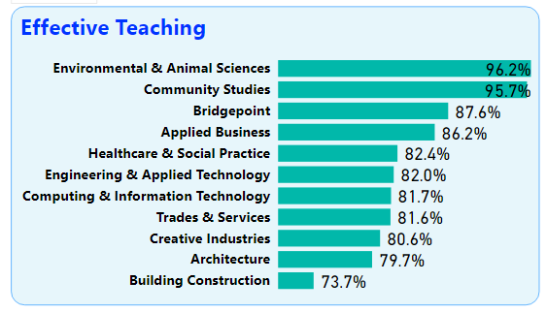
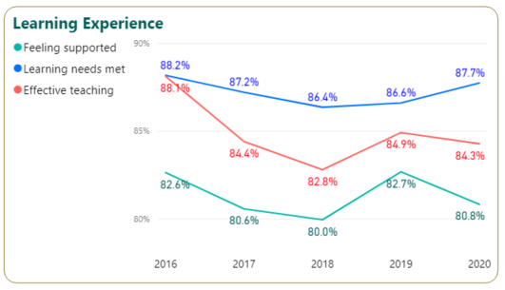
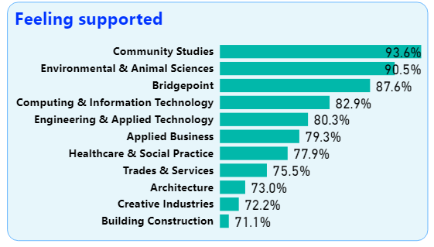
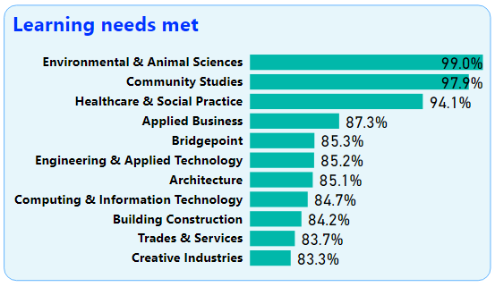
Learning experiences
2020 Graduate survey - Learning experiences
5-year trend at the institute level
Of the three measures, Unitec had the highest rating consistently in Learning needs met over 5 years, in the range of 86..4% to 88.2%.
Learning needs met and Effective teaching both follow the same pattern over the years with its highest in 2016 and lowest in 2018.
Feeling supported consistently lagged behind the other 2 measures and the gap between Learning needs met and Feeling supported is at its widest at 6.9% in 2020.
2020 results at the school level
Top performers: In 2020, Environmental & Animal Science topped the list in Effective teaching and Learning needs met. The school, together with Community Studies, achieved a 90%+ rate in all three measures.
Healthcare & Social Practice was the only other school that had a 90%+ rate in one of the measures (Learning needs met).
Low performers: Building Construction had the lowest rate in Effective Teaching (73.7%) and Feeling supported (71.1%).
Creative Industries, Trades & Services and Architecture are mostly at the bottom of the list in all three measures.

Slide 15
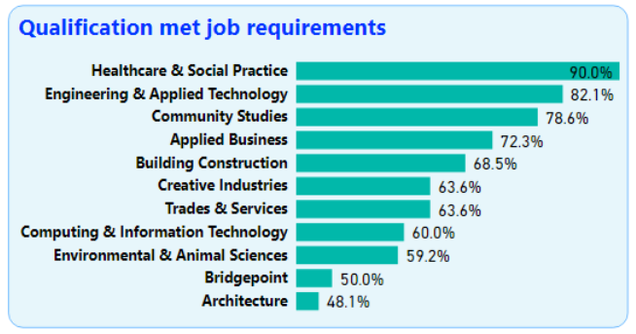
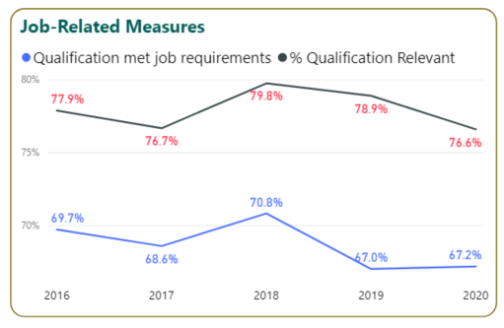
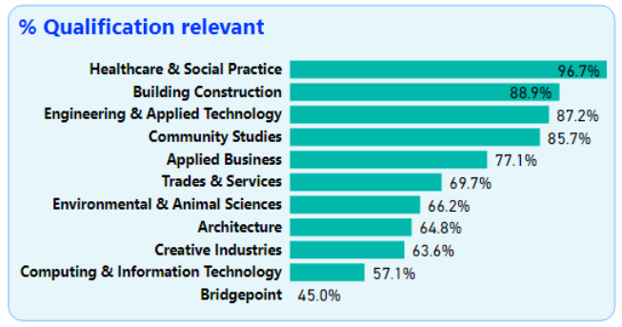
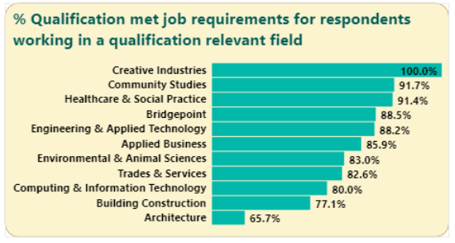
Job-related measures
2020 Graduate survey – Job-related measures
5-year trend at institute level (graph above)
The two measures show the same pattern in time as seen in the graph and further validated by the correlation statistics (at 0.83 on the next slide).
% Qualification Relevant to Employment consistently stayed above % Qualification met job requirements in the range of 8.1% to 11.9% over the past 5 years, suggesting that there is a consistent gap between relevant knowledge and practical work skills. This may be due to 1) insufficient alignment with real industry needs or 2) respondents working in a field not relevant to their qualifications (and so giving a low rating to % Qualification met job requirements).
2020 results at school level (3 graphs to the right)
Top performer: In 2020, Healthcare & Social Practice was well above other schools in both measures.
Greatest gap between the 2 measures: Building Construction exhibited the largest gap of 20.4% followed by Architecture at 16.7%,
For those who work in a qualification relevant field, Architecture was the school that least prepared students well for their relevant jobs (65.7%), followed by Building Construction (77.1%).

Slide 16
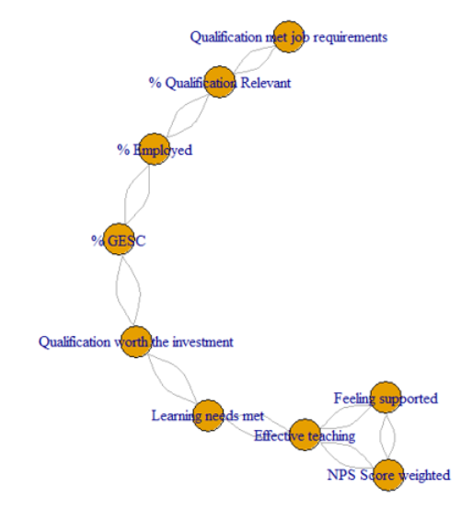
Correlation clusters
Highest correlations
% Qualification met job requirements and % Qualification relevant to employment have the highest correlation of 0.83, underlying the importance of working in a relevant field for knowledge and skills gained from a qualification to be applicable to meet work demands.
The second highest correlation is 0.8 between Learning needs met and Effective teaching, suggesting students perceived catering for diverse learning needs was of primary importance in effective teaching.
Cluster 1 – job-related
The first cluster shows a strong linear linking among measures related to employment. Of the four measures, % Qualification met job requirements and % Qualification relevant are respondent perceptions while % Employed and % GESC are actual % recording employment and higher study engagements. This suggests that respondent perceptions are reflections of their actual work and job hunting experiences. To increase the former pair requires increasing the latter pair.
Cluster 2 – learning-related
The second cluster with close relationships consists of measures of learning experiences (Feeling supported, Effective teaching and Learning needs met) and NPS Scores. This suggests that whether respondents would like to recommend Unitec (promoters) relate highly to their studying experience in Unitec and not directly related to their job encounters.
Linking between Clusters 1 and 2
The two conceptually distinct clusters are correlated with each other via % Qualification worth the investment, suggesting that perceptions of both areas (job and learning) are relevant considerations when respondents decide on whether the qualification is worth the money spent.
%
0.83
0.78
Cluster 1
0.75
Values shown are correlation statistics.
Only correlations with 0.6 or above are shown.
0.61
%
0.62
Cluster 2
%
%
0.78
0.8
0.75
%
0.65

Slide 17
Multivariate Regression Analysis of Graduate Survey Results 2016-2020
1) Qualification worth the investment
2) NPS Score
Feeling supported
Technology skills acquired
Being employed
Effective teaching
Multivariate Regression analysis was carried out to identify key contributors to the following two measures:
  NPS Score
  % Qualification worth the investment
The results indicate the following are statistically significant contributors (in order of importance):
  Feeling supported
  Technology skills acquired
  Being employed
  Effective teaching
R² = 0.72

Slide 18
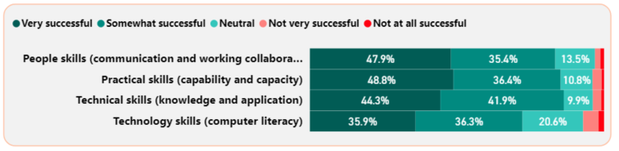
Programme success in providing skills 2020
Of the four skills, Unitec programmes are most successful in imparting technical skills with 86.2% of the respondents agreeing they have successfully acquired the skill.
High performers: Community Studies was the top school in providing 3 skills (practical, people and technical) out of 4. Similarly, Environmental & Animal Sciences was top in providing 2 out of 4 skills (practical and technical).
Low performers: Architecture is a low performer in providing practical, people and technical skills and Building Construction is low in providing practical and technical skills. This echoes the low % Qualification met job requirements for the two schools as noted in Slide 14.
 | High performers | Low performers
Practical skills | Community Studies (95.7%) Environmental & Animal Sciences (94.3%) | Building Construction (73.7%) Architecture (75.7%)
People skills | Healthcare & Social Practice (91.2%) Community Studies (89.4%) | Architecture (71.6%) Engineering & Applied Technology (73.8%)
Technical skills | Community Studies (95.7%) Environmental & Animal Sciences (95.2%) | Building Construction (77.6%) Architecture (79.7%)
Technology skills | Engineering & Applied Technology (91.8%) Computing & Information Technology (85.9%) | Environmental & Animal Sciences (61.9%) Community Studies (63.8%)
% indicating Very successful or Somewhat successful

Slide 19
Programme success in providing skills
2-year and 5-year trends
School | 2016 | 2017 | 2018 | 2019 | 2020 | 2019-2020 variance | 2016-2020 variance
Applied Business | 76.9% | 72.1% | 80.1% | 75.0% | 80.2% | 5.2% | 3.3%
Architecture | 77.6% | 68.2% | 73.5% | 71.9% | 73.3% | 1.4% | -4.3%
Bridgepoint | 75.0% | 79.1% | 78.5% | 82.6% | 78.5% | -4.2% | 3.5%
Building Construction | 71.4% | 73.3% | 67.2% | 73.8% | 76.3% | 2.6% | 5.0%
Community Studies | 79.3% | 81.6% | 86.2% | 88.3% | 86.2% | -2.2% | 6.8%
Computing & Information Technology | 78.1% | 68.4% | 79.8% | 83.9% | 85.2% | 1.3% | 7.2%
Creative Industries | 68.6% | 74.6% | 76.5% | 68.9% | 79.2% | 10.2% | 10.6%
Engineering & Applied Technology | 76.5% | 82.7% | 79.0% | 82.6% | 86.9% | 4.3% | 10.4%
Environmental & Animal Sciences | 76.0% | 77.9% | 81.2% | 76.8% | 83.3% | 6.6% | 7.3%
Healthcare & Social Practice | 77.2% | 78.3% | 83.4% | 87.5% | 84.2% | -3.3% | 7.0%
Trades & Services | 71.4% | 76.7% | 80.8% | 68.0% | 81.1% | 13.2% | 9.7%
% indicating Very successful or Somewhat successful and is an average of all four skills (practical, people, technology and people) combined
Promising trend:
It is encouraging that seven schools recorded an increase over both the 2-year and 5-year periods and only Architecture saw a drop over the 5-year period. While Creative Industries did not have high rates over the past 5 years, it is the only school that experienced a 2-digit rise over both periods.
No schools achieved a rate over 80% in 2016, but 2 successfully had their rates lifted to 80%+ in 2017, with the number increasing to 5 in in 2018 and 2019 and further mounting to 7 in 2020.

Slide 20
Comments from promoters in 2020 survey
Topic modelling was used to identify themes in the comments made by promoters of Unitec.
Great support
“there were many different options if you needed support for anything.”
“Supportive teachers and services”
“the student support is awesome”
“I felt extremely well supported at all times”
“The support I had while studying there was exceptional”
“The staff are very supportive”
Good teachers
“Lectures are friendly, helpful and can be easily approached”
“great staff Who really encourage you and are understanding”
“The teachers are supportive and helpful”
”I feel completely satisfied with everything unitec offered, I had amazing teachers”
“The staff were great - super knowledgeable and very supportive”
Practical emphasis on learning
“balance of understanding the theoretical and practical aspect”
“Fun theory and practical classes”
Support for International students
“i highly recommended unitec for international … THEY WILL SUPPORT YOU FOR EVERYTHING”
“Very supportive to International students from enrollment to the end of programme”
% indicating Very successful or Somewhat successful

Slide 21
Comments from detractors in 2020 survey
Topic modelling was used to identify themes in the comments made by detractors of Unitec.
Poor facilities
“its lack of facilities and remote location actually drove me to avoid studying on campus and attending lectures”
“No studio environment any more … facilities taken from us”
“Compared to other local universities in Auckland (and even outside of Auckland), Unitec simply does not have the facilities or
resources to compete with others”
“The facilities of building 1 were way below standard”
“I think Unitec do not provide enough areas of study or personal study areas such as study rooms for students. The hub is noisy and not a library at all”
Teaching issues
“disorganization and poor lecturers at times.
“Having a lecturer who lacks industry/teaching experience”
“lectures are not knowledgable”
“The project they assigned to us was a mess”
“changing teachers always”
“also a lot of changes happening in lecturers which made my learning a bit more difficult”
Poor communication
“Unitec's communication with students and their organisation leaves much to be desired”
“The lecturers … had poor communication and collaboration”
“aliasing with staff at the student center was extremely difficult and stressful; with breakdowns in communication, delays, and misinformation”
“Enrollment and administrative processes and communications need to be a bit more helpful”
“Enrollment process and communication felt very poor”
“The communication was all over the place”

Slide 22
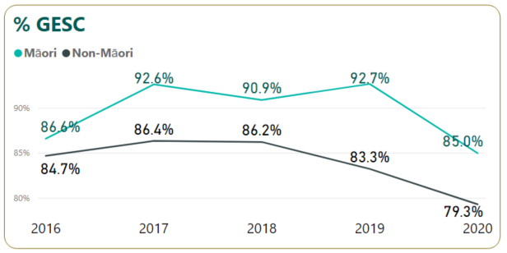
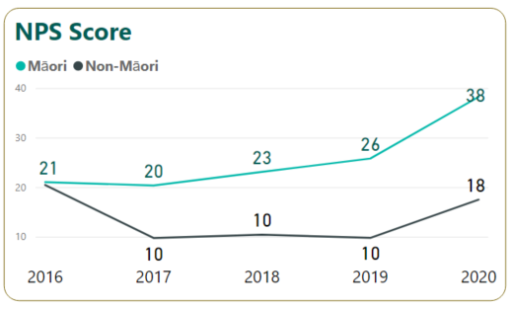
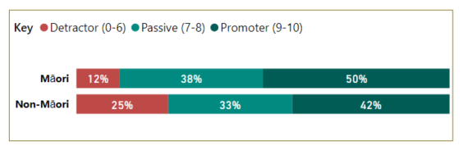
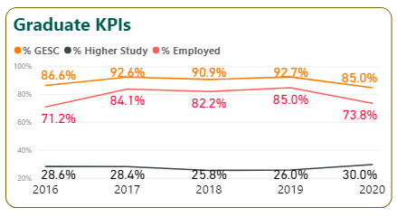
Priority Group - Māori
Investment target 85%
2020 Recommendation ratings breakdown
% GESC
During the 2016-2019 period, the % GESC for Māori students performed well above the investment target. However, 2020 saw a decline to 85%, on par with the target.
The Graduate KPIs graph (bottom left) indicates the decline was mainly driven by a drop to 73.8% in % Employed.
NPS Score
The NPS scores for Māori students are consistently higher than those for non-Māori students.
Over the years there was a rising trend for Māori NPS Score reaching 38 in 2020, well above the separate Unitec and non-Māori score of 18.

Slide 23
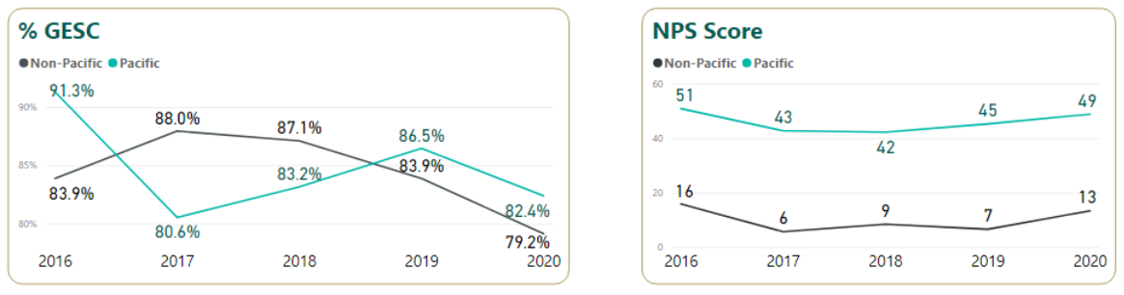
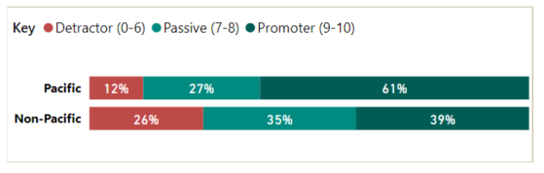
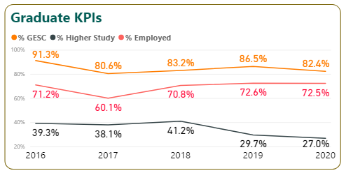
Priority Group - Pacific
Investment target 85%
2020 Recommendation ratings breakdown
% GESC
During the 2016-2020 period, the % GESC for Pacific fluctuated but the general 5-year trend is a declining one from its peak of 91.3% in 2016 to a rate below target for 3 years (2017, 2018 and 2020).
The Graduate KPIs graph (bottom left) indicates the downward trend was mainly driven by a decline in % Higher study.
NPS Score
Similar to the Māori priority group, the NPS scores for Pacific are consistently higher than those for non-Pacific students.
The NPS score for Pacific stayed high over the years to reach 49 in 2020, well above the Unitec score of 18 and the non-Pacific score of 13.

Slide 24
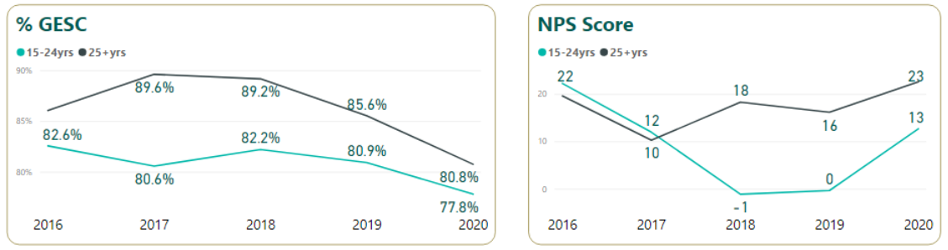
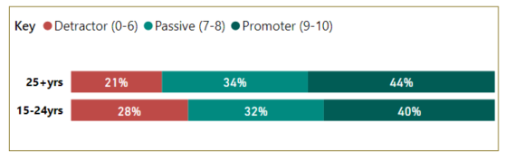
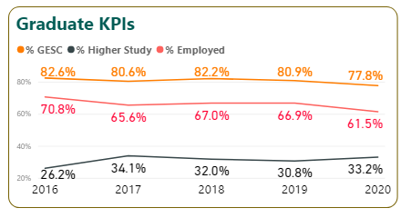
Priority Group – Under 25yrs
Investment target 85%
2020 Recommendation ratings breakdown
% GESC
During the 2016-2020 period, the % GESC for under 25yrs consistently failed to meet the investment target and stayed below that for 25yrs+.
In 2020, the % GESC for under 25yrs reached its lowest over the 5-year period to 77.8%, although the gap with 25yrs+ narrowed to 3%.
The Graduate KPIs graph (bottom left) indicates that the declining trend was mainly driven by a similar trend in % Employed while % Higher Study remained stable with minor fluctuations.
NPS Score
The NPS scores for under 25yrs showed a decreasing trend but rose steeply to 13 in 2020.
Despite this, there is cause for concern as the under 25yrs group is the ONLY priority group giving a lower NPS rating compared to its counterpart in 2020, bearing in mind the NPS Score correlates highly with the students’ learning experiences (feeling supported, effective teaching and learning needs met).

Slide 25
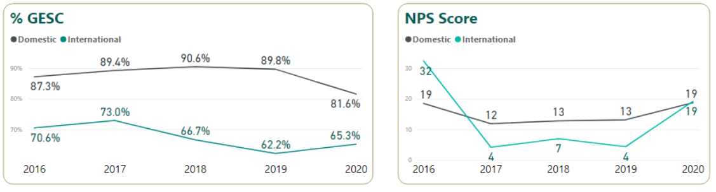
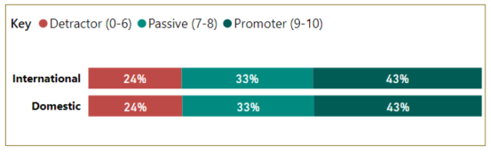
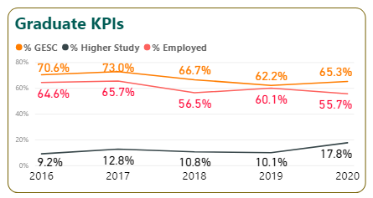
Priority Group – International
Investment target 85%
2020 Recommendation ratings breakdown
% GESC
During the 2016-2020 period, the % GESC for International are consistently lower than those for domestic students. Over time, the gap has been widening and finally narrowed in 2020.
The narrowing gap in 2020 was due more to a drop for Domestic than any significant increase for International.
In the Graduate KPIs graph (bottom left), while there was no rising trend observed for % Employed for International, there was an obvious increase from 2019 to 2020 in % Higher Study.
NPS Score
The NPS Score for International dropped significantly from 32 in 2016 to only 4 in 2017 and stayed low for 3 years, bouncing back to converge with that for Domestic at 19 in 2020.
This would also mean that for international students, their learning experiences improved in 2020. Comments from promoters validated the observations.

Slide 26
Summary and Recommendations
Summary
The 2020 graduate survey results have shown an obvious drop in % Employed but a rise in % Higher Study at the institute level and for most schools, resulting in a drop in % GESC. The changes in the two measures might have been impacted by the COVID-19 lockdown.
Learning experiences influenced respondents’ evaluation of whether they would recommend Unitec (NPS score) while job encounters underlied respondents’ perception of whether a qualification is worth the money spent.
Healthcare & Social Practice was a top school in the job measures in 2020 and over the past five years.
In 2020, Community Studies and Environmental & Animal Sciences led other schools in providing a satisfying learning experience as well as in providing various essential skills over the past five years.
Recommendation
The response rate of 37.1% in the 2020 graduate survey has increased slightly from 36.8% for the 2019 graduate survey, but still far below the target response rate of 60% recommended by the Higher Education Statistics Agency which runs surveys for the higher education sector in the UK. For the first time since graduate survey were run, the APMs were notified and given the email addresses of the students so that they could send reminders out. It is unclear how the follow-up actions, if any, have any impact on the response rate at the programme level as TKK does not have a record of whether the follow-up actions have been taken. If some form of coordination and recording can be implemented, TKK can identify if APM assistance will successfully lift the response rate.
Based on available information, graduate surveys in other institutes are held once a year, but in Unitec they are run twice a year. Given reporting is done on a yearly basis and to streamline the data collection process, it is suggested the Graduate survey in Unitec is also carried out once a year.

