Slide 1
Student Performance Report
2019
May 2020
Te Korowai Kahurangi

Slide 2
Unitec
Report on student performance measures for the reporting year of 2019 based on TEC criteria (see last slide)

Slide 3
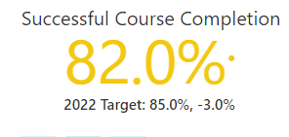
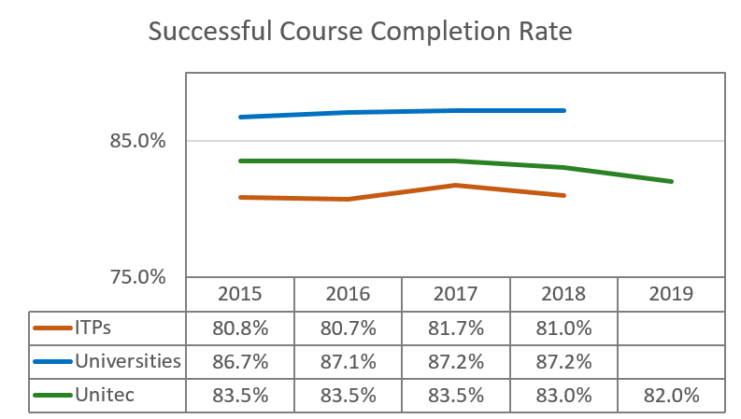

Successful Course Completion Rate in 2019 and Year Trends
Based on data submitted in May 2020 to Ngā Kete, Unitec achieved 82% in 2019, successfully meeting the institutional target of set for 2019.
For the period of 2015-2018, Unitec has been consistently above the ITP sector benchmarks by about 2% and below the University benchmarks by about 3%. The variance with the University sector is widening.

Slide 4
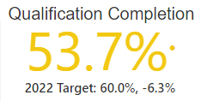
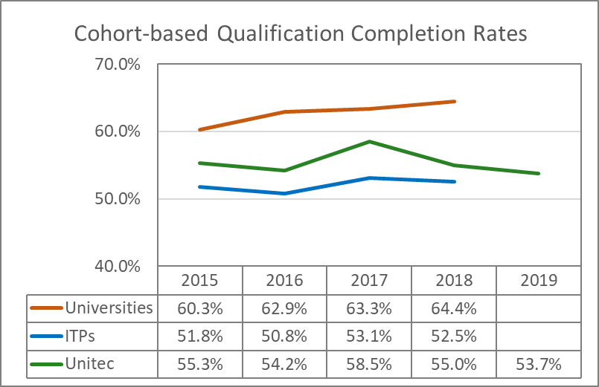

Cohort-based Qualification Completion Rate in 2019 and Year Trends
Based on the data submitted to Ngā Kete in May 2020, Unitec achieved a qualification completion rate of 53.7% which fell short of the institutional target of 55% for 2019.
For the period of 2015-2019, while Unitec stays above the ITP sector, the gap is narrowing and its variance with the University sector has been rising noticeably.

Slide 5
High Successful Course Completion Rate and Low Qualification Completion Rate
1. An analysis of non-completions for the Reporting Year of 2019 indicated that 38% of the students (or 1369 students) with a non-completion status passed all the courses they were enrolled in.
These students completed and passed all the enrolled courses but did not pursue their qualification for reasons other than failed grades.
These students did not move on to other qualifications of the same level within the cohort period (definition on the last slide).
2. Nearly half (or 47%) of the students who gave up pursuing their qualifications managed to pass at least 75% of the credits they were enrolled in, but still gave up on their qualifications.

Slide 6
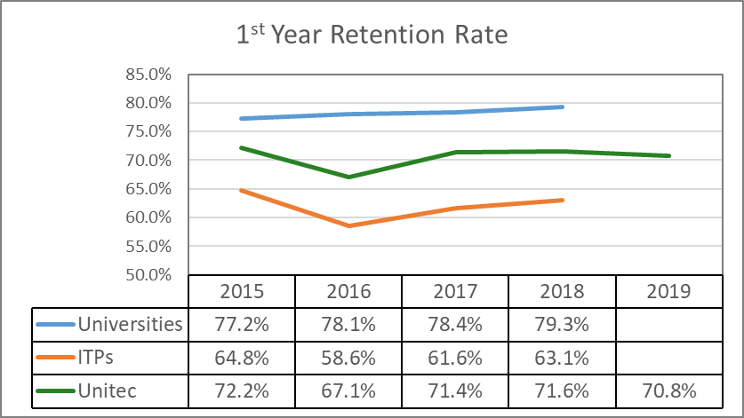
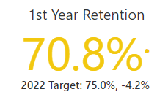

First Year Retention Rate in 2019 and Year Trends
The First Year Retention Rate dropped by 0.8% from 2018 to 70.8% in 2019, falling short of the institutional target for 2019 by 1.2%.
In 2015-2019, while Unitec stayed well above the ITP sector benchmark in the range of 7-9%, its variance with the University sector increased from 5% in 2015 to 7.7% in 2019.

Slide 7
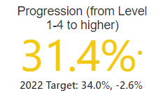
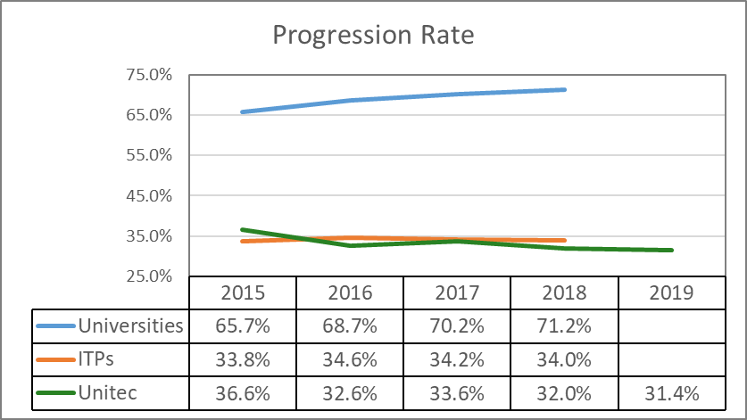
Progression Rate in 2019 and Year Trends
Unitec Targets | 2019 | 2020 | 2021 | 2022
Student Progression | 32.5% | 33.0% | 33.5% | 34.0%
Unitec achieved 31.4% in Level 1-4 Progression Rate in 2019, failing short of the institutional target of 32.5% for 2019 by 1.1%.
Except for 2015, Unitec consistently stayed below the ITP sector benchmark by 1-2% and was well below the University benchmark which has been rising over the years.

Slide 8
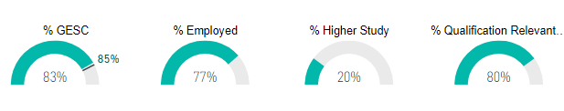

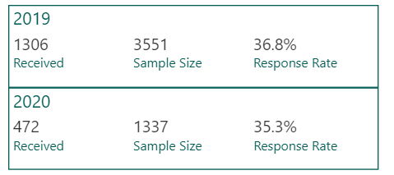
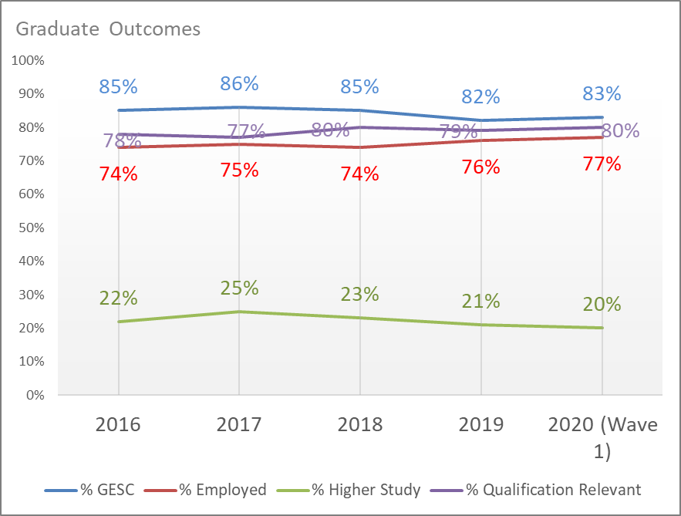
Unitec Graduate Outcomes
2020 Wave 1 (This wave is for graduates who completed qualifications in Semester 1, 2019)
While % Higher Study has shown a decreasing trend since 2017, the % employed fluctuated slightly between 74% and 77% in the 5-year period.
This combined to generate a similar pattern in % GESC (% of graduates in employment or further study) – slightly downward trend since 2017, bouncing back by 1% from 2018 to 2019 fuelled by a 1% increase in % employed.
The % GESC is yet to meet the institutional target, pending results from the second wave.

Slide 9
Schools

Slide 10
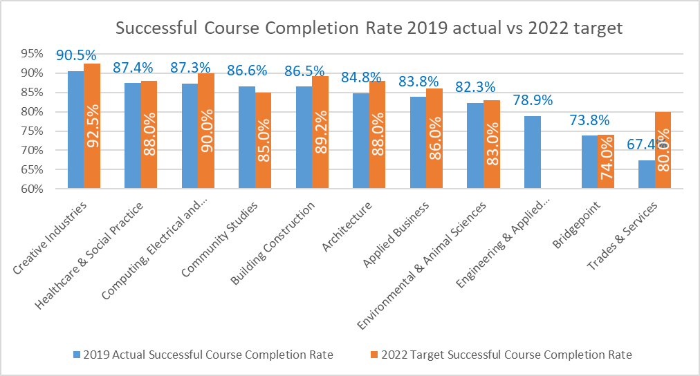
Successful Course Completion Rate by School – 2019 Actual vs 2022 Target
Note: Throughout the report, the school name Computing & Information Technology is used while in all the graphs it is replaced by its new name Computing, Electrical & Applied Technology due to graphing limitations. They both refer to the same school.

Slide 11
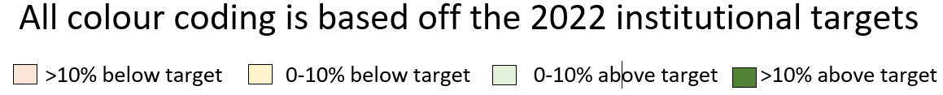
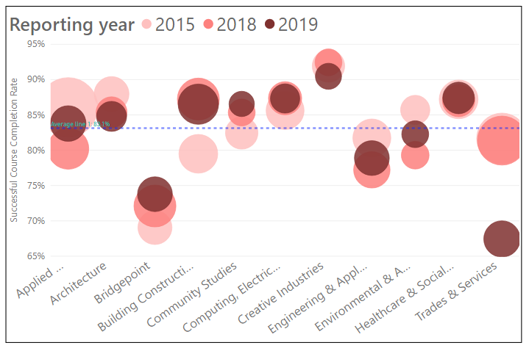
Year Trends - Successful Course Completion Rate by School
School | 2015 | 2016 | 2017 | 2018 | 2019 | Grand Total | Headcount for Reporting year 2019
Applied Business | 86.1% | 86.2% | 84.6% | 80.2% | 83.8% | 84.7% | 908
Architecture | 88.0% | 83.5% | 84.9% | 85.4% | 84.8% | 85.4% | 600
Bridgepoint | 69.1% | 75.8% | 74.1% | 72.1% | 73.8% | 72.9% | 866
Building Construction | 79.5% | 82.9% | 84.9% | 87.2% | 86.5% | 84.4% | 1233
Community Studies | 82.5% | 83.7% | 85.9% | 85.3% | 86.6% | 84.4% | 350
Computing, Electrical and Applied Technology | 85.6% | 84.8% | 87.6% | 87.4% | 87.3% | 86.4% | 539
Creative Industries | 91.9% | 91.5% | 91.0% | 92.4% | 90.5% | 91.5% | 394
Engineering & Applied Technology | 81.7% | 80.0% | 79.8% | 77.2% | 78.9% | 79.6% | 871
Environmental & Animal Sciences | 85.7% | 84.6% | 81.5% | 79.3% | 82.3% | 82.8% | 445
Healthcare & Social Practice | 87.2% | 86.5% | 85.6% | 87.0% | 87.4% | 86.8% | 695
Trades & Services | 81.7% | 81.6% | 78.9% | 81.4% | 67.4% | 79.0% | 982
Grand Total | 84.0% | 84.0% | 83.2% | 82.7% | 82.0% | 83.3% | 7768
Circles are Successful Course Completion Rates;
Size of a circle reflects the number of students
In both the 2-year and 5-year periods, Trades & Services saw a huge drop of about 15%. The impact on the institute rate was mitigated by the significant reduction in student size. Bridgepoint, the second lowest performer, stayed well below the institute target of 85%.
Creative Industries dropped slightly but together with Healthcare & Social Practice and Computing & Information Technology have remained high performers with stable performance throughout.
Building Construction started low in 2015 like Engineering & Applied Technology but had successively improved to an above target performance while the latter went down to below average performance.

Slide 12
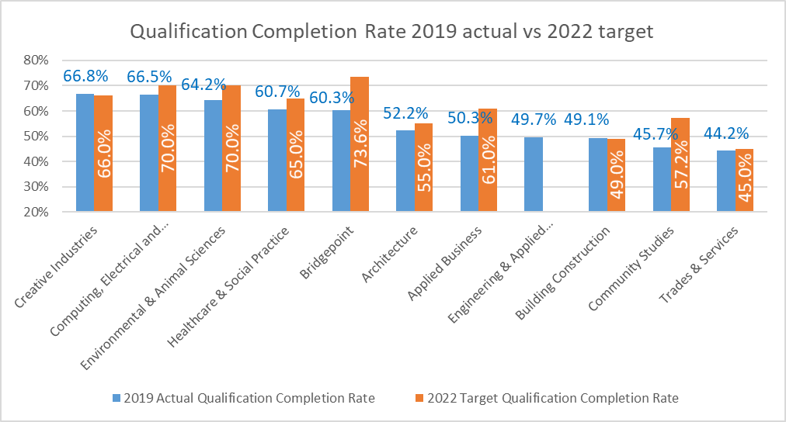
Cohort-based Qualification Completion Rate by School – 2019 Actual vs 2022 Target

Slide 13
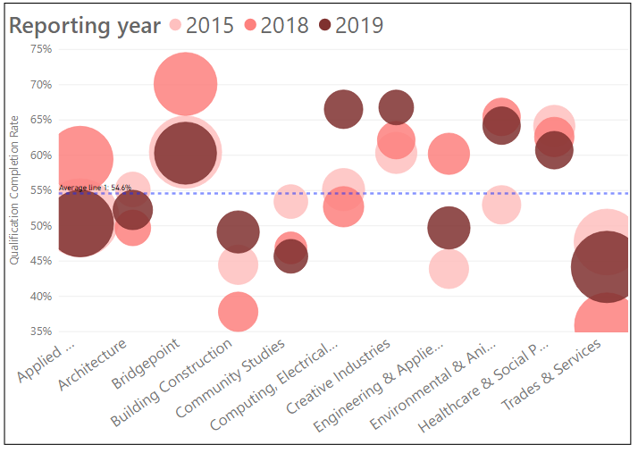
Year trends – Qualification Completion Rate by School
School | 2015 | 2016 | 2017 | 2018 | 2019 | Grand Total | Headcount for Reporting Year 2019
Applied Business | 51.1% | 54.2% | 64.8% | 59.4% | 50.3% | 55.7% | 1517
Architecture | 55.1% | 48.0% | 47.0% | 49.7% | 52.2% | 50.3% | 446
Bridgepoint | 60.4% | 58.3% | 66.4% | 70.1% | 60.3% | 62.4% | 1288
Building Construction | 44.5% | 39.5% | 41.4% | 37.8% | 49.1% | 42.6% | 510
Community Studies | 53.4% | 56.8% | 48.2% | 46.9% | 45.7% | 50.5% | 289
Computing & Information Technology | 55.1% | 52.5% | 58.1% | 52.7% | 66.5% | 56.7% | 423
Creative Industries | 60.3% | 57.7% | 67.3% | 62.1% | 66.8% | 62.4% | 316
Engineering & Applied Technology | 43.9% | 50.3% | 61.6% | 60.2% | 49.7% | 53.0% | 511
Environmental & Animal Sciences | 53.0% | 62.3% | 65.8% | 65.4% | 64.2% | 62.0% | 390
Healthcare & Social Practice | 64.2% | 58.2% | 64.1% | 62.6% | 60.7% | 62.1% | 392
Trades & Services | 47.7% | 45.0% | 44.3% | 35.9% | 44.2% | 43.5% | 1790
Grand Total | 53.6% | 53.0% | 57.0% | 54.9% | 53.1% | 54.2% | 7824
Circles are Qualification Completion Rates;
Size of a circle reflects the number of students
Trades and Services that has the largest student size over the years is the lowest performer despite a rise of 8.3% from 2018 to 2019. Second in student size is Applied Business which also has lower than average performance.
Engineering and Applied Technology saw the biggest drop by 10.5% from 2018 to 2019. Community Studies has steadily dropped over the 5-year period.
Computing and Information Technology saw the largest increase in 2015-2019, and Creative Industries the top performer also saw increases in both the 2-year and 5-year periods, their impact is, however, lessened by a relatively small student size.
Bridgepoint has above average performance, and with its large student size, helps to buttress the downward pressure on the institute rate. It has, however, dropped 9.8% from 2018 to 2019.

Slide 14
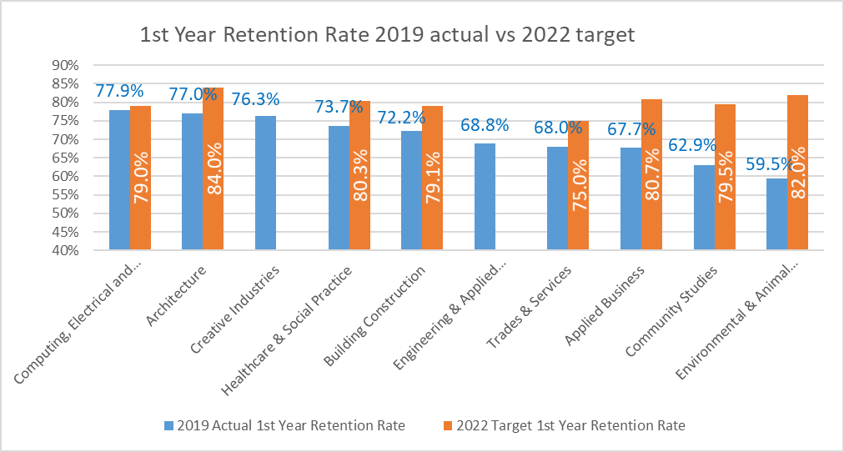
First Year Retention Rate by School – 2019 Actual vs 2022 Target

Slide 15
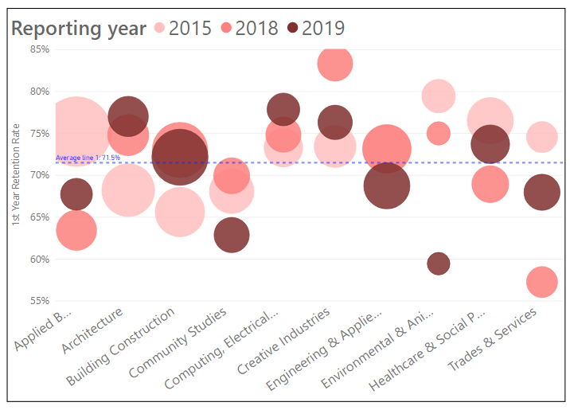
Year Trends – First Year Retention Rate by School
School | 2015 | 2016 | 2017 | 2018 | 2019 | Grand Total | Headcount for Reporting year 2019
Applied Business | 75.2% | 68.8% | 78.2% | 63.4% | 67.7% | 72.3% | 124
Architecture | 68.2% | 61.6% | 75.7% | 74.8% | 77.0% | 70.5% | 235
Bridgepoint | 64.3% | 71.4% | 91.7% | 100.0% | 0.0% | 66.7% | 5
Building Construction | 65.6% | 64.8% | 73.3% | 73.0% | 72.2% | 70.1% | 510
Community Studies | 68.1% | 64.7% | 57.9% | 69.9% | 62.9% | 64.9% | 167
Computing & Information Technology | 73.3% | 72.2% | 72.9% | 74.9% | 77.9% | 73.9% | 131
Creative Industries | 73.4% | 79.5% | 70.3% | 83.3% | 76.3% | 76.4% | 152
Engineering & Applied Technology | 73.2% | 71.4% | 64.6% | 73.2% | 68.8% | 70.3% | 320
Environmental & Animal Sciences | 79.5% | 60.0% | 62.5% | 75.0% | 59.5% | 68.9% | 37
Healthcare & Social Practice | 76.5% | 71.7% | 78.4% | 68.9% | 73.7% | 74.2% | 213
Trades & Services | 74.6% | 44.1% | 63.4% | 57.3% | 68.0% | 60.9% | 178
Grand Total | 72.3% | 67.1% | 71.5% | 71.7% | 71.2% | 70.6% | 2063
Circles are 1st Year Retention Rates;
Size of a circle reflects the number of students
*Bridgepoint is excluded to prevent its extreme figures skewing the graph. Bridgepoint no longer has any 2 EFTS or more programmes.
2018-2019 – Trades & Services and Computing & Information Technology and Healthcare & Social Practice are the schools that saw an encouraging increase. Of the three, Trades & Services saw the largest increase from but still stayed below average. The combined effect, however, was offset by decreases in other schools, particularly Environmental & Animal Sciences with a huge drop of 15.5%, and Engineering & Applied Technology and Building Construction which had the largest student size.
2015-2019 – Building Construction saw a healthy increase and given its larger student size, had a favourable impact on the overall rate. Schools with a small student size like Creative Industries, Architecture and Computing & Information Technology performed better than large players like Engineering & Applied Technology and Trades & Services. Environmental & Animal Sciences again experienced the biggest drop from 2015 to 2019 and fluctuated the greatest during the 5-year period.

Slide 16
Progression Rate by School – 2022 Target
Only targets are being shown here, as progression rate at the school level is not available.

Slide 17
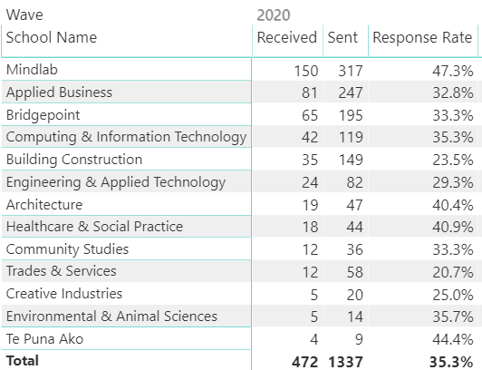
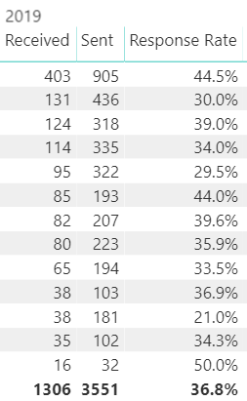
Graduate Survey Response rates by school
The Unitec graduate survey is run twice every year, consisting of waves 1 and 2 and targeting Semester 1 and 2 graduates respectively. The 2020 waves are for 2019 graduates and the 2019 waves are for 2018 graduates.
2020 Wave 1 only
2019 Waves 1 & 2

Slide 18
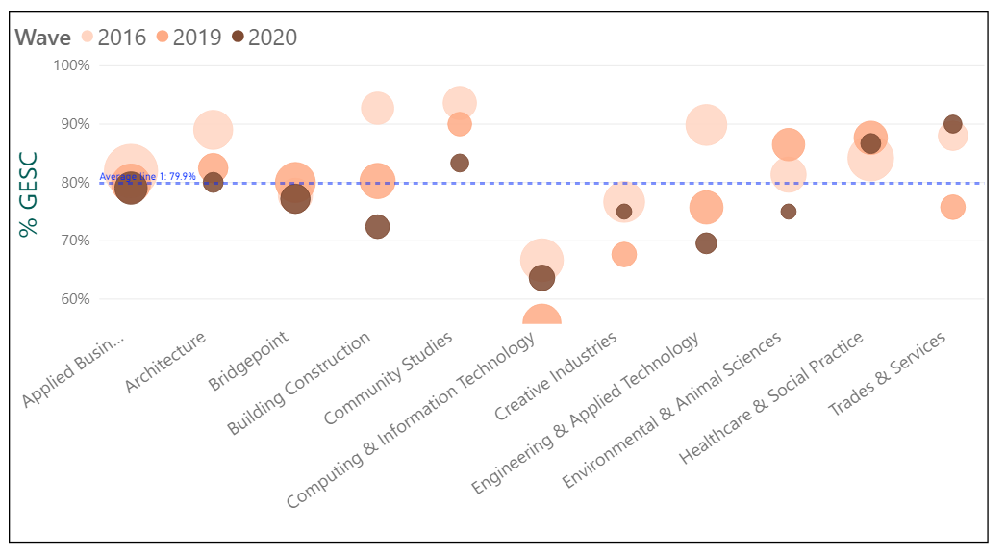
Year trends - % GESC by school
2019-2020
Computing and Information Technology with its relatively large student size and the lowest % GESC of all schools is a low performer despite a 7.7% increase.
Trades and Services has shown the biggest increase but its relatively small size does not impact significantly on the overall rate.
2016-2020
% GESC for all schools dropped except for Healthcare & Social Practice and Trades & Services but both schools have a relatively insignificant student size compared with Applied Business and Bridgepoint which have the largest impact on the overall Unitec rate but their % GESC have slightly decreased.
School | 2016 | 2017 | 2018 | 2019 | 2020 | 2016-2020 variance | 2019-2020 variance
Applied Business | 82.0% | 83.0% | 86.8% | 79.8% | 79.0% | -3.0% | -0.8%
Architecture | 89.0% | 80.9% | 82.1% | 82.5% | 80.0% | -9.0% | -2.5%
Bridgepoint | 77.8% | 85.7% | 79.2% | 80.0% | 77.2% | -0.6% | -2.8%
Building Construction | 92.7% | 90.7% | 80.0% | 80.2% | 72.4% | -20.3% | -7.8%
Community Studies | 93.6% | 88.0% | 93.6% | 90.0% | 83.3% | -10.3% | -6.7%
Computing & Information Technology | 66.7% | 67.1% | 62.4% | 55.9% | 63.6% | -3.1% | 7.7%
Creative Industries | 76.7% | 80.4% | 78.3% | 67.6% | 75.0% | -1.7% | 7.4%
Engineering & Applied Technology | 89.9% | 85.7% | 78.1% | 75.7% | 69.6% | -20.3% | -6.1%
Environmental & Animal Sciences | 81.3% | 92.9% | 87.1% | 86.5% | 75.0% | -6.3% | -11.5%
Healthcare & Social Practice | 84.2% | 84.3% | 91.0% | 87.7% | 86.7% | 2.5% | -1.0%
Trades & Services | 88.0% | 84.4% | 86.7% | 75.8% | 90.0% | 2.0% | 14.2%
Grand Total | 84.7% | 86.2% | 84.5% | 82.4% | 83.3% | -1.4% | 0.9%

Slide 19
Māori

Slide 20
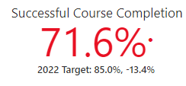
Māori Successful Course Completion Rate
2018 SCC Benchmarks | Māori | Non-Māori | Variance
Unitec | 73.3% | 83.6% | 10.3%
MIT | 73.4% | 81.7% | 8.3%
AUT | 81.2% | 85.2% | 4.0%
University of Auckland | 85.3% | 89.4% | 4.1%
ITP Sector | 71.8% | 82.5% | 10.7%
The variance between Māori and non-Māori Course Completion Rate has a worrying upward trend over the 5-year period.
While Unitec was above the ITP sector in 2018, it has the lowest Course Completion Rate compared with its key counterparts in Auckland.

Slide 21
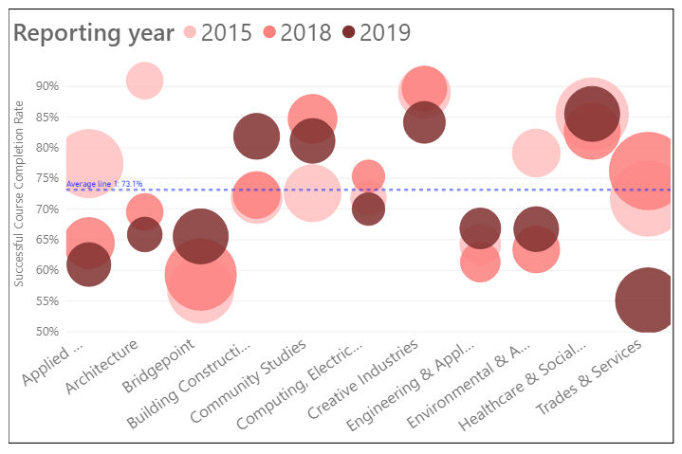
Maori Successful Course Completion by School and Year Trends
Healthcare & Social Practice is the top performer throughout the years. Building Construction showed a favourable upward trend with the biggest jump of all the schools from 2018.
Trades & Services experienced the biggest drop in 2018 -2019. As it has the largest student size of all schools, it has consistently exerted a downward pull on the overall Māori Course Completion Rate.
Both Architecture and Applied Business saw a continuous drop over the 5-year period but did not impact significantly on the overall rate given their relatively smaller student size especially in 2019.
Bridgepoint started low in 2015 and since then has continuously edged up, but given its lower than average Course Completion Rates and its relatively large student size, it remained a negative impact on the overall Maori performance.
*Student Headcount (Distinct) for the 2019 Reporting Year for SCC; EFTS are total regardless of measures
School | 2015 | 2016 | 2017 | 2018 | 2019 | 5-year variance | 2018-2019 variance | Student Headcount | EFTS
Applied Business | 77.4% | 76.6% | 73.2% | 64.5% | 61.0% | -16.4% | -3.5% | 59 | 27.1
Architecture | 90.9% | 74.0% | 72.4% | 69.5% | 65.9% | -25.0% | -3.6% | 31 | 27.1
Bridgepoint | 56.8% | 60.8% | 65.3% | 59.3% | 65.5% | 8.7% | 6.2% | 106 | 55.7
Building Construction | 71.8% | 77.0% | 81.8% | 72.3% | 81.9% | 10.1% | 9.6% | 68 | 41.2
Community Studies | 72.6% | 82.5% | 80.5% | 84.7% | 81.1% | 8.5% | -3.6% | 64 | 48.9
Computing & Information Technology | 71.8% | 61.7% | 75.5% | 75.3% | 70.0% | -1.8% | -5.3% | 25 | 17.6
Creative Industries | 89.0% | 89.0% | 82.7% | 89.7% | 84.1% | -4.9% | -5.6% | 53 | 50.9
Engineering & Applied Technology | 64.2% | 65.1% | 64.8% | 61.4% | 66.8% | 2.6% | 5.4% | 49 | 31.7
Environmental & Animal Sciences | 79.1% | 80.7% | 69.0% | 63.4% | 66.7% | -12.4% | 3.3% | 65 | 46.0
Healthcare & Social Practice | 85.5% | 84.4% | 83.1% | 82.7% | 85.5% | 0.0% | 2.8% | 102 | 80.3
Trades & Services | 71.7% | 69.7% | 65.8% | 76.2% | 55.1% | -16.6% | -21.1% | 153 | 95.4
Grand Total | 76.2% | 76.4% | 74.4% | 73.6% | 71.4% | -4.8% | -2.2% | 769 | 522.0

Slide 22
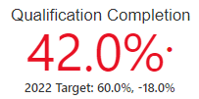
Māori Qualification Completion Rate
Unitec had the lowest Qualification Completion Rate compared with its key counterparts in Auckland and the ITP sector.
The gap between the Māori and non-Māori Qualification Completion Rates stood at 13% in 2019, the greatest of all years in the 5-year period.
2018 QC Benchmarks | Māori | Non-Māori | Variance
Unitec | 47.1% | 55.3% | 8.2%
MIT | 49.0% | 54.3% | 5.3%
AUT | 53.1% | 64.5% | 11.4%
University of Auckland | 59.2% | 71.0% | 11.8%
ITP Sector | 49.3% | 53.1% | 3.8%

Slide 23
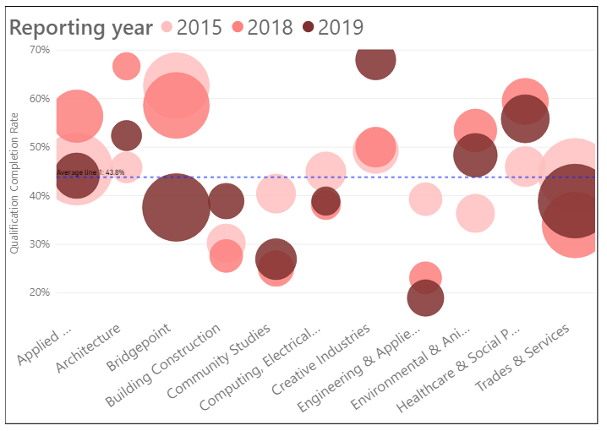
Maori Qualification Completion Rate by school and Year Trends
Creative Industries led other schools with the highest Qualification Completion rate and increase over both the 2-year and 5-year periods.
The overall Māori rate has however been negatively impacted by schools with a lower than average qualification rate and large student size such as Trades & Services and Bridgepoint. Bridgepoint in particular saw a drop of over 20% in both the 2-year and 5-year periods.
Building Construction showed a favourable increase over the 5 years but still its Qualification Completion Rate remained below average.
*Student Headcount (Distinct) for the 2019 Reporting Year for QC; EFTS are total regardless of measures
School | 2015 | 2016 | 2017 | 2018 | 2019 | 5-year variance | 2018-2019 variance | Student Headcount | EFTS
Applied Business | 45.5% | 48.0% | 54.9% | 56.4% | 44.1% | -1.4% | -12.3% | 68 | 27.1
Architecture | 45.8% | 52.6% | 52.2% | 66.7% | 52.4% | 6.6% | -14.3% | 21 | 27.1
Bridgepoint | 62.7% | 55.8% | 60.1% | 58.6% | 37.6% | -25.1% | -21.0% | 165 | 55.7
Building Construction | 30.2% | 26.1% | 26.9% | 27.6% | 38.9% | 8.7% | 11.3% | 36 | 41.2
Community Studies | 40.4% | 43.3% | 37.8% | 25.0% | 26.9% | -13.5% | 1.9% | 52 | 48.9
Computing & Information Technology | 44.9% | 28.6% | 35.0% | 38.1% | 38.9% | -6.0% | 0.8% | 18 | 17.6
Creative Industries | 49.3% | 47.9% | 54.8% | 50.0% | 68.0% | 18.7% | 18.0% | 50 | 50.9
Engineering & Applied Technology | 39.3% | 43.5% | 30.0% | 23.1% | 18.9% | -20.4% | -4.2% | 37 | 31.7
Environmental & Animal Sciences | 36.4% | 51.4% | 56.5% | 53.4% | 48.3% | 11.9% | -5.1% | 59 | 46.0
Healthcare & Social Practice | 46.0% | 51.6% | 56.7% | 59.4% | 55.8% | 9.8% | -3.6% | 77 | 80.3
Trades & Services | 44.3% | 36.2% | 33.3% | 34.0% | 38.9% | -5.4% | 4.9% | 197 | 95.4
Grand Total | 47.1% | 45.3% | 47.5% | 47.2% | 41.9% | -5.2% | -5.3% | 778 | 522.0

Slide 24

Māori First Year Retention Rate
In 2019, the Maori First Year Retention Rate slightly improved to narrow the gap between Māori and non-Māori performance.
Unitec was still well below its key counterparts in Auckland in 2018, although it stayed above the ITP sector benchmark.
2018 FYR Benchmarks | Māori | Non-Māori | Variance
Unitec | 62.0% | 72.2% | 10.2%
MIT | 67.1% | 68.6% | 1.5%
AUT | 75.7% | 79.4% | 3.7%
University of Auckland | 78.0% | 83.8% | 5.8%
ITP Sector | 56.2% | 63.9% | 7.7%

Slide 25
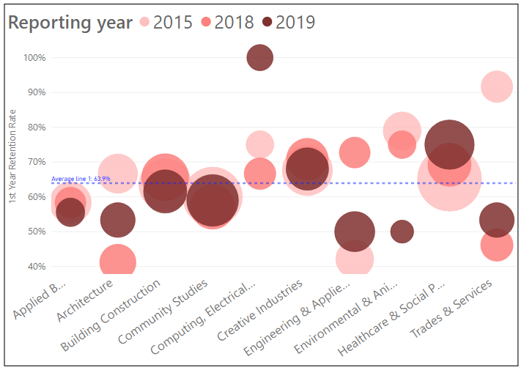
Māori First Year Retention Rate by school and Year Trends
In 2019, Computing & Information Technology secured the greatest increase in both the 2-year and 5-year periods to 100%.
The largest drop over the 5-year period is Trades & Services, impacting on the overall Maori results, although the school improved by 7.1% in 2019 from 2018.
Healthcare & Social Practice kept up its momentum throughout to become a high performer in 2019 with the second largest student size.
Of concern are Environmental and Animal Sciences and Engineering & Applied Technology showing a noticeably large downturn of 25% and 22.7% respectively.
*Bridgepoint is not included in the graph due to its huge fluctuations in 2015-2019 to avoid skewing the visual effect.
*Student Headcount (Distinct) for the 2019 Reporting Year for FYR; EFTS are total regardless of measures
School | 2015 | 2016 | 2017 | 2018 | 2019 | 5-year variance | 2018-2019 variance | Student Headcount | EFTS
Applied Business | 58.3% | 46.9% | 50.0% | 58.3% | 55.6% | -2.7% | -2.7% | 9 | 27.1
Architecture | 66.7% | 81.3% | 47.8% | 41.2% | 53.3% | -13.4% | 12.1% | 15 | 27.1
Bridgepoint | 100.0% | NA | NA | NA | NA | NA | NA |  | 55.7
Building Construction | 63.4% | 46.7% | 61.8% | 65.6% | 61.5% | -1.9% | -4.1% | 26 | 41.2
Community Studies | 60.0% | 57.4% | 62.2% | 57.1% | 59.0% | -1.0% | 1.9% | 39 | 48.9
Computing & Information Technology | 75.0% | 50.0% | 55.6% | 66.7% | 100.0% | 25.0% | 33.3% | 7 | 17.6
Creative Industries | 67.6% | 88.5% | 72.0% | 70.8% | 68.0% | 0.4% | -2.8% | 25 | 50.9
Engineering & Applied Technology | 42.1% | 36.0% | 42.9% | 72.7% | 50.0% | 7.9% | -22.7% | 22 | 31.7
Environmental & Animal Sciences | 78.9% | 30.8% | 42.9% | 75.0% | 50.0% | -28.9% | -25.0% | 4 | 46.0
Healthcare & Social Practice | 65.1% | 63.9% | 67.7% | 69.2% | 75.0% | 9.9% | 5.8% | 36 | 80.3
Trades & Services | 91.7% | 42.9% | 56.3% | 46.2% | 53.3% | -38.4% | 7.1% | 15 | 95.4
Grand Total | 64.7% | 56.5% | 58.7% | 62.3% | 62.6% | -2.1% | 0.3% | 198 | 521.9

Slide 26
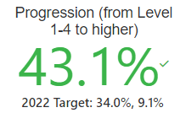
Māori Progression Rate
2019 Progression Rate is the only measure for the Māori priority group that more than met the target, reaching to 43.1% or 10.6% higher than the Unitec target of 32.5% set for 2019.
The Progression Rate is also the only measure that is consistently higher than that for non-Māori over the 5-year period, with this reversed for the other three measures.
The Unitec rate was, however, lower than the ITP sector benchmark and those achieved by its Auckland counterparts in 2018.
2018 Progression Benchmarks | Māori | Non-Māori | Variance
Unitec | 34.7% | 32.0% | -2.7%
MIT | 37.9% | 36.8% | -1.1%
AUT | 82.7% | 89.5% | 6.8%
University of Auckland | 91.7% | 88.0% | -3.7%
ITP Sector | 35.9% | 33.7% | -2.2%

Slide 27
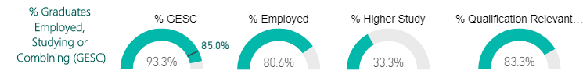
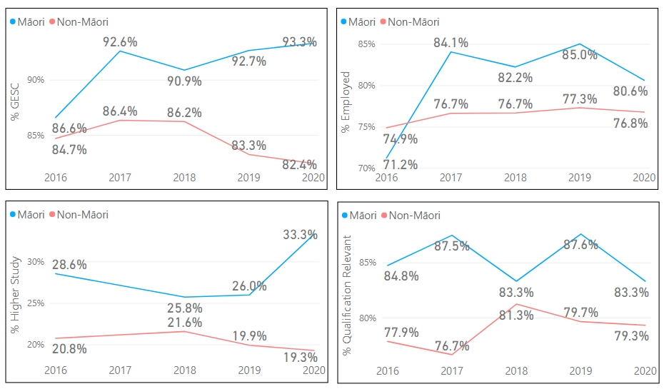
Māori Graduate Outcomes in 2020 wave
% GESC for Māori continued to stay high in 2020, mainly driven by a 7.3% increase in % Higher Study as % Employed dropped by 4.4% from 2019 to 2020.

Slide 28
Pacific

Slide 29
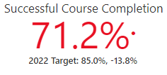
Pacific Successful Course Completion Rate in 2019 and Year Trends
In 2019, the Pacific Successful Course Completion Rate continued to stay well below its non-Pacific Course Completion Rate, though the variance has slightly decreased since its peak in 2017.
In 2018, the Pacific Successful Course Completion Rate was below the ITP sector benchmark and those of its key counterparts except Auckland University of Technology.
2018 scc Benchmarks | Pacific | Non-Pacific | Variance
Unitec | 71.5% | 84.2% | 12.7%
MIT | 73.3% | 83.7% | 10.4%
AUT | 68.9% | 87.2% | 18.3%
University of Auckland | 75.5% | 90.4% | 14.9%
ITP Sector | 72.3% | 81.5% | 9.2%

Slide 30
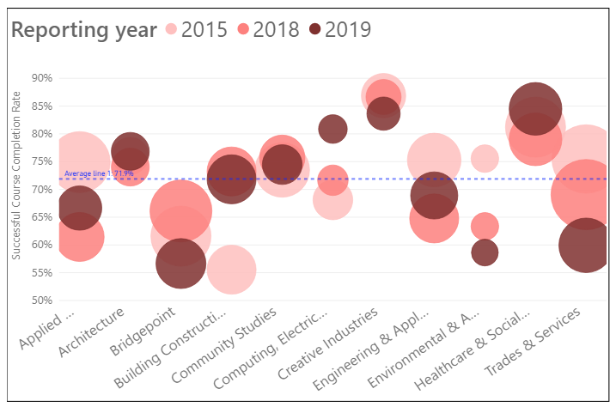
Pacific Successful Course Completion Rate by School and Year Trends
The school performance pattern almost repeats that for the Māori Successful Course Completion Rate.
Healthcare & Social Practice is the top performer throughout the years. Building Construction showed a favourable upward trend with the biggest jump of all the schools from 2015. Computing also saw an encouraging increase but its impact is relatively insignificant given its small student size.
Environmental & Animal Sciences and Trade & Services experienced the biggest drop in 2015-2019, with the latter exerting a more impactful downward pull on the overall rate given its large student size.
Bridgepoint also dropped significantly from 2018, creating a negative impact on the overall Institute performance.
*Student Headcount (Distinct) for the 2019 Reporting Year for SCC; EFTS are total regardless of measures
School | 2015 | 2016 | 2017 | 2018 | 2019 | 5-year variance | 2018-2019 variance | Student Headcount | EFTS
Applied Business | 74.9% | 72.6% | 67.5% | 61.4% | 66.6% | -8.3% | 5.2% | 129 | 73.3
Architecture | 76.0% | 69.8% | 67.8% | 74.0% | 76.9% | 0.9% | 2.9% | 88 | 77.9
Bridgepoint | 61.6% | 68.4% | 66.5% | 66.1% | 56.6% | -5.0% | -9.5% | 168 | 92.8
Building Construction | 55.5% | 62.3% | 66.5% | 73.2% | 71.8% | 16.3% | -1.4% | 160 | 112.4
Community Studies | 73.5% | 73.3% | 81.5% | 75.7% | 74.5% | 1.0% | -1.2% | 101 | 74.3
Computing & Information Technology | 68.1% | 70.2% | 72.5% | 71.6% | 80.9% | 12.8% | 9.3% | 40 | 27.8
Creative Industries | 86.9% | 83.3% | 80.8% | 86.6% | 83.6% | -3.3% | -3.0% | 59 | 53.2
Engineering & Applied Technology | 75.3% | 73.1% | 69.5% | 64.8% | 68.9% | -6.4% | 4.1% | 148 | 100.0
Environmental & Animal Sciences | 75.5% | 64.3% | 56.6% | 63.3% | 58.6% | -16.9% | -4.7% | 32 | 24.1
Healthcare & Social Practice | 81.2% | 79.8% | 77.1% | 79.0% | 84.5% | 3.3% | 5.5% | 195 | 148.0
Trades & Services | 75.5% | 74.9% | 66.1% | 69.1% | 59.9% | -15.6% | -9.2% | 204 | 127.2
Grand Total | 73.70% | 73.50% | 71.00% | 71.10% | 71.10% | -2.6% | 0.0% | 1303 | 910.7

Slide 31
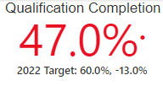
Pacific Qualification Completion Rate in 2019 and Year Trends
The gap between the Pacific and non-Pacific Qualification Completion Rates in 2019 narrowed to almost the 2017 level.
However, Unitec performed poorly in 2018 as its Pacific Qualification Completion Rate was below the ITP sector benchmark and its Auckland counterparts.
2018 QC Benchmarks | Pacific | Non-Pacific | Variance
Unitec | 43.5% | 56.3% | 12.8%
MIT | 51.8% | 54.6% | 2.8%
AUT | 48.4% | 65.7% | 17.3%
University of Auckland | 55.6% | 72.1% | 16.5%
ITP Sector | 48.5% | 52.7% | 4.2%

Slide 32
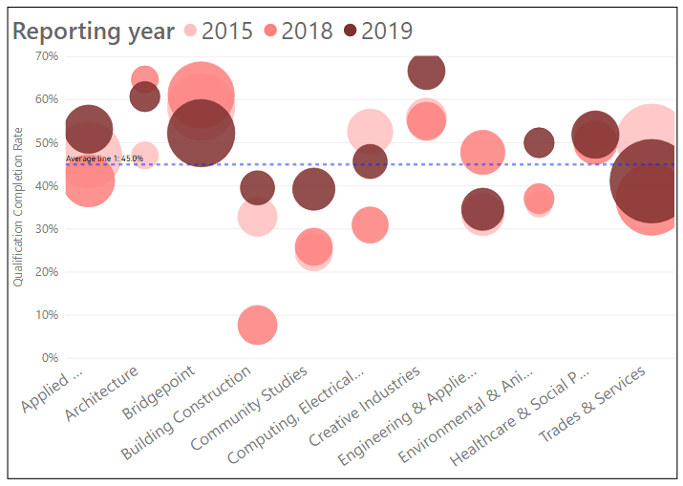
Pacific Qualification Completion Rate by School and Year Trends
Trades & Services had slightly below average performance in 2019. Given its huge student size, lifting the rate for the school should push up the Institute rate well.
Six out of 11 schools achieved a 2-digit increase from 2018 to 2019.
Bridgepoint performed relatively well and above average which is the opposite of its performance in course completion.
Engineering & Applied Technology saw a large drop of 13.2% from 2018 to 2019, back to their lacklustre 2015 performance.
Healthcare and Social Practice continued to be a robust performer, and along with Applied Business and Creative Industries which is a top performer, impacted favourably on the overall Pacific Qualification Completion Rate.
*Student Headcount (Distinct) for the 2019 Reporting Year for QC; EFTS are total regardless of measures
School | 2015 | 2016 | 2017 | 2018 | 2019 | 5-year variance | 2018-2019 variance | Student Headcount | EFTS
Applied Business | 47.1% | 49.5% | 47.4% | 41.2% | 53.2% | 6.1% | 12.0% | 111 | 73.3
Architecture | 47.1% | 40.9% | 53.8% | 64.7% | 60.7% | 13.6% | -4.0% | 28 | 77.9
Bridgepoint | 58.3% | 58.5% | 63.5% | 61.1% | 52.2% | -6.1% | -8.9% | 247 | 92.8
Building Construction | 32.8% | 26.0% | 30.9% | 7.7% | 39.5% | 6.7% | 31.8% | 43 | 112.4
Community Studies | 24.6% | 41.9% | 40.5% | 25.9% | 39.2% | 14.6% | 13.3% | 79 | 74.3
Computing & Information Technology | 52.6% | 30.6% | 48.2% | 30.9% | 45.7% | -6.9% | 14.8% | 44 | 27.8
Creative Industries | 55.7% | 58.1% | 63.0% | 55.0% | 66.7% | 11.0% | 11.7% | 57 | 53.2
Engineering & Applied Technology | 33.3% | 31.8% | 54.3% | 47.8% | 34.6% | 1.3% | -13.2% | 81 | 100.0
Environmental & Animal Sciences | 35.7% | 44.4% | 52.4% | 37.0% | 50.0% | 14.3% | 13.0% | 28 | 24.1
Healthcare & Social Practice | 52.8% | 59.7% | 49.5% | 50.0% | 51.9% | -0.9% | 1.9% | 106 | 148.0
Trades & Services | 50.7% | 46.7% | 57.5% | 36.8% | 41.1% | -9.6% | 4.3% | 389 | 127.2
Grand Total | 48.7% | 47.6% | 52.0% | 43.3% | 46.8% | -1.9% | 3.5% | 1206 | 910.7

Slide 33
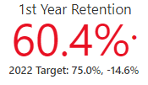
Pacific First Year Retention Rate - 2019 and year trends
The variance between the Pacific and non-Pacific First Year Retention Rates has continuously increased from 2015 to 2018. In 2019, this worrying gap has improved by 4.4%.
However, similar to its performance in Qualification Completion Rate, the Unitec First Year Retention Rate was below the ITP sector benchmark and well below its key Auckland counterparts.
2018 FYR Benchmarks | Pacific | Non-Pacific | Variance
Unitec | 56.0% | 73.2% | 17.2%
MIT | 67.6% | 69.2% | 1.6%
AUT | 68.8% | 80.2% | 11.4%
University of Auckland | 80.4% | 83.8% | 3.4%
ITP Sector | 58.7% | 63.3% | 4.6%

Slide 34
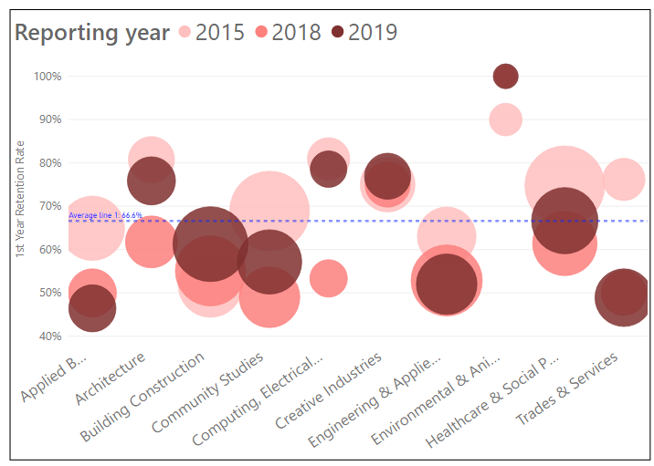
Pacific First Year Retention Rate by school and Year Trends
Schools that performed above average had the smallest student size.
Again Trades & Services had below average performance in 2019, only second to Applied Business. The latter, however, had a much smaller student size and so smaller negative impact.
Environmental & Animal Sciences had outstanding performance for 2 consecutive years in 2018 to 2019, achieving a 100% retention rate, but with almost negligible impact on the overall rate because of its small student size.
*Bridgepoint is not included in the graph due to its huge fluctuations in 2015-2019 to avoid skewing the visual effect.
*Student Headcount (Distinct) for the 2019 Reporting Year for FYR; EFTS are total regardless of measures
School | 2015 | 2016 | 2017 | 2018 | 2019 | 5-year variance | 2018-2019 variance | Student Headcount | EFTS
Applied Business | 64.9% | 62.9% | 56.1% | 50.0% | 46.4% | -18.5% | -3.6% | 28 | 73.3
Architecture | 80.8% | 79.1% | 60.0% | 61.8% | 75.9% | -4.9% | 14.1% | 29 | 77.9
Bridgepoint | 0.0% | 0.0% | NA | NA | NA | NA | NA | 0 | 92.8
Building Construction | 51.8% | 48.6% | 60.0% | 55.1% | 61.3% | 9.5% | 6.2% | 80 | 112.4
Community Studies | 68.9% | 62.0% | 46.8% | 49.0% | 57.1% | -11.8% | 8.1% | 56 | 74.3
Computing & Information Technology | 81.0% | 73.1% | 52.6% | 53.3% | 78.6% | -2.4% | 25.3% | 14 | 27.8
Creative Industries | 75.0% | 83.7% | 62.5% | 75.0% | 76.9% | 1.9% | 1.9% | 26 | 53.2
Engineering & Applied Technology | 63.0% | 66.3% | 60.0% | 52.9% | 52.0% | -11.0% | -0.9% | 50 | 100.0
Environmental & Animal Sciences | 90.0% | 62.5% | 66.7% | 100.0% | 100.0% | 10.0% | 0.0% | 3 | 24.1
Healthcare & Social Practice | 74.7% | 64.8% | 73.1% | 61.4% | 66.7% | -8.0% | 5.3% | 60 | 148.0
Trades & Services | 76.2% | 28.0% | 52.9% | 50.0% | 48.9% | -27.3% | -1.1% | 45 | 127.2
Grand Total | 69.1% | 61.7% | 59.2% | 56.0% | 60.9% | -8.2% | 4.9% | 389 | 910.7

Slide 35

Pacific Progression Rate in 2019 and Year Trends
Similar to the Māori pattern, the 2019 Progression Rate is the only measure for Pacific that met the Institute target of 32.5% for 2019, reaching to 45.9% or 13.4% higher than the set target.
The Progression Rate is also the only measure that is consistently higher than that for non-Pacific over the 5-year period, with this reversed for the other three measures.
However, the Pacific Progression Rate is still lower than the ITP sector benchmark and that achieved by its key Auckland counterparts.
2022 Target: 34% +11.9%
2018 Progression Benchmarks | Pacific | Non-Pacific | Variance
Unitec | 37.6% | 31.4% | -6.2%
MIT | 41.6% | 34.7% | -6.9%
AUT | 93.2% | 87.9% | -5.3%
University of Auckland | 88.7% | 89.3% | 0.6%
ITP Sector | 38.6% | 33.7% | -4.9%

Slide 36
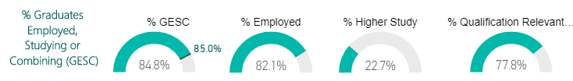
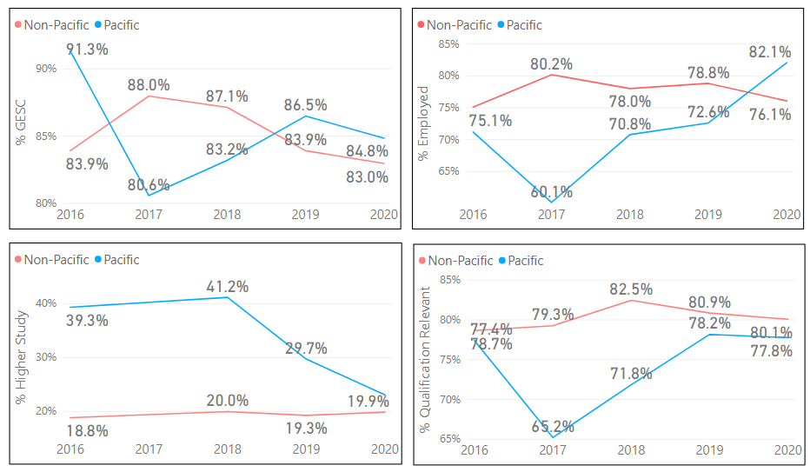
Pacific Graduate Outcomes in 2020 wave
In 2020, % Employed for Pacific went up substantially by 9.5%.
This was offset by a 7% reduction in % Higher Study, giving an overall 1.7% drop in % GESC.
The variance between the Pacific and non-Pacific % Qualification Relevant to Employment continued to narrow to only 2% in 2020, almost back to the 2016 level.
22.7%

Slide 37
Under 25yrs

Slide 38
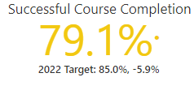
Under 25yrs Successful Course Completion Rate in 2019 and Year Trends
In 2019, Unitec’s Under 25yrs Successful Course Completion Rate edged down slightly by 0.3% from 2018 but with a greater fall for 25+yrs, the variance has dwindled to 6.2%.
In 2018, the Under 25yrs Successful Course Completion Rate was below the ITP sector benchmark and those of its key counterparts except Manukau Institute of Technology.
2018 SCC Benchmarks | Under 25yrs | 25+yrs | variance
Unitec | 79.4% | 86.6% | 7.2%
MIT | 76.5% | 85.3% | 8.8%
AUT | 84.0% | 88.1% | 4.1%
University of Auckland | 88.8% | 91.9% | 3.1%
ITP Sector | 79.8% | 82.1% | 2.3%

Slide 39
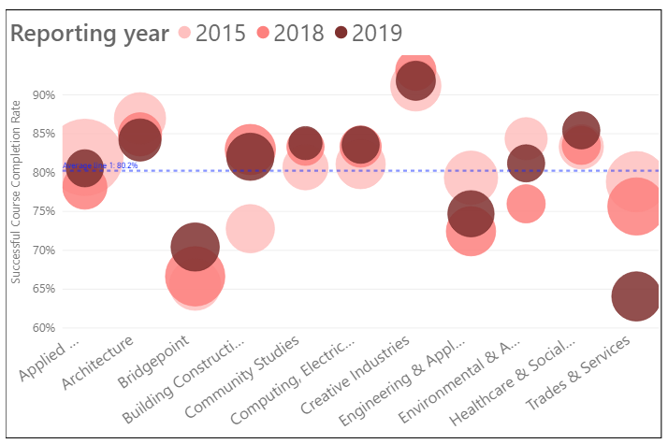
Under 25yrs Successful Course Completion Rate by School and Year Trends
Creative Industries led other schools in each of the past 5 years.
Building Construction kept a rising trend in 2015-2018. Although it levelled off since 2018 and dropped slightly in 2019, it still showed an above average performance and contributed favourably to the overall Unitec rate given its relatively large student size.
Trades & Services again performed poorly with a significant drop of 11.5% from 2018 to 2019.
In 2019, there are 7 schools with above average performance and only three low performing schools but the latter are those with a large student size, hence weighing down the overall Unitec performance.
*Student Headcount (Distinct) for the 2019 Reporting Year for SCC; EFTS are total regardless of measures
School | 2015 | 2016 | 2017 | 2018 | 2019 | 5-year variance | 2018-2019 variance | Student Headcount | EFTS
Applied Business | 82.0% | 83.2% | 80.6% | 78.1% | 80.6% | -1.4% | 2.5% | 266 | 166.8
Architecture | 87.0% | 81.7% | 83.1% | 84.9% | 84.2% | -2.8% | -0.7% | 385 | 367.6
Bridgepoint | 65.6% | 74.1% | 72.6% | 66.6% | 70.4% | 4.8% | 3.8% | 536 | 306.1
Building Construction | 72.8% | 78.1% | 79.5% | 83.0% | 82.0% | 9.2% | -1.0% | 509 | 384.7
Community Studies | 80.7% | 80.8% | 84.6% | 83.3% | 83.8% | 3.1% | 0.5% | 204 | 157.3
Computing & Information Technology | 81.1% | 78.5% | 84.7% | 83.3% | 83.6% | 2.5% | 0.3% | 269 | 205.7
Creative Industries | 91.2% | 91.7% | 92.2% | 93.2% | 91.8% | 0.6% | -1.4% | 309 | 291.8
Engineering & Applied Technology | 79.3% | 76.0% | 77.4% | 72.5% | 74.7% | -4.6% | 2.2% | 496 | 361.0
Environmental & Animal Sciences | 84.4% | 82.3% | 78.0% | 76.0% | 81.2% | -3.2% | 5.2% | 281 | 224.1
Healthcare & Social Practice | 83.3% | 84.3% | 82.3% | 83.5% | 85.4% | 2.1% | 1.9% | 281 | 208.9
Trades & Services | 78.8% | 77.9% | 69.8% | 75.6% | 64.1% | -14.7% | -11.5% | 577 | 382.4
Grand Total | 81.0% | 80.9% | 80.1% | 79.2% | 79.2% | -1.8% | 0.0% | 4049 | 3056.5

Slide 40

Under 25yrs Qualification Completion Rate in 2019 and Year Trends
In 2019, the Qualification Completion Rate for Under 25yrs dropped 6.1% from 2018 while that for 25+ years increased 5%, resulting in a 12.1% variance, despite the near closing of the gap in the previous 2 years.
In 2018, the 25yrs Qualification Completion Rate was above Manukau Institute of Technology and the ITP sector rates but below those of the two Auckland universities.
2018 QC Benchmarks | Under 25yrs | 25+yrs | Variance
Unitec | 54.5% | 55.5% | 1.0%
MIT | 52.6% | 55.4% | 2.8%
AUT | 62.8% | 66.3% | 3.5%
University of Auckland | 70.4% | 70.8% | 0.4%
ITP Sector | 53.8% | 51.4% | -2.4%

Slide 41
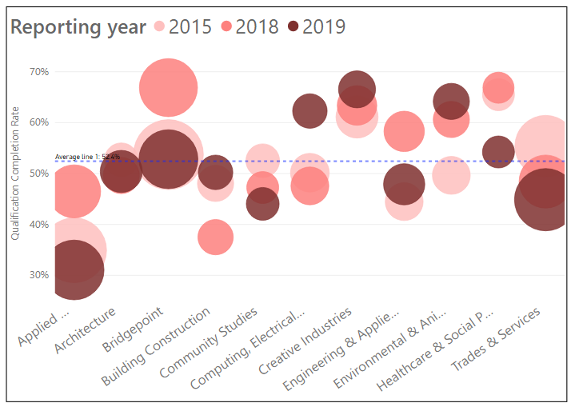
Under 25 Qualification Completion Rate by School and Year Trends
Creative Industries, Computing & Information Technology and Environmental and Animal Sciences stayed well above the others in 2019, though all had a relatively small student size.
Applied Business and Bridgepoint that had the second and third largest student size both saw a biggest drop from 2018. Applied Business hit a record low of 31.3% in 2019.
Healthcare and Social Practice reversed its good performance and had a 2-digit decrease during both the 2-year and 5-year period.
Trades & Services that had the largest student size reached its lowest in 2019 over the 5-year period.
Together this resulted in a low of 48.3% in 2019, the lowest for Unitec over the past 5 years.
*Student Headcount (Distinct) for the 2019 Reporting Year for QC; EFTS are total regardless of measures
School | 2015 | 2016 | 2017 | 2018 | 2019 | 5-year variance | 2018-2019 variance | Student Headcount | EFTS
Applied Business | 34.9% | 36.8% | 51.4% | 46.5% | 31.1% | -3.8% | -15.4% | 818 | 166.8
Architecture | 52.7% | 44.9% | 44.0% | 49.6% | 50.4% | -2.3% | 0.8% | 363 | 367.6
Bridgepoint | 53.7% | 55.4% | 64.6% | 66.9% | 52.8% | -0.9% | -14.1% | 796 | 306.1
Building Construction | 48.1% | 35.3% | 40.7% | 37.5% | 50.2% | 2.1% | 12.7% | 212 | 384.7
Community Studies | 52.5% | 54.9% | 45.7% | 47.3% | 44.0% | -8.5% | -3.3% | 193 | 157.3
Computing & Information Technology | 50.2% | 47.3% | 55.7% | 47.6% | 62.3% | 12.1% | 14.7% | 226 | 205.7
Creative Industries | 61.1% | 60.0% | 66.7% | 63.4% | 66.5% | 5.4% | 3.1% | 269 | 291.8
Engineering & Applied Technology | 44.5% | 47.9% | 60.8% | 58.3% | 47.9% | 3.4% | -10.4% | 355 | 361.0
Environmental & Animal Sciences | 49.6% | 59.0% | 62.9% | 60.6% | 64.2% | 14.6% | 3.6% | 253 | 224.1
Healthcare & Social Practice | 65.5% | 55.9% | 61.1% | 66.9% | 54.2% | -11.3% | -12.7% | 177 | 208.9
Trades & Services | 55.4% | 55.8% | 58.5% | 48.4% | 44.9% | -10.5% | -3.5% | 899 | 382.4
Grand Total | 50.0% | 50.1% | 56.3% | 54.5% | 48.3% | -1.7% | -6.2% | 4531 | 3056.5

Slide 42
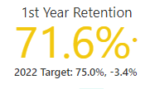
Under 25yrs First Year Retention Rate in 2019 and Year Trends
In 2019, the variance in First Year Retention Rate between under 25yrs and 25+yrs further narrowed.
In 2018, Unitec had the smallest variance when compared with the ITP Sector and its key Auckland counterparts.
2018 Retention Benchmarks | Under 25yrs | 25+yrs | variance
Unitec | 73.3% | 69.0% | -4.3%
MIT | 72.0% | 62.6% | -9.4%
AUT | 80.5% | 73.6% | -6.9%
University of Auckland | 84.9% | 77.3% | -7.6%
ITP Sector | 68.7% | 55.9% | -12.8%

Slide 43
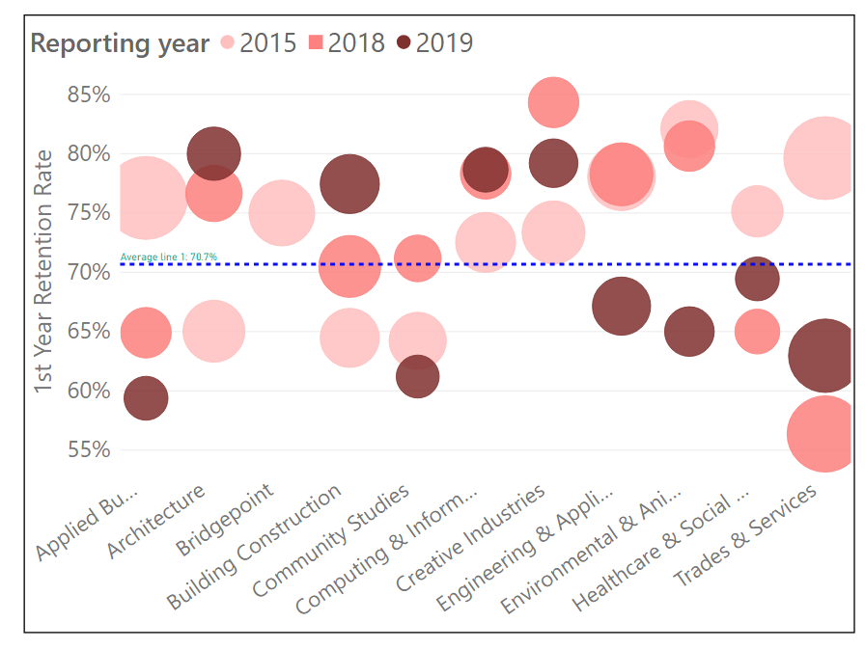
Under 25 First Year Retention Rate by School and Year Trends
Architecture, Building Construction, Creative Industries and Computing & Information Technology stayed high above the average in 2019. The first 2 in particular saw a consistent robust rising trend.
Environmental and Animal Sciences suffered the biggest drop over the 2-year and 5-year periods.
Both Applied Business and Trades & Services again witnessed a significant drop in the 5-year period, although Trades & Services went up from 2018 to 2019 to become the third lowest performer. Given its largest student size, its impact dwarfed that made by others.
Engineering & Applied Technology performed well in 2018 but declined to below average in 2019.
*Bridgepoint is not included in the graph due to its huge fluctuations in 2015-2019 to avoid skewing the visual effect.
*Student Headcount (Distinct) for the 2019 Reporting Year for FYR; EFTS are total regardless of measures
School | 2015 | 2016 | 2017 | 2018 | 2019 | 5-year variance | 2018-2019 variance | Student Headcount | EFTS
Applied Business | 76.3% | 69.0% | 81.0% | 64.9% | 59.4% | -16.9% | -5.5% | 64 | 166.8
Architecture | 65.0% | 59.5% | 79.1% | 76.6% | 80.0% | 15.0% | 3.4% | 165 | 367.6
Bridgepoint | 75.0% | 100.0% | 100.0% | 100.0% | 0.0% | -75.0% | -100.0% | 5 | 306.1
Building Construction | 64.5% | 68.1% | 74.1% | 70.5% | 77.4% | 12.9% | 6.9% | 235 | 384.7
Community Studies | 64.2% | 61.4% | 53.6% | 71.2% | 61.2% | -3.0% | -10.0% | 116 | 157.3
Computing & Information Technology | 72.5% | 74.4% | 69.4% | 78.3% | 78.7% | 6.2% | 0.4% | 89 | 205.7
Creative Industries | 73.4% | 78.9% | 72.5% | 84.3% | 79.2% | 5.8% | -5.1% | 125 | 291.8
Engineering & Applied Technology | 78.1% | 74.8% | 66.2% | 78.3% | 67.1% | -11.0% | -11.2% | 210 | 361.0
Environmental & Animal Sciences | 82.1% | 59.8% | 67.9% | 80.6% | 65.0% | -17.1% | -15.6% | 20 | 224.1
Healthcare & Social Practice | 75.1% | 66.2% | 80.0% | 65.0% | 69.4% | -5.7% | 4.4% | 108 | 208.9
Trades & Services | 79.6% | 42.0% | 62.7% | 56.4% | 63.0% | -16.6% | 6.6% | 81 | 382.4
Grand Total | 72.5% | 67.5% | 72.5% | 73.3% | 71.6% | -0.9% | -1.7% | 1214 | 3056.5

Slide 44
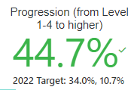
Under 25 Progression Rate in 2019 and Year Trends
in 2019, the Progression Rate for Under 25yrs increased 4.3%, widening the variance and lifting the group further above the 25+yrs.
Unitec Under 25yr Progression Rate was only slightly above the ITP Sector benchmark but fell below Manukau Institute of Technology and far below its University counterparts.
2018 Progression Benchmarks | Under 25yrs | 25+yrs | Variance
Unitec | 40.4% | 23.8% | -16.6%
MIT | 40.9% | 33.8% | -7.1%
AUT | 90.3% | 65.4% | -24.9%
University of Auckland | 89.9% | 80.0% | -9.9%
ITP Sector | 40.0% | 29.6% | -10.4%

Slide 45

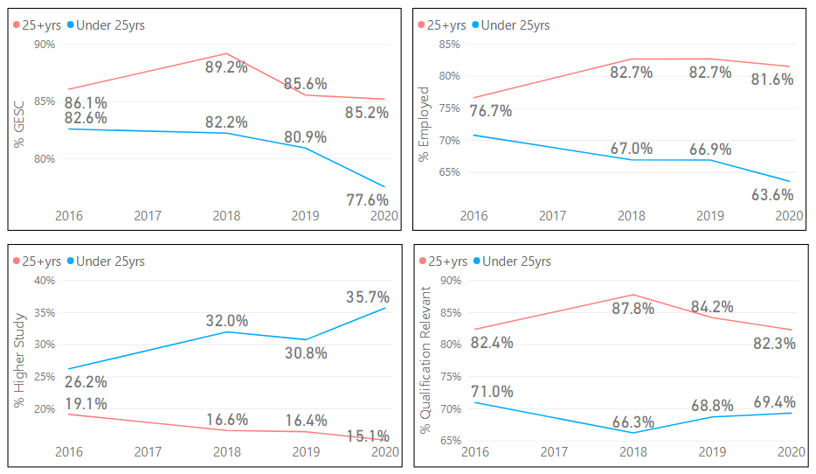
Under 25yrs Graduate Outcomes
In 2020, % GESC went down 3.3% due to the same percentage drop in % Employed.
This is despite an increase of 4.9% in % Higher Study, suggesting that those who were engaged in Higher Study were also employed, hence offsetting the increase.
The % Qualification Relevant to Employment for the Under 25yrs remains consistently lower than that for the 25+yrs group.

Slide 46
International

Slide 47
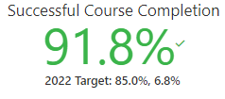
International Successful Course Completion Rate in 2019 and Year Trends
In 2019, the Successful Course Completion Rate for International exceeded the Institute target of 82% by 9.8%.
Back in 2018, Unitec had the lowest rate when compared with the ITP Sector and its key Auckland counterparts.
2018 SCC Benchmarks | International | Domestic | Variance
Unitec | 89.6% | 81.1% | -8.5%
MIT | 92.6% | 77.9% | -14.7%
AUT | 91.2% | 83.7% | -7.5%
University of Auckland | 90.7% | 89.0% | -1.7%
ITP Sector | 91.4% | 78.9% | -12.5%

Slide 48
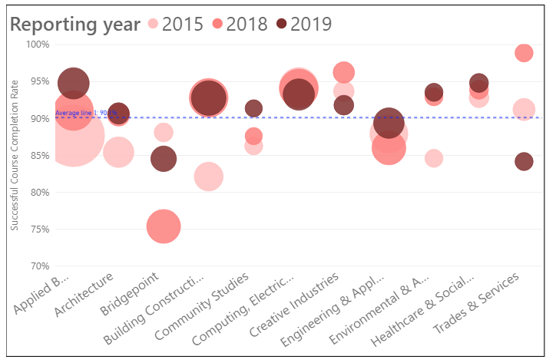
International Successful Course Completion Rate by School and Year Trends
Applied Business has shown a rising trend and reached 94.8% in 2019 to become the top performers together with Healthcare & Social Practice.
Also performing well was Building Construction which increased continuously over the years to reach 90.8%. With its large student size, it has contributed favourably to the overall Unitec rate together with the buoyant performer Computing & Information Technology.
Trades & Services as the lowest performer has decreased over the years considerably but has not hugely impacted on the overall rate given its small student size. Similarly for the low performer Bridgepoint which fluctuated in the 5-year period but did not produce a significant impact on the Unitec rate.
Community Studies saw a nice climb in 2019 after having plateaued in 2018.
*Student Headcount (Distinct) for the 2019 Reporting Year for SCC; EFTS are total regardless of measures
School | 2015 | 2016 | 2017 | 2018 | 2019 | 5-year variance | 2018-2019 variance | Student Headcount | EFTS
Applied Business | 87.7% | 89.4% | 88.8% | 91.1% | 94.8% | 7.1% | 3.7% | 259 | 181.8
Architecture | 85.4% | 86.1% | 91.0% | 90.5% | 90.7% | 5.3% | 0.2% | 69 | 83.1
Bridgepoint | 88.1% | 88.4% | 79.1% | 75.4% | 84.6% | -3.5% | 9.2% | 134 | 72.7
Building Construction | 82.1% | 87.8% | 88.9% | 92.8% | 92.8% | 10.7% | 0.0% | 324 | 251.0
Community Studies | 86.3% | 81.2% | 87.8% | 87.6% | 91.4% | 5.1% | 3.8% | 10 | 7.3
Computing & Information Technology | 94.3% | 92.5% | 92.5% | 94.1% | 93.3% | -1.0% | -0.8% | 263 | 195.2
Creative Industries | 93.7% | 92.8% | 97.7% | 96.2% | 91.8% | -1.9% | -4.4% | 46 | 41.7
Engineering & Applied Technology | 87.9% | 82.7% | 85.4% | 86.0% | 89.4% | 1.5% | 3.4% | 244 | 205.0
Environmental & Animal Sciences | 84.6% | 89.0% | 89.8% | 93.0% | 93.6% | 9.0% | 0.6% | 26 | 21.4
Healthcare & Social Practice | 92.8% | 96.0% | 91.8% | 93.9% | 94.8% | 2.0% | 0.9% | 39 | 31.4
Trades & Services | 91.2% | 94.7% | 88.6% | 98.9% | 84.2% | -7.0% | -14.7% | 21 | 12.1
Grand Total | 88.5% | 88.5% | 88.3% | 89.6% | 91.7% | 3.2% | 2.1% | 1390 | 1102.7

Slide 49

International Qualification Completion Rate in 2019 and Year Trends
In 2019, the Qualification Completion Rate dropped 7.2% from 2018 to 2019 but managed to meet the institutional target of 55% for 2019.
In 2018, although Unitec was below its University counterparts in Qualification Completion rate, it performed better than the ITP sector and Manukau Institute of Technology.
2018 QC Benchmarks | International | Domestic | Variance
Unitec | 63.5% | 52.9% | -10.6%
MIT | 57.9% | 53.3% | -4.6%
AUT | 76.2% | 61.6% | -14.6%
University of Auckland | 74.6% | 70.0% | -4.6%
ITP Sector | 63.0% | 51.3% | -11.7%

Slide 50
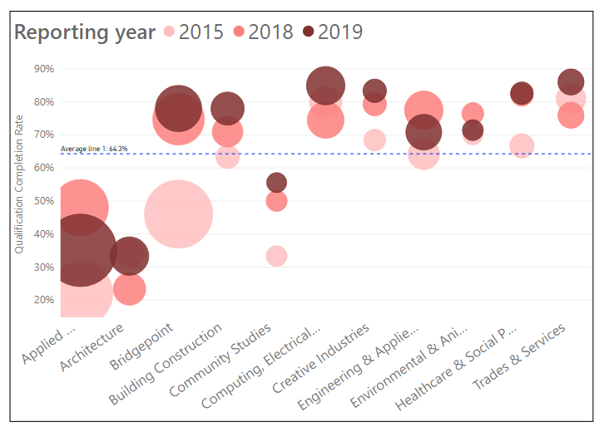
International Qualification Completion Rate by School and Year Trends
Building Construction kept up its rising momentum throughout the 5-year period while Computing & Information Technology rebound from its low in 2018 to a high of 84.9% to become the second top performer.
Engineering & Applied Technology also performed above average despite a drop of 6.7% from 2018 to 2019.
Both Applied Business and Architecture were low performers in the 5-year period though the former had a much larger student size and hence greater negative impact.
Of interesting concern is Applied Business which had the top Successful Course Completion Rate but the second lowest Qualification Completion Rate in 2019 for this priority group.
*Student Headcount (Distinct) for the 2019 Reporting Year for QC; EFTS are total regardless of measures
School | 2015 | 2016 | 2017 | 2018 | 2019 | 5-year variance | 2018-2019 variance | Student Headcount | EFTS
Applied Business | 22.0% | 31.2% | 49.6% | 48.0% | 35.1% | 13.1% | -12.9% | 753 | 181.8
Architecture | 34.1% | 22.4% | 23.2% | 23.4% | 33.3% | -0.8% | 9.9% | 174 | 83.1
Bridgepoint | 46.0% | 53.5% | 47.1% | 74.7% | 78.0% | 32.0% | 3.3% | 279 | 72.7
Building Construction | 63.3% | 61.3% | 65.4% | 71.0% | 78.0% | 14.7% | 7.0% | 116 | 251.0
Community Studies | 33.3% | 50.0% | 42.9% | 50.0% | 55.6% | 22.3% | 5.6% | 9 | 7.3
Computing & Information Technology | 79.8% | 72.6% | 83.2% | 74.5% | 84.9% | 5.1% | 10.4% | 170 | 195.2
Creative Industries | 68.4% | 60.7% | 83.3% | 79.3% | 83.3% | 14.9% | 4.0% | 30 | 41.7
Engineering & Applied Technology | 64.2% | 60.0% | 78.2% | 77.5% | 70.8% | 6.6% | -6.7% | 144 | 205.0
Environmental & Animal Sciences | 70.0% | 63.6% | 66.7% | 76.5% | 71.4% | 1.4% | -5.1% | 14 | 21.4
Healthcare & Social Practice | 66.7% | 58.6% | 88.0% | 82.1% | 82.6% | 15.9% | 0.5% | 23 | 31.4
Trades & Services | 81.0% | 79.5% | 79.4% | 75.9% | 86.0% | 5.0% | 10.1% | 50 | 12.1
Grand Total | 43.2% | 46.9% | 56.9% | 63.3% | 55.7% | 12.5% | -7.6% | 1740 | 1102.7

Slide 51
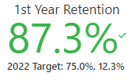
International First Year Retention Rate in 2019 and Year Trends
In 2019, the International First Year Retention Rate continued its rising trend and went up 1.7% to 87.3%, well above the institutional target.
In 2018, although Unitec was below its University counterparts in the First Year Retention Rate, it performed better than the ITP sector and was far above Manukau Institute of Technology.
2018 FYR Benchmarks | International | Domestic | Variance
Unitec | 85.6% | 67.2% | -18.4%
MIT | 57.1% | 71.6% | 14.5%
AUT | 90.9% | 77.4% | -13.5%
University of Auckland | 92.5% | 82.3% | -10.2%
ITP Sector | 71.6% | 61.4% | -10.2%

Slide 52
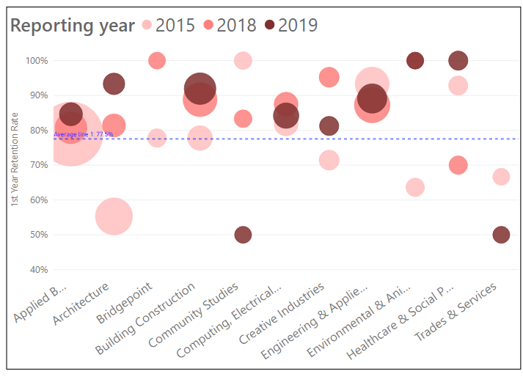
International First Year Retention Rate by School and Year Trends
Despite being top performers in 2019, Environmental & Animal Sciences and Healthcare & Social Practice had a very small student size and so minimal impact on the overall rate.
Building Construction continued its excellent performance.
Of interest is Engineering & Applied Technology which did not do well or was below average in all other priority groups performed well in the International Group.
Community Studies continued its downward turn over the 5-year period and Trades & Services showed a rebound but was still far below average.
*Student Headcount (Distinct) for the 2019 Reporting Year for FYR; EFTS are total regardless of measures
School | 2015 | 2016 | 2017 | 2018 | 2019 | 5-year variance | 2018-2019 variance | Student Headcount | EFTS
Applied Business | 78.9% | 74.4% | 87.8% | 80.7% | 84.6% | 5.7% | 3.9% | 39 | 181.8
Architecture | 55.3% | 32.0% | 86.0% | 81.4% | 93.3% | 38.0% | 11.9% | 30 | 83.1
Bridgepoint | 77.8% | 100.0% | 100.0% | 100.0% | 0.0% | -77.8% | -100.0% | 5 | 72.7
Building Construction | 77.8% | 81.9% | 88.4% | 88.8% | 92.0% | 14.2% | 3.2% | 112 | 251.0
Community Studies | 100.0% | 92.3% | 100.0% | 83.3% | 50.0% | -50.0% | -33.3% | 4 | 7.3
Computing & Information Technology | 81.8% | 86.3% | 84.5% | 87.5% | 84.2% | 2.4% | -3.3% | 57 | 195.2
Creative Industries | 71.4% | 72.2% | 90.5% | 95.2% | 81.3% | 9.9% | -13.9% | 16 | 41.7
Engineering & Applied Technology | 93.3% | 91.1% | 81.9% | 87.2% | 89.1% | -4.2% | 1.9% | 92 | 205.0
Environmental & Animal Sciences | 63.6% | 70.0% | 60.0% | 100.0% | 100.0% | 36.4% | 0.0% | 4 | 21.4
Healthcare & Social Practice | 92.9% | 42.9% | 92.9% | 70.0% | 100.0% | 7.1% | 30.0% | 14 | 31.4
Trades & Services | 66.7% | 0.0% | 66.7% | 0.0% | 50.0% | -16.7% | 50.0% | 4 | 12.1
Grand Total | 77.0% | 73.8% | 86.4% | 85.7% | 87.3% | 10.3% | 1.6% | 377 | 1102.7

Slide 53
International Progression Rate in 2019 and Year Trends
Progression
(from Levels 1-4 to higher)
73.2%
2022 Target: 34.0%, +39.2
In 2019, the Progression Rate dropped 8.1% from 2018 to 73.2% in 2019 after a 4-year rising trend.
In 2018, the Unitec rate was below that for the University of Auckland but otherwise above its other counterparts and the ITP sector.
2018 Progression Benchmarks | International | Domestic | Variance
Unitec | 81.3% | 33.2% | -48.1%
MIT | 57.6% | 37.9% | -19.7%
AUT | 72.7% | 67.2% | -5.5%
University of Auckland | 94.2% | 89.0% | -5.2%
ITP Sector | 66.2% | 32.9% | -33.3%

Slide 54

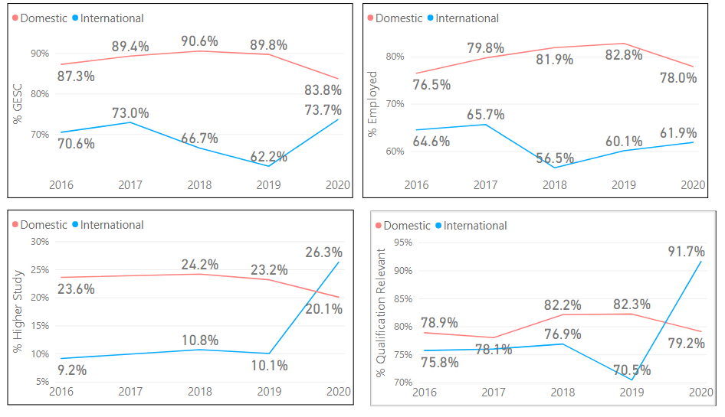
International Graduate Outcomes
In 2020, % GESC for International went up 11.5% fuelled by both a 1.8% rise in % Employed and a significant 16.2% rise in % Higher Study.
% Qualification Relevant to Employment for International jumped 21.2% to its highest over the last 5 years.

Slide 55
Student Performance KPIs & Definitions
All New Zealand tertiary institutes are measured and benchmarked using the same EPI metrics and definitions. Below is a brief description of each. More detailed information and methodology can be found at https://www.tec.govt.nz/assets/Forms-templates-and-guides/631b96b442/EPI-Guidelines-Methodology-Update-August-2018.pdf
EPI #1: Successful course completion rate – the proportion of course enrolments (calculated on an EFTS delivered basis) ending in a given year that have been successfully completed
EPI #2: Cohort-based first year retention rate - the proportion of students in a cohort who enrol in a qualification at the same level in the year after they enter the cohort. First year retention rates are measured for students who are enrolled in a 2 EFTS or above qualification at level 4 and above.
EPI #3: Cohort-based qualification completion rate - the proportion of students in a cohort who go on to complete a qualification at the same level as the cohort.
EPI #4: Student progression rate – the proportion of students completing a qualification who then enrol, within a given time period, in a higher-level qualification. The enrolment in a higher level qualification can be at any TEO.
Graduates employed, studying or combining (GESC) - the proportion of students who have graduated that are either employed, studying or both. This is based off survey data conducted by students who have graduated.
Relevance of qualification to employment - the proportion of graduate students who are employed who rate their main job as 'highly related' or 'moderately related' to their qualification. This is based off survey data conducted by students who have graduated.

