Slide 1
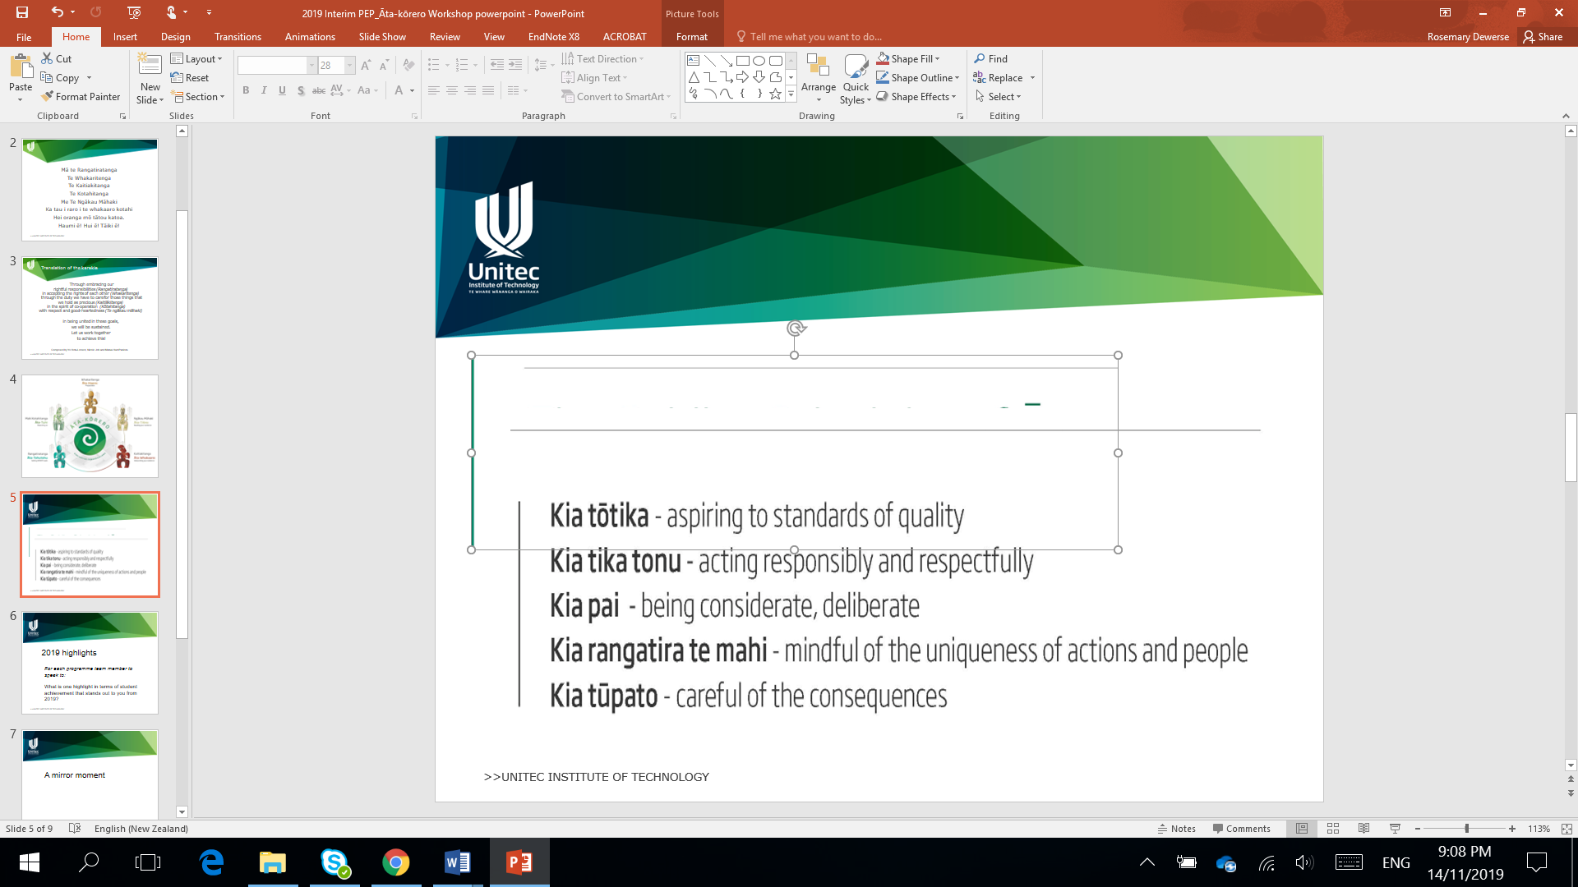
Āta-kōrero
2020 Interim PEP

Slide 2
Mā te Rangatiratanga
Te Whakaritenga
Te Kaitiakitanga
Te Kotahitanga
Me Te Ngākau Māhaki
Ka tau i raro i te whakaaro kotahi
Hei oranga mō tātou katoa.
Haumi ē! Hui ē! Tāiki ē!
Karakia tīmatanga

Slide 3
Through embracing our rightful responsibilities (Rangatiratanga) ​
in accepting the rights of each other (Whakaritenga) ​
through the duty we have to care for those things that we hold as precious (Kaitiākitanga) ​
in the spirit of co-operation (Kōtahitanga) ​
with respect and good-heartedness (Te ngākau māhaki) ​
​
in being united in these goals, ​
we will be sustained. ​
Let us work together ​
to achieve this!
Composed and translated by Yo Heta-Lensen, Nicole Job and Matua Hare Paniora

Slide 4
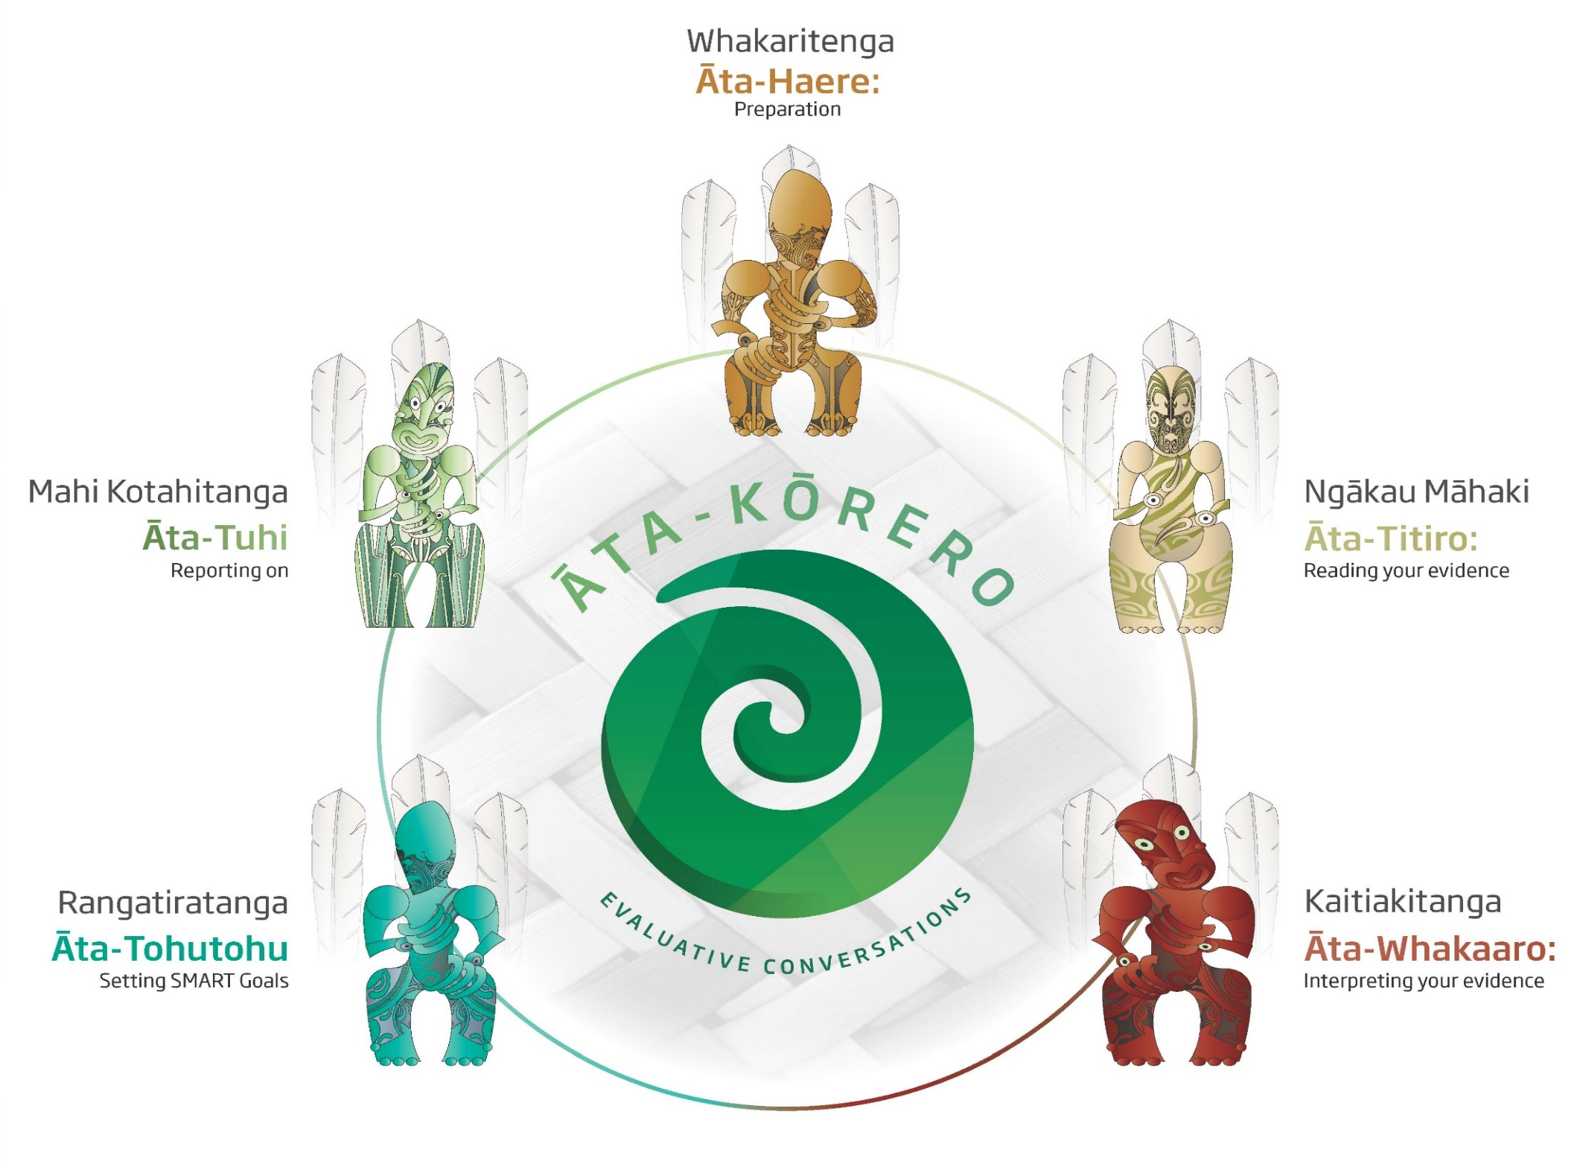

Slide 5
Guiding principles
Take pū
Kia tōtika aspiring to standards of quality
Kia tika tonu acting respectfully and responsibly
Kia pai being considerate and deliberate
Kia rangatira te mahi mindful of the uniqueness of actions and people
Kia tūpato careful of the consequences

Slide 6
2020 Interim PEP: 5 focus areas
1 Successful Course Completion (SCC)
2 Graduate outcomes
3 Implementation of various actions relating to the various strategies and related plans (e.g., the “I see me” initiatives)
4 Impact and support relating to Covid19, the campus lockdown and the shift to online learning
5 Progress against SMART goals set in previous PEP
Note: The most informative conversations will happen around Areas 2, 3 and 4. Focus area 1 reporting can be enriched by reflecting on these conversations.

Slide 7
Focus Area 3: How effective were the implementation of 2020 Semester 1 priority group strategies, plans and actions in supporting students?
Consider:
Student transition including orientation, pōwhiri, whanau fanau evenings, tuākana mentoring, etc.
Low stakes assessments
Learner Outreach Project
Embedding of Māori & Pacific pedagogies in courses
International students
Participation in relevant badges
Impact of previous SMART goals/New SMART goals

Slide 8
Focus Area 4: How effective was the programme response to the impact of COVID-19 in supporting teaching and learning?
Consider:
Changes to course delivery/assessments
Strategies to support priority learners during lockdown
Support for staff during remote teaching
Strategies for communication with students during lockdown
Strategies to ensure quality of learning and teaching & rigour in assessments
Impact of previous SMART goals/New SMART goals

Slide 9
Focus Area 1: How well did students achieve in Semester 1, 2020?
Consider:
Reflect on your conversations about focus areas 3 &4, draw insight into your Focus Area 1 data for:
Priority groups (Māori, Pacific, Under 25s and International)
Overall result for all students
Performance of courses
Impact of previous SMART goals/New SMART goals

Slide 10
Focus Area 2: What is the value of outcomes for students, who graduated in 2019?
Consider:
What do you know about:
Where graduates are employed or studying in 2020?
The value of the qualification to graduates?
The relevance of the of the qualification to employment?
The extent GPOs were met in the graduates opinion?
Impact of previous SMART goals/New SMART goals

Slide 11
Focus Area 5: How well have previous PEP SMART goals progressed, to support educational achievement?
Consider:
2019 EoY PEP SMART goals:
Are they on target for completion
If they have changed has this been documented
Has the impact of the goals been addressed in Focus Area 1, 2, 3 and 4?
New 2020 Interim PEP goals
Have actions from the 2020 Interim PEP evaluative conversations been written as SMART goals
Has the impact of
Where graduates are employed or studying in 2020?
The value of the qualification to graduates?
The relevance of the of the qualification to employment?
The extent GPOs were met in the graduates opinion?

Slide 12
Next steps
Who will be writing the Interim PEP?
15 Aug – 31 Aug PAQC evaluation of interim PEP reports
31 Aug Deadline for submission of PEP reports to qab@unitec.ac.nz
1-15 Sep Evaluation of process and outcomes of Interim PEP cycle

Slide 13
Ka wehe atu tātou
I raro i te rangimārie
te harikoa, me te manawanui
Haumi ē! Hui ē! Tāiki ē!
Karakia whakamutunga

