Slide 1
Interim PEP
Semester 1
2020
Writer’s Briefing
15 July 2020
Te Korowai Kahurangi

Slide 2
Karakia Timatanga
Manawa mai te mauri nuku
Manawa mai te mauri rangi
Ko te mauri kai au
he mauri tipua
Ka pakaru mai te pō
Tau mai te mauri
Haumi e, hui e, taiki e!

Slide 3
Kaupapa
Background of the Interim PEP
What’s new? Why?
Introducing the new interim PEP template
The five focus areas, discussion, examples and questions for each including:
  Using Sem 1 CEP
  Sem 2 CEP use
Where to from here?
  Āta kōrero timing
Further support?
Feedback

Slide 4
Rationale for the Interim PEP
Self-assessment is good practice and is supported by our Te Noho Kotahitanga principles supported by Academic Board.
Internal self-assessment of the 2019 PEP process indicated
good Āta kōrero
evaluative writing support could be improved
Internal Evaluation and Review (IER) feedback:
  strengthen the use of rubrics
  benchmark against previous years, school targets and across sector
  judge more reliably, "What is “Excellent”, “Good”, Marginal” and “Poor”?

Slide 5
Relationship to Academic Board
Over-riding Policy: Academic Evaluation, Review, and improvements policy
Academic Board sub-committee Quality Alignment Board on the 20 May approved the Interim PEPs approach in principle pending discussion on resourcing with HoS
Director – Ako and Executive Director – Schools and Performance and Manager Te Korowai Kahurangi
Heads of Schools

Slide 6
Five focus areas
Successful Course Completion (SCC)
Graduate outcomes
Implementation of various actions relating to the various strategies and related plans (e.g., the “I see me” initiatives)
Impact and support relating to Covid19, the campus lockdown and the shift to online learning
Progress against smart goals set in previous PEP
See Appendix A for FINE PRINT

Slide 7
Which programmes?
All programmes and training schemes excluding those:
expiring due to 2018 Suspension of programmes
expiring due to MRoQ
This equates to 74 programmes or training schemes.
List of Programmes, Schools, APMs and AAQs are on the nest.
Home » Teaching and Research » Te Korowai Kahurangi – Academic Quality » Evaluation, Monitoring and Review » Programme Evaluation and Planning (PEP)

Slide 8
What’s new? Processes
More autonomy for Schools and programmes to own their Āta kōrero and process:
Leading Āta kōrero: Evaluative conversations (APM or Programme Co-ordinator or other)
Logistics – fit in with your academic meetings
Facilitation and note-taking
Fit in with your sub-culture
Business as usual processes:
Writing interim PEP
Submisison to PAQC and QAB
PAQC self-assessment of interim PEP
Review of PEPs by review team

Slide 9
What’s new? Documentation
Pre-population of more parts of the template where possible
Better educational performance rubrics to improve judgements
Some pre-written text
Provision of exemplar for writers' to benchmark their writing
Better self-assessment rubrics of how PEPs will be evaluated

Slide 10
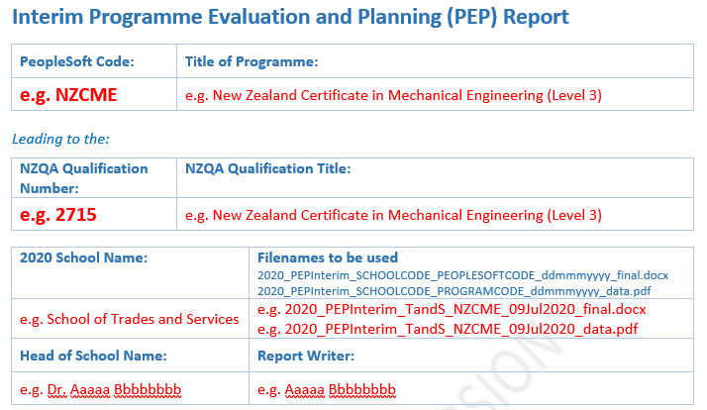
Pre-population

Slide 11
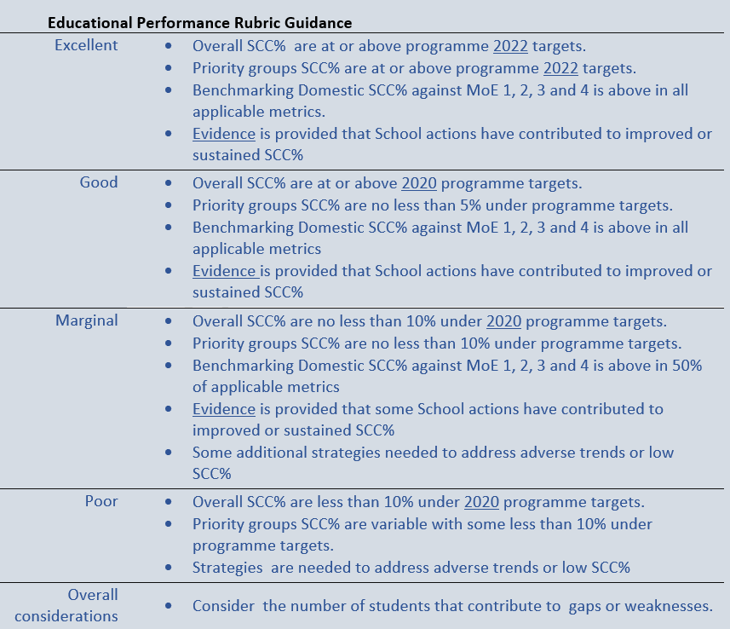
Embedded Educational Performance Rubrics (5)
Example: Focus Area 1

Slide 12
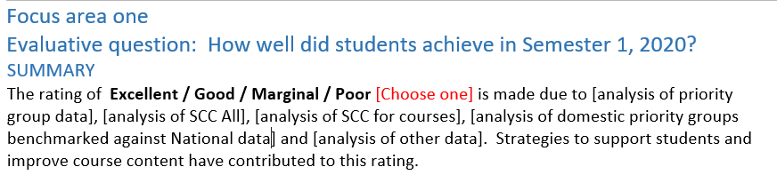
Embedded Pre-written text

Slide 13
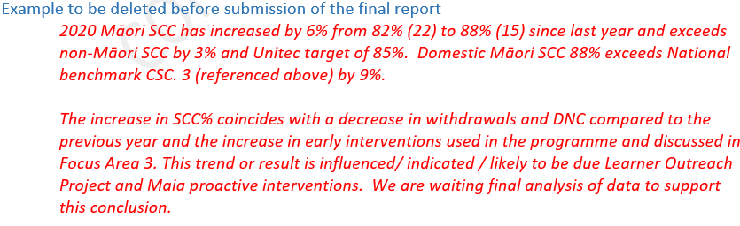
Embedded examples of evaluative writing

Slide 14
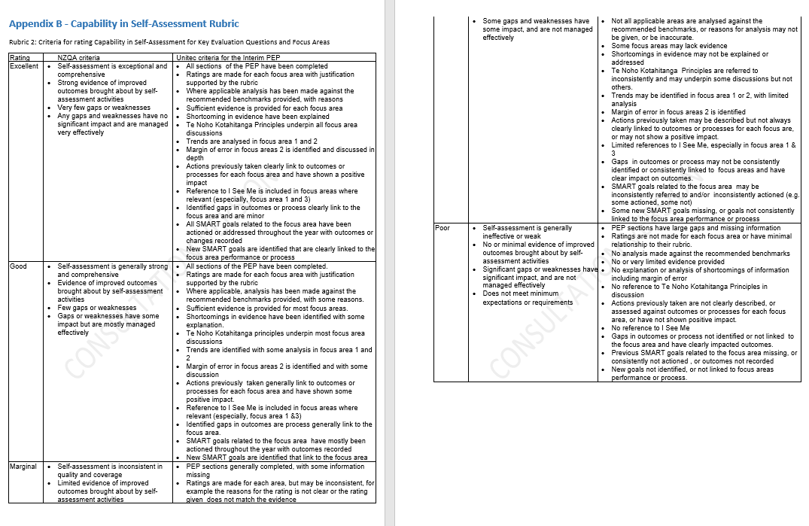
How will your writing be evaluated?

Slide 15
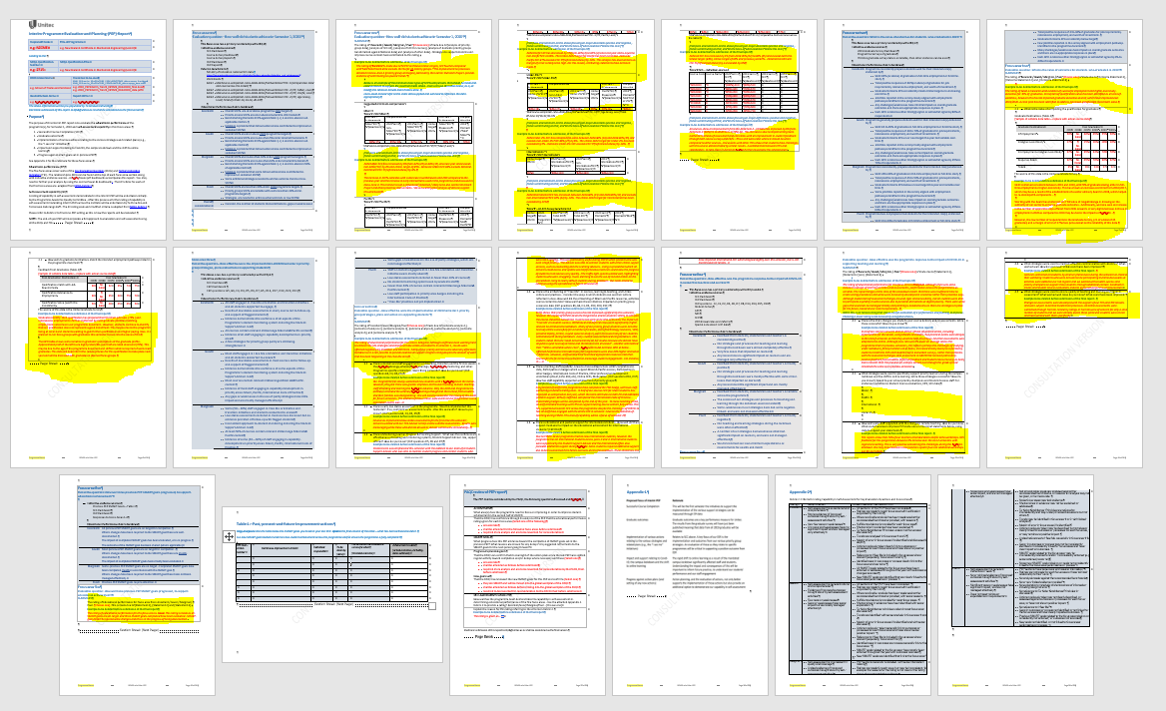
Big picture of the template?

Slide 16
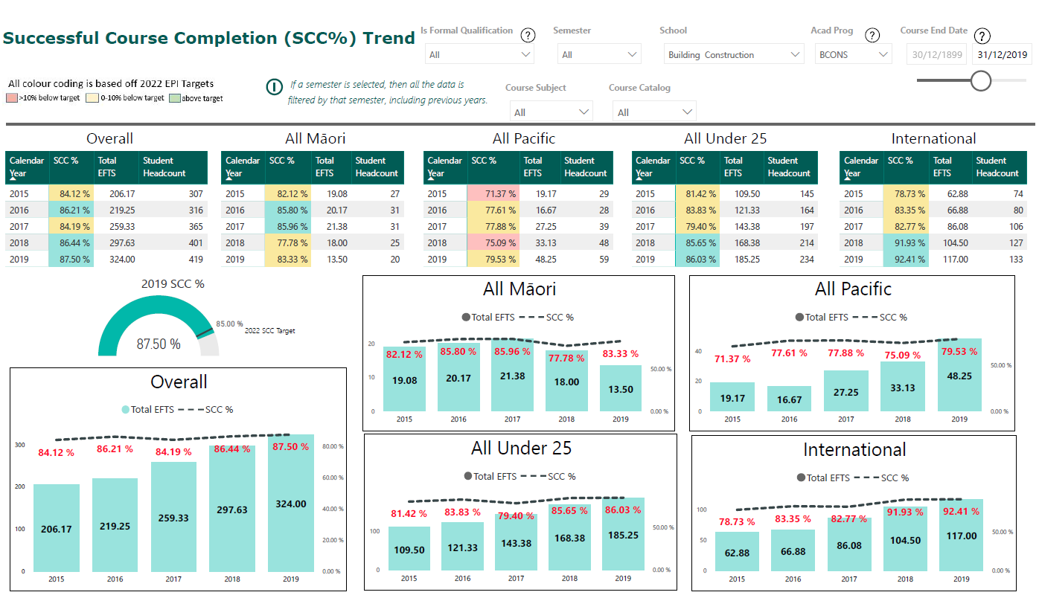
SCC Dashboard

Slide 17
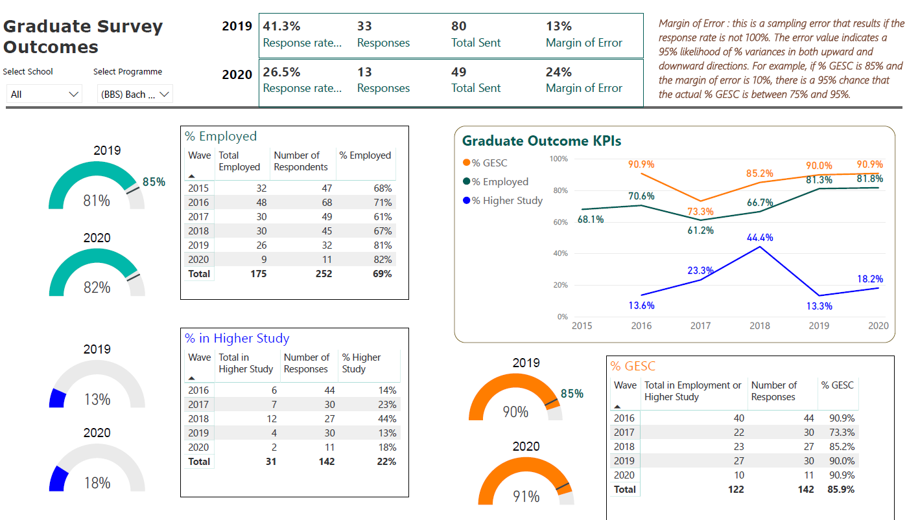
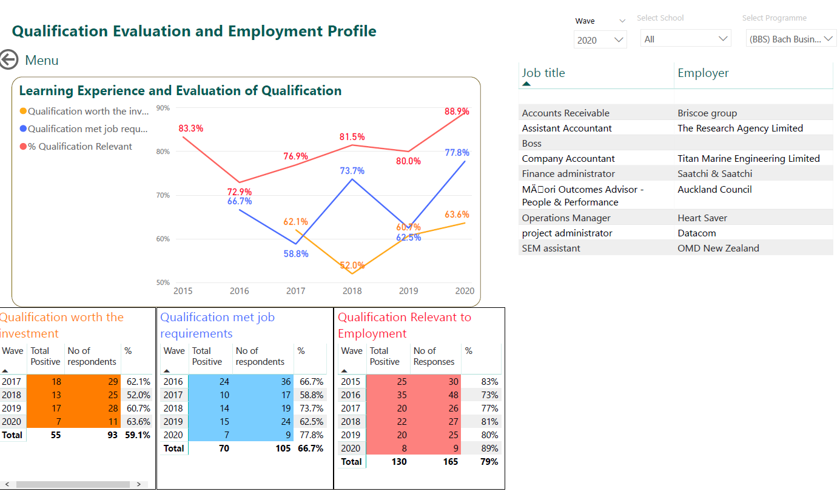
Graduate Outcomes Survey Dashboard pdf

Slide 18
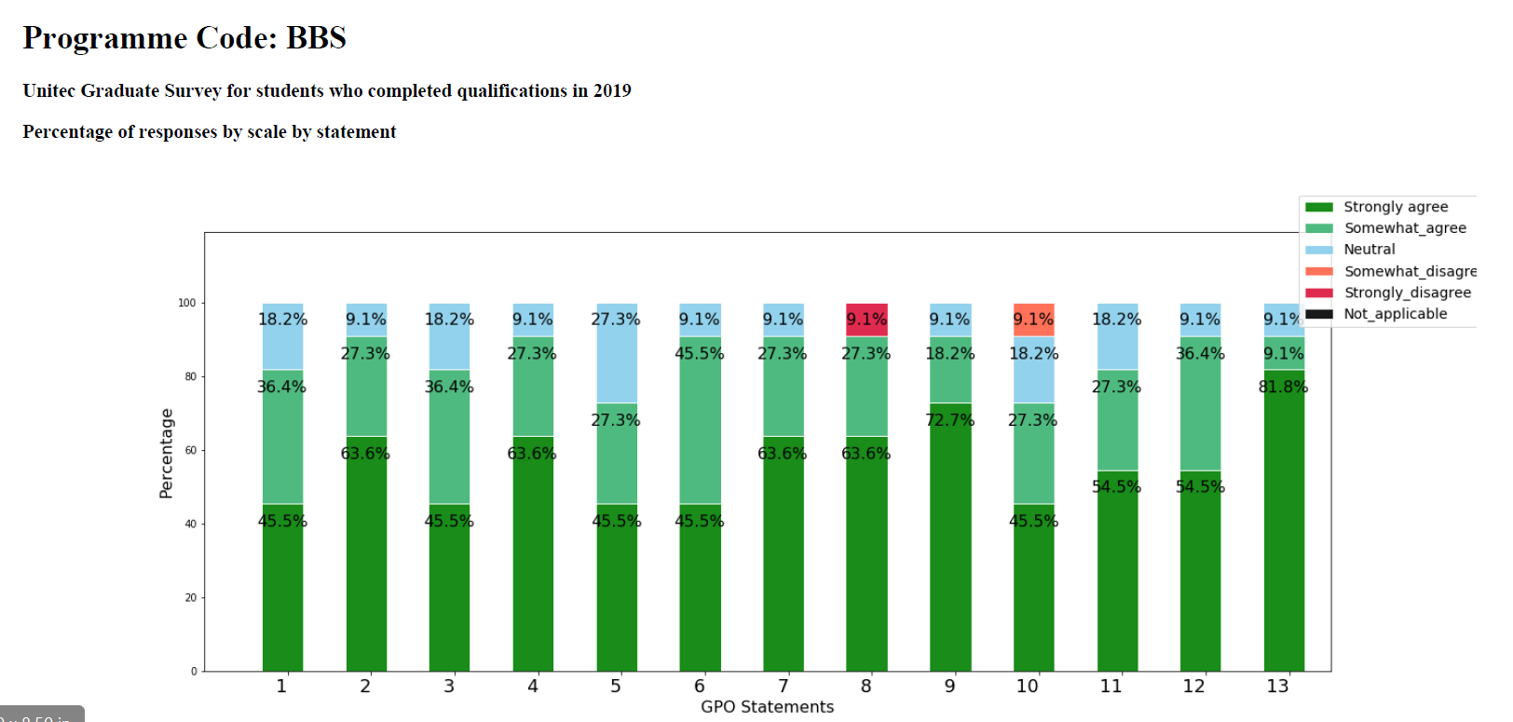
SCC Data Dashboard GPO statements pdf

Slide 19
Focus on writing skills 1
In groups of xx take 3 minutes and analyse the data. Note this data is in a table however it could just as easily be in PowerBI dashboard.
Report back to the group.
Discussion Points.

Slide 20
Focus on writing skills - example
2020 Māori SCC has increased by 6% from 82% (22) to 88% (15) since last year and exceeds non-Māori SCC by 3% and Unitec target of 85%. Domestic Māori SCC 88% exceeds National benchmark CSC. 3 (referenced above) by 9%.
The increase in SCC% coincides with a decrease in withdrawals and DNC compared to the previous year and the increase in early interventions used in the programme and discussed in Focus Area 3. This trend or result is influenced/ indicated / likely to be due Learner Outreach Project and Maia proactive interventions. We are waiting final analysis of data to support this conclusion.

Slide 21
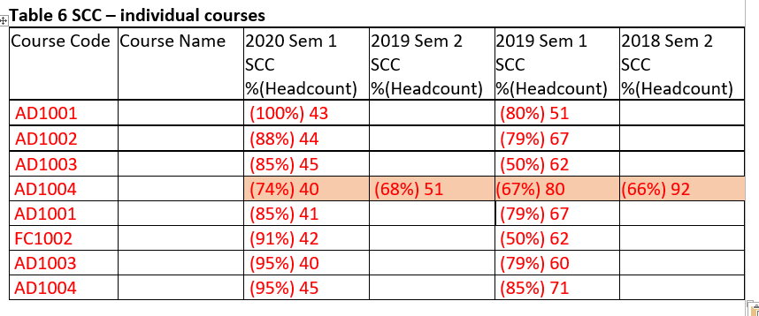
Focus on writing skills 2
In groups of xx take 3 minutes and analyse the 2020 Sem 1 and 2019 Sem 1. Note this data is in a table however it could just as easily be in PowerBI dashboard.
Report back to the group.
Discussion Points.

Slide 22
Focus on writing skills - example
All courses show an improvement from the 2019 Sem 2. AD1004 has improved by 7% to (74%) 40) from a trendless average over the previous three semesters of 67% (2019 Sem 2 (68%) 51, 2019 (Sem1 (67%) 80, 2018 Sem 2(66%) 92.
This increase correlates with the implementing of more authentic methods of assessment and correlates with an improvement in student feedback on assessment through both course surveys and CEPs. This SCC% is below where it should be when compared to other courses. Discussions with other ITPs shows that students have challenges with this course demonstrated by similar results. A collaboration between ITPs and stakeholders to take place in dd mmm yyyy to further investigate this phenomenon.

Slide 23
Focus on writing skills - Example
Ministry of Education national Course Completion Rate data SCC data
Worksheets:
CSC.3 Course completion rates for domestic students by sub-sector, ethnic group, and qualification type/NZQF level for courses that ended in 2019 (Comparative Field and Level across the nation)
CSC.6 Course completion rates for domestic students by field of study and qualification type/NZQF level for courses that ended in 2019

Slide 24
Main changes – Capability Development
Capability development improvements and new initiatives include:
Pre-Āta kōrero briefing session for APMs/Programme co-ordinators/Facilitators/Note-takers
Go-to Te Korowai Kahurangi/Te Puna Ako partner for each School
Home » Teaching and Research » Te Korowai Kahurangi – Academic Quality » Evaluation, Monitoring and Review » Programme Evaluation and Planning (PEP)
PAQC development session focussing on self-assessing interim PEPs

Slide 25

Your go-to person as at 15 July

Slide 26
Broad Timelines
24 June Course survey results published
28 June End of (standard) semester 1
29 June – 12 July Grade processing and CEP
15 July to 9 August Request your Interim PEP template and data
dashboard from tkkinsights@unitec.ac.nz
13 July – 14 August Āta-kōrero evaluative conversations
15 August – 31 August PAQC evaluation of interim PEP reports
31 August Deadline for submission of reports to qab@unitec.ac.nz
1-15 September Evaluation of process and outcomes of Interim PEP cycle
The Te Poari Whai Kounga (QAB) support flexibility for courses and programmes with late end dates and subsequent processing of grades.
QAB Meeting Minutes 2020-05-20

Slide 27
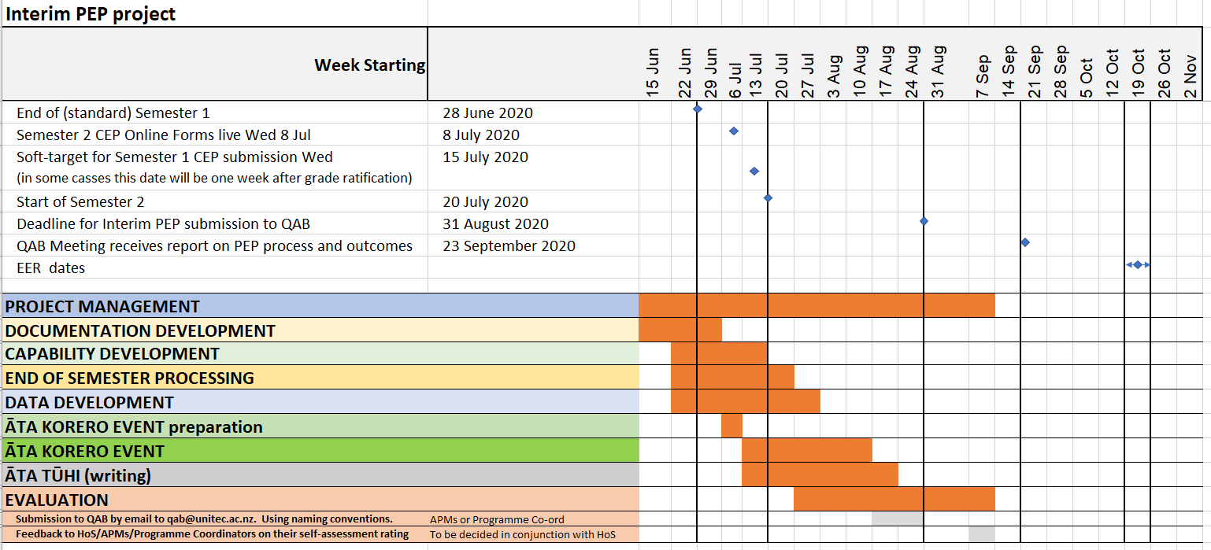
Timeline - 2020 Interim PEP Gannt Chart

Slide 28
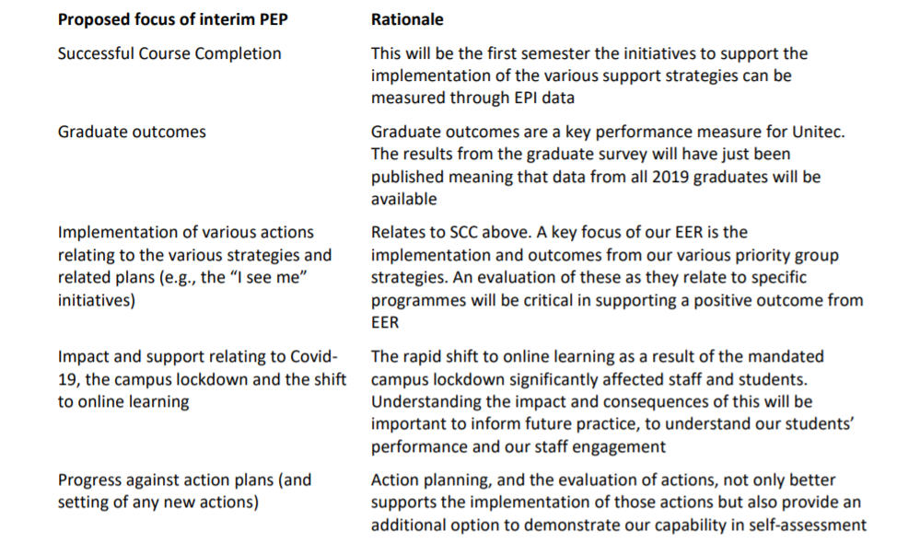
Appendix A

Slide 29
2020 Interim PEP
Ngā pātai
Questions about the content of this presentation can be directed to Eric Stone, Quality Partner Te Korowai Kahurangi

Slide 30
Karakia Whakamutunga
Ka wehe atu tātou
I raro i te rangimārie
Te harikoa
Me te manawanui
Haumi ē! Hui ē! Taiki ē!

