Slide 1
Coronavirus Hygiene Instructions
For Unitec Learners and Staff
Notes:
Step by step process:
Presenter is to click Enable content.
Click the slideshow icon below bottom right of the screen
Run the presentation slide by slide click on the video for it to start ( requires an internet connection)

Slide 2
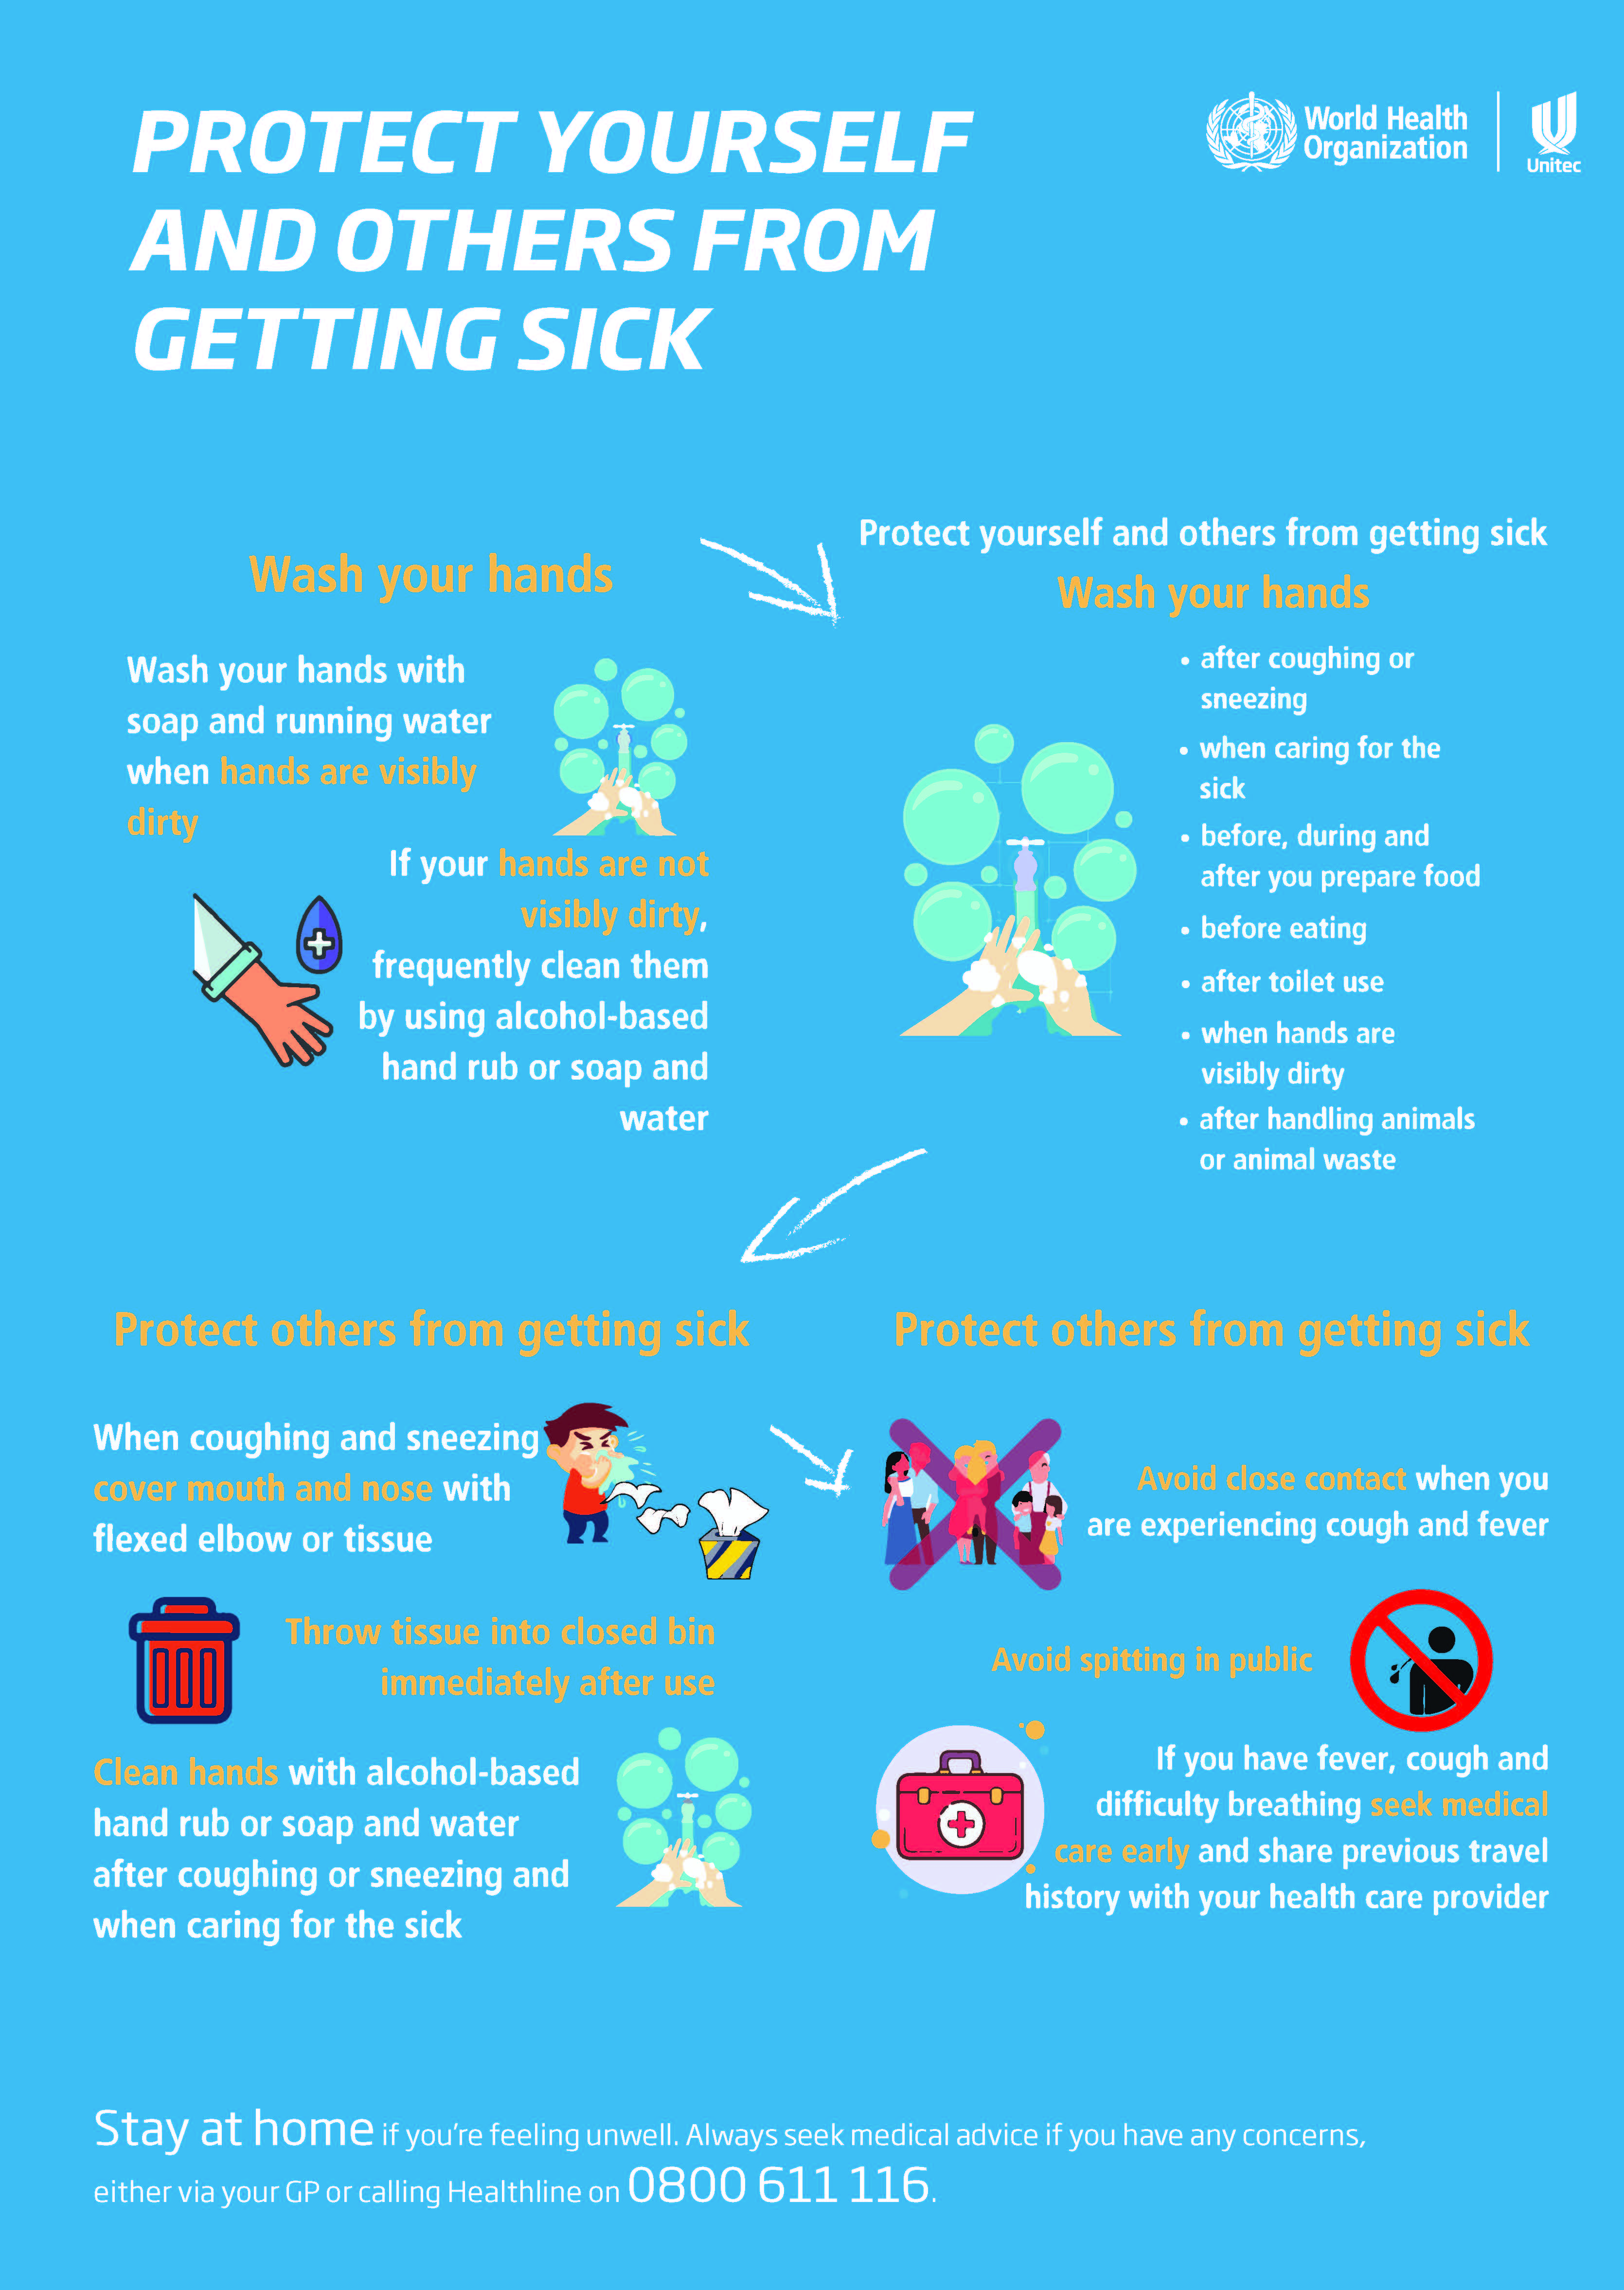
Notes:
To achieve a new layout – insert a new slide, then in the slide thumbnail left side view, Right Click, choose layout – and pick a content style to use

Slide 3

No Spitting

Slide 4

World Health Organization
Recommendations
Next slide

Slide 5
Handwashing with soap and water
Click on CC to add subtitles
Next slide

Slide 6

Print and use these 4 posters
https://www.who.int/images/default-source/health-topics/coronavirus/social-media-squares/blue-1.png

Slide 7
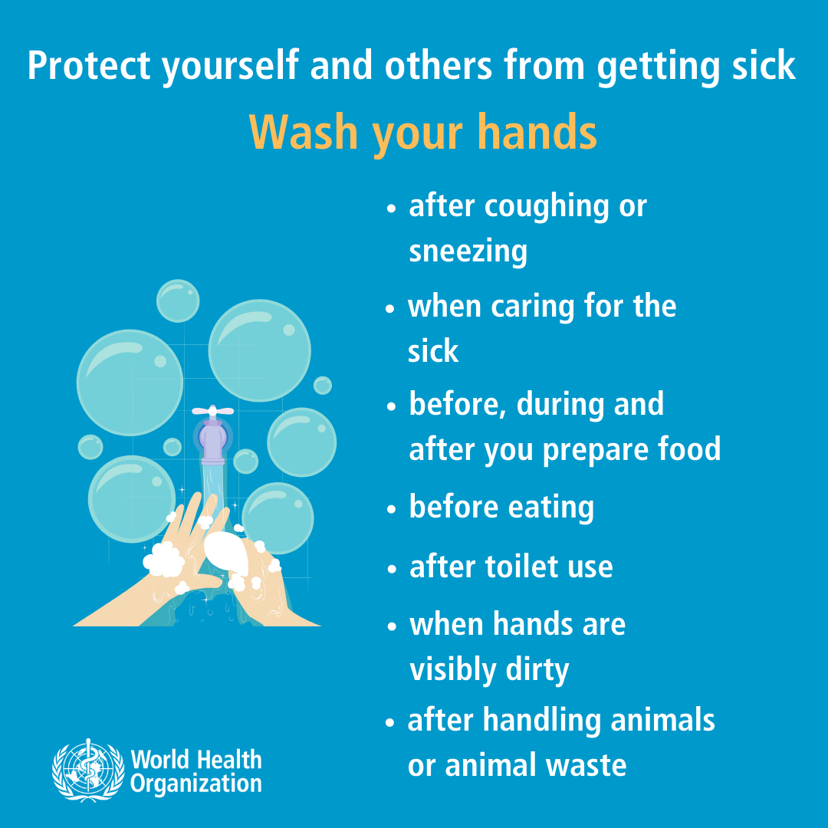
Print and use these 4 posters
https://www.who.int/images/default-source/health-topics/coronavirus/social-media-squares/blue-2.png

Slide 8
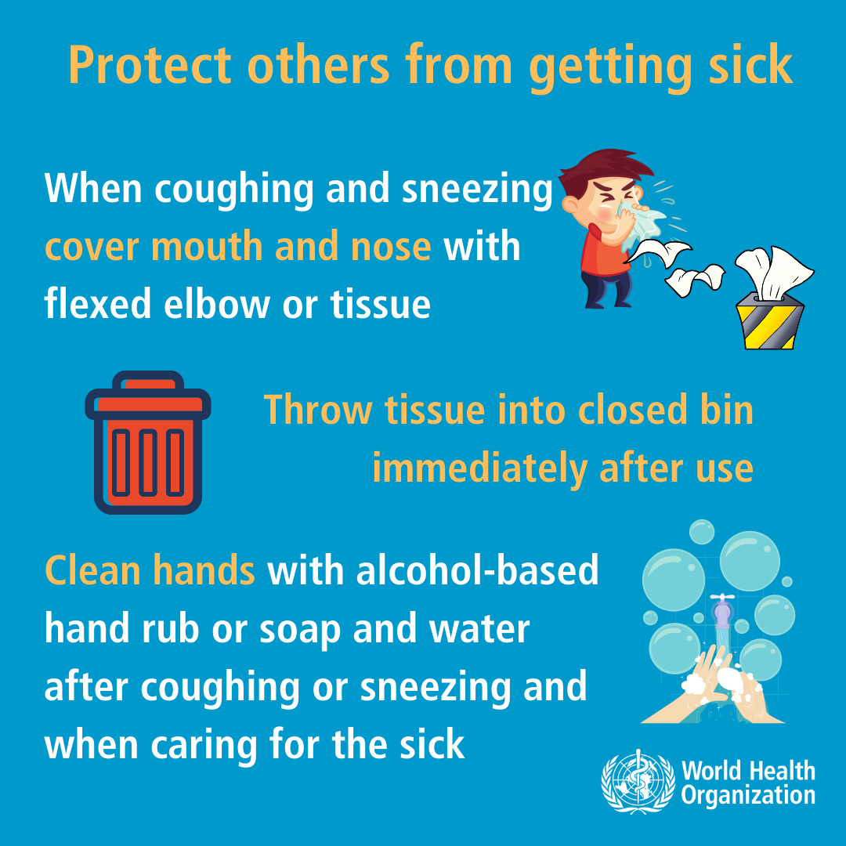
Print and use these 4 posters
https://www.who.int/images/default-source/health-topics/coronavirus/social-media-squares/blue-3.png

Slide 9
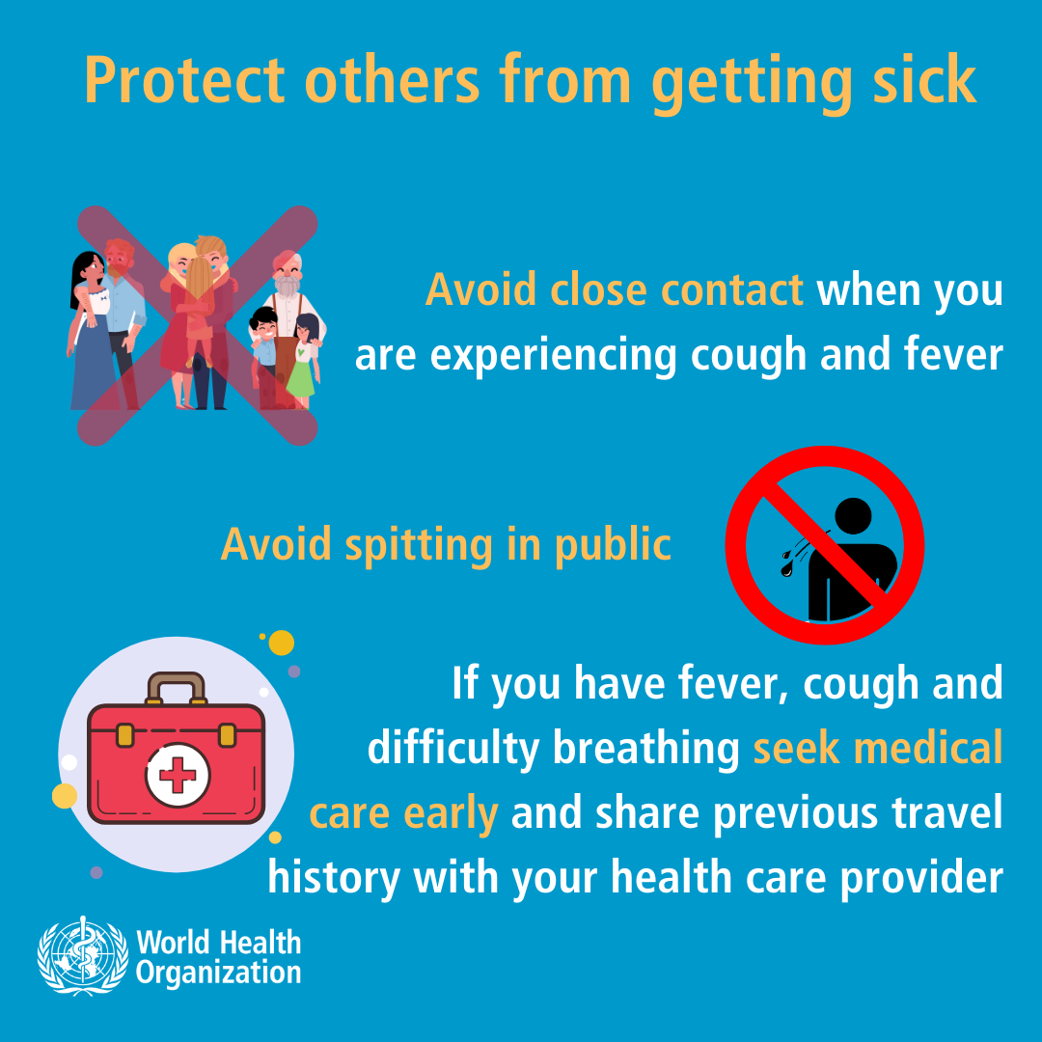
Print and use these 4 posters
https://www.who.int/images/default-source/health-topics/coronavirus/social-media-squares/blue-4.png

Slide 10
Contacts
Healthline - 0800 358 5453
Student Health Centre (Te Puna Waiora) - 0800 10 85 10
Ministry of Health website for the latest updates.
https://www.health.govt.nz/our-work/diseases-and-conditions/novel-coronavirus-2019-ncov#status

