Slide 1
Graduate Surveys
Institutional Summary
2015-2019
Te Korowai Kahurangi
August 2019
Notes:
Use title slide layout

Slide 2
Graduate Survey Overview
Unitec’s Graduate Surveys are carried out to provide a robust and consistent approach to measuring graduate outcomes, programme success and graduate satisfaction. Graduate surveys are monitored and audited to ensure reporting is done in a statistically fair manner.
Graduate surveys are sent out for completion online twice a year, in April and September to capture all the graduates graduating either in the middle or the end of the year. The survey aims to collect data about graduates’ employment or study status, further study plans, current job information and satisfaction with their learning experiences in Unitec. For larger programmes, graduates were also asked to comment on the expected Graduate Programme Outcomes (GPO) as outlined in the NZQA website.
Reporting is delivered at three levels:
Institutional Summary Report - Analysis and reporting of performance at institutional and school level based on 2019 Graduate Survey results; trend analysis based on 2015-2019 combined survey results.
Graduate Survey Dashboard - Interactive dashboard which allows you to filter data by school, programme, course, class, priority group and year. Located in the Institutional Reports App of Power BI Link
School Reports - Graduate KPIs and ratings and verbatim feedback.
This Institutional Summary Report provides analysis into the overall results for the past five years with suggested improvements:
Overall Graduate KPIs
  % Graduate Employed, Studying or Combined (GESC)
  % Employed
  % Further Study
  % Qualification relevant to Employment
Satisfaction with Unitec
  Likelihood of recommending Unitec (using the Net Promoter Score ratings)
  Qualification being worth the investment
  Qualification meeting the main job requirement
Ratings of learning experiences and skills acquired
Notes:
Explain Cohort timeframes
Outline EPI measures

Slide 3

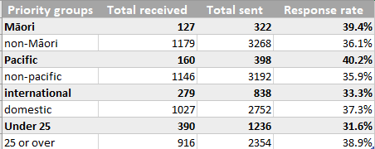
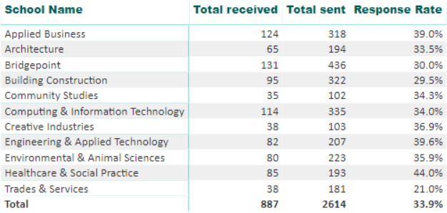
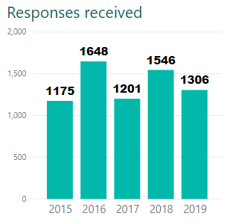
2019 Sample size and Response rate
Surveys for 2018 graduates were sent out in Sept 2018 and Apr 2019. Slightly over one-third of the sample responded, amounting to 36.8% in response rate.
For Māori and Pacific students, the response rates were higher than the Unitec average, but for international and Under 25 priority groups, the response rates were below average.
Healthcare & Social Practice led the other schools in response rate, standing at 44%, and Trades & Services had the lowest at 21%.

Slide 4
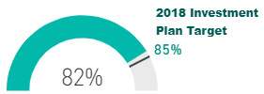
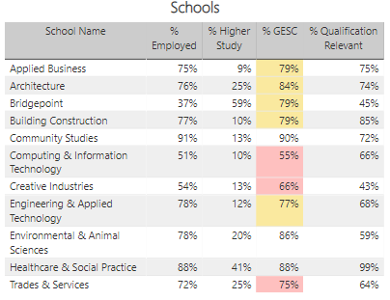
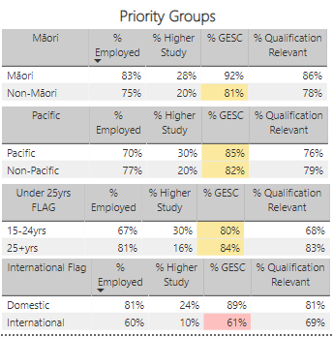

2019 Graduate KPIs
Investment target not met: The overall % Graduates Employed, Studying or Combined (GESC) stood at 82%, failing to meet the Investment Plan Target of 85%. Community Studies, Health & Social Practice and Environmental & Animal Sciences successfully met the target at 90%, 88% and 86% respectively. Well below are Computing & Information Technology (55%), Creative Industries (66%) and Trades & Services (75%).
……………………………………………………………………………………..…..
% GESC
Impressive performers are Community Studies with a 91% employment rate and Healthcare & Social Practice peaking at 99% in % Qualification Relevant to Employment and landing the highest % Higher Study at 41%. Bridgepoint was the strongest in % Higher Study but weakest in % Employed at 37% because its programmes focus on achieving the former.
Weak performers: The lowest % Qualification Relevant to Employment came from Creative Industries at 43%; School-collated evidence indicates graduates can take 3-5 years to obtain employment relevant to their studies. Computing & Information Technology had unexpectedly low % Qualification Relevant to Employment at 66% and in % Employed at 51% despite a robust IT job market*. Similarly, Trades & Services did not do well in % Qualification Relevant to Employment at 64% which may not be representative as it had the lowest response rate of 21%. Graduate feedback from different schools focused on the need for internships to increase job opportunities.
Priority groups: Māori and domestic students attained above target rates in % GESC at 92% and 89% respectively; international students fared the worst at only 61%. Comments from international students indicated a lack of support for finding jobs.
*Job market tougher for some, but IT stars in pole position https://www.stuff.co.nz/business/112141773/job-market-tougher-for-some-but-it-stars-in-pole-position
Notes:
Explain Cohort timeframes
Outline EPI measures

Slide 5
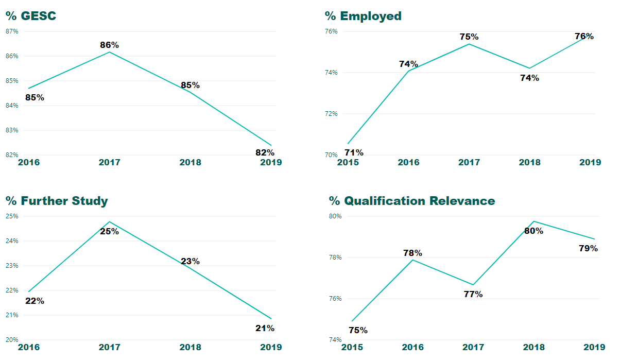
Graduate KPIs over time
Trend:
% GESC showed a decreasing trend from 86% in 2017 onwards to 82% in 2019, reflecting a similar pattern in % Further Study which reached 25% in 2017 and then declined to 21% in 2019.
% Employed showed a slightly rising trend from 71% in 2015 to 76% in 2019, despite a slight dip in 2018.
% Qualification Relevance to Employment fluctuated over the years, but slowly climbing up from 75% in 2015 to 79% in 2019.

Slide 6
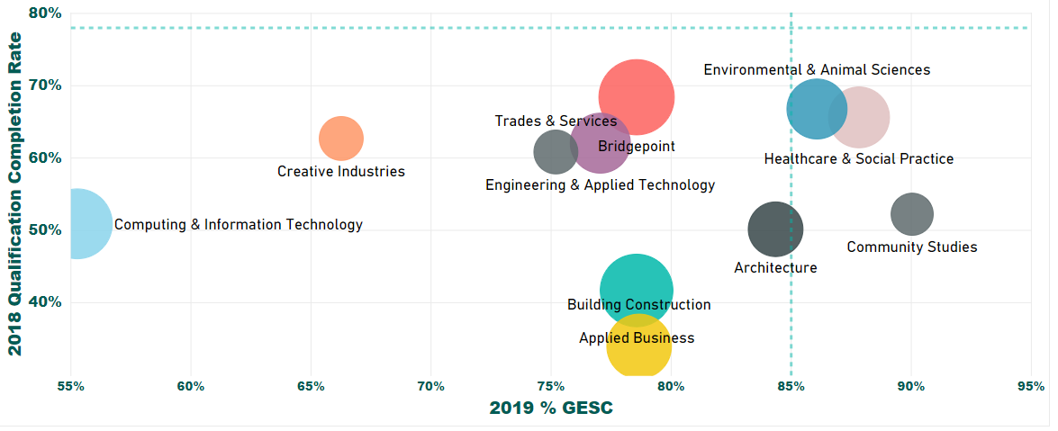
% GESC vs Qualification Completion Rate
2019 % GESC vs 2018 Qualification Completion Rate
There is no identifiable relationship between the 2 measures. Hence a high qualification completion rate as an achievement for a school does not suggest employment success. Separate strategies to improve both KPIs may be needed.
Despite this, high performers can easily be identified. Environmental & Animal Sciences and Healthcare & Social Practice had high rates on both measures.
Computing & Information Technology is a low performer on both measures.
Size of the circle indicates the number of respondents

Slide 7
Performance by school
% GESC
% Employed
School | 2016 | 2017 | 2018 | 2019 | 4-year trend
Applied Business | 82% | 83% | 85% | 79% | -3%
Architecture | 89% | 81% | 81% | 84% | -5%
Bridgepoint | 77% | 84% | 78% | 79% | 2%
Building Construction | 92% | 92% | 78% | 79% | -13%
Community Studies | 94% | 86% | 94% | 90% | -4%
Computing & Information Technology | 68% | 70% | 61% | 55% | -13%
Creative Industries | 77% | 80% | 75% | 66% | -11%
Engineering & Applied Technology | 90% | 87% | 78% | 77% | -13%
Environmental & Animal Sciences | 81% | 92% | 87% | 86% | 5%
Healthcare & Social Practice | 85% | 86% | 92% | 88% | 3%
Trades & Services | 89% | 83% | 86% | 75% | -14%
School | 2015 | 2016 | 2017 | 2018 | 2019 | 4-year trend
Applied Business | 72% | 72% | 75% | 71% | 75% | 3%
Architecture | 78% | 74% | 64% | 66% | 76% | -2%
Bridgepoint | 43% | 43% | 45% | 40% | 37% | -6%
Building Construction | 81% | 91% | 90% | 74% | 77% | -4%
Community Studies | 82% | 79% | 74% | 79% | 91% | 9%
Computing & Information Technology | 72% | 62% | 63% | 55% | 51% | -21%
Creative Industries | 71% | 70% | 65% | 59% | 54% | -17%
Engineering & Applied Technology | 78% | 75% | 78% | 78% | 78% | 0%
Environmental & Animal Sciences | 71% | 77% | 76% | 72% | 78% | 7%
Healthcare & Social Practice | 81% | 77% | 82% | 91% | 88% | 7%
Trades & Services | 69% | 78% | 68% | 80% | 72% | 3%
Low performers
In terms of % Employed, Computing & Information Technology experienced a sharp decrease of 21% from 72% in 2015 to 51% in 2019, thereby driving down its % GESC by 13%. Graduate feedback focused on existing learning gaps in the rapidly changing job environment.
“My expectations were more higher. Now I am working so hard on receiving Microsoft certification as Unitec just gave me 20 percent of what I should know. I am doing a lots of self study. Unitec should have more courses for front end developers and mobile developers”.
“Unitec should improve more courses, which are related to improvement industry’
In terms of % GESC, Building Construction went down from 92% for 2 consecutive years to only 78% in 2018 and 79% in 2019. External factors (a shrinking property market) may have an effect. Graduate comments were generally around teaching and job preparation.
“Losing the quality of teaching by losing the experienced lecturers”
“There needs to be more industry involvement, site visits, guest lectures by industry professionals.”
High performers
Healthcare & Social Practice was a high performer with increases in both measures.
Community Studies stayed strong in the 4-year period.
For both schools, graduate feedback was about having environmental support, flexible learning experience, highly relevant course content and good teachers.

Slide 8
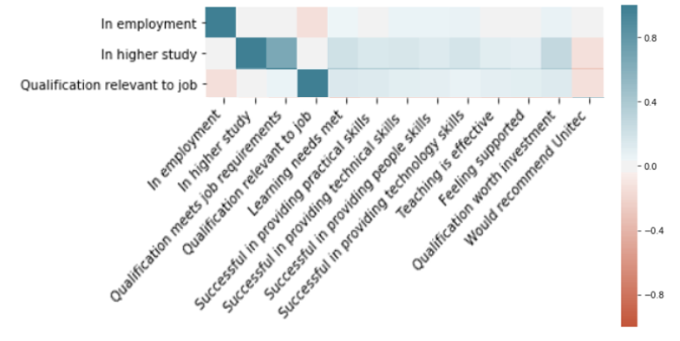
Correlations between KPIs and other questions
Correlation analysis:
Correlation analysis of 2015-2019 data reveals little relationship between employment status and all other questions in the survey (including the question asking if qualification met main job requirements).
The same is true of Qualification Relevance to Employment which has no relationship with all other questions in the survey.
Since there are no correlations, improving learning experiences and skills acquired will not lift KPIs. Effort should instead be directed at employment help for graduates.
There is a slightly positive relationship of 0.66 between further study and qualification meeting job requirements, suggesting further study is motivated by job considerations.
Graduate feedback for improvements in 2019 Graduate Survey:
Factors affecting the employment rate may be due to external factors like the job market. For those that Unitec can have control over, some recurring themes found in the graduate comments are listed below:
Industry placements – internship in the “real world work place” as part of programme
Greater relevance to real jobs; less focus on theoretical knowledge
Understanding the correlation heatmap:
The heatmap (on the left) displays the correlation values between answers to the relevant questions (along X and Y axes).
The deeper the colour, the higher the correlations.
Red indicates a negative relationship and Green a positive relationship.
Correlation values are shown only when they are above 0.5 (as statistically significant).
0.66

Slide 9
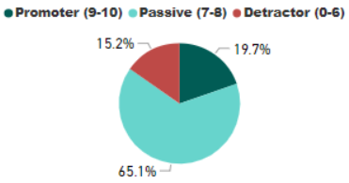
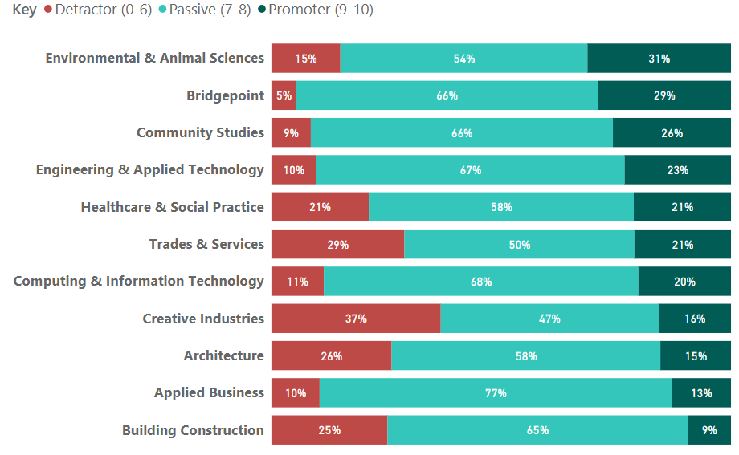
2019 Net Promoter Score (NPS) Ratings
Graduates were asked if they would recommend Unitec to others and had to give a rating of 0-10. This is called a Net Promoter Score (NPS) rating. NPS ratings measure a graduate’s satisfaction with studying in Unitec.
Based on the NPS ratings given, graduates are classified into 3 groups:
Promoters: those who gave a rating of 9-10
Passive: those who gave a rating of 7-8
Detractors: those who gave a rating of 0-6.
2019 NPS ratings and associated comments
Overall, 84.8% of respondents gave a rating of 7 or above.
Comments were highly positive for those who gave a rating of 7 or above.
Top performers
Bridgepoint led other schools with 95% of its respondents being promoters.
Community Studies came second at 91%, followed by Engineering & Applied Technology at 90%.
Low performer
Creative Industries had the largest percentage of respondents (37%) giving ratings of 0-6. The School also had the lowest % Qualification Relevance to Employment. However, there was no evidence the two were related as few graduates commented on the relevance aspect.

Slide 10
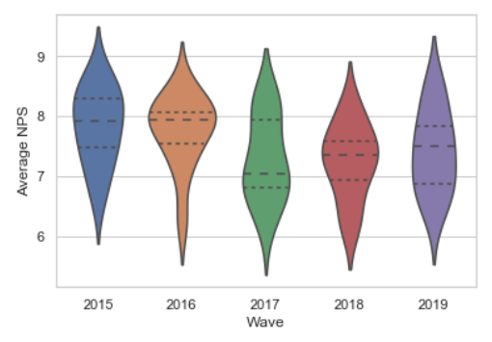
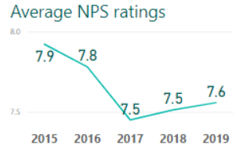
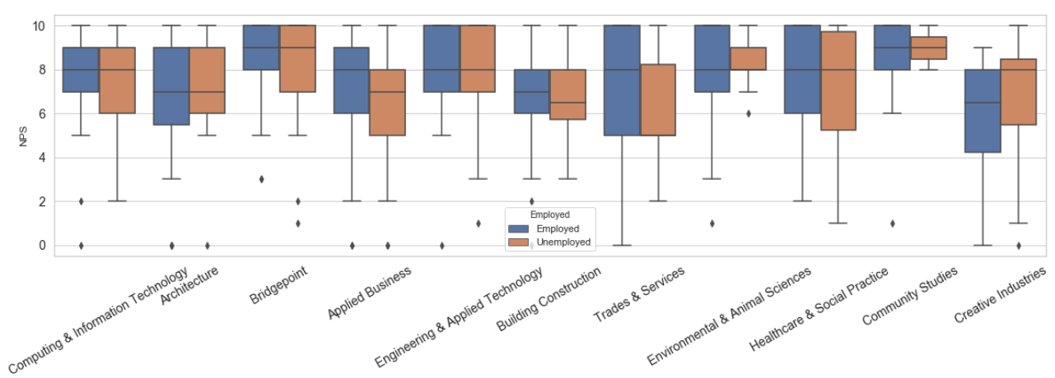
Average NPS Ratings over time
25% of the respondents choose a value above this line.
The bar chart (left) shows the distribution of the ratings given by respondents. The widest part of each bar shows the most frequently occurring rating for the corresponding year.
Ideally, the widest part should appear near the top of the bar chart with most respondents giving high ratings. 2016 is the year with the best distribution of ratings (wide near top, narrow near bottom) and 2017 the worst. In 2019, the ratings are more evenly spread, but with an unhealthy downward distribution pattern.
The median – most respondents choose this value (scaled)
Unitec witnessed a drop in average NPS ratings, from a high of 7.9 in 2015 to 7.5 in 2017, then edged up slightly to 7.6 in 2019.
25% of the respondents choose a value below this line.
Employment status irrelevant to ratings given for schools – there is no significant difference in the average NPS (2015-19) given to schools by students who were employed and those who were not (except for Creative Industries). Hence, other factors contributed to the difference in ratings.
The graph shows the distribution of ratings by employment status.
This middle line shows the average NPS rating for the corresponding school.

Slide 11
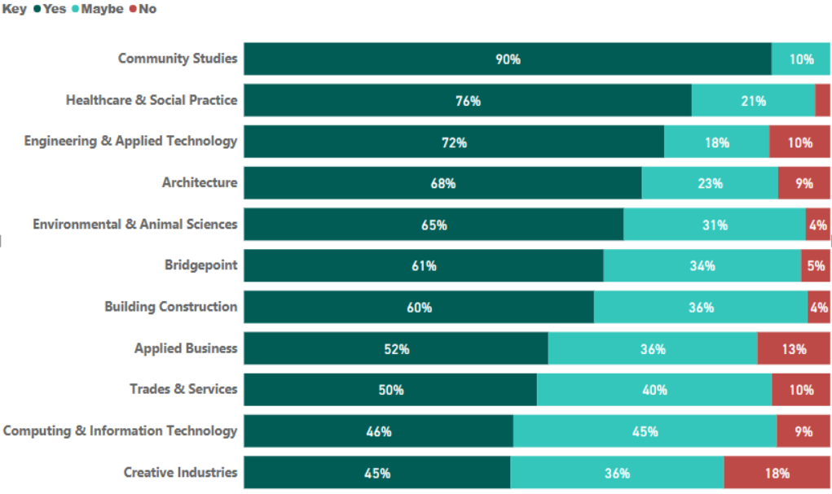
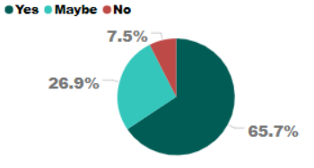
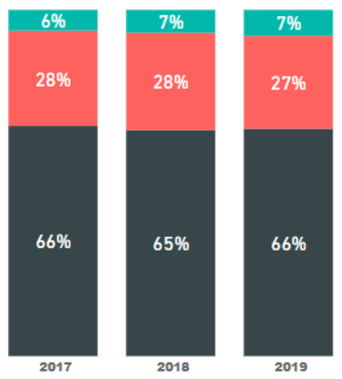
Qualification worth the investment
More than half, or 65.7%, of the respondents in 2019 agreed the qualification obtained was worth the investment. Only 7.5% disagreed.
Employment status - key to perception of qualification being worth the investment
In 2019, Community Studies led other schools with 90% of the respondents agreeing the qualification obtained was worth the investment, followed by Healthcare & Social Practice at 76% and Engineering & Applied Technology at 72%.
At the other end was Creative Industries with only 45%, followed by Computing & Information Technology at 46%, Trades & Services at 50% and Applied Business at 52%.
This replicated the pattern of % of graduates employed by school, i.e. with Community Studies having the highest % of employed graduates and Creative Industries the lowest and so forth (Bridgepoint excluded given the nature of its programmes). Hence, it is evident that graduates’ employment status impacts on their perception of the qualification being worth the investment.
The distribution of responses remains stable over the years.

Slide 12
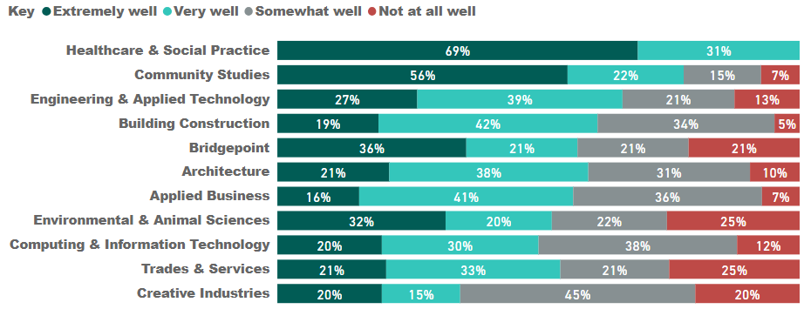
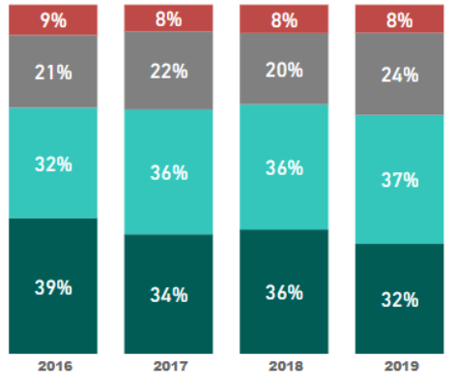
Qualification met job requirements
Over the years, there is a slight decrease in the percentage of graduates thinking the qualification met their job requirements well (very or extremely).
Despite this, in 2019, a strong 92% of the respondents agreed the qualification met their job requirements.
High performers
All respondents from Healthcare & Social Practice agreed the qualification met their job requirements. Graduate feedback was highly positive.
  “Large amount of exposure through placements”
Community Studies came second with 78% of respondents answering “Extremely well” or “Very well”.
  “Work placement every week as part of the degree had me doing exactly what I would be doing when I qualified.”
Only 5% of respondents from Building Construction thought the qualification did not meet their job requirements.
  “Unitec has a connection with lots of company and have all the practical skills need on site”
However, the school had the second lowest rate (19%) of graduates thinking the qualification met the job requirements extremely well. So
there is still room for improvement.
  “Plz match the currently situation of construction in NZ,some courses use the example from 10yeas before “
Low performers
Applied Business had the lowest rate (only 16%) of respondents thinking the qualification met their main job requirements extremely well. This may be due to the general nature of the program which help fit graduates into different professions as only 7% of its respondents thought their qualification did not meet their job requirements.
  “I am doing lots of administrative and analytical work, not communication.”
For Computing & Information Technology, only 50% of the respondents thought the qualification met the job requirements very (or extremely) well. Given the school had a very low % employed rate, the following may shed some light on the situation.
  “I am struggling to find a job in IT and the course what I have learned in Unitec it (is sic.) not up to the match with current job openings in New Zealand.”

Slide 13
Statistical analysis of key drivers for ratings 2015-2019
Statistical analysis* of all the questions in the survey indicates there are 3 questions that relate to the students’ likelihood to recommend Unitec (NPS rating) and perception of the qualification being worth the investment.
These 3 questions measure a graduate’s learning experiences:
How supported did you feel through your programme of study at Unitec?
How effective was the teaching in your Unitec programme?
How successful was your Unitec programme in terms of meeting your learning needs?
Learning experiences
Feeling supported
Effective teaching
Learning needs met
Skills acquired
Practical skills
People skills
Technical skills
Technology skills
NPS ratings
Qualification worth the investment
Of the above three, the last one also correlates with 4 questions that measure to what extent skills have been acquired during the course of study. These 4 questions are:
How successful was your Unitec programme in terms of providing you with
  Practical skills (capability and capacity)
  Technical skills (knowledge and application)
  People skills (communication and working collaboratively)
  Technology skills ( computer literacy)
*Factor analysis and canonical correlation analysis indicate the correlations are statistically significant.

Slide 14
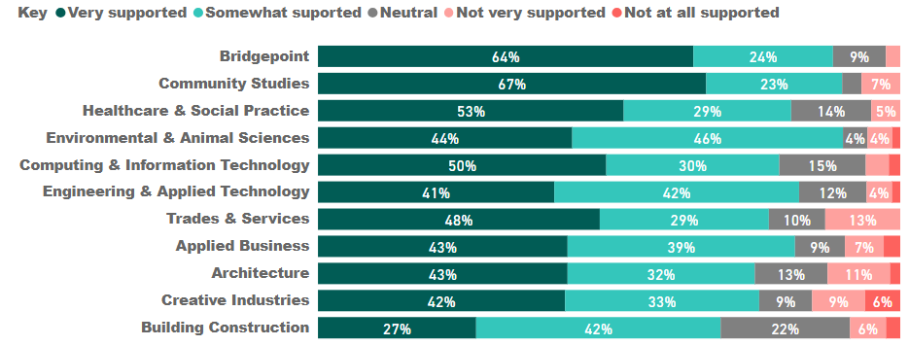
Feeling supported (2019 survey)
……………………………………………………………………………….
Unitec 2019
Overall in 2019, 83% of the respondents felt supported during their course of study.
  Community Studies led other schools with 90% of graduates thinking they were well supported (Very supported or Somewhat supported), followed by Bridgepoint at 88% and Engineering & Applied Technology at 83%.
  Building Construction fared comparatively poorly with only 69% feeling supported, followed by Architecture and Creative Industries, both at 75%.

Slide 15
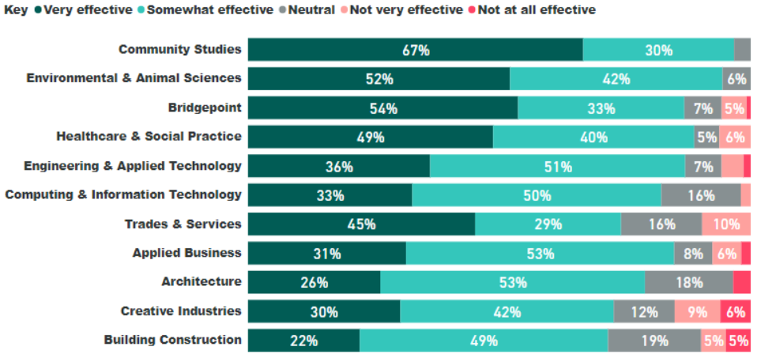
Effective teaching (2019 survey)
……………………………………………………………………………….
Unitec 2019
Overall in 2019, 86% of the respondents found teaching effective during their course of study.
  Community Studies led other schools with an overwhelming 97% of graduates thinking the teaching was effective. (Very effective or Somewhat effective), followed by Environmental & Animal Sciences at 94%.
  Building Construction again fared comparatively poorly with only 71% finding teaching effective, followed by Creative Industries at 72%.

Slide 16
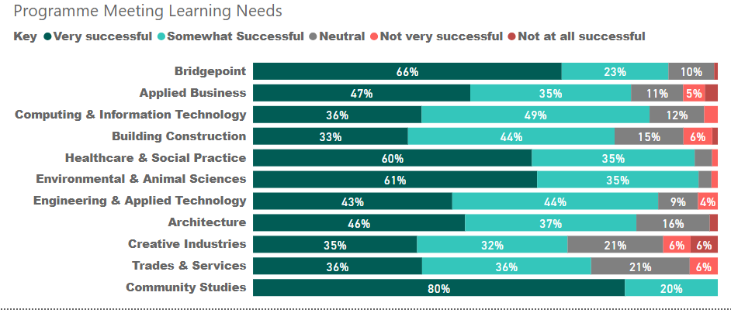
Programme meeting learning needs (2019 survey)
Unitec 2019
Overall in 2019, 88% of the respondents felt their learning needs were met during their course of study.
  Community Studies once again led other schools with 100% of graduates thinking their learning needs were met (Very successful or Somewhat successful), followed by Environmental & Animal Sciences at 96% and Healthcare & Social Practice at 95%.
  Creative Industries had the lowest rate at 67% only 69% feeling supported, followed by Trades & Services at 72%.
3%

Slide 17
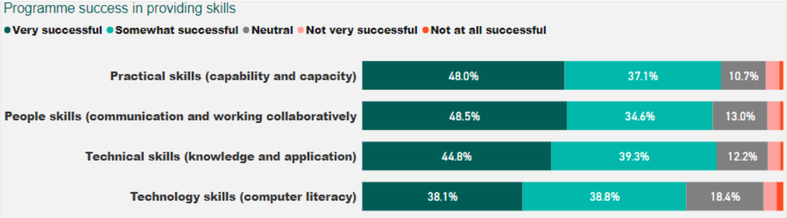
Programme success in providing skills
(2019 survey)
Unitec overall
 | High performers | Low performers
Practical skills | Healthcare & Social Practice (95%) Environmental & Animal Sciences (94%) | Architecture (69%) Building Construction (72%)
People skills | Community Studies (97%) Healthcare & Social Practice (94%) | Trades & Services (63%) Creative Industries (66%)
Technical skills | Community Studies (90%) Environmental & Animal Sciences (89%) | Trades & Services (72%) Creative Industries (72%)
Technology skills | Computing & Information Technology (86%) Engineering & Applied Technology (84%) | Environmental & Animal Sciences (55%) Trades & Services (56%)
% indicating Very successful or Somewhat successful

Slide 18
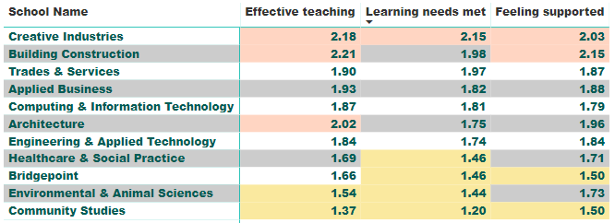
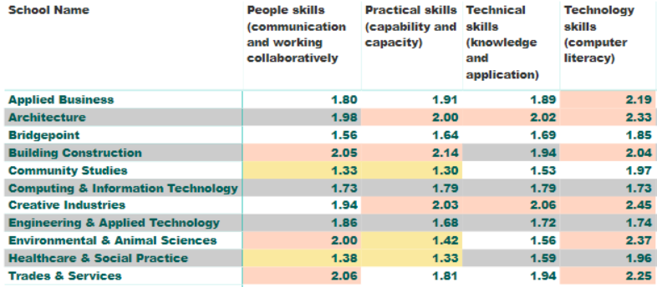
Top school performers 2015-2019
Ratings of 3 aspects of learning experiences (low numbers indicate good ratings)
As ratings of learning experiences and skills acquired correlate with NPS ratings and qualification being worth the investment ratings, top school performers can readily be identified.
Community Studies and Healthcare & Social Practice are top performers.
Schools that did not perform well are Creative Industries, Building Construction and Trades & Services.
Ratings of 4 types of skills acquired (low numbers indicate good ratings)
Poor ratings (>= 2)
Good ratings (< 1.5)

Slide 19
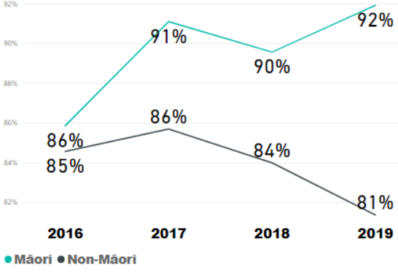
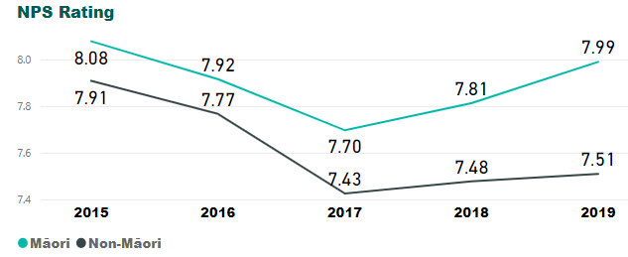
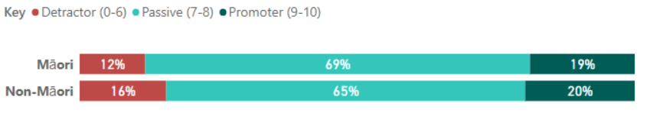
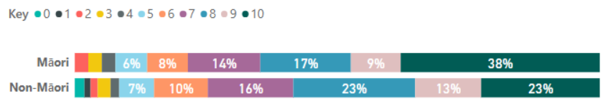
% GESC and NPS ratings 2015-2019 for Priority Groups - Māori
% GESC in time
NPS in time
Investment target 85%
2019 NPS ratings breakdown
During the 2015-2019 period, the % GESC and NPS ratings for Māori students are consistently higher than those for non-Māori students and the investment target. Over time, there is a favourable rising trend as opposed to the overall declining trend.
Given the positive comments regarding support for Māori students, this is highly encouraging.

Slide 20
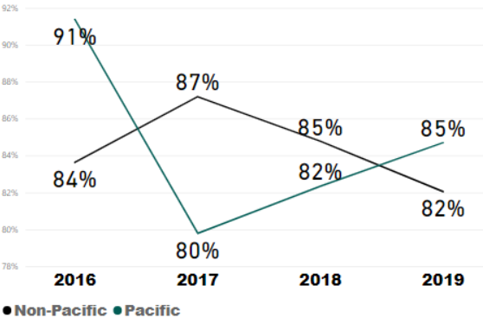
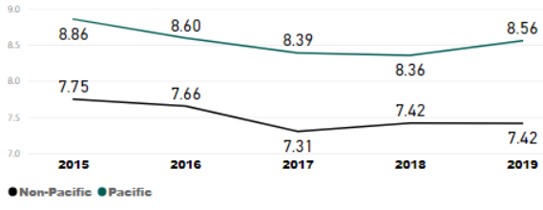
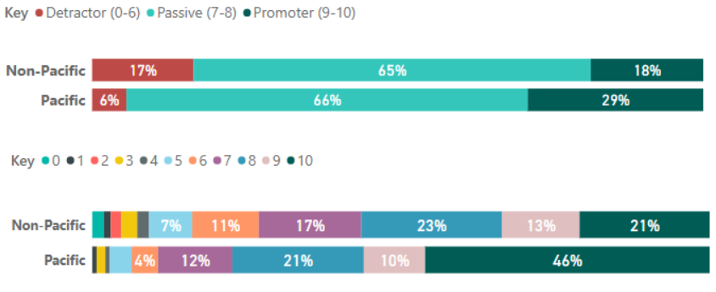
% GESC and NPS ratings 2015-2019 for Priority Groups - Pacific
% GESC in time
NPS in time
Investment target 85%
2019 NPS ratings breakdown
During the 2015-2019 period, the % GESC for Pacific students dropped from 91% to 80%, then bounced back to 85% meeting the Investment Plan target. Because of the huge drop from 2016 to 2017, more time may be required to decide if the rising trend from 2017 onwards will persist over time.
Statistical testing* shows that the Pacific students’ NPS ratings of Unitec are significantly higher than those of non-Pacific students, suggesting Pacific students have significantly more satisfactory learning experiences.
*Kruskal Wallis statistics significant at p<0.001

Slide 21
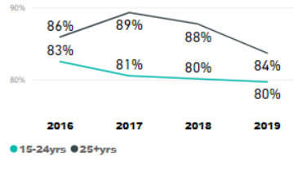
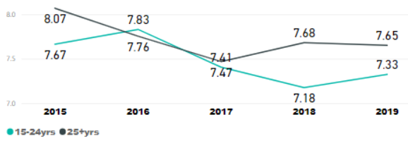
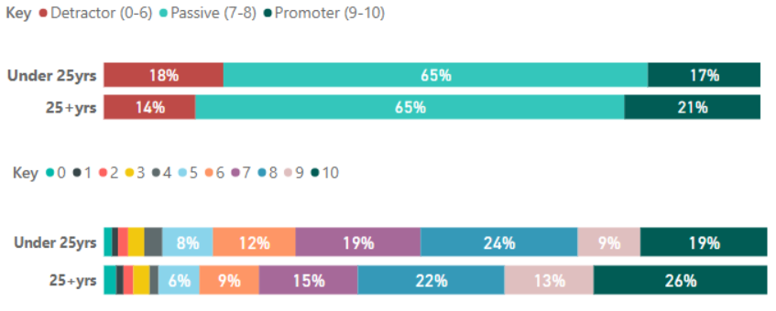
% GESC and NPS ratings 2015-2019 for Priority Groups – Under 25yrs
% GESC in time
NPS in time
Investment target 85%
During the 2015-2019 period, the % GESC for the under 25yrs consistently failed to meet the investment target.
The NPS ratings the under 25yrs gave also show a decreasing trend in 2015-2019. Furthermore, statistics testing indicates the ratings given by under 25yrs to Unitec are significantly lower than those given by those at 25 or over.
This is a cause for concern, with the under 25yrs group being the ONLY priority group giving a statistically lower NPS rating compared to its counterparts..
2019 NPS ratings breakdown

Slide 22
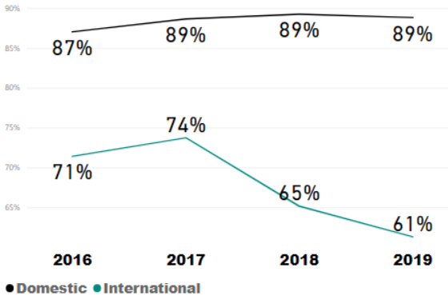
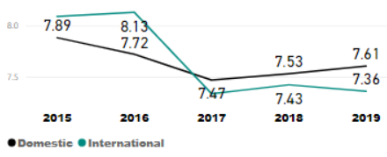
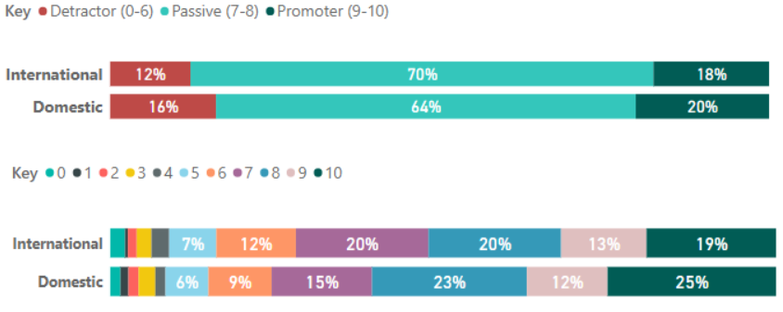
% GESC and NPS ratings 2015-2019 for Priority Groups – International
% GESC in time
NPS in time
Investment target 85%
During the 2015-2019 period, the % GESC and NPS ratings for international students are consistently lower than those for domestic students. Over time, the gap is widening.
Given the international students’ feedback asking for more help in finding jobs, more targeted support should be designed for this priority group.
As feeling supported correlates with the NPS ratings, the downward trend in these ratings by international students over time also indicates a need for extra help.
2019 NPS ratings breakdown

Slide 23
Recommendations
The process
There was confusion when invitations were sent to graduates with wrongly matched email addresses in the April 2019 Graduation survey. To ensure correct matching, all graduates’ current email/contact addresses should be kept/entered in PeopleSoft. Te Korowai Kahurangi is currently consulting with the Graduation Office regarding this issue.
The response rate of 36.8% for the 2019 graduate survey is far below the target response rate of 60% recommended by the Higher Education Statistics Agency which runs surveys for the higher education sector in the UK. The low response rate impacts on the representativeness of the survey results. We suggest consideration be given to how response rates can be increased. One option may be for graduates to complete the survey during the Graduation Ceremony.
Survey design
We currently exclude a survey reply where the student has answered the question on employment status but failed to answer questions relating to further study. This is to ensure statistical validity but also means valuable replies are not included. To correct this, either we include those replies or re-design the survey to ensure graduates will have to answer all the key questions first before quitting. Considering that the question numbers should ideally stay the same for fast and accurate data piping into the Power BI dashboard, the re-design option can be complex and should be avoided.
Currently only questions that relate to Graduate KPIs and NPS ratings are mandatory. This results in lots of survey replies submitted with empty answers for all the other questions. Statistical analysis requires all surveys to be fully filled in and hence lots of replies have to be dropped out of analysis, leading to less representative results. It is suggested that in future graduate surveys, all questions are mandatory as they help collect valuable information.
Reporting
Due to the non-standard nature of the GPO statements, no reporting has been carried out on these since they were introduced for some qualifications in the September 2018 survey. As customised reporting is not currently possible, raw reports will be provided to programme teams.
A section of the survey consists of questions about the Graduation ceremony itself. As Te Korowai Kahurangi focuses on student performance, future responsibility for the analysis is being negotiated with the relevant teams.

