Slide 1
Student Course Surveys
Institutional Summary
Semester One 2019
Te Korowai Kahurangi
July 2019
Notes:
Use title slide layout

Slide 2
Student Course Survey Programme Overview
Overview
Unitec’s student course survey programme is designed to provide a robust and consistent approach of measuring course performance across all of Unitec. Student course surveys are a key requirement for self-evaluation and an enabler for us to improve our course and programme delivery.
Each semester we ask students to provide feedback on course structure, content, assessment, teaching and practical components (if applicable) via an online survey that we send directly to our students. The base survey questions were informed by NZQA’s Key Evaluative Questions and Tertiary Education Indicators. Feedback on the question design was received from students, teachers, Academic Leaders, HoPPs and Deans and the Unitec Ako Ahimura Committee.
Reporting is delivered at three levels (more detail is shown in the Appendix):
Instiutional Summary Report - Analysis and reporting of performance at institutional and school level
Student Survey Course Dashboard - Interactive dashboard which allows you to filter data by school, programme, course, class, priority group and semester. Located in the Insitutional Reports App of Power BI Link
Course/ Class Reports - Student ratings and verbatim comments on course content, teaching, assessments and practical components (if applicable) for each specific course/ class.
This institutional summary report provides analysis into the overall results for the past three semesters and an evaluation of the survey process and suggested improvements:
Overall Results
  Overall course ratings
  Course content
  Course teaching
  Course assessments
  Course practical components (if applicable)
  What drives performance?
Course Survey Process
  Survey response rates
  Process improvement
Notes:
Explain Cohort timeframes
Outline EPI measures

Slide 3
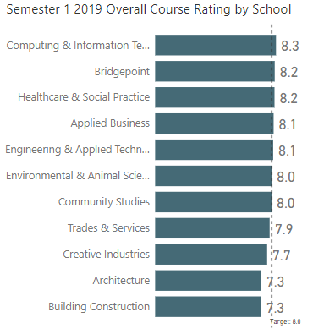
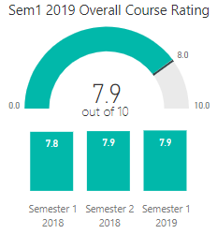
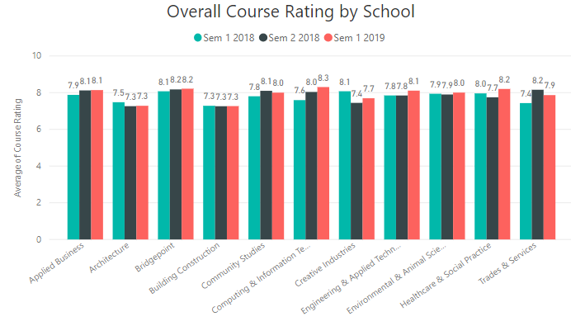
Overall Course Ratings
Overall Course Ratings
Students’ overall course ratings across all Unitec courses in Semester 1 2019 averages at 7.9 out of 10 which is on par (within margin of error) with the target of 8.0. This level of overall performance is consistent across the last three semesters.
Over time, Computing & Information Technology has improved the most over the past three semesters to now lead the schools in Semester 1 2019 at an average of 8.3 out of 10. Feedback from the school suggests the increased focus over the past two years and following factors may have driven this improvement:
Focus on the quality of teaching and learning: dedicated representative from Te Puna Ako permanently sitting with the team. Over the past three semesters, that role has helped colleagues with creating assessments, ensuring they are meeting the prescribed learning outcomes, etc. As a school, they have also gone through a number of internal badges: one being on Moderation.
Traditionally, they have had a high number of casual staff members, some of whom weren’t particularly keen on maintaining the high quality of education. Over time they have been able to hire and have recently been given approval to hire more permanent staff members. This has and will continue to help increase the quality of their product (courses), teaching and research.
In terms of the student course survey process, they have been working closely with Te Korowai Kahurangi on ensuring students get their feedback on time and within the 10 day period.
The continuous focus and work on CEPs and PEPs which encourages colleagues to self-reflect more and identify practices which lead to a better environment for our students.
Notes:
Explain Cohort timeframes
Outline EPI measures

Slide 4
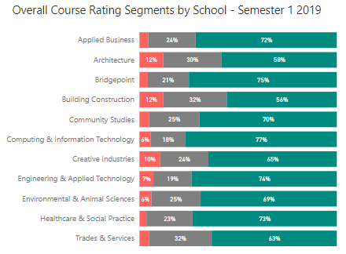
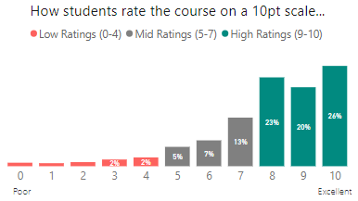

Overall Course Segments
Overall Course Ratings
Segmenting the overall ratings that students give each course into low, medium and high rating groups provides a more detailed and visual way to compare performance when compared to an overall average rating.
As shown below, there is more variation by school using this analysis. Top performing schools such as Computing & Information Technology, Bridgepoint and Engineering & Applied Technology show strong proportions of high ratings while the low performing schools such as Architecture, Building Construction and Creative Industries show greater proportions of low ratings. For these schools, approximately one in ten students are rating their course 4 or below out of 10 and are potentially at risk.
Te Korowai Kahurangi plan to conduct driver modelling analysis to understand the relationship between low course ratings and student success measures. From this analysis, the plan is to identify what survey measures can be used as lead indicators of retention and successful course completion.
Semester 1 2019
Notes:
Explain Cohort timeframes
Outline EPI measures

Slide 5
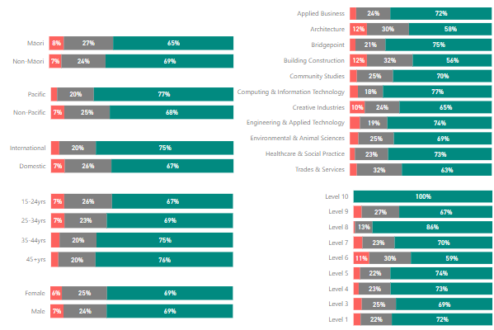
Overall Course Segments Profiling
Overall Course Ratings
Profiling the course segments by key groups helps identify areas that need attention/ further investigation. At a total Unitec level, overall course performance is stronger amongst Pacific & International students (when compared to non-Pacific and domestic students) while Māori and Under 25yr students show lower ratings in comprason.
This profiling is available at school and programme level via the Student Course Surveys Dashboard located in Power BI here Link
Notes:
Explain Cohort timeframes
Outline EPI measures

Slide 6
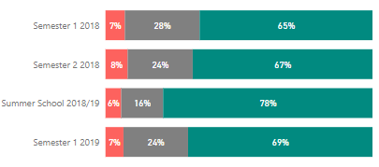

Overall Course Segments Trend
Overall Course Ratings
Although Unitec’s average rating is relatively consistent across semesters, there is an increase in the percentage of students who are giving high ratings (rate 8-10) from 65% in Semester 1 2018 to 69% in Semester 1 2019. This increase has been driven by a decline in the mid rating segment while low ratings continue to trend at 7%.
Trends at a school level show Computing & Information Technology showing strong increases in high ratings (+14%) coupled by a reduction in low ratings (-3%). Schools that have also shown a strong increase in high ratings include Engineering & Applied Technology (+9%), Applied Business (+6%) and Healthcare & Social Practice (+6%).
Creative Industries and Architecture show negative trends with increasing low ratings and decreasing high ratings.
School Name | Low Ratings (0-4 out of 10) |  |  | High Ratings (8-10 out of 10)
 | Sem1 2018 | Sem1 2019 | Var | Sem1 2018 | Sem1 2019 | Var
Applied Business | 6% | 4% | -2% | 66% | 72% | 6%
Architecture | 7% | 12% | 5% | 59% | 58% | -1%
Bridgepoint | 6% | 4% | -2% | 71% | 75% | 4%
Building Construction | 10% | 12% | 2% | 57% | 56% | -1%
Community Studies | 8% | 5% | -3% | 66% | 70% | 4%
Computing & Information Technology | 9% | 6% | -3% | 63% | 77% | 14%
Creative Industries | 4% | 10% | 6% | 70% | 65% | -5%
Engineering & Applied Technology | 8% | 7% | -1% | 65% | 74% | 9%
Environmental & Animal Sciences | 4% | 6% | 2% | 67% | 69% | 2%
Healthcare & Social Practice | 7% | 4% | -3% | 67% | 73% | 6%
Trades & Services | 10% | 5% | -5% | 61% | 63% | 2%
Total Unitec | 7% | 7% | 0% | 65% | 69% | 4%
Notes:
Explain Cohort timeframes
Outline EPI measures

Slide 7
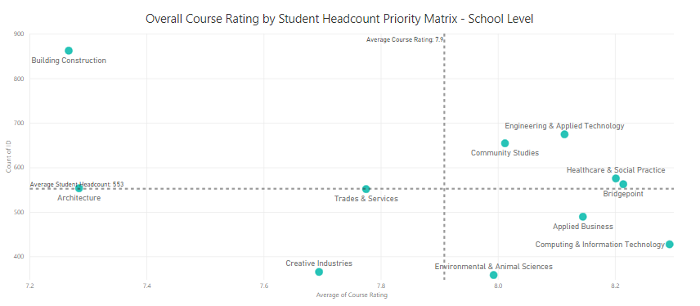

School Priority Matrix
Overall Course Ratings
School performance can also be plotted using a priority matrix that plots each school’s size/ value (approx number of students) by performance (average course ratings). Those positioned top left are considered a priority (higher value with lower performance when compared to other schools) while those top right are considered strong performers (high value with high performance). The dotted lines that create the four quadrants are based off the average across all schools.
Based on overall course performance and number of students impacted, schools which require the greatest priority to improve are Building Construction and Architecture. Improvements in these areas will have the greatest impact on Unitec’s overall result.
Similar analysis can be conducted at a programme level via the Student Course Surveys Dashboard located in Power BI here Link
Notes:
Explain Cohort timeframes
Outline EPI measures

Slide 8
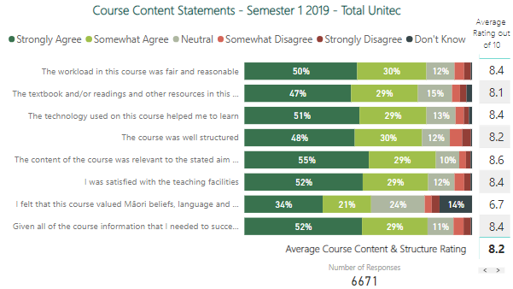
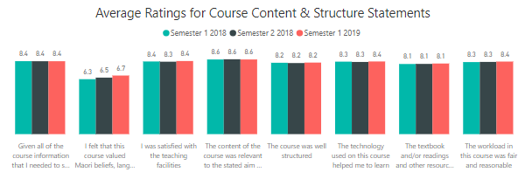
Course Content
Course Content
Students are asked to rate a number of statements pertaining to the content and structure of each course.
Overall, students show high appreciation of Unitec’s course content with approximately 80% of students expressing positive agreement to each statement.
The only exception is the perception that their course valued Māori beliefs, language and practices which received the lowest level of endorsement. On a positive note, this statement has improved from an average of 6.3 in Semester 1 2018 to 6.7 in Semester 1 2019, however is still averaging well below the other course content statements.
Notes:
Explain Cohort timeframes
Outline EPI measures

Slide 9
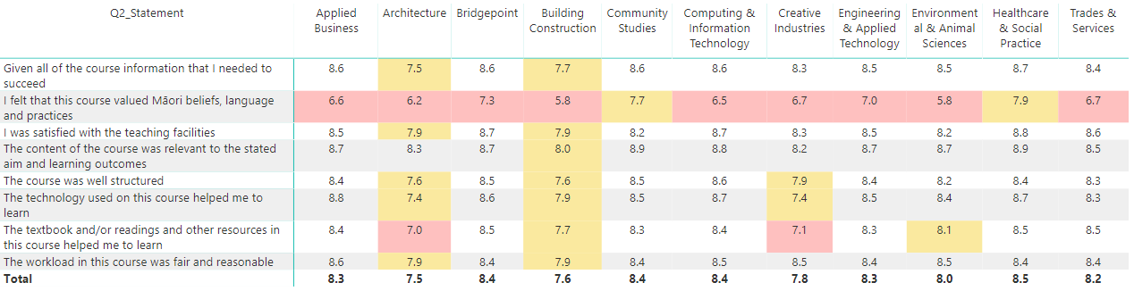
Course Content by School
Course Content
Despite having strong performance at a total Unitec level, student’s perceptions of course content is quite varied by school. The top performing Schools of Bridgepoint, Community Studies and Healthcare & Social Practice are driven by very high endorsement of their courses having content that was relevant to the stated aim and learning outcomes. Architecture and Building Construction show the lowest peformance across most content statements.
All schools show low ratings in terms of providing courses that value Māori beliefs, language and practices, with the exception of Community Studies and Healthcare & Social Practice.
The top five performing programmes in terms of course content all share the same strengths as rated by students; having relevant content, being well prepared & structured, providing appropriate levels of information and having saisfactory teaching facilities.
Sem1 2019 Top 5 Performing Programmes* | Content Rating | Perceived Strengths
NZDSR - NZDip Sport Recreation Exercie MS | 9.6 | Relevant content, well structured, appropriate info given, satisfied with teaching facilities
DCMUS – Diploma Contemporary Music | 9.3
GDPA – Diploma Professional Accountancy | 9.0
NZDIS – NZ Diploma Information Systems | 8.9
PGDBS – PG Diploma Business | 8.9
*Only includes programmes that received at least 10 survey responses
Course Content Performance by School – Semester 1 2019
Notes:
Explain Cohort timeframes
Outline EPI measures

Slide 10
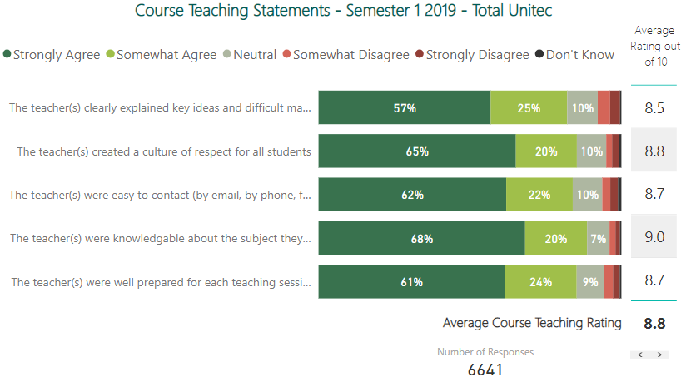
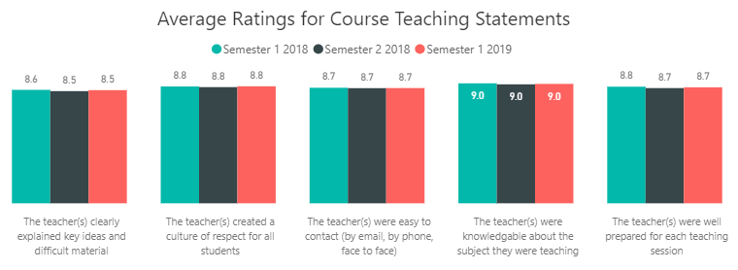
Course Teaching
Course Teaching
Students are asked to rate a number of statements pertaining to the teaching performance of each course.
Teaching receives the highest overall ratings (averaging almost nine out of ten across each statement).
Teachers’ clearly explaining key ideas and difficult material is the only area that has room for improvement, however still receives relatively high ratings of 8.5 out of 10.
Performance is consistent across the past three semesters for all teaching statements.
Notes:
Explain Cohort timeframes
Outline EPI measures

Slide 11
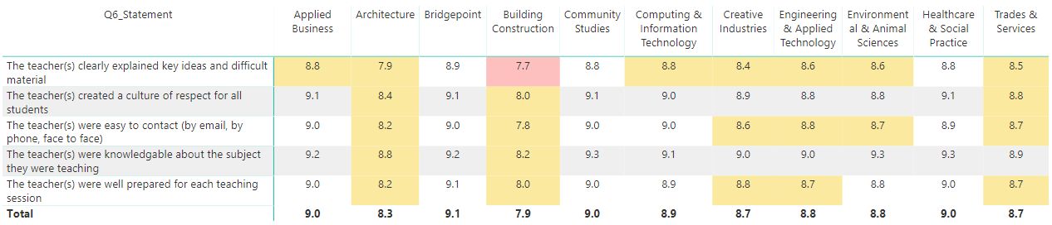
Course Teaching by School
Course Teaching
Sem1 2019 Top 5 Performing Programmes* | Content Rating | Perceived Strengths
NZDSR - NZDip Sport Recreation Exercie MS | 9.9 | Everything - Knowledgeable, well prepared, clearly explained ideas/ difficult material, create culture of respect, contactable
MOST – Master Osteopathy | 9.8
DCMUS – Diploma Contemporary Music | 9.6
PGDBS – PG Diploma Business | 9.5
GDPA – Diploma Professional Accountancy | 9.5
Teacher ratings are relatively high across all schools with slightly lower ratings shown towards Building Construction and Architecture.
The top five performing programmes in terms of teaching are similar to those rated the highest for content and rate high across all teaching attributes.
*Only includes programmes that received at least 10 survey responses
Course Teaching Performance by School – Semester 1 2019
Notes:
Explain Cohort timeframes
Outline EPI measures

Slide 12
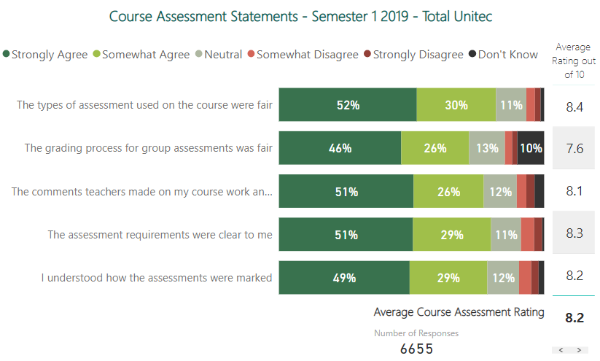
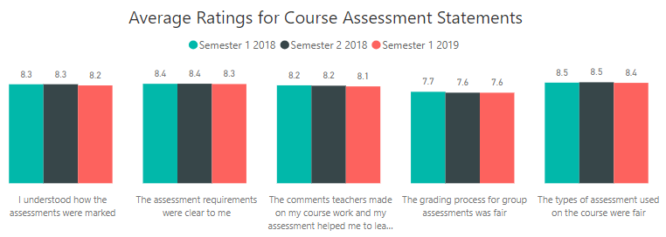
Course Assessments
Course Assessments
Students are asked to rate a number of statements pertaining to the assessments of each course.
Most assessment attributes receive high ratings (over 8 out of 10) with the only exception being students’ perception that the grading process for group assessments was fair.
This raises the question, can anything be done to improve the group assessment process and the perception of fair grading in a group situation?
Performance is consistent across the past three semesters for all assessment statements.
Notes:
Explain Cohort timeframes
Outline EPI measures

Slide 13
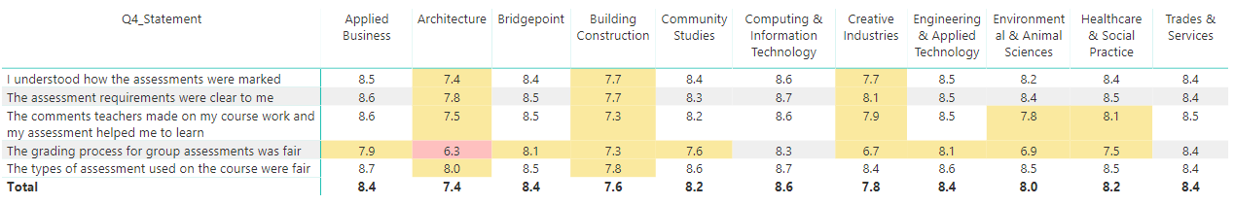
Course Assessments by School
Course Assessments
Sem1 2019 Top 5 Performing Programmes* | Content Rating | Perceived Strengths
NZDSR - NZDip Sport Recreation Exercie MS | 9.8 | Clear assessment requirements & teachers assessment comments helped learning
NZDIS – NZ Diploma Information Systems | 9.3
GDPA – Diploma Professional Accountancy | 9.2
PGDBS – PG Diploma Business | 9.2
DCMUS – Diploma Contemporary Music | 9.0
Course assessment ratings are quite varied across schools with
lower ratings shown towards Architecture , Building Construction and Creative Industries.
The top five performing programmes in terms of assessments are similar to those rated the highest for content and teaching and are driven by having clear assessment requirements and providing advice to students to help them learn.
*Only includes programmes that received at least 10 survey responses
Course Assessment Performance by School – Semester 1 2019
Notes:
Explain Cohort timeframes
Outline EPI measures

Slide 14
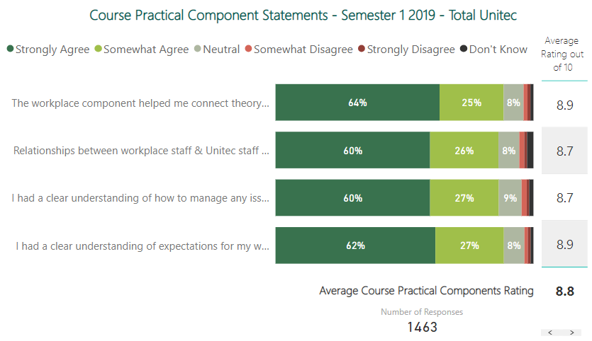
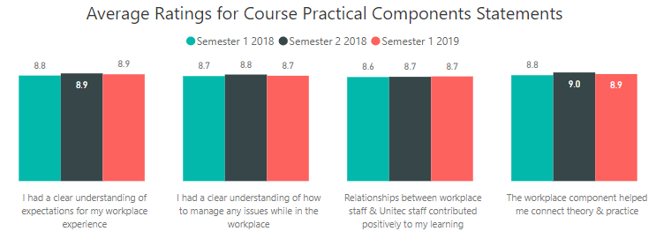
Course Practical Components
Course Practical Components
Students are asked to rate a number of statements pertaining to the practical components if applicable to their course.
Similar to teaching performance, Unitec’s courses receive very high endorsement towards the practical components (averaging 9 out of 10 across all attributes).
Performance is consistent across the past three semesters for all statements.
Notes:
Explain Cohort timeframes
Outline EPI measures

Slide 15
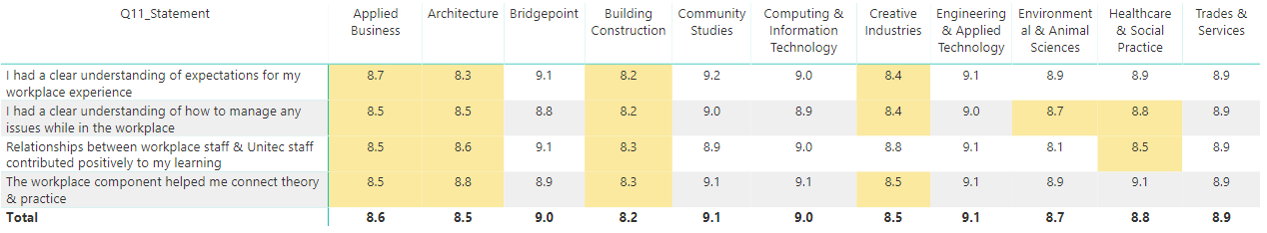
Course Practical Components by School
Course Practical Components
Sem1 2019 Top 5 Performing Programmes* | Content Rating | Perceived Strengths
NZDSR - NZDip Sport Recreation Exercie MS | 9.8 | Clear assessment requirements & teachers assessment comments helped learning
NZDIS – NZ Diploma Information Systems | 9.3
GDPA – Diploma Professional Accountancy | 9.2
PGDBS – PG Diploma Business | 9.2
DCMUS – Diploma Contemporary Music | 9.0
Despite some variation between schools in terms of performance, all schools receive ratings above 8 out of 10.
The top five performing programmes in terms of assessments are similar to those rated the highest for content and teaching and are driven by having clear assessment requirements and providing advice to students to help them learn.
One point to note throughout this report is that some top performing schools/ programmes are consistently excelling in all areas. Is there the potential to leverage this data/ information and provide these schools/ programmes with the appropriate accolades through a programme awards type event/ activity? This may help to drive awareness and engagement of the student course survey programme also.
*Only includes programmes that received at least 10 survey responses
Course Practical Components Performance by School – Semester 1 2019
Notes:
Explain Cohort timeframes
Outline EPI measures

Slide 16
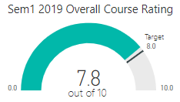
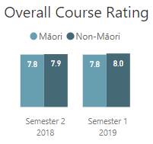
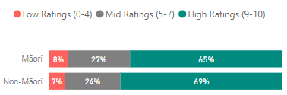
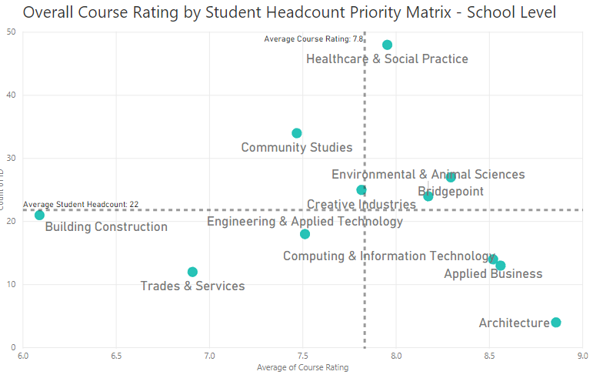
Māori Performance
Priority Segments
Overall course ratings amongst Māori students remains constant at an average of 7.8 out of 10. This is on par (within margin of error) with the institutional target and result shown for non-Māori students of 8.0. Building Construction is the highest priority for Māori students based on number of students impacted and lower performance while Healthcare & Social Practice which contains the largest number of Māori students, receives realtively high ratings. Parity between Māori and non-Māori is relaltively even across most course attributes.
Course Content | Māori | Non-Māori | Variance
Given all of the course information that I needed to succeed | 8.4 | 8.4 | 0
I felt that this course valued Māori beliefs, language and practices | 7 | 6.7 | 0.3
I was satisfied with the teaching facilities | 8.3 | 8.4 | -0.1
The content of the course was relevant to the stated aim and learning outcomes | 8.4 | 8.6 | -0.2
The course was well structured | 8 | 8.3 | -0.3
The technology used on this course helped me to learn | 8.1 | 8.4 | -0.3
The textbook and/or readings and other resources in this course helped me to learn | 8.1 | 8.1 | 0
The workload in this course was fair and reasonable | 8.3 | 8.4 | -0.1
Average Course Content | 8.1 | 8.2 | -0.1
Course Teaching | Māori | Non-Māori | Variance
Given all of the course information that I needed to succeed | 8.5 | 8.5 | 0.0
I felt that this course valued Māori beliefs, language and practices | 8.7 | 8.8 | -0.1
I was satisfied with the teaching facilities | 8.6 | 8.7 | -0.1
The content of the course was relevant to the stated aim and learning outcomes | 9.0 | 9.0 | 0.0
The course was well structured | 8.7 | 8.7 | 0.0
Average Teaching Content | 8.7 | 8.8 | -0.1
Course Assessment | Māori | Non-Māori | Variance
Given all of the course information that I needed to succeed | 8.1 | 8.2 | -0.1
I felt that this course valued Māori beliefs, language and practices | 8.2 | 8.4 | -0.1
I was satisfied with the teaching facilities | 7.9 | 8.2 | -0.2
The content of the course was relevant to the stated aim and learning outcomes | 7.5 | 7.6 | -0.1
The course was well structured | 8.3 | 8.5 | -0.1
Average Course Assessment | 8 | 8.2 | -0.2
Course Practical Components | Māori | Non-Māori | Variance
I had a clear understanding of expectations for my workplace experience | 8.8 | 8.9 | -0.1
I had a clear understanding of how to manage any issues while in the workplace | 8.5 | 8.8 | -0.3
Relationships between the workplace staff & Unitec staff contributed positively to my learning | 8.3 | 8.7 | -0.4
The workplace component helped me connect theory and practice | 9.1 | 8.9 | 0.2
Average Course Practical Components | 8.6 | 8.8 | -0.2
Notes:
Explain Cohort timeframes
Outline EPI measures

Slide 17
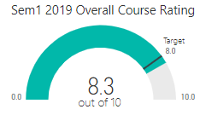
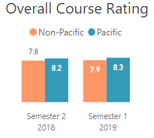
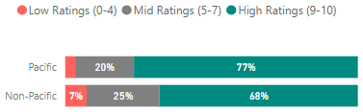
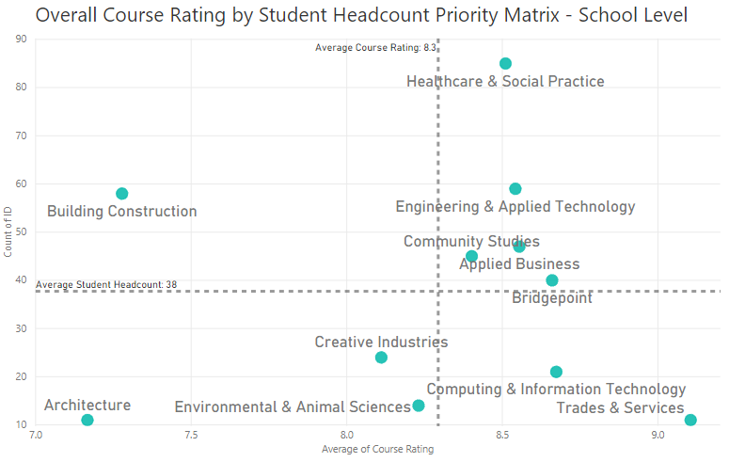
Pacific Performance
Priority Segments
Overall course ratings amongst Pacific students remains constant at an average of 8.3 out of 10 which is above the institutional target of 8.0 and ratings shown for non-Pacific students. Building Construction is the highest priority for Pacific students based on number of students impacted and lower performance while Healthcare & Social Practice which contains the largest number of Pacific students, receives realtively high ratings. Pacific student ratings are higher across most course attibutes when compared to non-Pacific.
Course Content | Pacific | Non-Pacific | Variance
Given all of the course information that I needed to succeed | 8.8 | 8.3 | 0.5
I felt that this course valued Māori beliefs, language and practices | 7.2 | 6.7 | 0.5
I was satisfied with the teaching facilities | 8.8 | 8.4 | 0.4
The content of the course was relevant to the stated aim and learning outcomes | 8.9 | 8.5 | 0.4
The course was well structured | 8.6 | 8.2 | 0.4
The technology used on this course helped me to learn | 8.8 | 8.3 | 0.5
The textbook and/or readings and other resources in this course helped me to learn | 8.6 | 8 | 0.6
The workload in this course was fair and reasonable | 8.6 | 8.3 | 0.3
Average Course Content | 8.5 | 8.1 | 0.4
Course Teaching | Pacific | Non-Pacific | Variance
Given all of the course information that I needed to succeed | 8.9 | 8.5 | 0.5
I felt that this course valued Māori beliefs, language and practices | 9.0 | 8.8 | 0.2
I was satisfied with the teaching facilities | 8.9 | 8.7 | 0.2
The content of the course was relevant to the stated aim and learning outcomes | 9.2 | 9.0 | 0.3
The course was well structured | 9.1 | 8.7 | 0.4
Average Teaching Content | 9 | 8.7 | 0.3
Course Assessment | Pacific | Non-Pacific | Variance
Given all of the course information that I needed to succeed | 8.5 | 8.2 | 0.3
I felt that this course valued Māori beliefs, language and practices | 8.6 | 8.3 | 0.3
I was satisfied with the teaching facilities | 8.5 | 8.1 | 0.4
The content of the course was relevant to the stated aim and learning outcomes | 8.1 | 7.5 | 0.5
The course was well structured | 8.7 | 8.4 | 0.3
Average Course Assessment | 8.5 | 8.1 | 0.4
Course Practical Components | Pacific | Non-Pacific | Variance
I had a clear understanding of expectations for my workplace experience | 8.9 | 8.9 | 0.0
I had a clear understanding of how to manage any issues while in the workplace | 9.0 | 8.7 | 0.3
Relationships between the workplace staff & Unitec staff contributed positively to my learning | 8.9 | 8.7 | 0.2
The workplace component helped me connect theory and practice | 8.9 | 8.9 | 0.0
Average Course Practical Components | 8.9 | 8.8 | 0.1
Notes:
Explain Cohort timeframes
Outline EPI measures

Slide 18
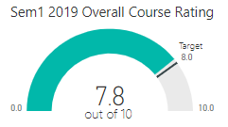
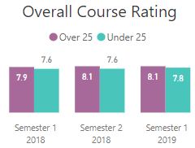
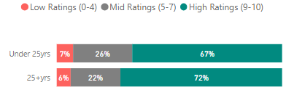
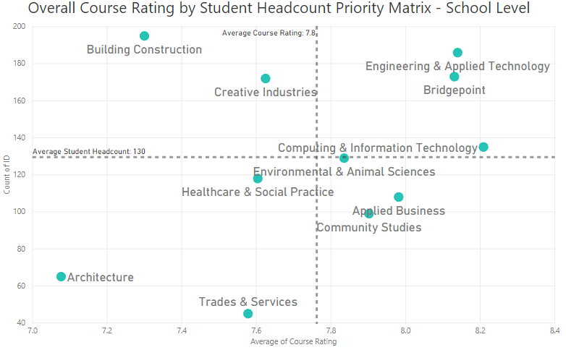
Under 25years Performance
Priority Segments
Overall course ratings amongst Under 25yr students has increased slightly to an average of 7.8 out of 10 which is below the institutional target of 8.0 and ratings shown for 25+yr students. Building Construction is the highest priority for Under 25yr students based on number of students impacted and lower performance while Engineering & Applied Technology and Bridgepoint which contain a large number of Under 25yr students, receives relatively high ratings. Parity between Under 25yrs and 25+yrs students is relatively even across most course attributes.
Course Content | Under 25 | Over 25 | Variance
Given all of the course information that I needed to succeed | 8.3 | 8.5 | -0.2
I felt that this course valued Māori beliefs, language and practices | 6.7 | 6.8 | -0.1
I was satisfied with the teaching facilities | 8.4 | 8.5 | -0.1
The content of the course was relevant to the stated aim and learning outcomes | 8.5 | 8.7 | -0.2
The course was well structured | 8.2 | 8.3 | -0.1
The technology used on this course helped me to learn | 8.2 | 8.5 | -0.3
The textbook and/or readings and other resources in this course helped me to learn | 7.9 | 8.3 | -0.4
The workload in this course was fair and reasonable | 8.3 | 8.4 | -0.1
Average Course Content | 8.1 | 8.3 | -0.2
Course Teaching | Under 25 | Over 25 | Variance
Given all of the course information that I needed to succeed | 8.4 | 8.7 | -0.3
I felt that this course valued Māori beliefs, language and practices | 8.7 | 8.9 | -0.2
I was satisfied with the teaching facilities | 8.5 | 8.9 | -0.3
The content of the course was relevant to the stated aim and learning outcomes | 8.9 | 9.1 | -0.2
The course was well structured | 8.7 | 8.8 | -0.2
Average Teaching Content | 8.6 | 8.9 | -0.3
Course Assessment | Under 25 | Over 25 | Variance
Given all of the course information that I needed to succeed | 8.1 | 8.4 | -0.3
I felt that this course valued Māori beliefs, language and practices | 8.2 | 8.5 | -0.2
I was satisfied with the teaching facilities | 8.0 | 8.3 | -0.3
The content of the course was relevant to the stated aim and learning outcomes | 7.5 | 7.7 | -0.2
The course was well structured | 8.4 | 8.5 | -0.1
Average Course Assessment | 8 | 8.3 | -0.3
Course Practical Components | Under 25yrs | 25+ yrs | Variance
I had a clear understanding of expectations for my workplace experience | 8.9 | 8.8 | 0.1
I had a clear understanding of how to manage any issues while in the workplace | 8.7 | 8.8 | -0.1
Relationships between the workplace staff & Unitec staff contributed positively to my learning | 8.7 | 8.6 | 0.1
The workplace component helped me connect theory and practice | 8.8 | 8.9 | -0.1
Average Course Practical Components | 8.8 | 8.8 | 0
Notes:
Explain Cohort timeframes
Outline EPI measures

Slide 19
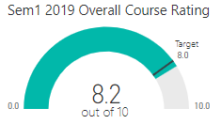
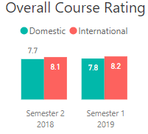
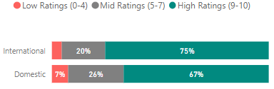
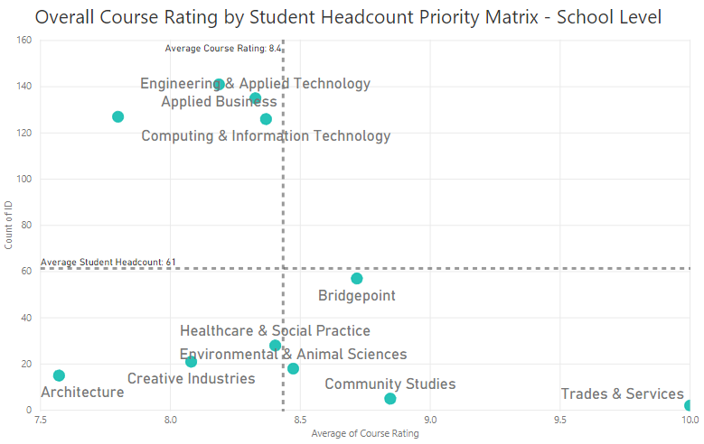
International Performance
Priority Segments
Overall course ratings amongst International students remains constant at an average of 8.2 out of 10 which is above the institutional target of 8.0 and ratings shown for Domestic students. The schools that contain the most International students (Computing & Information Technology, Engineering & Applied Technology, Applied Business) receive slightly lower ratings when compared to other schools however the ratings are still relatively strong. Parity between International and Domestic students is relatively even across most course attributes except for perceptions of courses valueing Māori beliefs and the course being relevant to the stated aim and learning outcomes.
Course Content | International | Domestic | Variance
Given all of the course information that I needed to succeed | 8.6 | 8.3 | 0.3
I felt that this course valued Māori beliefs, language and practices | 7.4 | 6.5 | 0.9
I was satisfied with the teaching facilities | 8.6 | 8.3 | 0.3
The content of the course was relevant to the stated aim and learning outcomes | 8.7 | 8.5 | 0.2
The course was well structured | 8.6 | 8.1 | 0.5
The technology used on this course helped me to learn | 8.7 | 8.2 | 0.5
The textbook and/or readings and other resources in this course helped me to learn | 8.5 | 8 | 0.5
The workload in this course was fair and reasonable | 8.5 | 8.3 | 0.2
Average Course Content | 8.5 | 8 | 0.5
Course Teaching | International | Domestic | Variance
Given all of the course information that I needed to succeed | 8.7 | 8.5 | 0.3
I felt that this course valued Māori beliefs, language and practices | 9.0 | 8.8 | 0.2
I was satisfied with the teaching facilities | 8.9 | 8.6 | 0.3
The content of the course was relevant to the stated aim and learning outcomes | 9.0 | 9.0 | 0.0
The course was well structured | 8.9 | 8.7 | 0.2
Average Teaching Content | 8.9 | 8.7 | 0.2
Course Assessment | International | Domestic | Variance
Given all of the course information that I needed to succeed | 8.6 | 8.1 | 0.5
I felt that this course valued Māori beliefs, language and practices | 8.7 | 8.2 | 0.4
I was satisfied with the teaching facilities | 8.6 | 8.0 | 0.6
The content of the course was relevant to the stated aim and learning outcomes | 8.4 | 7.4 | 1.0
The course was well structured | 8.6 | 8.4 | 0.3
Average Course Assessment | 8.6 | 8 | 0.6
Course Practical Components | International | Domestic | Variance
I had a clear understanding of expectations for my workplace experience | 9.0 | 8.8 | 0.2
I had a clear understanding of how to manage any issues while in the workplace | 8.9 | 8.7 | 0.2
Relationships between the workplace staff & Unitec staff contributed positively to my learning | 9.0 | 8.5 | 0.5
The workplace component helped me connect theory and practice | 9.0 | 8.8 | 0.2
Average Course Practical Components | 9 | 8.7 | 0.3
Notes:
Explain Cohort timeframes
Outline EPI measures

Slide 20
What Drives Course Performance?
Driver modelling shows that well structured courses & teachers clearly explaining key ideas & difficult material have the largest impact on overall course performance.
Delivering more structure in class seems to be a simple and fast action that will have the greatest impact on overall course performance. Is this a potential ‘quick win’ that can be delivered across all Unitec courses quickly?
Course Content Factors | Impact
The course was well structured | High
The content of the course was relevant to the stated aim and learning outcomes | Med
The workload in this course was fair and reasonable | Low
I was given all of the course information that I needed to succeed in this course | Low
The textbook and/or readings and other resources in this course helped me to learn | Low
The technology used on this course helped me to learn | Low
I was satisfied with the teaching facilities | Low
I felt that this course valued Māori beliefs, language and practices | Low
Category impact weight
33%
Course content
Course Assessment Factors | Impact
The comments teachers made on my course work and my assessment helped me to learn | High
The types of assessment used on the course were fair | Med
The assessment requirements were clear to me | Low
I understood how the assessments were marked | Low
The grading process for group assessments was fair | Low
Overall Course Performance
12%
Course assessment
R²=0.69
Course Teaching Factors | Impact
Clearly explained key ideas and difficult material | High
Was well prepared for each teaching session | Med
Created a culture of respect for all students | Low
Was knowledgeable about the subject they were teaching | Low
Was easy to contact | Low
24%
Course teaching
Notes:
Explain Cohort timeframes
Outline EPI measures

Slide 21
The Student Course Survey Process
Response Rates
Process & Suggested Improvements
Notes:
To achieve a new layout – insert a new slide, then in the slide thumbnail left side view, Right Click, choose layout – and pick a content style to use

Slide 22
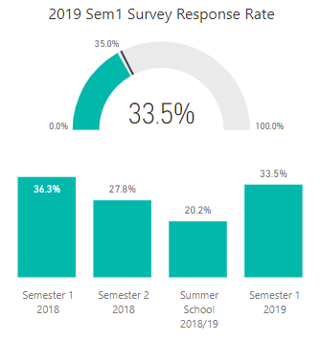
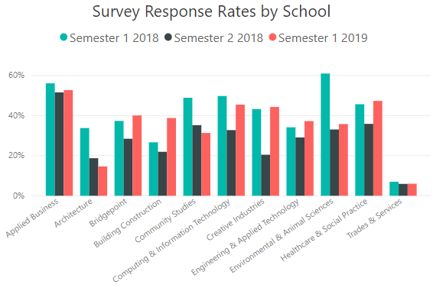
Survey Response Rates
Overview & Process
To ensure a representative sample of results and enable robust measurement at a school, programme and course level, it is imperative that high response rates are reached. 6,714 surveys were completed out of 20,028 sent in Semester 1 2019 which equates to an overall response rate of 33.5%. Response rates by school are varied and show an inconsistent level of engagement across schools and programmes throughout Unitec.
Response Rates at other institutions are known to average 60-80% as some institutes make it compulsory for students to give feedback before they release their grades.
Notes:
Explain Cohort timeframes
Outline EPI measures

Slide 23
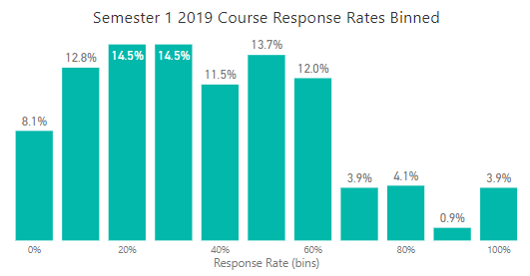
Improving Survey Response Rates
Overview & Process
Learnings across the past three semesters proves that when the process of allocating time in class for students to conduct the survey is followed, response rates are very high. Despite the continued effort to engage staff to follow this process, not all areas follow this process and there is inconsistent response rates as a result.
If the process of allocating time is followed, you would expect a response rate of at least 50%. Using that cutoff for the most recent semester 1 2019, 75% of courses are receiveing response rates below that level which suggests that the majority of courses are not following that process. A lack of cut through on the process continues to be a major barrier as attempts to drive engagement with staff through internal communications/ campaigns and direct communications via their Academic Leaders continue to be the major challenge.
RECOMMENDATION: Te Korowai Kahurangi to conduct review into options for improving engagement and response rates
0-50% response rate = 75% of courses
51-100% response rate = 25% of courses
Notes:
Explain Cohort timeframes
Outline EPI measures

Slide 24
Process Feedback and Suggested Improvements
Overview & Process
The student course survey programme has been running for three semesters now and it has evolved over time.
Key changes that have occurred over time:
Simplified the survey deployment process that has reduced the overall fieldwork period
AAQs involved to help with administering surveys for schools
Increased coverage to include all courses (e.g. summer school, short course)
Earlier course/ class reporting to allow teachers to share results with students before study break (this is best practice to improve student engagement with the process and overall experience)
Monitoring queries and obtaining feedback from stakeholders and AAQs has highlighted the following suggested improvements for future waves:
Standard semester dates/ blocks don’t suit all courses, need to find a more flexible solution that caters for all course types/ timings
Hard to conduct the survey while students are in practicum/apprenticeship
Some students are getting confused on which course they are to give feedback on
Because the survey is at a course level, it isn’t set up to cater for differing performance between classes/ teachers
Too many emails in students inbox
Some questions don’t suit certain courses
Even when we allocate time in class, not all students in class are doing the survey
Reduce in-house surveys online from Unitec e.g. library, student services etc. not to clash with course survey
Let us know the date of the survey as early as possible, this will help us be prepared
RECOMMENDATION: Te Korowai Kahurangi will review all feedback received with the aim to improve the process and survey design for Semester 2 2019
Notes:
Explain Cohort timeframes
Outline EPI measures

Slide 25

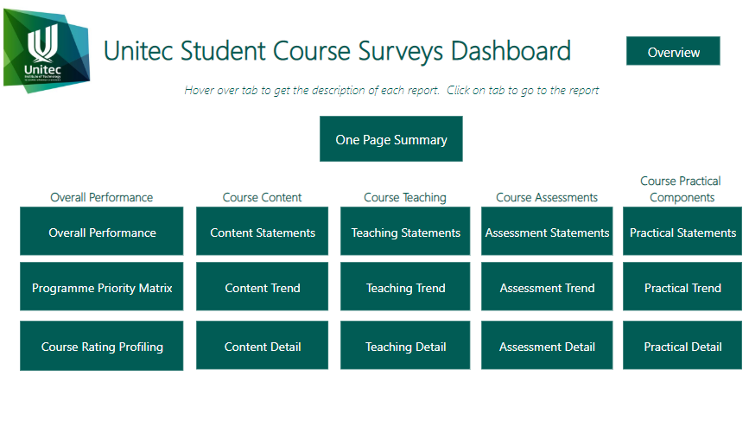
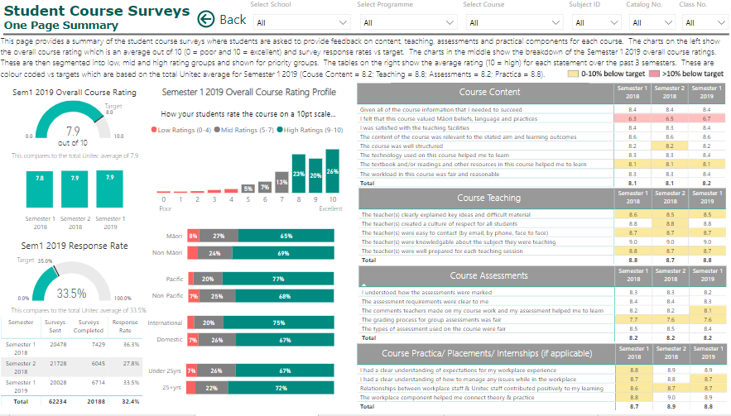

APPENDIX: Student Course Survey Programme Reporting
Overview & Process
The student course survey programme provides reporting at three levels catered for different audiences. Student verbatim comments are only included in the individual course/ class reports due to the need for confidentiality.
Reporting | Content | Audience | Location
 | Analysis of process and suggested imporvements Analysis and reporting of performance at institutional and school level Driver modelling | All Unitec staff | tbc
 | Interactive dashboard which allows you to filter data by school, programme, course, class, priority group and semester Detailed reporting of response rates, overall course ratings, course content, teaching, assessments and practical components Programme priority matrix | Heads of School Academic Leaders Programme Managers Academic Support staff | Available to all Power BI users Link
 | Course/ class specific report for current semester Student ratings and verbatim comments on course content, teaching, assessments and practical components (if applicable) | Heads of School Academic Leaders Programme Managers Course Teacher only (due to confidential student comments) | Saved in secure folders for HoS/AL/PMs to distribute to teaching staff
Institutional Report
Student Course Survey Dashboard
Course/ Class Reports
Notes:
Explain Cohort timeframes
Outline EPI measures

