Slide 1


Yammer end user guide

Slide 2

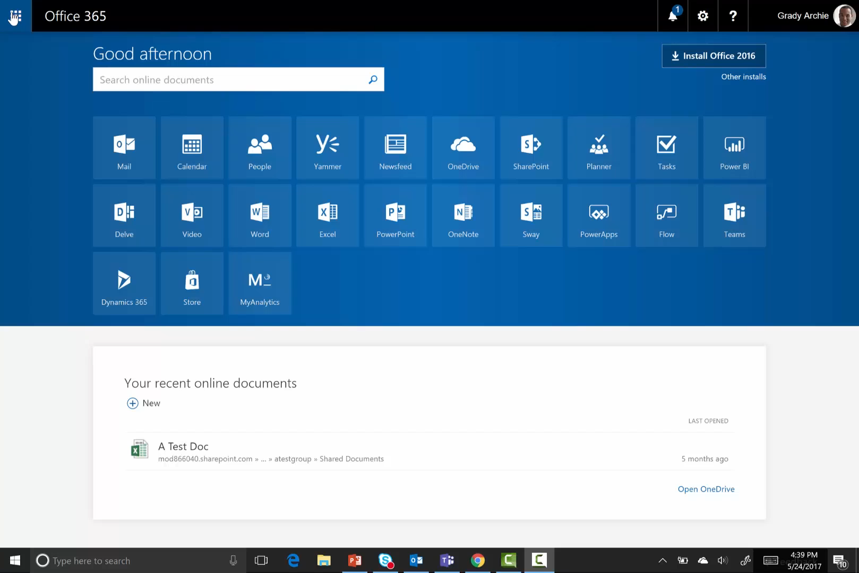
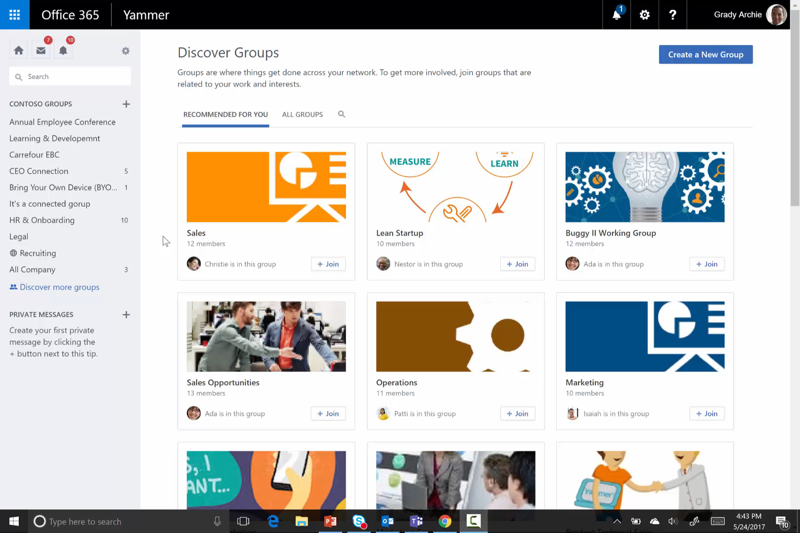
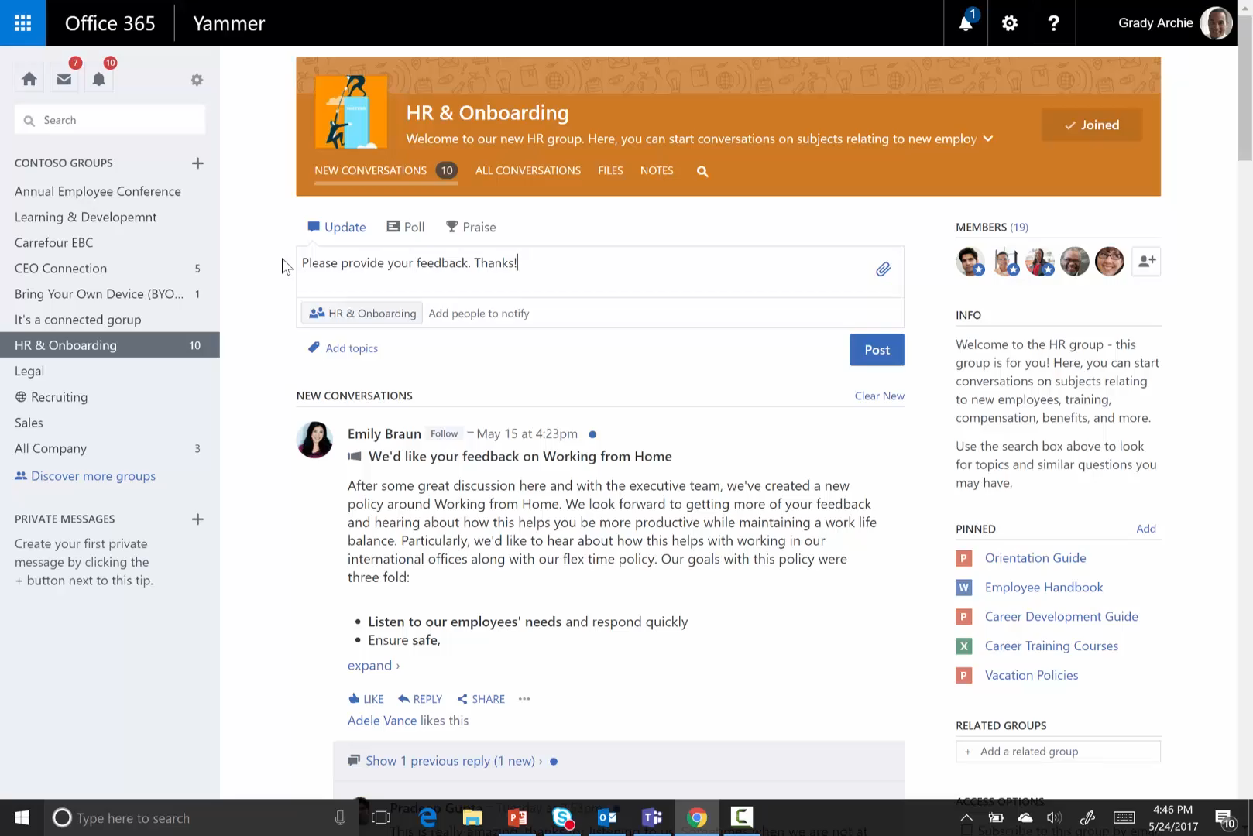
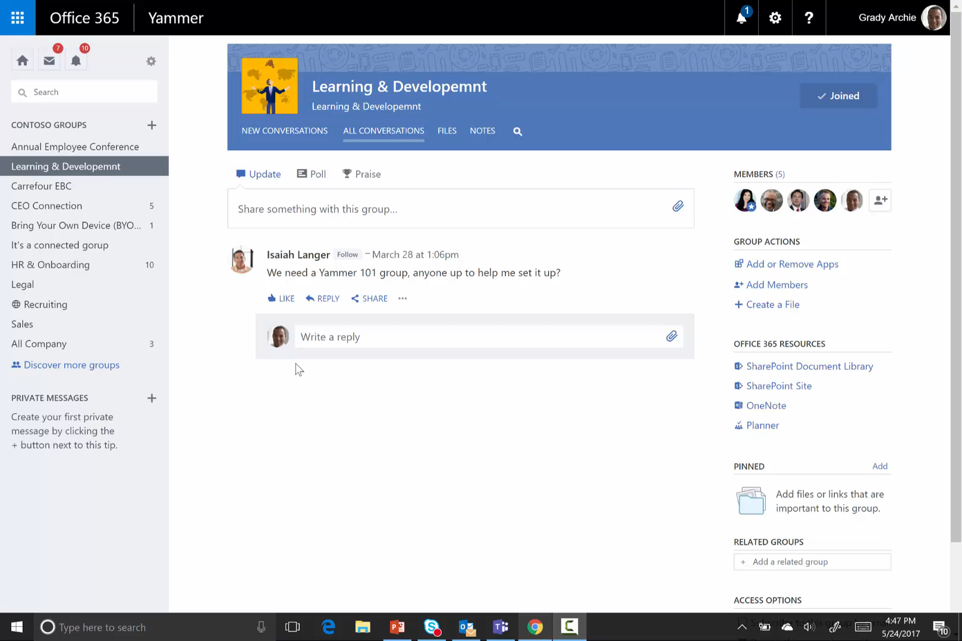
Quick Start Guide
Get started
Log in to the Yammer network and download the app.
Find out what people are saying
Join three groups related to your work and your interests.
Click to view
Click to view
Share and collaborate
Ready to move an idea forward with the group? Use shared resources to create a new resource, upload files, edit a document, or take notes.
Join the conversation
Spend 20 minutes a day scanning your feed to stay up to date. Then engage—like a post, reply to an @mention, ask a question, or add your insights to another conversation.
Click to view
Click to view

Slide 3

Table of contents
Learn how to use Yammer, a tool for connecting you with people and information across your organization.
Get started
Find discussions and groups
Participate in the conversation
Create special messages
Collaborate quickly

Slide 4





Get started
Yammer is the faster, smarter way to share and collaborate with everyone at your company. Get started by customizing your profile and notification settings, then download the app to access Yammer from wherever you are.
Sign into Yammer
Edit your Yammer profile
Set notifications
Download the Yammer mobile app

Slide 5
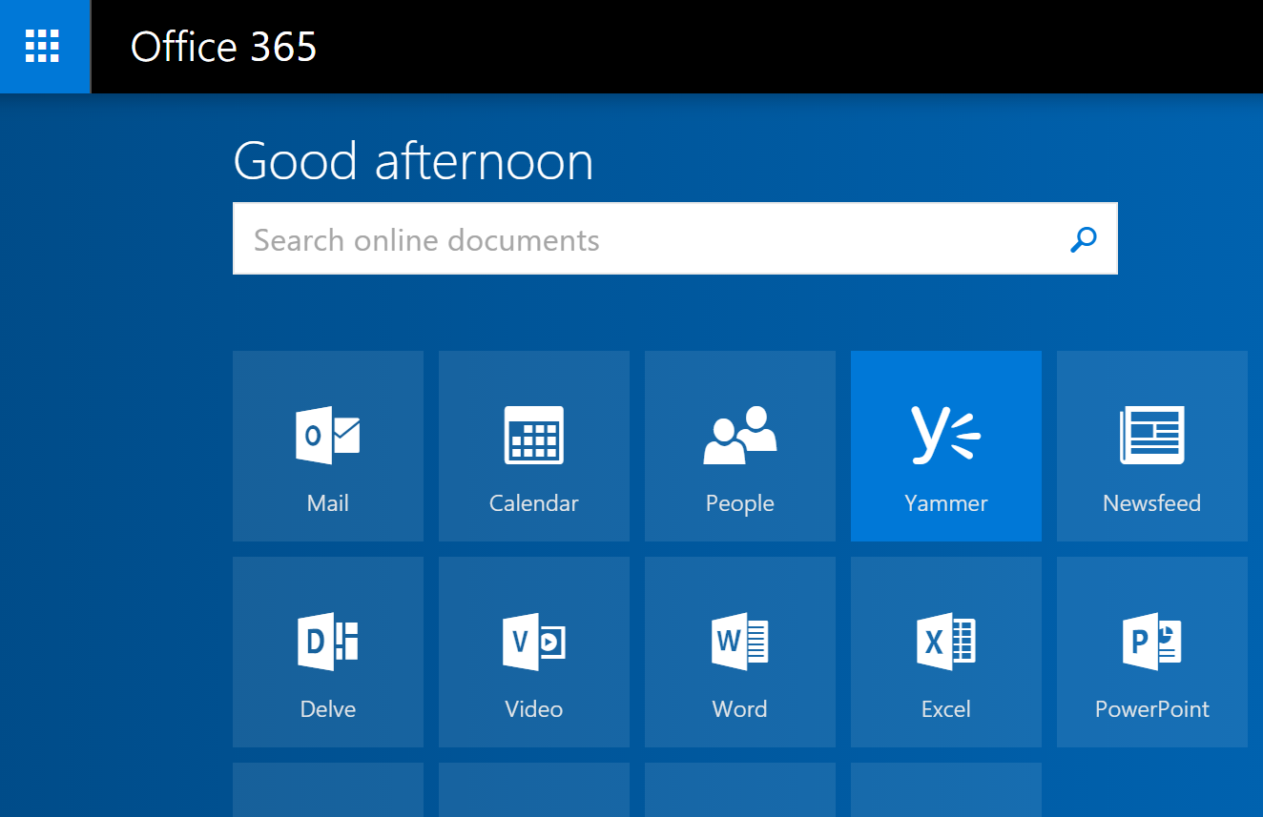
Sign into Yammer
Set up your Yammer account to connect with people across
your organization.
Inside any Office 365 application, you can access Yammer.
Click on the app launcher in the upper-left corner of your
screen and select Yammer.
Click Log in and follow the steps to enter your company email
and password.
You’ll soon receive a confirmation email to activate your account. Click the web address in the confirmation email to complete setup. You’ll automatically be redirected to your organization’s network.
1
The next time you sign in, you will go directly to your organization’s Yammer network.

Slide 6
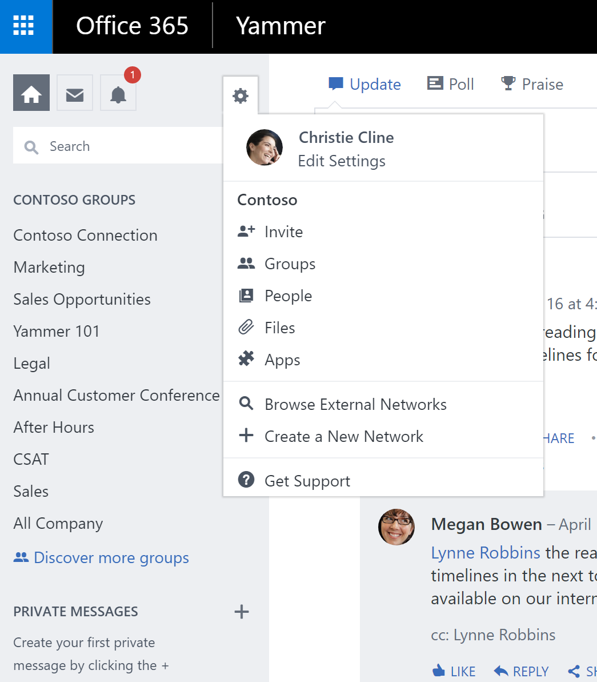
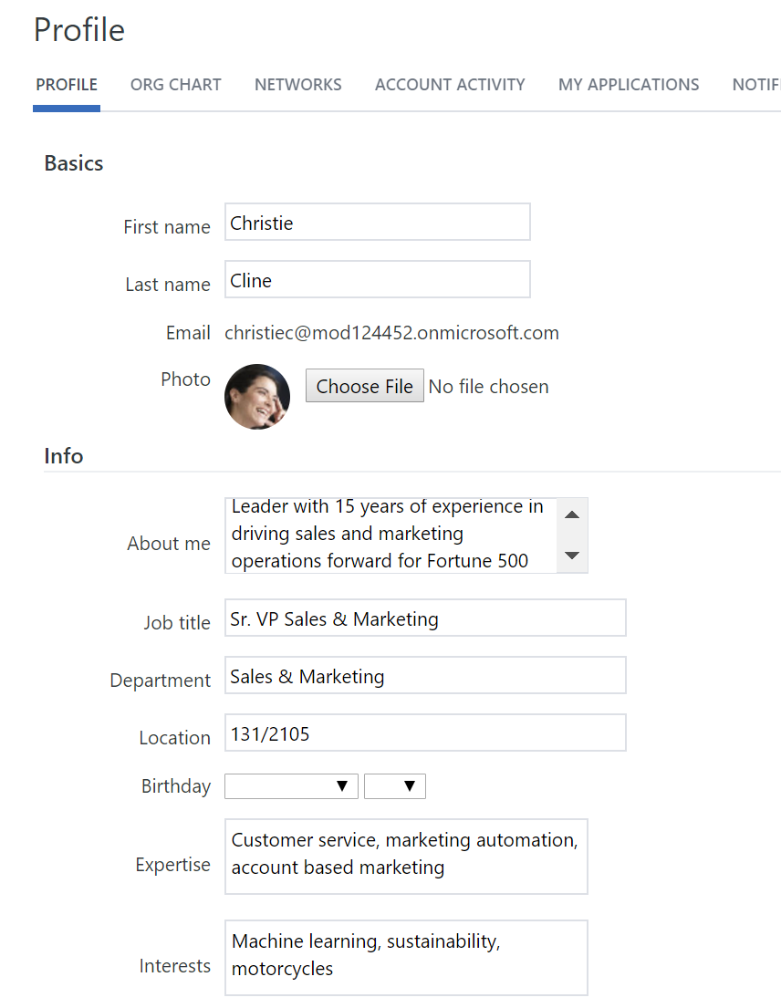

Edit your Yammer profile
1
2
  Your Yammer profile helps coworkers learn more about you, the work you do, and your interests. Yammer also uses your profile information to help you create connections and build a strong network.
  Click on the settings icon and select Edit Settings.
  On the Profile tab, add information collaborators may find helpful, like your expertise, interests, experience, and a link to your LinkedIn profile.
  Click Save.
    Pro tip: As part of Office 365, Yammer uses your organization’s directory to automatically fill in your name, email, Office 365 profile picture, job title, department, location, and work phone number.
  The next time coworkers click your name or photo, they will see your profile information.

Slide 7
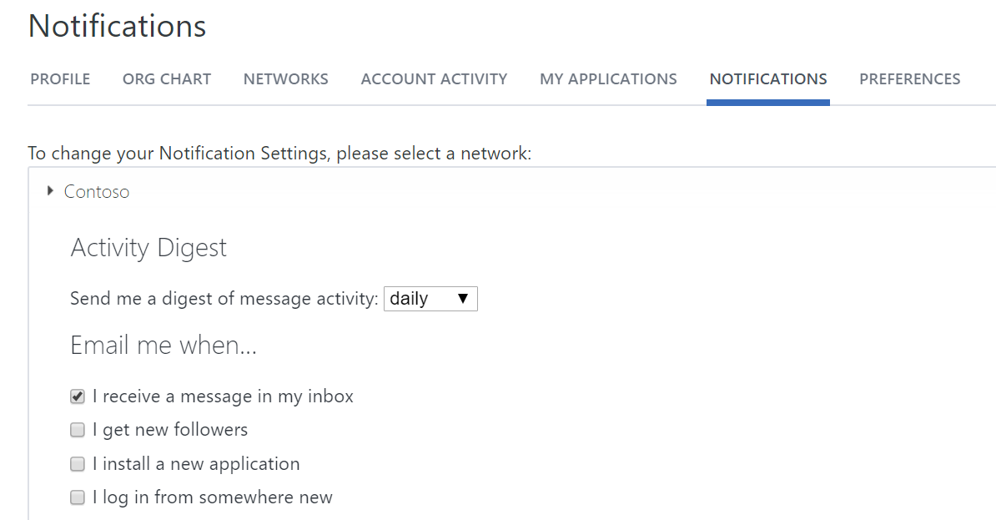
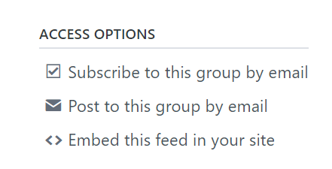
Set notifications
1
Never miss an important update in your Yammer network, and stay up-to-date on your conversations.
Click on the settings icon and select Edit Settings.
Configure your preferences on the Notifications tab.
  Activity digest sends daily or weekly emails to help you discover new activity.
  Follow groups to get notifications and messages in your Yammer inbox.
Or, on the bottom-right rail of your group, click the
checkbox next to Subscribe to this group by email under Access options.
You can receive an email every time there’s new activity in
your group.
2
3
Pro tip: Try these notifications to stay on top of your network’s activity: “Receive a message in my inbox,” “Someone invites me to a group,” and “Someone requests to join a private group I administer.”

Slide 8
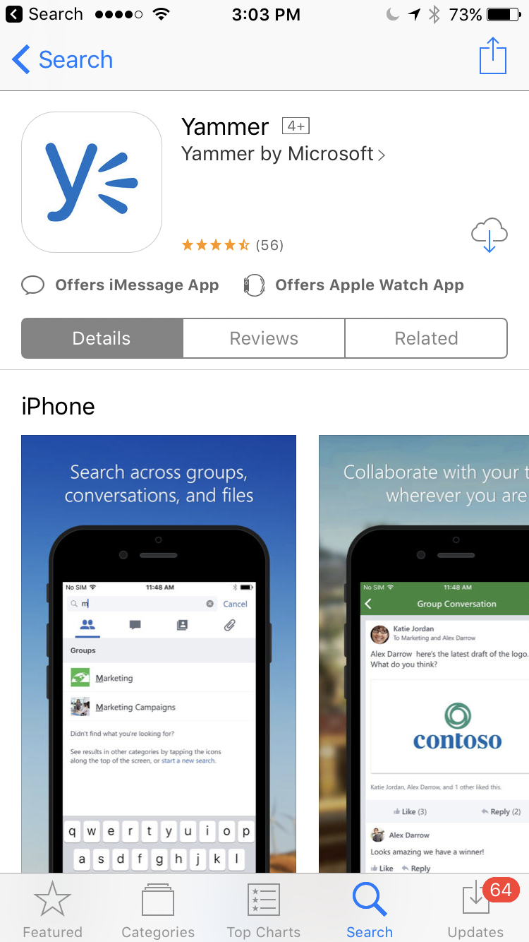
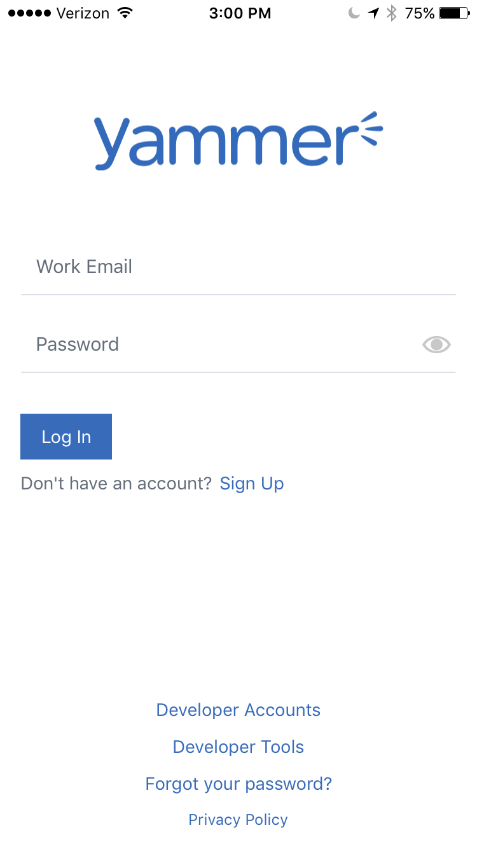
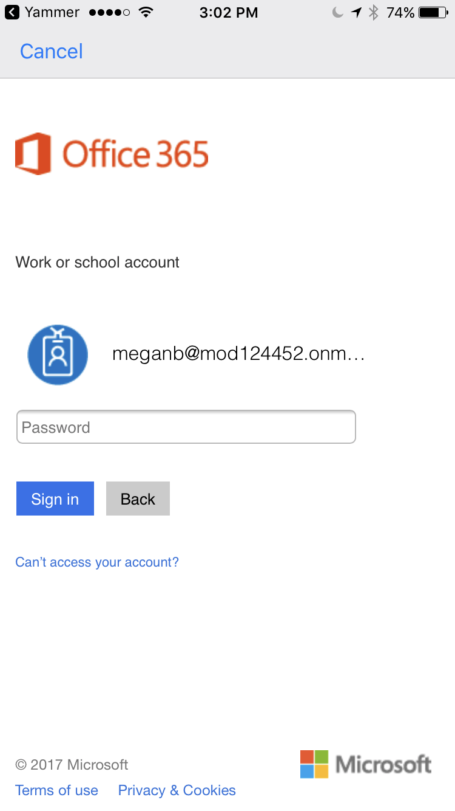
Download the Yammer mobile app
1
Stay connected when you’re on the go with the Yammer app.
Go to your phone’s app store, search for “Yammer,” and download the free app.
Sign in for the first time using your work email and password.
For security reasons, your organization may require you to enter your password again.
After entering your credentials for the first time, you should be able to jump right into your conversations any time you open up the Yammer app.
2
3

Slide 9


Find discussions and groups
Tap into your organization’s most valuable resource—its people. Discover other groups that match your interests, and find conversations and content that are relevant to you.
Discover conversations
Search for answers
Join an existing group
Create a new group

Slide 10
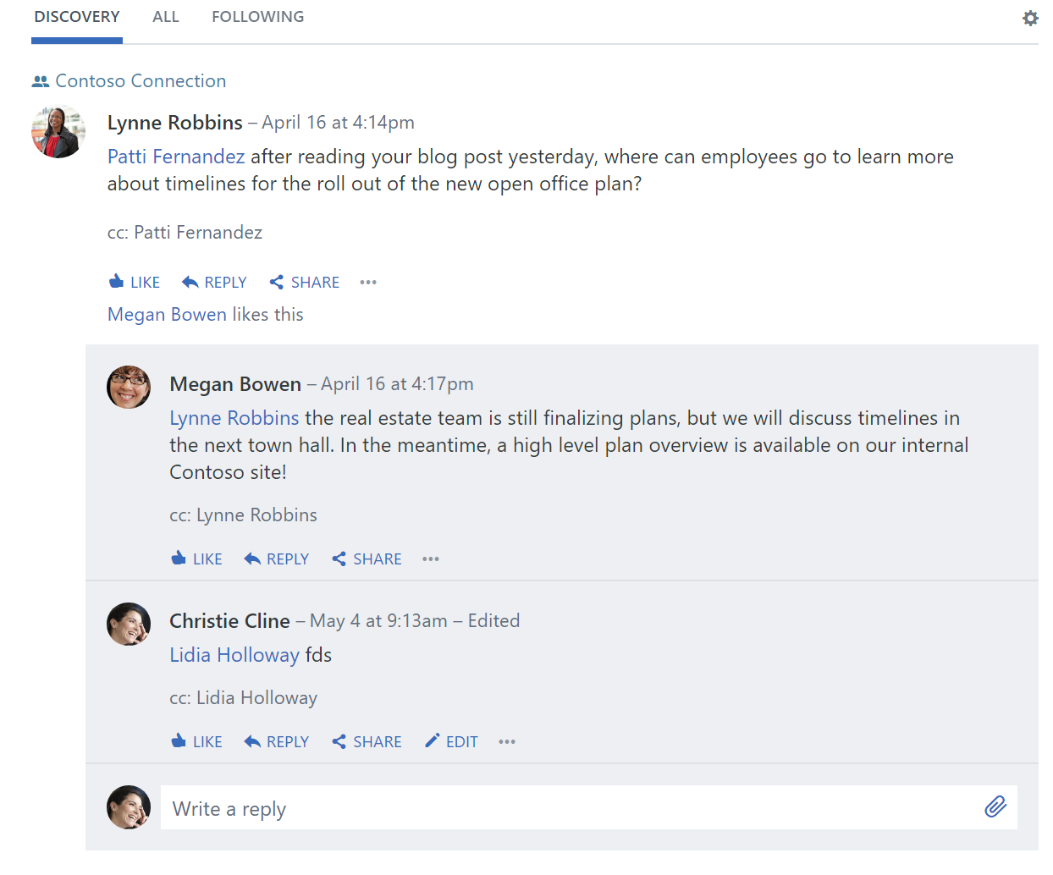


Discover conversations
3
Uncover helpful information through conversations happening in your network. Build off the work of others by discovering conversations in your home feed.
Click on the Yammer home tab on the left rail.
The Discovery tab suggests conversations relevant to you based on what you subscribe to and interact with on your Yammer network.
The All tab shows all conversations you can access on your organization’s network.
The Following tab shows the conversations that you are subscribed to, followers have participated in or liked, or have been tagged with a topic you follow.
2
4
1
    Pro tip: Follow someone on Yammer to see when they post content that might be interesting to you. Just hover over their
    name and click the + Follow button.
Every time you visit the Discovery, All, and Following feeds, you will see the newest information available.

Slide 11
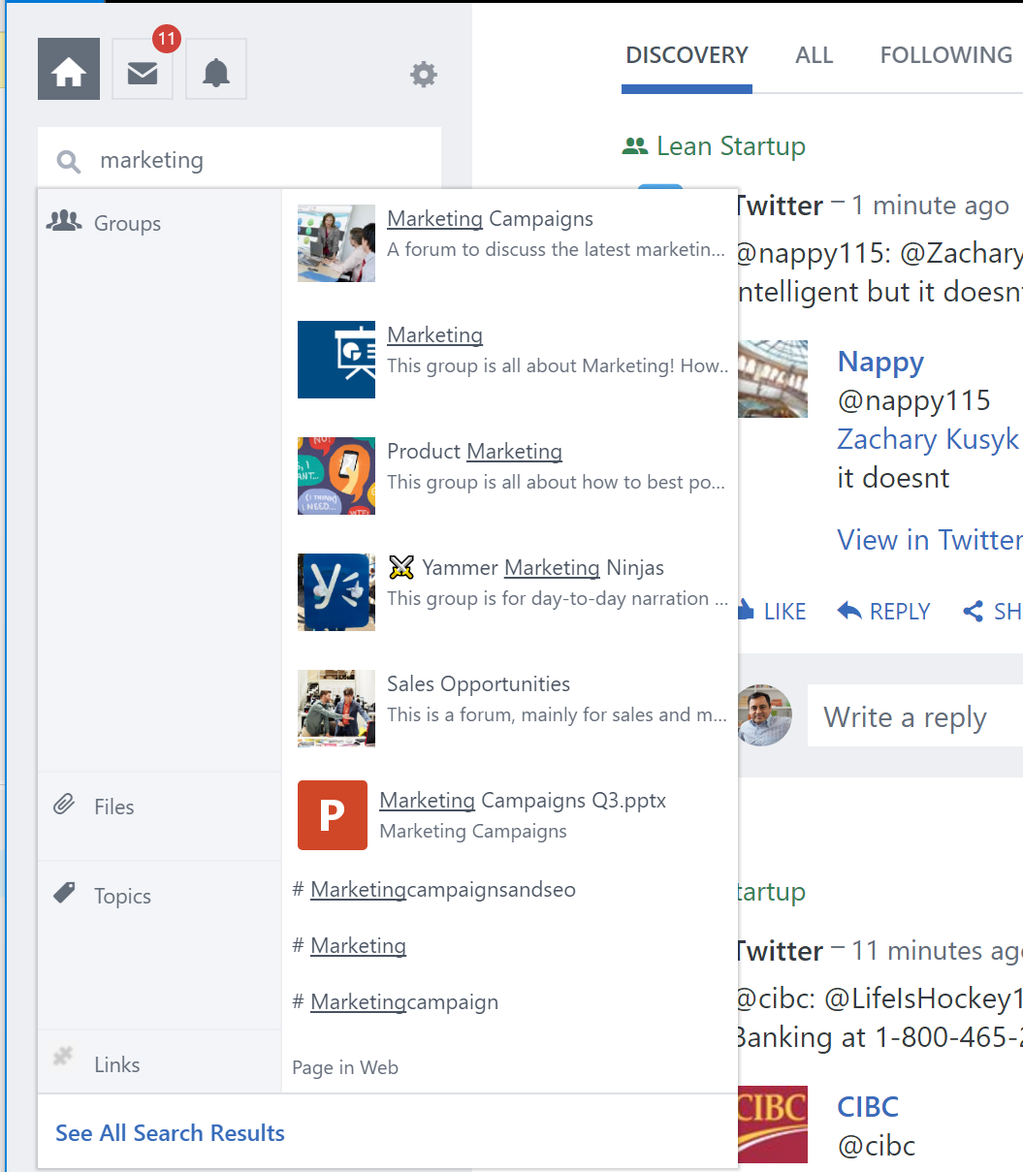
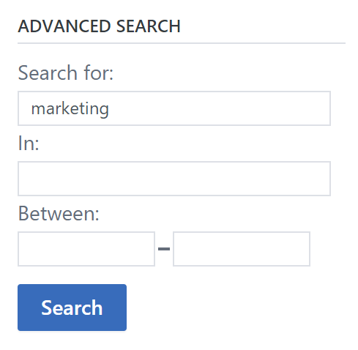
Search for answers
1
Search Yammer to quickly find files, conversations, people, notes, and data across your network.
In the left side rail, in the Search bar, type in related keywords to find what you need. As you type, a list of categorized results is displayed with suggested people, groups, files, topics, and links.
If you don’t see what you’re looking for, click See all search results. Browse the complete search results, which are categorized by tabs.
If you need to narrow your search, use Advanced search on the Search Results page.
2
3
Yammer connects you with the information you’re looking for and others who have similar questions.
Pro tip: You can also search within a group by clicking on the Search icon in the group header.

Slide 12
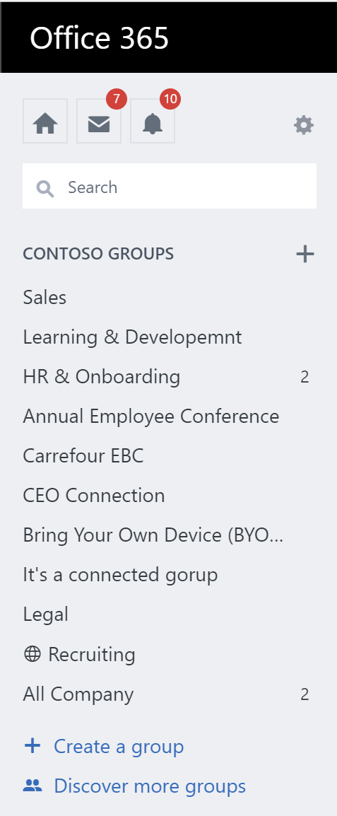
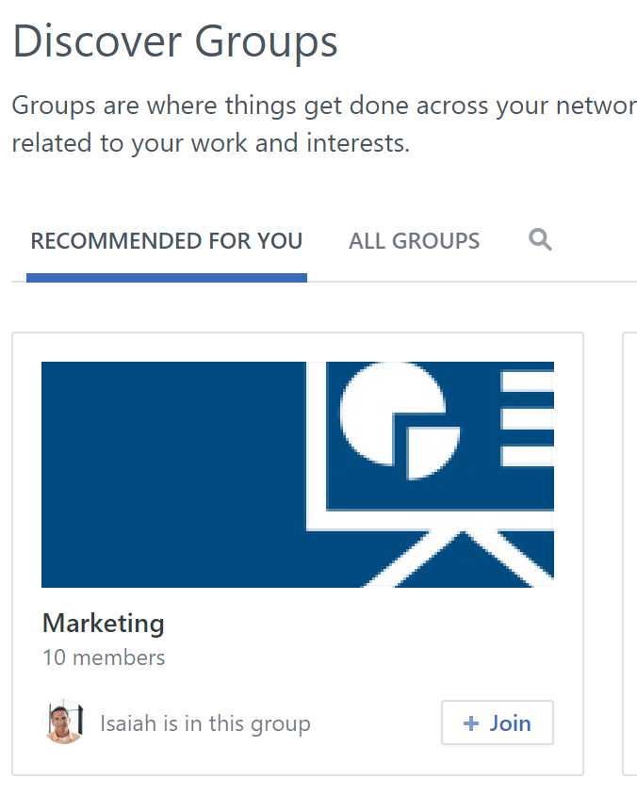
Join an existing group
2
Groups are a great way to stay informed about a topic or collaborate with communities of people. Some groups are public and easy to join, while others are private and require approval.
On the left navigation, click Discover more groups.
Browse or use Search to find groups. Read through descriptions, scroll through the group feed, or look at members to figure out if the group is relevant to you.
  The All Company group is the default group, and you’re automatically part of it.
Click + Join when you find a group that interests you.
  If the group is public, you will be instantly added to it; if it is private, the group administrator will need to approve your join request.
All groups you are a member of will appear in the left navigation pane.
3
1
Pro tip: Every group has an email address. Find it by clicking Post to this group by email under Access options.

Slide 13
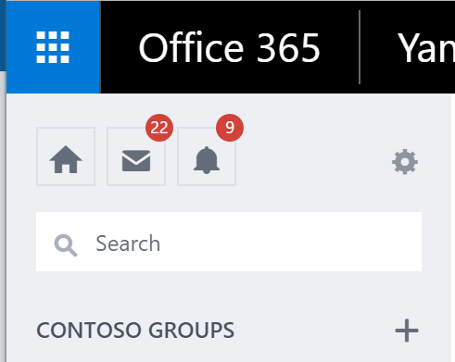
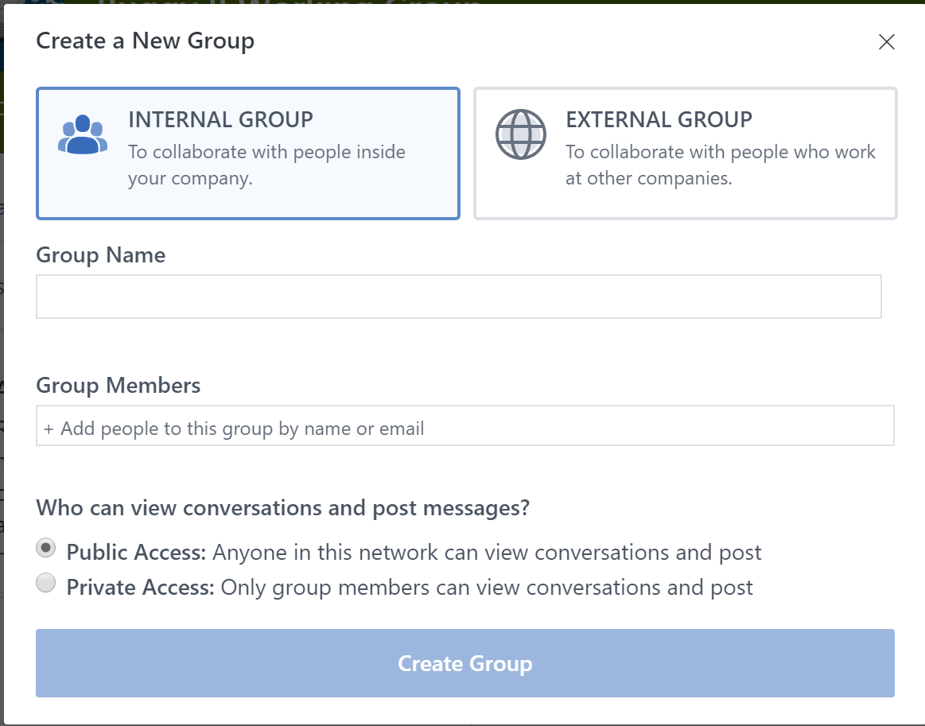

Create a new group
Don’t see a group for your interest, or want to create a group for a new project? Start a new group and customize it for your members.
In the left navigation, click the + sign.
Select the group type (Internal or External), type a Group Name, add Group Members, and set access to Public or Private.
  When an external group is created, members from outside your organization will only have access to the information and conversations of that specific group.
  Public groups are available to anyone in your network
  to join; access must be granted to new members in a
  Private group.
Customize your group information by clicking the gear icon
in the group header. Edit group settings like the description,
group image, and group header.
Your group is now active and will appear in your network’s group list.
2
1
3
    Pro tip: You can bulk add members to a group from a CSV file in group settings.

Slide 14

Participate in the conversation
Work out loud and let others know you’re listening. Join in, add insight, and engage with everyone at your company.
Like and reply to posts
Post an update
Attach a file

Slide 15
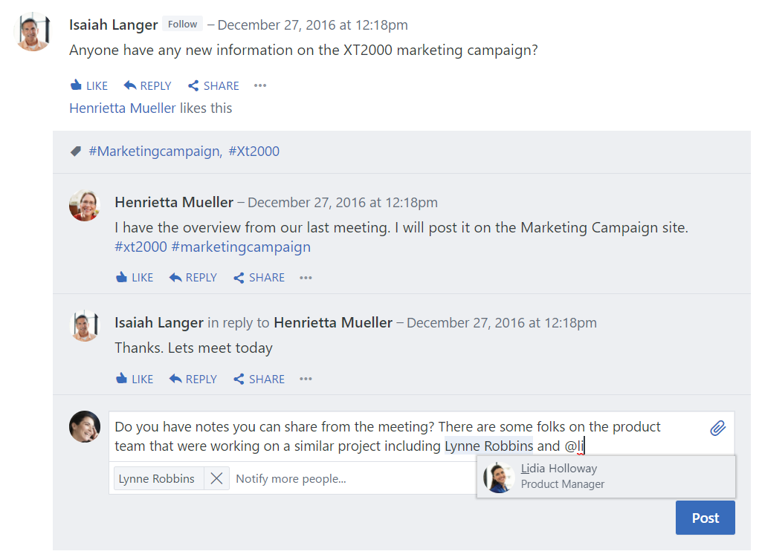
Like and reply to posts
1
  Yammer makes it easy to engage with your colleagues and keep the conversation going wherever you are.
  Click Like on a post to indicate that you agree with an idea, have seen a message, or just want to let someone know you find what they’re saying helpful. Yammer will show how many people have liked the message, including yourself.
  Click Reply to add your insights or ask a question.
  @mention other people who can contribute to the conversation or would find it helpful. @mention also triggers an email by default so you can be confident they’ll see your post.
  You can also Notify more people of your message in the text box below.
  Click Post.
2
4
3
  Pro tip: Yammer helps you reply to the right person when there are already several replies; look at the top of the Reply box to see who you’re replying to. Yammer also lets people know when you’re replying directly to them.
  Your reply will appear in the conversation thread.

Slide 16
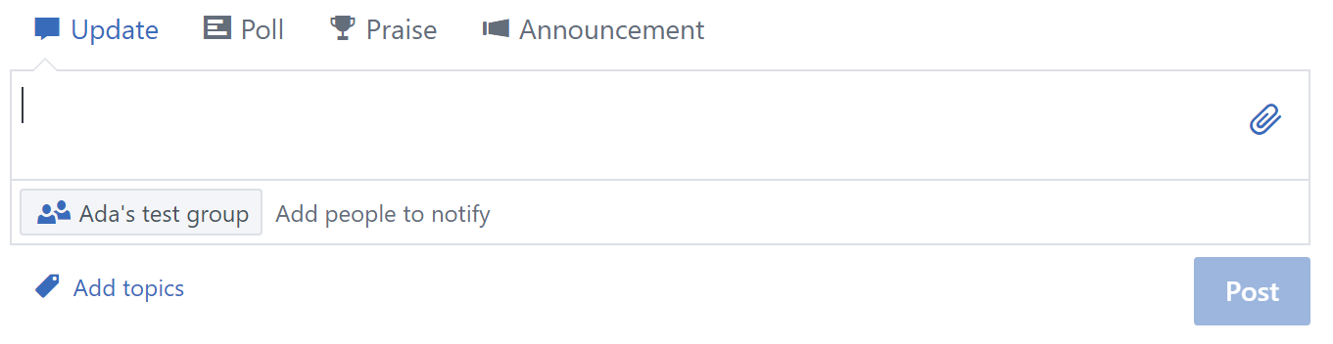
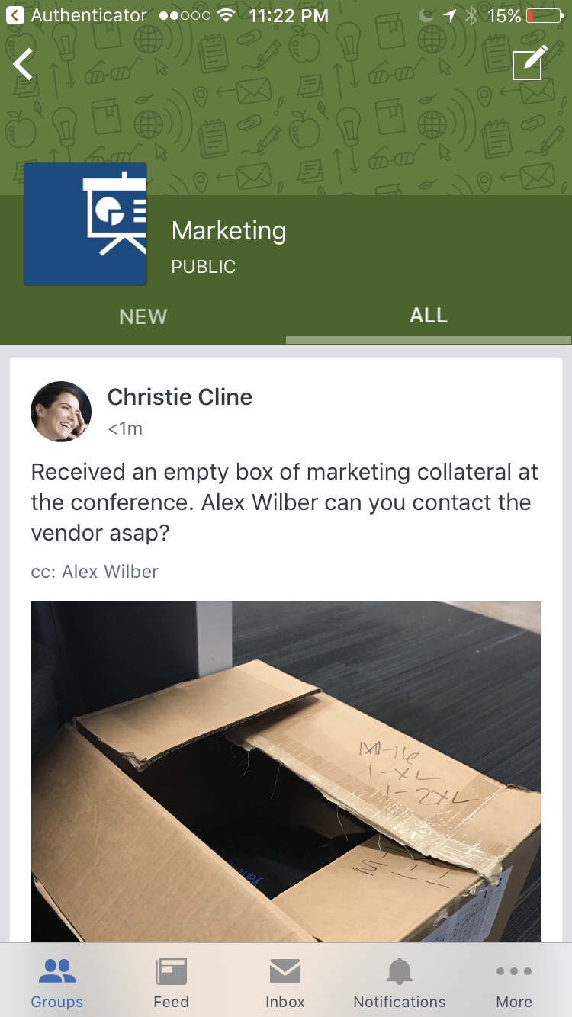
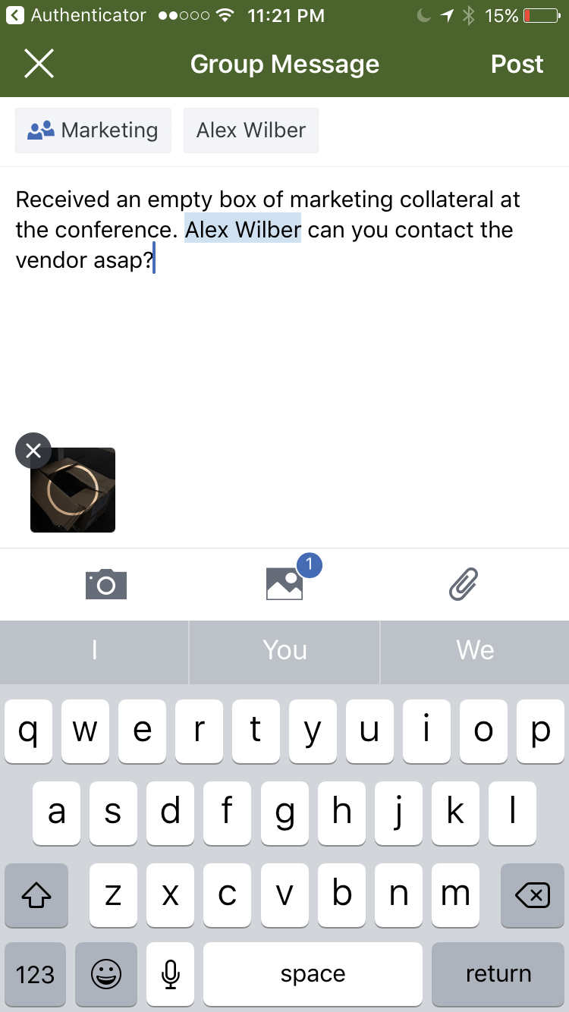
Post an update
2
1
  Start a new conversation by sharing updates and information others across your organization will find useful or interesting.
  On web and desktop, click on Update in the box at the top of the group and enter your message.
  On mobile, click on the Post pencil icon on the upper-right side of the group.
  Type in your message. Hashtag (type ‘#’) topics relevant to the message to help others discover your update.
  Upload videos, photos, and documents for context or collaboration.
  When you have finished, click Post.
4
Pro tip: If you make a mistake, you can click Edit to alter your original post.
  Your post and any files you’ve added will appear in the group feed.

Slide 17
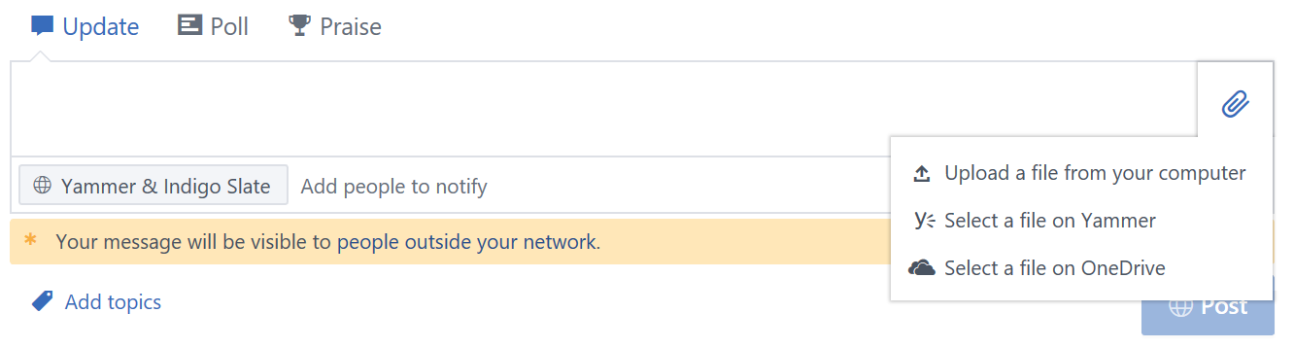
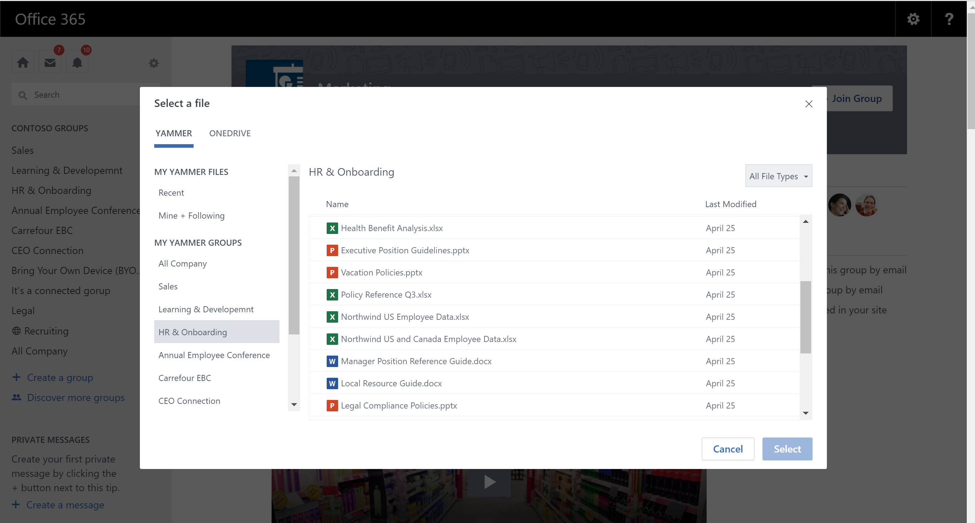
Attach a file
1
Easily share resources for others to leverage, or get feedback on your work in real time.
Click the Attach paperclip icon inside the Update or Reply
text box.
Select a file location (your computer, Yammer, or OneDrive).
Locate the file and click Select.
Type a message to give context to your colleagues, and @mention people who will find the file helpful, if you like.
Click Post.
2
3
Pro tip: Pin a file for easy access in the future. The file will then appear under “Pinned” on the right side of the screen.
The file will be embedded into the thread.

Slide 18

Create special messages
Communicate however is best for your message, your audience, what you want to know, and what you have to share. Yammer offers a variety of ways to interact with the people in your network.
Create a Poll
Praise a collaborator
Make an announcement
Send a private message
Share a conversation

Slide 19
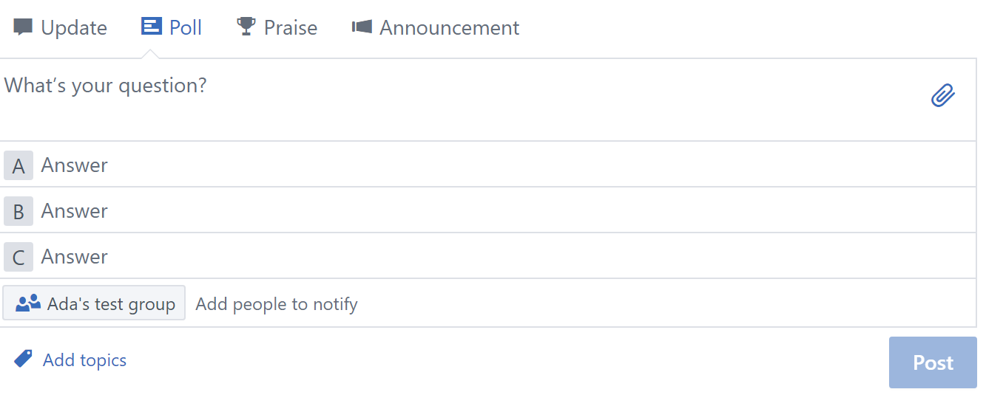
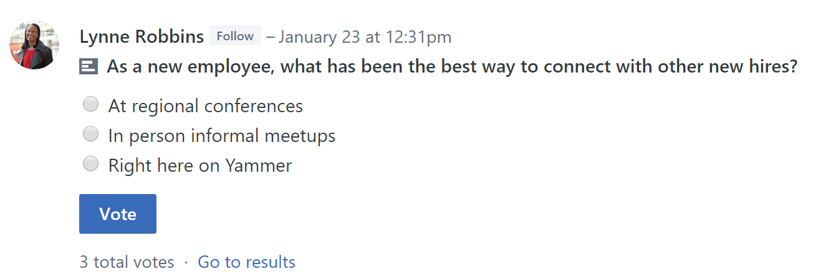
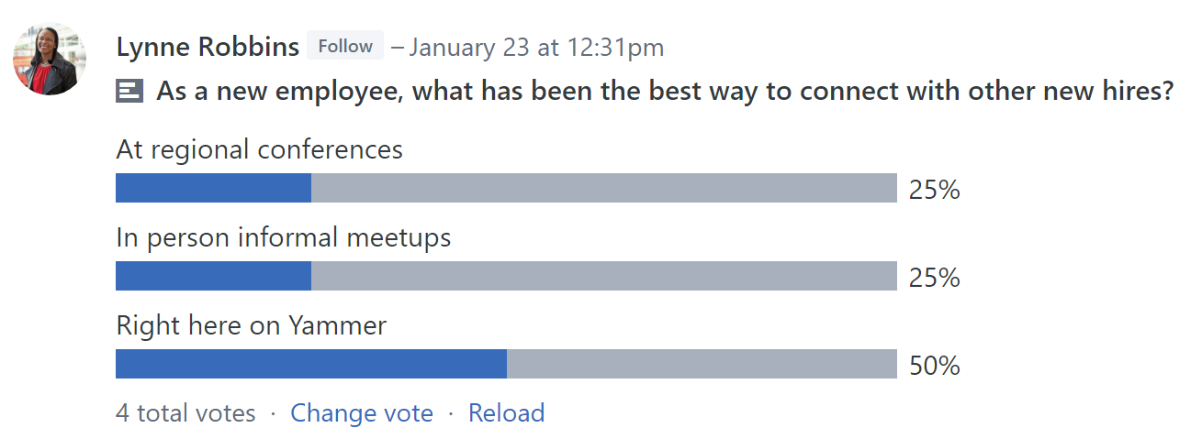
Create a Poll
1
2
Need to crowdsource feedback, or want to get a pulse on your company? Use polls to create a quick survey and get answers fast.
At the top of the group page, click Poll.
Type your question and options for answers.
Click Post.
Your collaborators can vote on your poll by selecting an answer option and clicking Vote. Don’t worry, Yammer won’t show who voted for what option. You can always change your vote if needed.
Once posted, click Go to results.
3
4
5
Your poll results appear in the group feed.
Pro tip: Yammer recalculates the percentage of responses, so the numbers are updated every time the group page is refreshed.

Slide 20
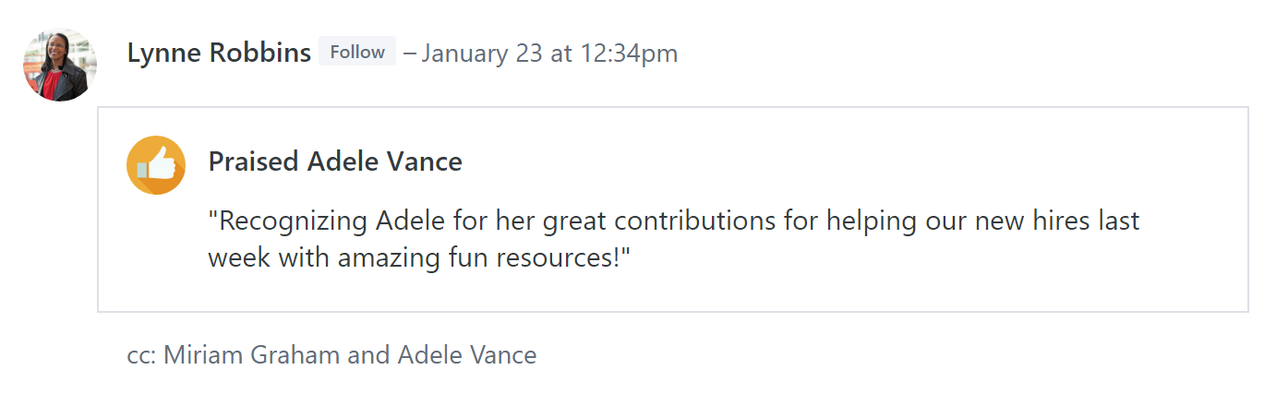
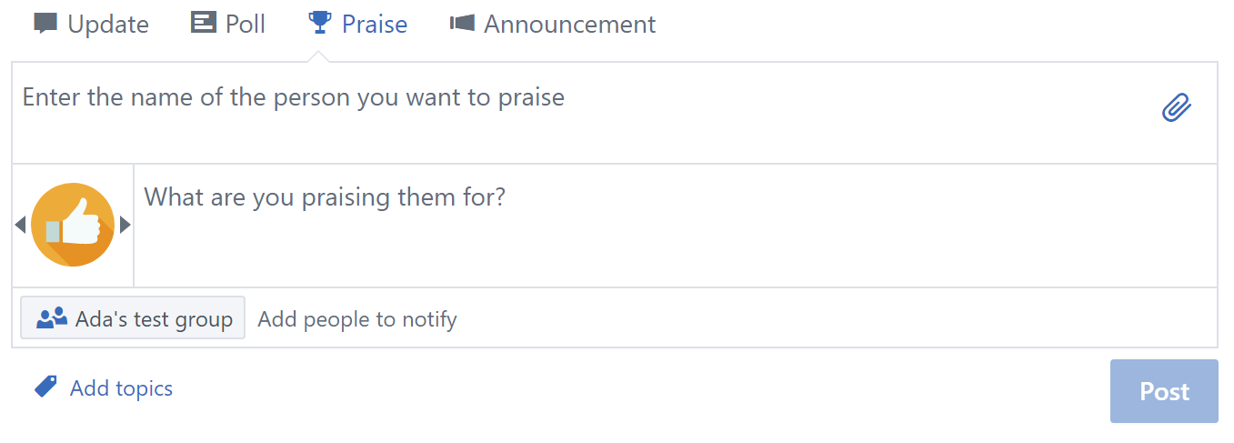
Praise a collaborator
  Good work should always be recognized. Praise people in your network who have shared valuable business knowledge or skills, or celebrate successes.
  At the top of the group page, select Praise to display the Praise dialog box.
  Enter the name of the person you want to praise in the top box. You can enter more than one.
  Use the left and right arrows to select a fun praise image.
  Enter your message in the lower box, where it asks, What are you praising them for?
  It’s a good idea to add the person’s supervisor to the Add people to notify box so they have visibility into a job well done.
  Attach a file or Add Topics, if you like. When done, click Post.
2
1
3
4
5
Pro tip: You can Praise multiple people in the same post.
Your Praise will appear in the group page.

Slide 21
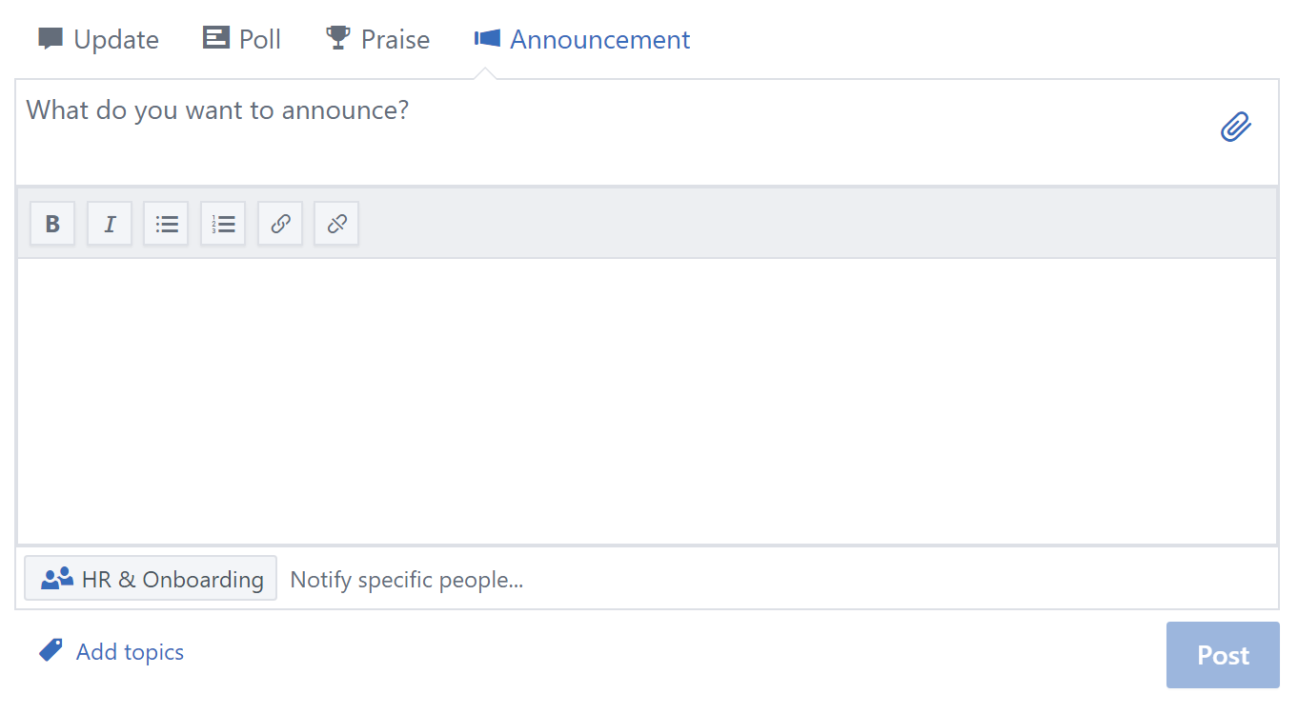
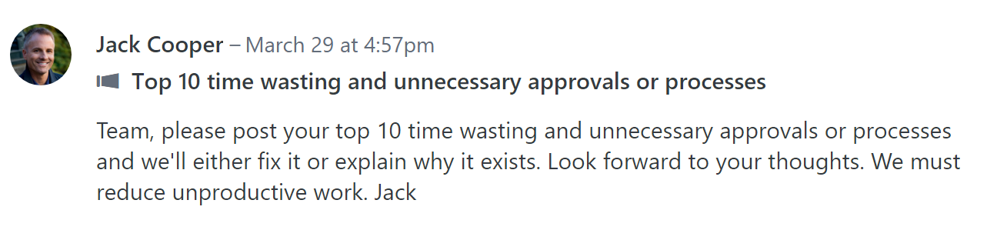
Make an announcement
1
2
3
  Group administrators can make announcements to share
  need-to-know information with the entire group.
  Click Announcement.
  Type a title in the box What do you want to announce? If you do not fill in the title, your announcement won’t send.
  Type the body of your announcement in the blank box below. You can format your announcement with bold, italics, bullet points, or numbered paragraphs, and include a hyperlink, if you like.
  Attach a file, Notify specific people, or Add topics, if
  you like.
  Click Post.
4
5
Pro tip: Office 365 Network Admins can make an announcement in any group, including All Company.
Members will see a notification about the announcement in their inbox, and also receive an email by default.

Slide 22

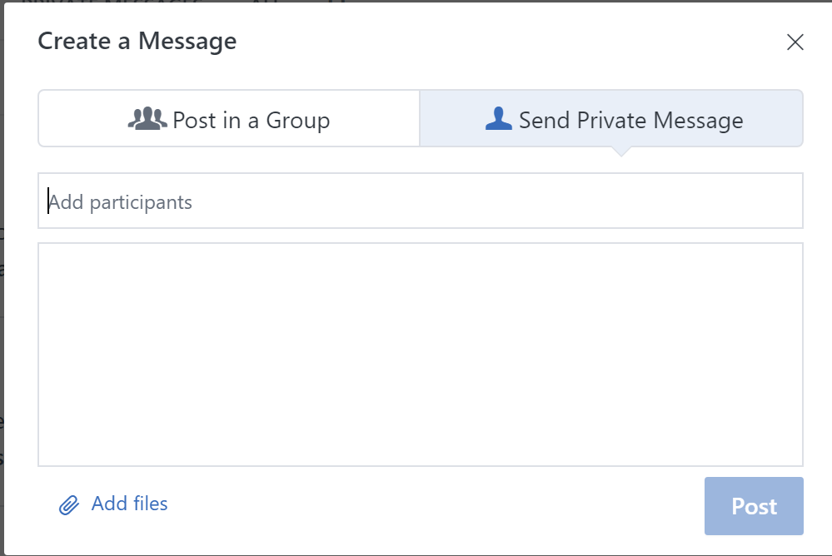
Send a private message
1
  Sometimes you need to have a private conversation with an individual or small number of people in your network. You can send a private message that won’t be posted to the group page, and will be delivered directly to your recipient’s Inbox.
  To quickly send a private message, scroll over the person’s name anywhere you see them in Yammer, and click Send Message.
  You can also send a private message from your Inbox.
  Click the Inbox icon on the upper-left rail.
  In your Yammer Inbox, click Create Message.
  Select Send Private Message.
  Type the name of the person or people in the Add Participants box, and then type your private message in the blank box below.
  Add files, if you like, and click Post.
2
3
4
Pro tip: Yammer displays an icon showing whether people in your network are online or available via the Yammer mobile app.
  The private message will appear in their Inbox, and they will receive a notification in Yammer.

Slide 23

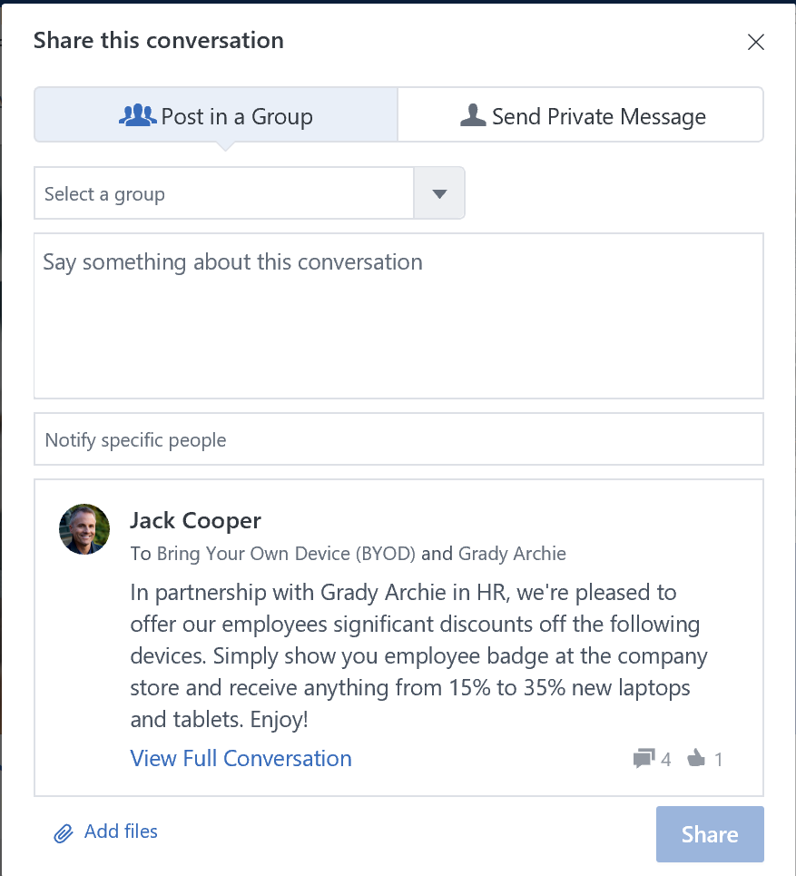
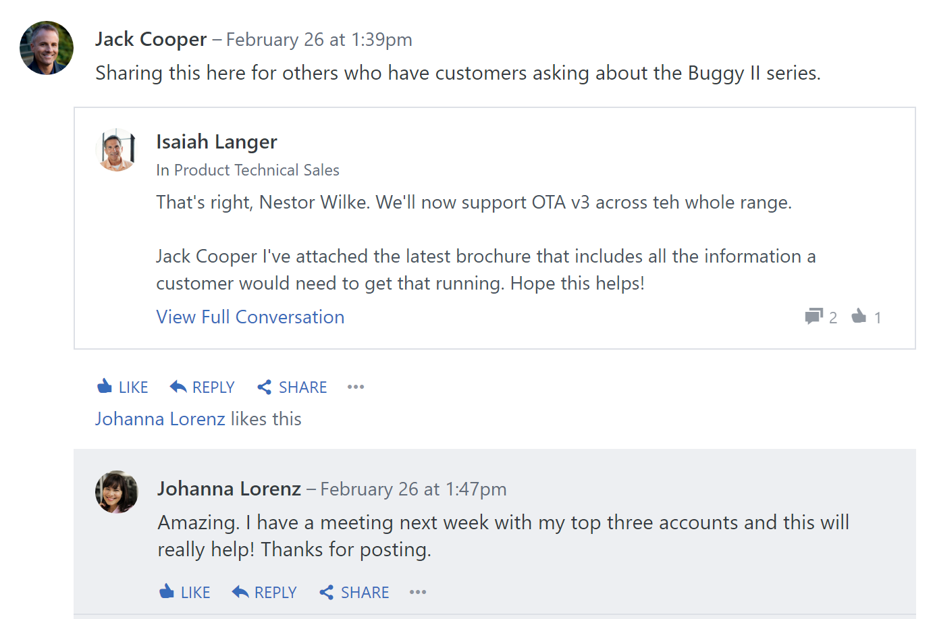
Share a conversation
1
2
4
Share conversation threads across groups to add even more voices to the conversation. Sharing threads builds on existing conversations instead of fragmenting them around the same topic.
On an existing post, click Share.
In the window, select Post in a Group or Send Private Message.
If you are sharing to a group, Select a group from the
drop-down menu.
Enter a personalized message in the Say something about
this conversation box.
Notify specific people and Add files, if you like.
Click Share.
3
5
6
Pro tip: Yammer displays the number of times the conversation has been shared at the top
of the thread.
The conversation will now appear in the feed of the group you specified or as a Private Message to the specified recipients.
Now your collaborators can reference and join the conversation.

Slide 24

Collaborate quickly
Not only does Yammer connect you with the people and information you need to achieve more, it also gives you the tools to work better together, no matter where your collaborators are.
Create a new document
Edit a document
Take group notes
Share from anywhere in Office 365*
Use shared group resources*
*Requires Yammer group to be connected to Office 365 groups

Slide 25
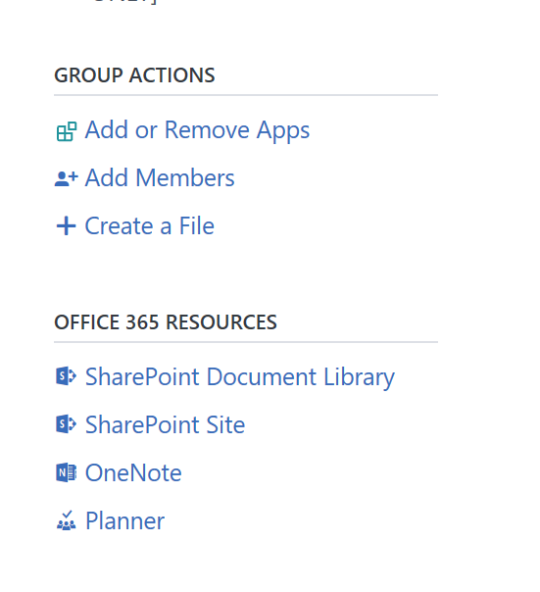
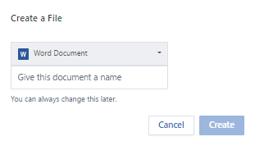
Create a new document
You don’t have to leave Yammer to create new files in Word, PowerPoint, or Excel.
In the right rail below Group Actions, click on + Create a File
Select Word Document, PowerPoint Presentation, or Excel Workbook from the pull-down menu and give your new file a name.
Click Create.
1
3
The new file will appear in the list for anyone in the group to access.
2
Pro tip: To invite others to review or edit a new file, notify them by attaching the file to an Update. Choose Select a file on Yammer in the dropdown menu under the paperclip icon.

Slide 26
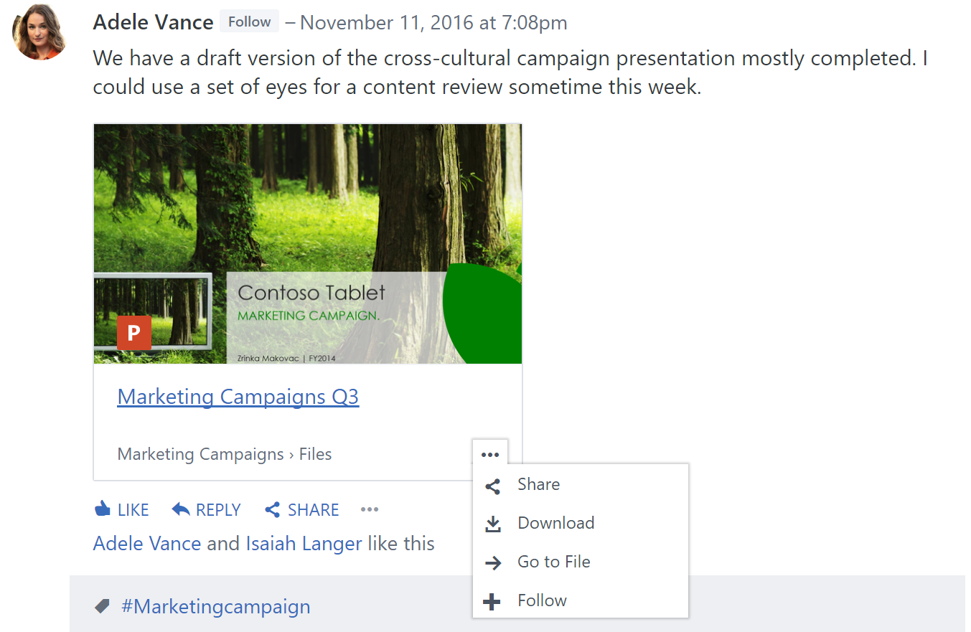
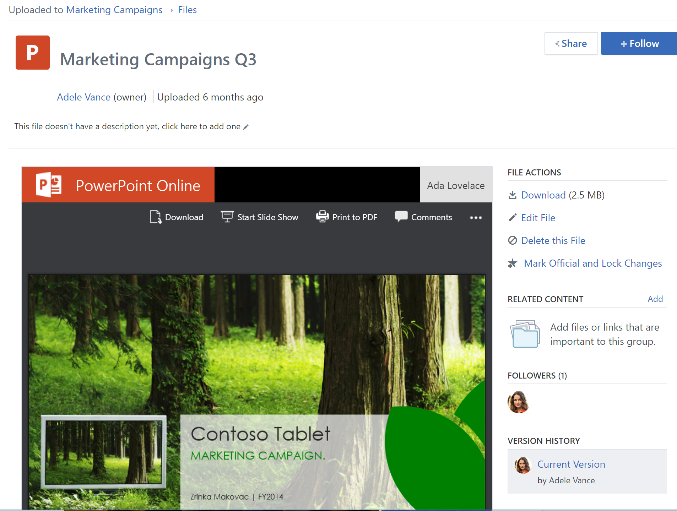
Edit a document
With real-time coauthoring, you and your colleagues can edit a single version of a file simultaneously, without causing version control issues.
Click on the file you wish to edit from the Files list, or click
Go to file on a document in your feed.
On the right side of the screen, click Edit file.
Make your edits in Word Online, PowerPoint Online, or
Excel Online.
1
2
Updates are saved to the file automatically.
Pro tip: To retrieve previous versions of a file, click Version History. You can also Mark Official and Lock Changes when all edits are complete.

Slide 27
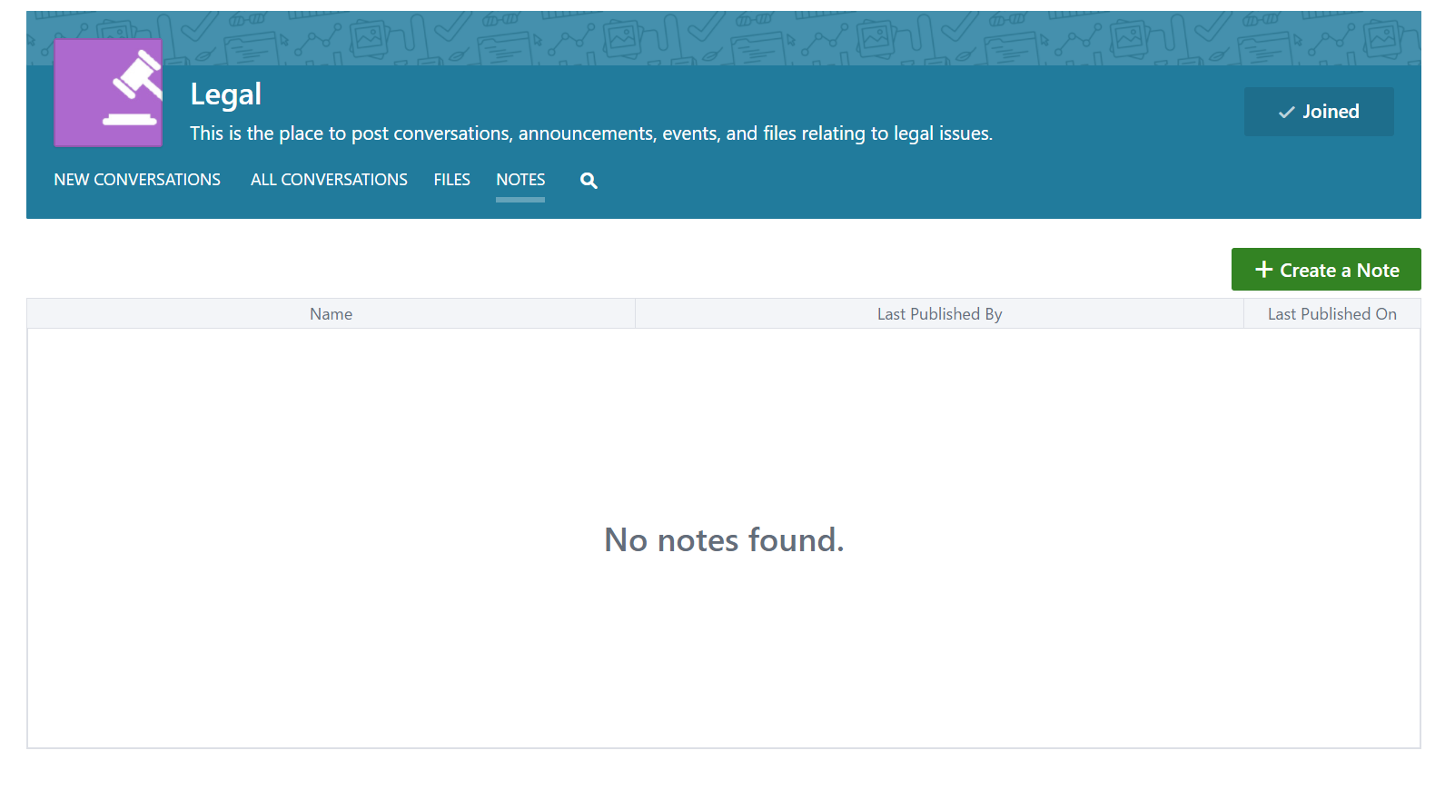
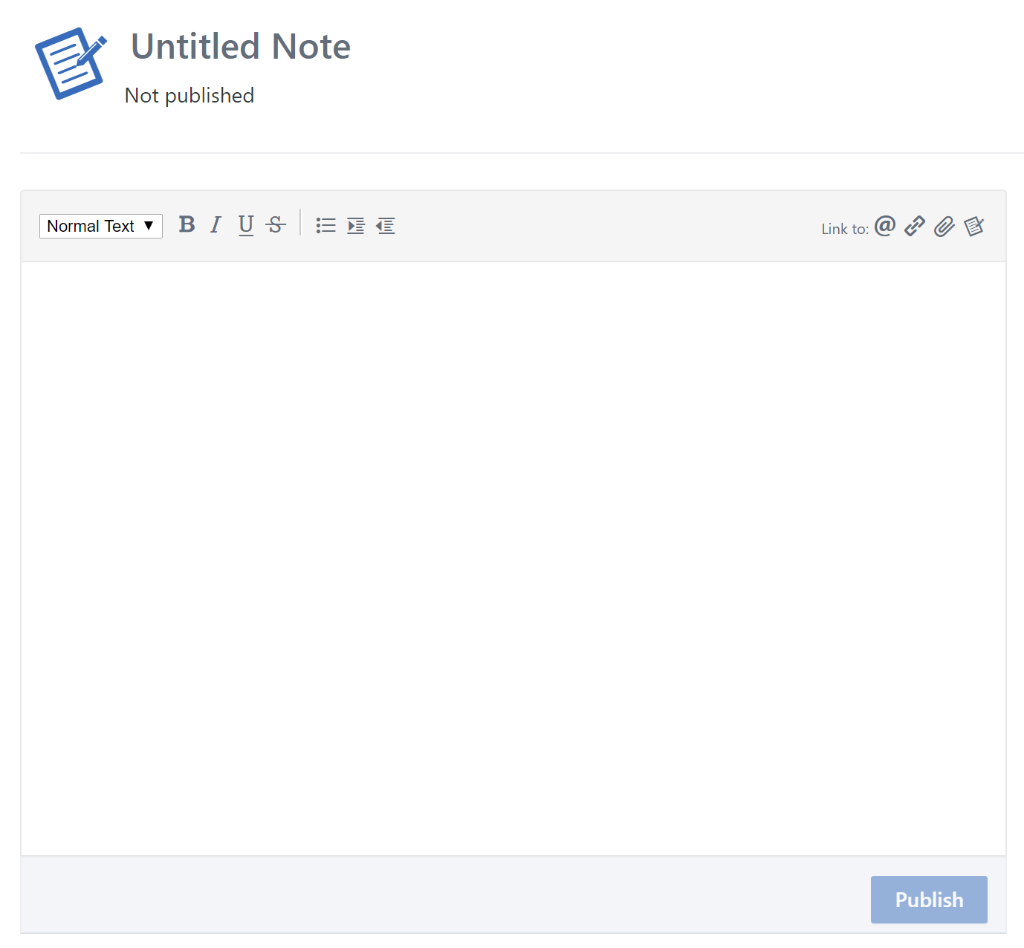
Take group notes
1
2
Use a single consolidated location for note keeping to move work forward and reference later.
In a group page, click on Notes.
Click + Create a Note.
Enter a title for the note and your text.
Click Publish.
3
Notes will be retained in this location and sorted by most
recent date.
Pro tip: Notes can be edited, deleted, or marked as final by anyone in the group.

Slide 28
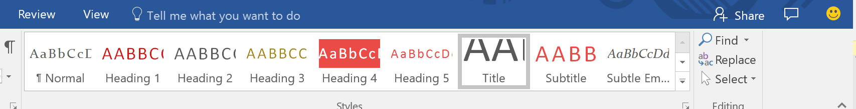
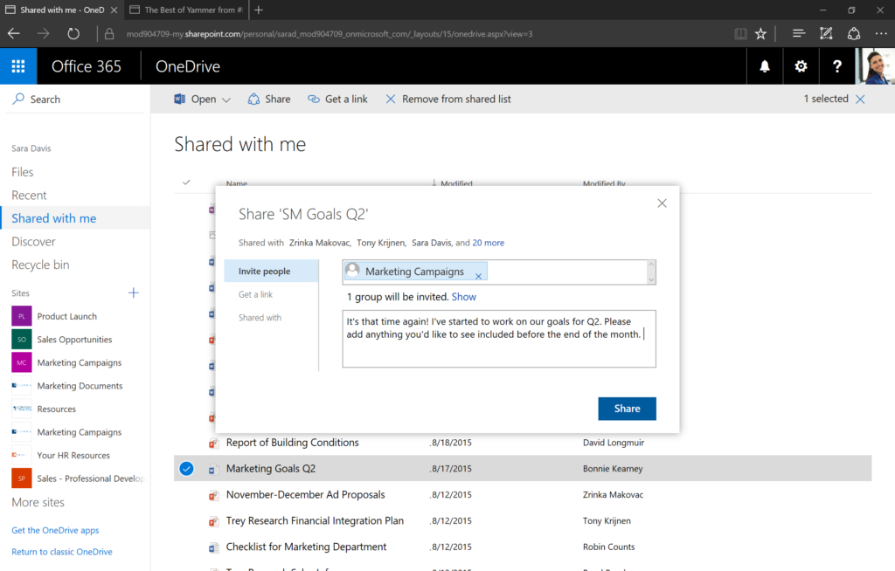
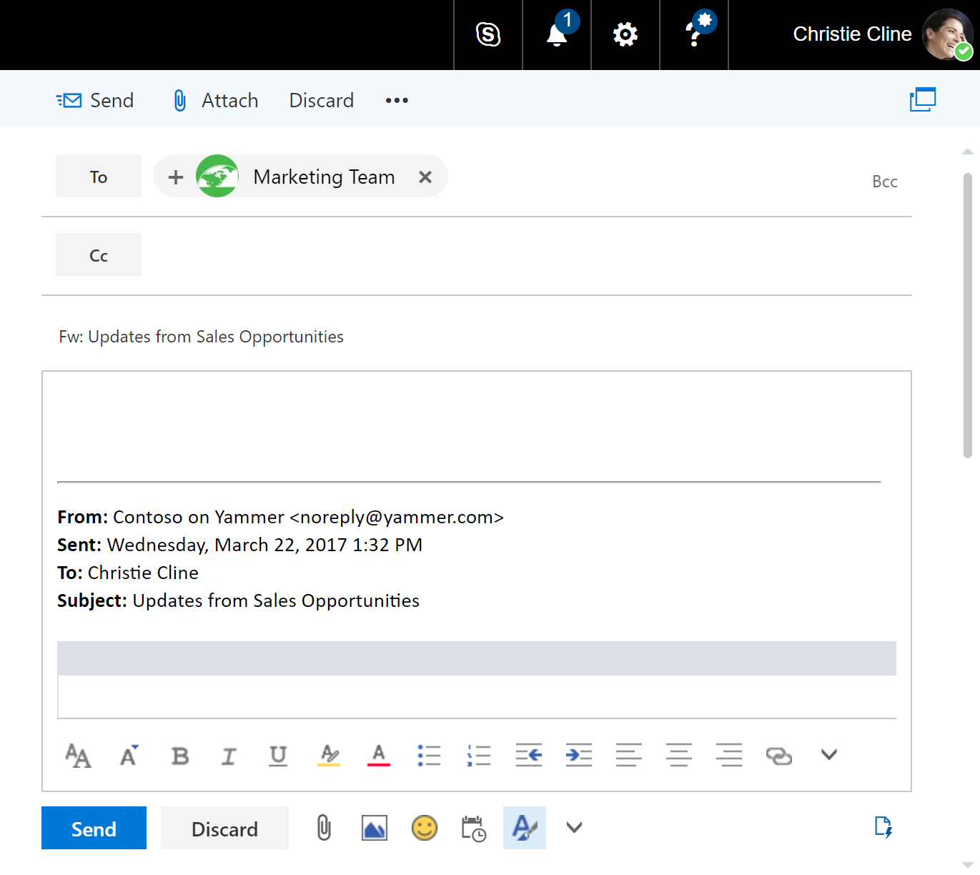
Share from anywhere in Office 365
1
Sharing your work is seamless because Yammer is built on Office 365. Be more productive by sharing and granting permission to documents right inside the apps and services where you do your best work.
To share straight from Word, PowerPoint or Excel, click on the Share person icon in the upper-right corner.
To share from SharePoint or OneDrive, right-click on the file and click Share, or select the file and click on Share at the top.
To share from Outlook, forward the email.
Type in the name of the Yammer group you want to share with.
The name should populate from your organization’s directory.
Select the right permission (Edit or View).
Write a message to the group to give members context, then click
Share or Send.
Your file or message should now show up in your group feed and members will have appropriate access.
2
3
ONLY FOR OFFICE 365 CONNECTED GROUPS IN YAMMER

Slide 29
Use shared group resources
  Kickstart new projects and initiatives right away with a robust set of shared resources just for your group. Now you can focus on getting to work instead of spending time setting up a way to collaborate with your group.
  In the right rail below Office 365 Resources, click on the service or app you want to access:
    Manage content and knowledge in a group
    SharePoint Document Library.
    Build a SharePoint Site for your group.
    Manage notetaking in a shared OneNote.
    Manage tasks for the group in Planner.
1
2
3
4
ONLY FOR OFFICE 365 CONNECTED GROUPS IN YAMMER

